Slide 1
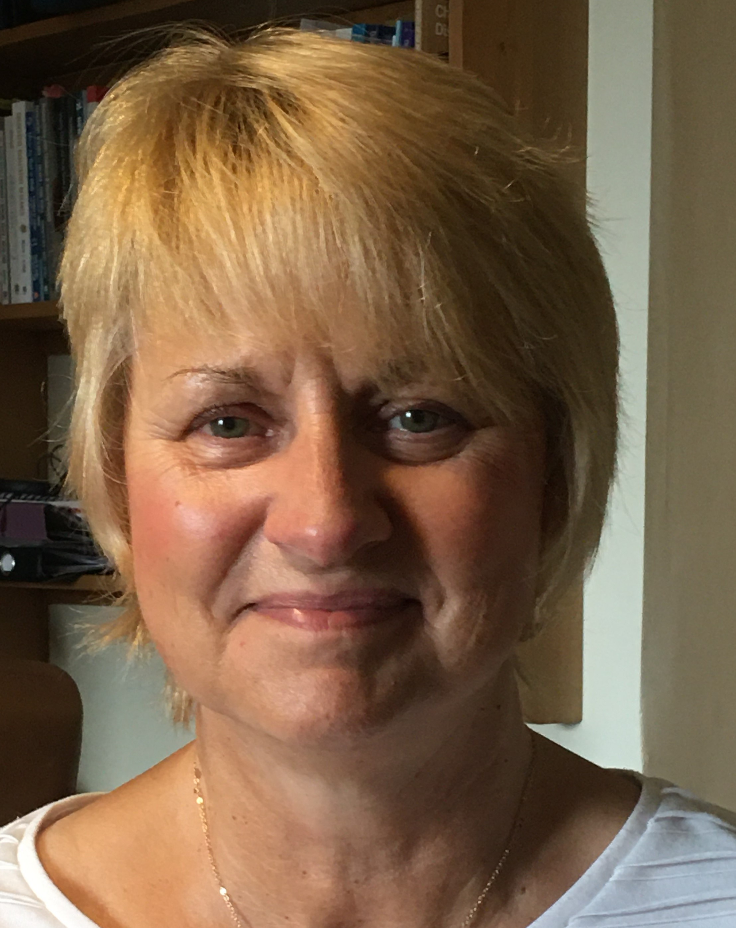
Using a creative case study method to explore non-verbal and non-ambulant children’s well-being experiences from
their participation in recreational activities
Dr Dawn M Pickering
Senior Lecturer
Physiotherapy
School of Healthcare Sciences
Online seminar 20th June @ 5pm (AEST); 8am (BST) 2022
pickeringdm@cf.ac.uk
Twitter@DawnMPickering

Slide 2
Creative methods
My aim was to do research ‘with’ children and young people with cerebral palsy not ‘on’ them (Curran & Runswick-Cole, 2013; 2014)
Gap in literature was about the children and young people who cannot walk or talk:
Less choices for participation in recreational activities
Little is know about their well-being
Research question: How do children and young people with cerebral palsy and their parents view, experience, and choose their level of participation in recreational activities, to benefit their well-being?
Problem of finding a suitable method to be able to position the children's ‘voices’ at the centre of this enquiry. My PhD study was abbreviated to ‘VOCAL’.

Slide 3
VOCAL illustration
This ‘VOCAL’ picture representation shows a ramp with various activities the participants spoke
about which included adapted cycling, surfing, skiing, musical events and Race Running.
All of these were easier if there was access to a changing places toilet and a mobile hoist.

Slide 4
Qualitative approaches
Qualitative design Creswell (2014) suggests choosing from five approaches:
Narrative-story telling
Phenomenological-lived experiences (nearly did this)
Grounded theory- produces a new theory where little is known
Ethnographic- live alongside participants
Case study design-the how and why of a situation
Emancipatory approach:
Barton and Hayhoe (2020) outline that emancipatory research seeks to transform power to the disabled individuals, by seeking to empower the participants at all stages of the research process, from design to dissemination.
However, Mietola et al (2017) critiqued that current emancipatory research did not include those without a physical voice, which was a limitation for my study.

Slide 5
Case study design
Yin (2018) proposes six sources which can provide evidence to make up each case.
Documentation,
Archival records,
Interviews,
Direct observations,
Participant observation
Physical artefacts.
Offered a way to compare the different levels of participation and how this effected the well-being of the participants.

Slide 6
Case study details
Each case study comprised of two interviews, using photographs(artefacts) and diaries(documentary) to elicit discussion, supported by observations. These observations provided evidence of well-being indicators that were interpreted by the researcher in tandem with their parents.
There was no obvious archival records that were relevant.
Engagement in sandbox activities with toys to represent their choice of activities, as well as using eye gaze and augmentative and alternative communication, enabled a unique depth of data generation.
This triangulation of data sources which made up each case, enhanced the trustworthiness in my study (Yin 2018).
Data collection over 12 weeks

Slide 7
Consent/ Assent
Gaining consent for any research usually involves the participant’s signature on a consent form.
Alderson and Morrow (2011) propose that depending upon age and cognitive ability, the children themselves can give consent under the age of sixteen, which is termed ‘Gillick’ competency. However, when considering vulnerable populations such as those with communication and learning disabilities, this is not straightforward, and the concept of assent was introduced. Alderson and Morrow (2011) suggest that assent can mean that children understand some, but not all of the main issues required for consent, and it can mean ‘at least not refusing’.
Renold et al (2008) have proposed that assent is an ongoing process and should not be taken for granted. For my study, the latter was helpful as the children’s indicative behaviours were part of this assent process and were revisited at every research contact, to ensure they were happy with my intent to interview, take photographs or observe.

Slide 8
Alternative means of communicating
The children who used Augmentative and Alternative Communication/ Eye Gaze Technology were included in this study, with support from a familiar adult, who explained the study to them and introduced me to them.
The first visit contact visit took place in their home and enabled me to understand what their interests were-this informed the first interview questions as a way of getting to know them.

Slide 9
Strength and limitations of case study design
Flyvbjerg (2006) suggested that a good case study enables the researcher to get close to the reality of their participants, to explore the viewpoints and behaviours that characterise them as social actors.
A case study provides an authentic and credible method which may not be generalisable to other populations, due to the small sample size, but provides depth not breadth.
The transferability of creative methods within a case study to other non-verbal populations shows potential, but has yet to be fully realised (Sandelowski, 1993; Hammersly and Atkinson, 2007; Creswell, 2014; Yin 2018).

Slide 10
Consultation/ Pilot data
I had quite long lead in period after I had achieved ethical approval before I could register for my PhD. So I developed some consultation groups and pilot data:
I explored using sandbox play, diaries and collages (Mannay 2015).
The pilot cases enable me to narrow down my inclusion criteria to those aged 9-16 years and levels III-V of the Gross Motor Function Classification System and Communication Functional Classification system.
Seven participants took part in my VOCAL study: 4 who participated frequently and 3 whose participation was limited.

Slide 11
Children and young people who took part
Participatory group(PG)/Limited participatory group(LPG) | Pseudonyms | Age | Gender | Type of Cerebral Palsy | Muscle Tone | Gross Motor Function Classification System | Communication Function Classification System
LPG | Bree | 9 | Female | Diplegia | Ataxia | Walking Aid III | Non-verbal/ IV
PG | Clare | 9 | Female | Quadriplegia | Dystonia | Non-ambulant IV | Communication aid III-IV
LPG | James | 14 | Male | Quadriplegia | Spasticity | Non-ambulant V | Non-verbal/ V
PG | Lily-May | 16 | Female | Diplegia | Dystonia | Walking aid III | Communication aid IV
PG | Matthew | 14 | Male | Quadriplegia | Spasticity | Non-ambulant IV | Non-verbal/ IV
PG | Nick | 14 | Male | Quadriplegia | Spasticity | Non-ambulant IV | Non-verbal III
LPG | Poppy | 9 | Male | Diplegia | Ataxia | Walking aid IV | Non-verbal- Eye-Gaze Technology/ IV

Slide 12
Pilot data –findings published in a book chapter
Becky’s Puppet theatre
Becky’s Sandbox (Pickering 2017)

Slide 13
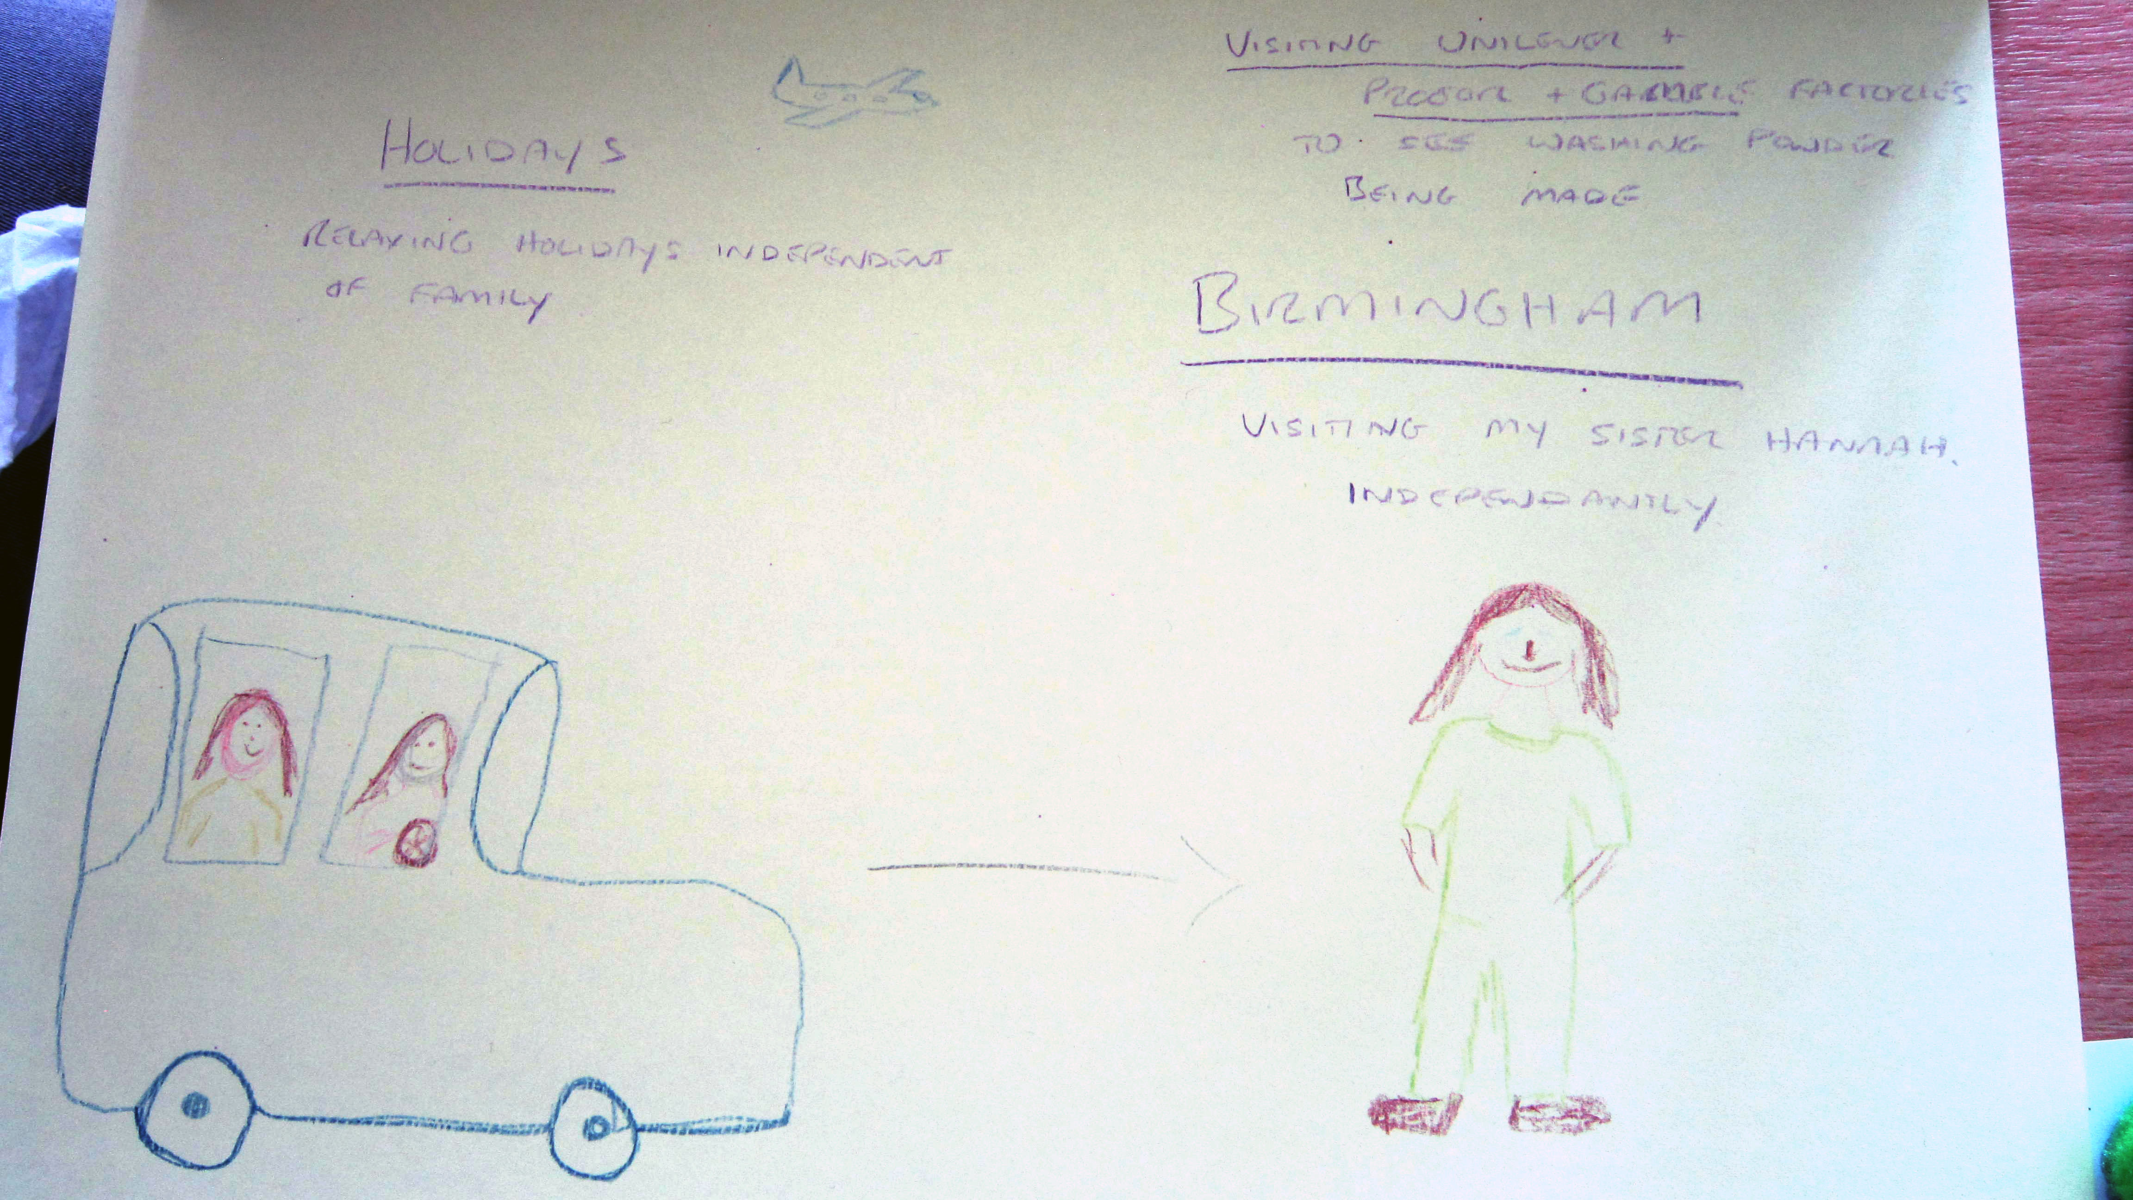
Collages- young adults with learning disabilities
Jugs
Angelica
Future ambitions for recreational activities
Dora

Slide 14
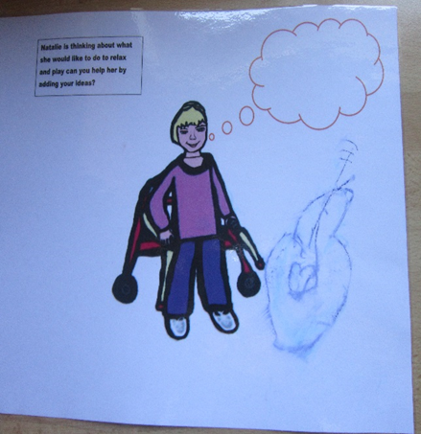
Drawings- laminated sheets
Pickering and Pickering (2015)
Clare’s Drawing of a guitar

Slide 15
Clare’s Grid 3 for iPad to show participation choices

Slide 16
Augmentative and Alternative communication screens/ Eye Gaze
Poppy’s Eye Gaze ipad screen
Lily May’s iPad Go Talk

Slide 17
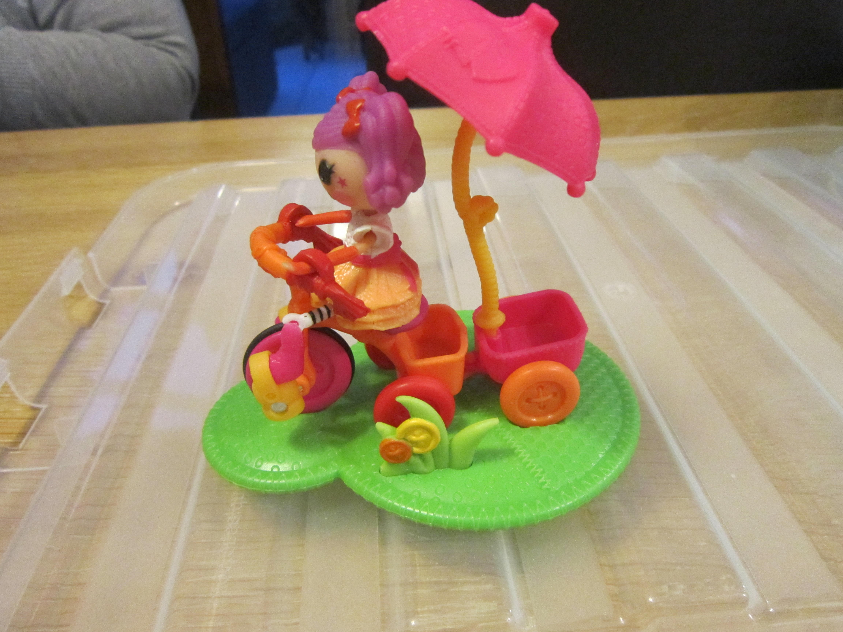
From initial meeting I was able to select toys to engage in conversation
LaLaLoopsy trampolining
Lily- May’s interview
LaLaLoopsy Trike riding

Slide 18
Photographs/ observations/ field notes
James was gastrostomy fed to maintain his body weight, it was interesting when observing at the summer play-scheme to see him being fed outside.
This would be unusual to see in a local park area, but in this space, there were several families doing the same and no one seemed perturbed by this, as it appeared acceptable behaviour in this context.
Previously James mother said they had been stared at in the local park when she had done this.

Slide 19
Annotation of photograph as part of the analysis
Matthew in sit-ski waiting to go up ski lift with volunteer- here they are said to be ‘safe’ skier- so skilled
Siblings included – Matthew’s sister who had learnt to ski here- inclusive activity- enhances participation
Matthew waiting to go up, screaming with excitement –audible positive emotional well-being response

Slide 20
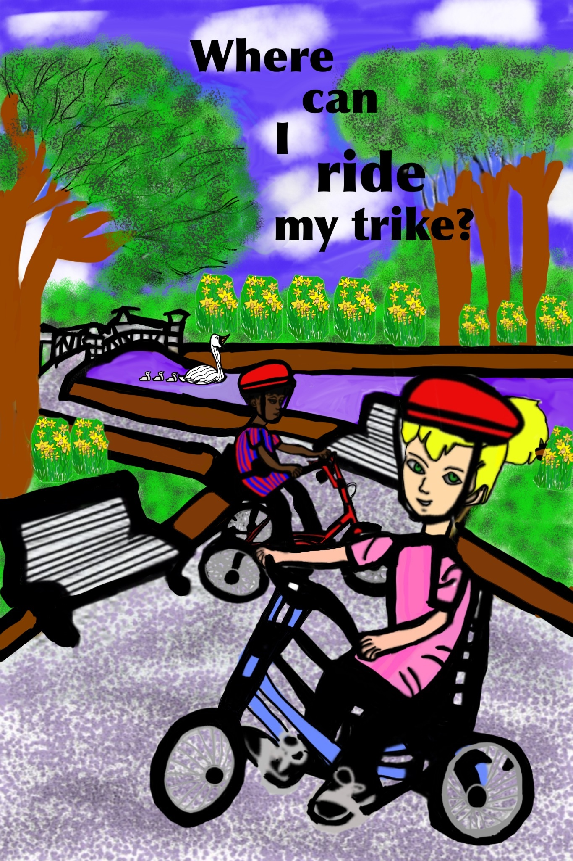
Diary Bree – written by her mother in first person
The parental diaries added value when the participants could not speak about their own well-being.
“Entry 1…..I had an assessment for a bike. They decided a Tom Cat Trike was the best one for me- I went for a ride along the caravan site and I really enjoyed it…
Entry 2 ..In the afternoon my mum, dad, sister and I went cycling, I rode the Tom Cat trike for an hour, I had a brilliant time….
Entry 3…After school I went to after-school club where the people from the cycling centre had brought my Tom Cat Trike. I had lots of fun encouraging the staff to make me go faster!”
Pickering
and
Pickering
2015

Slide 21
Poppy excluded from the bat crawl- photograph matched with mother’s diary entry
“We then went for a walk around the farm to see the animals but it was hindered a little because we didn’t have his all-terrain chair just his regular wheelchair.
There were some children’s activities and a play area that Poppy couldn’t access due to his wheelchair” (see the photograph of the bat crawl- sent by Poppy’s mother).

Slide 22
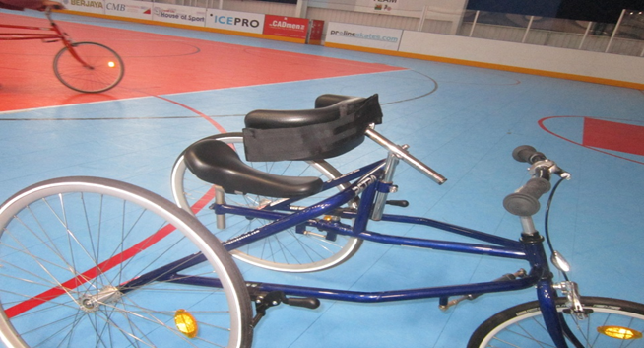
Nick’s intentional behaviours from observational field notes
“Nick then ready to go on RaceRunner(see top insert), Dad lifts him, I assist to ensure his legs go astride the saddle area. Nick tends to cross his legs due to spasticity. Nick is spinning 2 spinners today one in each hand. Dad has to remove them for him to hold onto the handle bars.
Dad walks to the left side spinning both spinners and I walk on the right side as we enter the outer part of the running track. Nick starts moving his legs once the RaceRunner starts, when Dad has pushed it. Sometimes his legs are together, sometimes alternating. I walk around the track (Picture below) asking about how the diary is going? Nick does one lap, then directs himself back to his wheelchair. He was dribbling and did retch once but was not sick.”

Slide 23
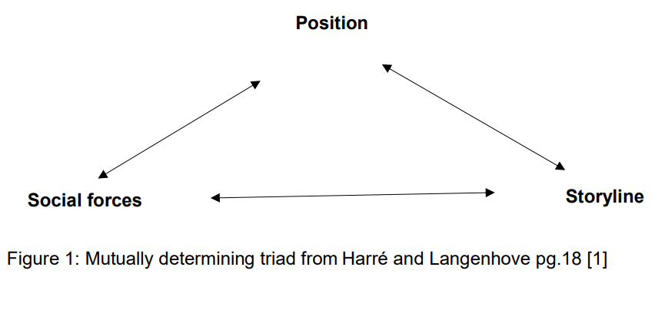
Intentional behaviours
The importance of working in partnership with their parents, ensured my correct interpretation of the children’s intentional behaviours from my observations- achieved through member checking.
Braun and Clark’s (2013) six stages of analysis, then framed within ‘Positioning theory’ (Harre and Langenhove, 1999).

Slide 24
Themes identified
Key results included that the children showed they could be their own advocates by choosing their level of participation, sometimes choosing not to participate, to manage their own well-being. The data was framed within positioning theory and is represented by a kaleidoscope of well-being (under review-Disability and Rehabilitation).
The 3 themes identified:
1. Participation enhancers
2. Champions for disabled children and young people's well-being
3. Hindrances to participation

Slide 25
Kaleidoscope of well-being
Figure 1:Kaleidoscope of Well-being
Figure 2: Skewed Kaleidoscope of Well-being

Slide 26
Closing slide

Slide 27
References
Alderson P. and Morrow V. 2011. The Ethics of Research with children and young people: A practical handbook. London: Sage.
Alderson P. 2012. Rights-respecting research: a commentary on ‘the right to be properly researched: research with children in a messy, real world’, Children’s Geographies,10,4, 2009. Children’s Geographies, 10, 2, 233-239
Barton, J. and Hayhoe, S., 2020. Emancipatory and Participatory Research on Disability for Emerging Educational Researchers: Theory and Case Studies of Research in Excluded and Under-Represented Communities. In Qualitative and Visual Methodologies in Educational Research. Available from https://www.routledge.com/Qualitative-and-Visual-Methodologies-in-Educational-Research/book-series/QVMER [Accessed 10.3.21]
Braun V. and Clarke V. 2013. Successful qualitative research: A practical guide for beginners. Los Angeles: Sage.
Creswell, J. W. 2014. Qualitative Inquiry and Research Design. SAGE.
Curran T. and Runswick-Cole K. 2013. Disabled Children's Childhood Studies: Critical Approaches in a Global Context. Basingstoke: Palgrave Macmillan.
Curran, T. and Runswick-Cole, K. 2014. Disabled children’s childhood studies: a distinct approach? Disability and Society 29(10), pp. 1617-1630.
Flyvbjerg, B. 2006. Five misunderstandings about case-study research. Qualitative inquiry 12(2), pp. 219-245.
Hammersly, M. and Atkinson, P. 2007. Ethnography: principles in Practice. 3rd ed. Oxon: Routledge.

Slide 28
References continued
Harré, R. and Langenhove, L. 1999. Positioning theory: moral contexts of intentional action. Malden, Mass.: Oxford
Mannay, D. 2015. Visual, narrative, and creative research methods: application, reflection and ethics. Oxon: Routledge.
Mietola, R. et al. 2017. Voiceless subjects? Research ethics and persons with profound intellectual disabilities. International Journal of Social Research Methodology 20(3), pp. 263-274.
Pickering, D.M. 2017. Shared perspectives: 'The Embodiment of disabled children and young people voices about participating in RA'. In: Runswick-Cole K, Liddiard KM, Curran T. (Ed.s) The Palgrave Handbook of Disabled Children’s Childhood Studies. Frankfurt: Palgrave Macmillan pp 101-123
Pickering, D.M. and Pickering H.R. (2015) Where can I ride my Trike? Self- published. Sheffield: Northend Printers.
Renold, E. et al. 2008. Becoming participant: problematizing ‘informed consent in participatory research with young people in care. Qualitative Social Work 7, pp. 427-477.
Sandelowski, M. 1993. Rigor or rigor mortis: the problem of rigor in qualitative research revisited. Advances in nursing science 16(2), pp. 1-8.
Yin, R. 2018. Case study Research: designs and methods. 6th ed. Los Angeles: Sage Publications.
You Tube link to audio of Where can I ride my trike? https://www.youtube.com/watch?v=brXCcsz0-3Y&t=5s
Acknowledgments to my PhD supervisors: Dr Paul Gill , Dr Carly Reagon and Dr Jane Davies.

Slide 29
Link to you tube audio book
Where Can I ride my Trike?
https://www.youtube.com/watch?v=brXCcsz0-3Y&t=42s

