Slide 1
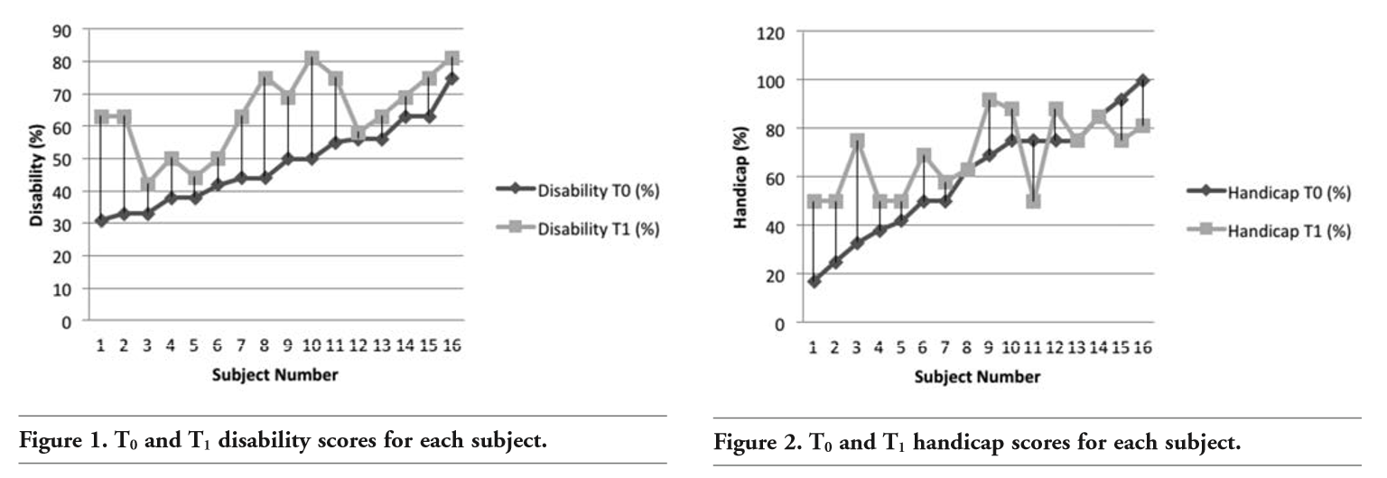
An exploratory study identifying a possible response shift phenomena of the Glasgow Hearing Aid Benefit Profile
Dr Jonathan Arthur ^{1,2} & Dr Tessa Watts ^{3,2}
¹ Cwm Taf Morgannwg University Health Board, ² Swansea University, Faculty of Medicine, Health and Life Science
³ Cardiff University, School of Healthcare Sciences
Background and Research Question
Patient Reported Outcome Measure Used
Response shift can be defined as a change in the subjective opinion or belief related to a clinical intervention over a time period during a sustained period of illness or chronic condition
Response shift can be observed in various health related quality of life (HR-QoL) patient reported outcome measures (PROMS)
In the Audiology profession, the Glasgow Hearing Aid Benefit Profile (GHABP)¹ has been widely used across the United Kingdom (UK) and internationally.
Researchers, including those in audiology, have described three reasons for response shift²:
Recalibration, for example, changes in perception of hearing disability post Hearing Aid (HA) fitting.
Re-prioritisation, for example, changes in perceptual importance of HR-Qol.
Reconceptualization, a redefinition of a target construct. For example, a questionnaire examining mental health, might be understood later in time as a something measuring loneliness.
Research Question
Does the GHABP question exhibit a possible response shift?
The GHABP¹ questionnaire measures self-reported auditory disability (degree of hearing problems), handicap (degree to which hearing problems impact on day-to-day life) and HA use pre- and post- intervention.
The pre- (part I) and post- HA fitting (part II) questionnaires show the effectiveness of the HA intervention.
The GHABP questionnaire examines responses in 4 pre-defined listening situations: 1) listening to television with other family or friends when volume is adjusted to suit others; 2) having a conversation with one other person when there is no background noise; 3) carrying on a conversation in a busy street or shop; and 4) having a conversation with several people in a group. Individuals are initially asked to answer “yes” or “no” to having difficulty in hearing in each of these listening environments. If respondents answer “yes”, they are asked to grade how much difficulty they have in that situation. There are five response categories along the lines of a Likert scale, namely: not applicable, not at all, only a little, a moderate amount, quite a lot and very much indeed.
Results
How To Assess Response Shift
Figure 1 shows the GHABP (disability) scores in percentages showing the change observed in T₀ and T₁. Every T₁ value shows an increase compared with the T0 value.
Figure 2 shows T₀ and T₁ values for GHABP (handicap). As both sets of scores for disability data were normally distributed a paired T test was appropriate and indicated that the GHABP disability (T₁) group score was higher than the GHABP disability group score at T₀ (t=5.95, p=0.000027). This score was statistically significant. The handicap (T₁) group score was not normally distributed so the non-parametric Wilcoxon Signed Ranks test was used. There was no significant difference between [GHABP (handicap) T₁] and [GHABP (handicap) T0] (Z=67, p=0.132).
The then-test is one of the most common that can be applied to a given outcome measure. Only one study has described response shift in those with hearing loss³. The response shift in HA respondents was measured using EuroQol-5D. The authors suggested response shift is an important factor when assessing PROMs related to the clinical effectiveness of medical interventions. Moreover, response shift could have an impact on health economic aspects of various interventions, if not fully understood³.
Methods
Participants Sixteen adults attending an Audiology clinic in Cwm Taf Morgannwg University Health Board, South Wales, UK were invited by letter to participate in this study. Inclusion criteria were: referred to the Audiology clinic for initial assessment; fitted with digital HA’s optimally programmed to NAL-NL1; invited for first follow up after hearing aid fitting appointment; able to give informed consent and proficient in the English language.
The first stage of data collection (T₀) took place at the initial hearing assessment. Demographic information together with information about the average hearing loss of individual ears and mean hearing loss were collected. The second stage of data collection (T₁) took place 14 weeks later at the post HA follow-up appointment. At this appointment participants were asked to complete the GHABP (part I) questionnaire again (T₁) and GHABP (part II). During this appointment participants were asked to think back to before they had their HAs fitted, to re-establish the disability and handicap scores (T₁)
Conclusions
1) Participants might be demonstrating a level of recalibration of their own perception of hearing disability. This could mean participants initially underestimated their hearing difficulties when seen during the first appointment.
2) It could be that at T₁ participants’ answers represented their reality prior to hearing aid fitting with greater accuracy. This suggests that at T₀ participants underplayed the extent of their hearing loss. Drawing on Luterman⁴ and Schum⁵, this may relate to the possibility that at T₀ participants were in denial of their hearing disability: disability denial ^{4,5}.
3) Participants in this study may have initially underplayed the degree of hearing loss disability experienced to reduce the likelihood of the HA intervention and the perceived associated risk of enacted stigma.
4) The findings reported here have implications for clinical practice not least because they suggest that patients underplay the extent of their hearing loss. This may relate to a re-calibration effect or a denial of disability effect. This may suggest that the HA intervention has a larger reduction in disability when taking the response shift into account.
Summary
Clinicians should be aware that response shift can affect some administered PROMS. PROMS that are used to inform treatment options and those PROMS that are administered before and after a clinical intervention may be more prone to response shift. Larger response shifts might be seen where clinical interventions are stigmatising, undesirable or those that may involve patient cooperation such as rehabilitation packages. Awareness of response shift to avoid bias is therefore an important consideration in research studies and clinical practice and thus may have implications for clinical effectiveness or health economics issues.
References
.
Gatehouse S. Glasgow Hearing Aid Benefit Profile: Derivation and validation of a client-centered outcome measure for hearing aid services. J Am Acad Audiol 1999;10:80-103.
2.Schwartz CE, Sprangers MA. Guidelines for improving the stringency of response shift research using the thentest. Qual Life Res 2010;19:455-64
3. Joore MA, Potjewijd J, Timmerman AA, Anteunis LJC. Response shift in the measurement of quality of life in hearing impaired adults after hearing aid fitting. Qual Life Res 2002;11:299-307
4. Lutman ME. Hearing disability in the elderly. Acta Otolaryngol Suppl 1991;476:239-48
5. Schum D. The Sociology of age-related hearing loss. Audiol Online 2015;July:14504
6. Arthur J, Watts T, Davies R, Manchaiah V, Slater J. An Exploratory Study Identifying a Possible Response Shift Phenomena of the Glasgow Hearing Aid Benefit Profile. Audiol Res. 2016 Nov 24;6(2):152. doi: 10.4081/audiores.2016.152. PMID: 27942371; PMCID: PMC5134677.

