Slide 1
An exploration of well-being with children and young people with complex disabilities, and their families, from using the Innowalk (WEBS study).
Dr Dawn Pickering,
PhD seminar, School of Healthcare Sciences, Cardiff University
25th October 2022

Slide 2
Background
PhD completed in 2021
Context with children who cannot walk or talk
Well-being was a construct that I highlighted as needing further research
Research Development Programme – 1 year
Applied for funding – 2 grants not awarded but small bursary from clinical interest group: Association of Paediatric Chartered Physiotherapists

Slide 3
PICo
Problem: The lack of a valid and reliable measurement scale for the well-being of children and young people with complex disabilities (Mpundu-Kaambwa et al (2018).
Interest: Developing and testing a new scale by observing the well-being of non-ambulant and non-verbal children and young people when using the Innowalk.
Context: Special School setting for children and young people with complex disabilities
Outcome: The domains established will enable the content validity to be evaluated in larger funded study to test the psychometric properties of the WEBS.

Slide 4
Innowalk research
Novak et al (2019) recommend robotic devices as having a strong evidence base for effectiveness in cerebral palsy and other childhood onset disabilities.
The Innowalk, is a dynamic standing frame has recently been reported to demonstrate an improvement in quality of life (Lauruschkus et al 2022). Health economic review- cost effective for parents, but not health services in Sweden.
Previously reported to have benefits for respiratory, circulation, skin integrity, light physical activity, gastrointestinal function, stretching of muscles and joints, mental function (linked to well-being) and bone mineral density (Verschuren et al 2016).

Slide 5
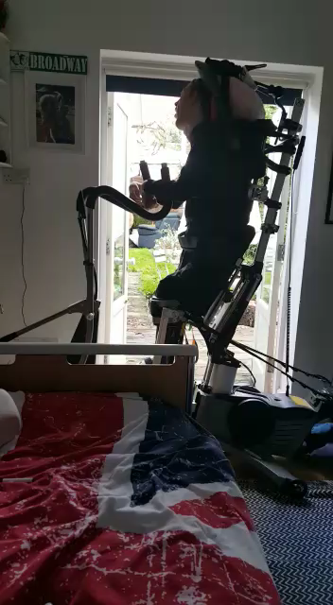
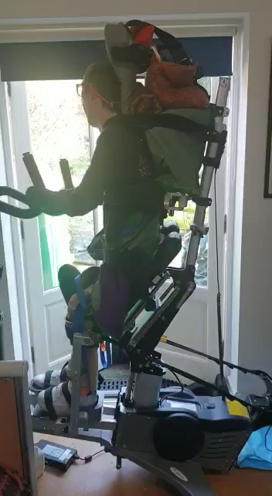
Consultation-Innowalk-Joe young adult
I was away for a week and my PA noticed that without the Innowalk, I had more spasms. So it really helps my body to feel more relaxed.
Email: I’ve been doing an hour each time and am going faster now. Yes fine to use my videos
5 weeks
9 weeks

Slide 6
Well-being
Watson et al (2012) describe emotional well-being as both a contextual and relational dynamic as well as an embodied, subjectively experienced phenomena
Researchers did not found a valid and reliable measure of well-being for those with complex disabilities- Mpundu-Kaambwa et al (2018)

Slide 7
Research question and aims
Research question: How can the well-being of children and young people with complex disabilities be better understood, from using the Innowalk?
Aims/ objectives
1. To carry out a review of current well-being measures/checklists/scales for adults and children with complex disabilities.
2. To pilot, by observations, develop and test an observational scale that enables well-being indicators to be recorded with non-verbal children and young people with complex disabilities.
3. To obtain child and parental opinions by written diary records and an interview related to well-being following them using the Innowalk.

Slide 8
Well-being measures
Be-Well checklist
PRIME- O
Leuven Scale
Own ideas from PhD data

Slide 9
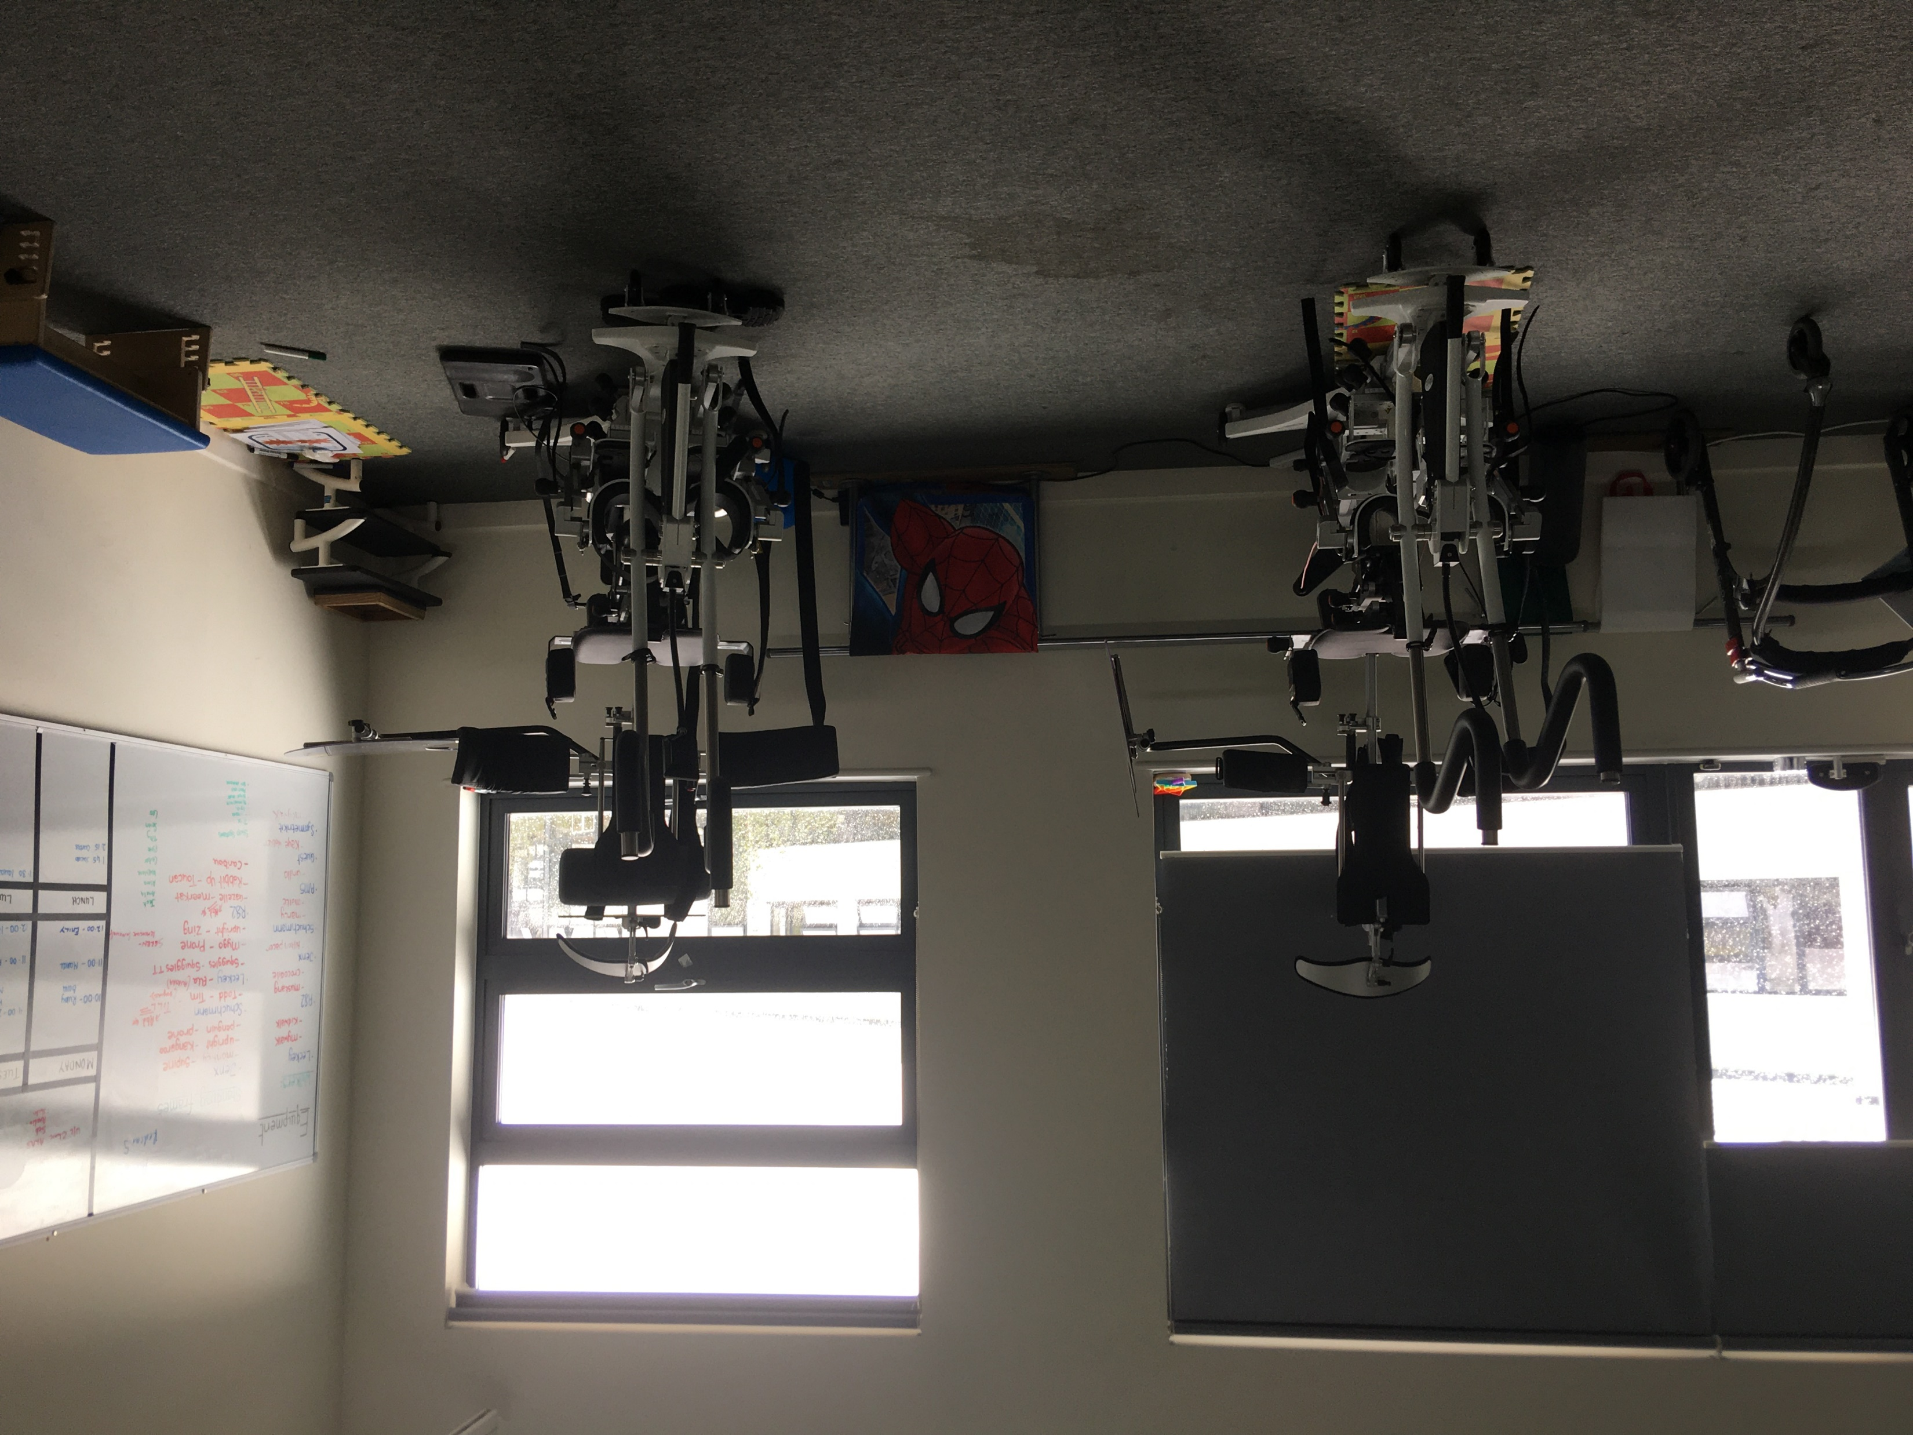
Context- special school
Innowalk-Made for movement

Slide 10
Consultation
Leo aged 10 years spoke with me on a Microsoft Teams video call about using the Innowalk and how he perceives this benefits his well-being. When asked if he would recommend this for other children who cannot walk, he said
"it's good for your legs, it's good for your arms, it's good for your belly, it's really good”
He gave it 100/10 as he said it was the first time he was able to feel walking and he likes being taller than other people. It makes him feel good.
Leo’s mum stated:
“the Innowalk has improved Leo’s well-being by making his legs more comfortable by increasing his range of movement and it being easier for him to lift his legs afterwards. He has slept better and now has regular bowel movements”.

Slide 11
Research design
Case study- 10 participants, plus their parents
Each case made up from observational field notes, diaries and interviews with children and their parents.
Analysis will be carried out using Braun and Clarke’s⁽²⁰¹⁸⁾ thematic analysis for the qualitative aspects and descriptive statistics will be used from the proposed devised well-being measurement scale.
Dissemination will include a booklet ‘My well-being’ for the children (if secure more funding) as well as academic conferences and publications.

Slide 12
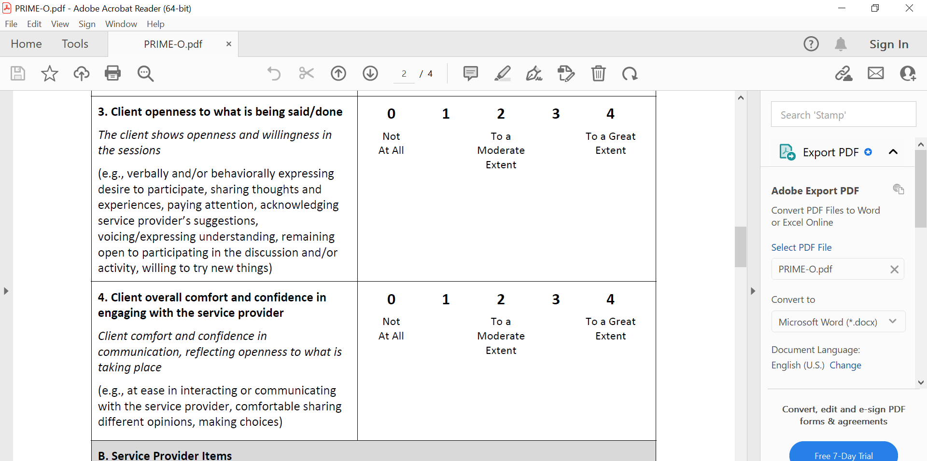
PRIME-O

Slide 13
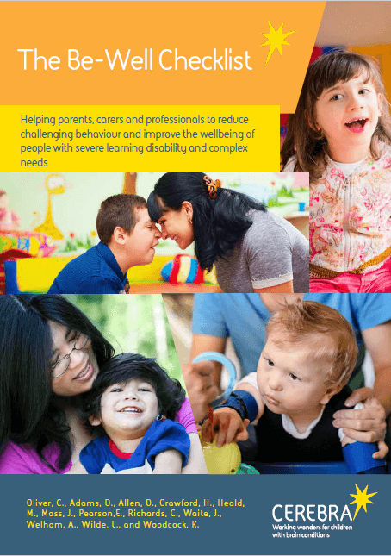
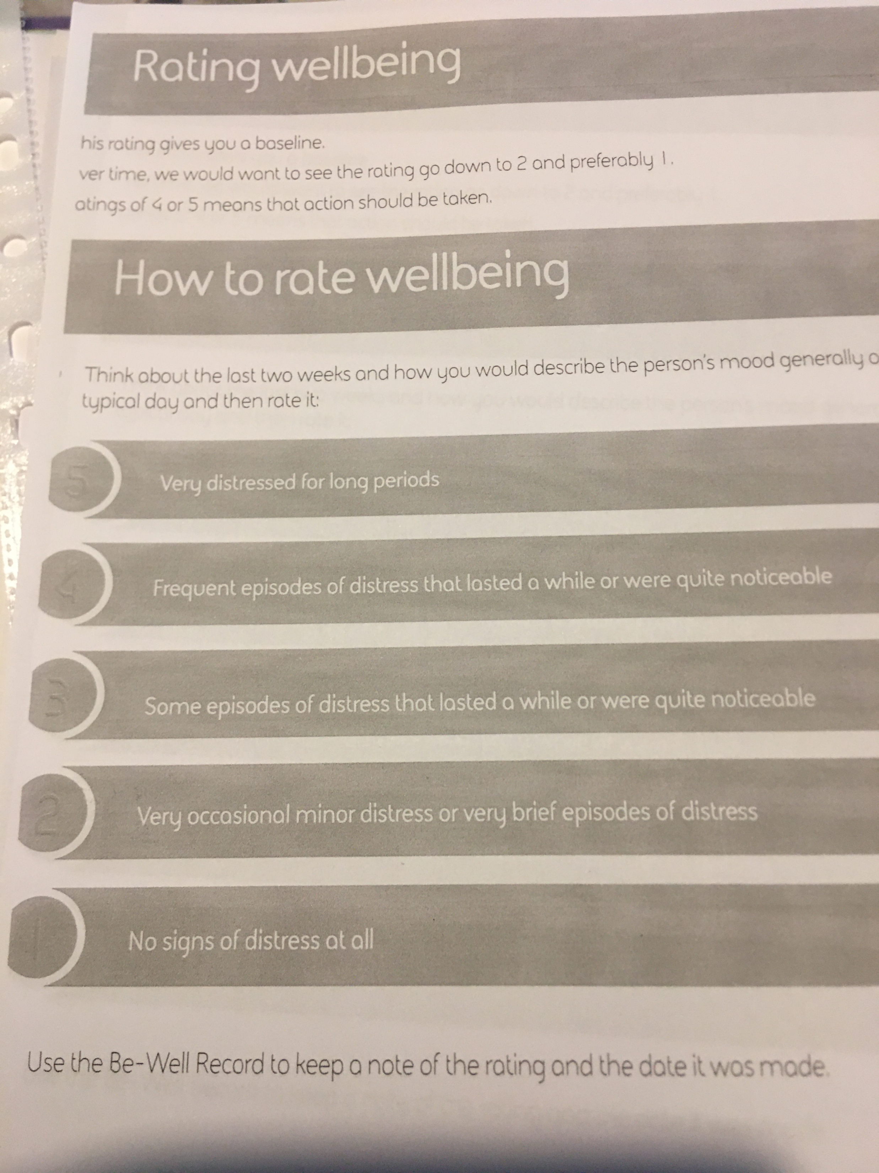
Be-Well checklist

Slide 14
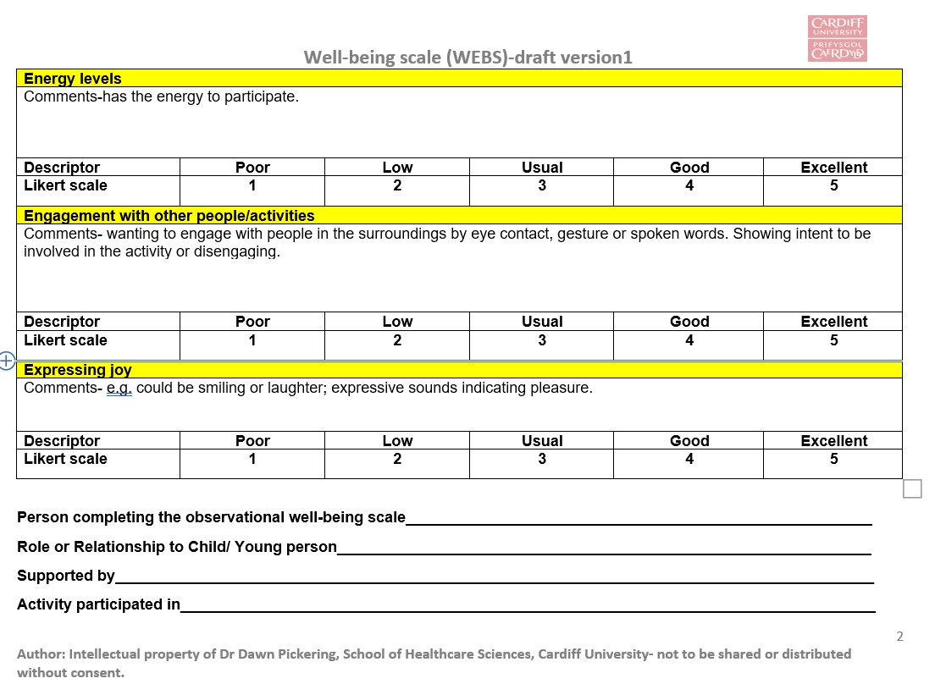
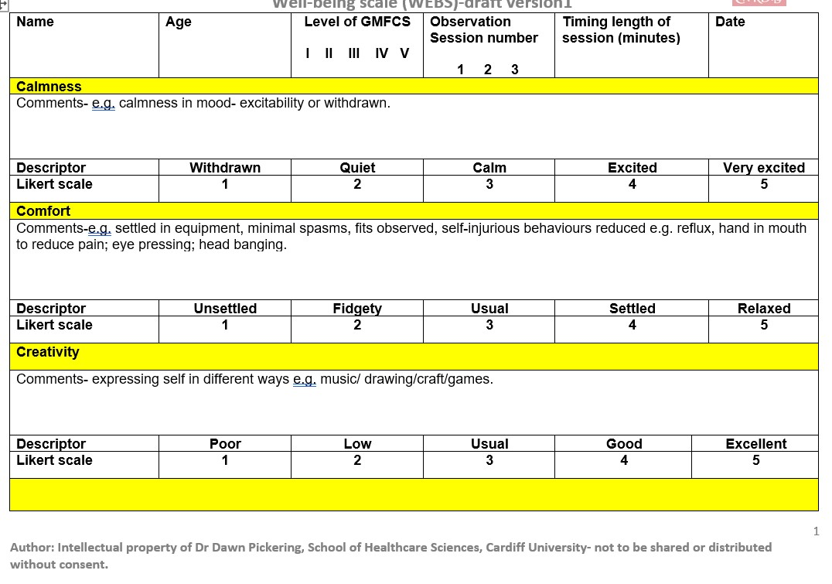
Domains being tested from observations

Slide 15
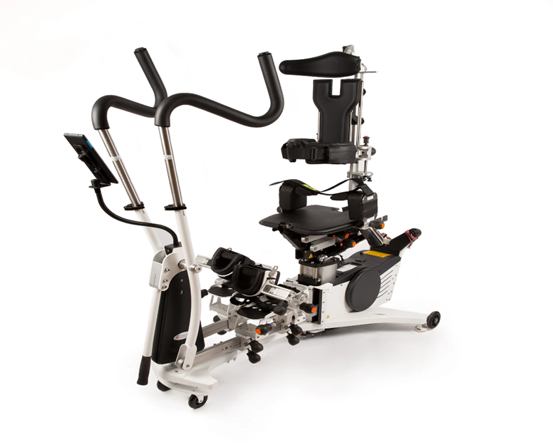
Diary instructions
Diary instructions for WEBS study
This record is where you can write down anything that you think relates to your child or young person’s well-being in relation to using the Innowalk at Ysgol Y Deri. You can write the date and anything you have observed such as their level of stiffness, comfort, enjoyment that you think has changed since using the Innowalk. I will collect the diary at school, and it will help to inform the questions we can chat about in your interview, after I have observed your child or young person using the Innowalk three times in school. Any questions please get in touch. Contact: pickeringdm@cf.ac.uk
An exploration of well-being with children and young people with complex disabilities, and their families, from using the Innowalk (WEBS study)

Slide 16
Questions
Twitter @DawnMPickering
pickeringdm@cf.ac.uk

