Slide 1
An exploration of well-being with children and young people with complex disabilities, and their families, from using the Innowalk (WEBS study).
Dr Dawn Pickering, Senior Lecturer, Cardiff University
Population Health Research Impact Away Day 2 Feb 2023
SWALEC stadium, Cardiff

Slide 2
Background
PhD completed in 2021
Context with children who cannot walk or talk
‘Well-being’ was a construct that I highlighted as needing further research
Research Development Programme – 1 year in School of Healthcare Sciences
Applied for funding – 4 grants not awarded but small bursary from clinical interest group:
Association of Paediatric Chartered Physiotherapists
(1st August 2022-31 July 2023)

Slide 3
PICo
Problem: The lack of a valid and reliable measurement scale for the well-being of children and young people with complex disabilities (Mpundu-Kaambwa et al (2018).
Interest: Developing and testing a new scale by observing the well-being of non-ambulant and non-verbal children and young people when using the Innowalk.
Context: Special School setting for children and young people with complex disabilities
Outcome: The domains established will enable the content validity to be evaluated in larger funded study to test the psychometric properties of the WEBS.

Slide 4
Innowalk research
Novak et al (2019) recommend robotic devices as having a strong evidence base for effectiveness in cerebral palsy and other childhood onset disabilities.
The Innowalk, is a dynamic standing frame has recently been reported to demonstrate an improvement in quality of life (Lauruschkus et al 2022). Health economic review- cost effective for parents, but not health services in Sweden(although prescribed here and Norway for non-ambulant children).
Previously reported to have benefits for respiratory, circulation, skin integrity, light physical activity, gastrointestinal function, stretching of muscles and joints, mental function (linked to well-being) and bone mineral density (Verschuren et al 2016).

Slide 5
Consultation-Innowalk-Joe young adult
I was away for a week and my PA noticed that without the Innowalk, I had more spasms. So it really helps my body to feel more relaxed.
Email: I’ve been doing an hour each time and am going faster now. Yes fine to use my video

Slide 6
Well-being
Watson et al (2012) describe emotional well-being as both a contextual and relational dynamic as well as an embodied, subjectively experienced phenomena.
Pickering et al (in press) I have proposed a kaleidoscope of well-being- which fluctuates in different contexts
Researchers did not found a valid and reliable measure of well-being for those with complex disabilities- Mpundu-Kaambwa et al (2018)

Slide 7
Research question and aims
Research question: How can the well-being of children and young people with complex disabilities be better understood, from using the Innowalk?
Aims/ objectives
1. To carry out a review of current well-being measures/checklists/scales for adults and children with complex disabilities.
2. To pilot, by observations, develop and test an observational scale that enables well-being indicators to be recorded with non-verbal children and young people with complex disabilities.
3. To obtain child and parental opinions by written diary records and an interview related to well-being following them using the Innowalk.

Slide 8
Context- special school
Innowalk-Made for movement

Slide 9
Consultation
Leo aged 10 years spoke with me on a Microsoft Teams video call about using the Innowalk and how he perceives this benefits his well-being. When asked if he would recommend this for other children who cannot walk, he said
"it's good for your legs, it's good for your arms, it's good for your belly, it's really good”
He gave it 100/10 as he said it was the first time he was able to feel walking and he likes being taller than other people. It makes him feel good.
Leo’s mum stated:
“the Innowalk has improved Leo’s well-being by making his legs more comfortable by increasing his range of movement and it being easier for him to lift his legs afterwards. He has slept better and now has regular bowel movements”.

Slide 10
Research design
Case study- 10 participants (children and young people), plus their parents
Each case made up from 3 sessions of observational field notes, diaries and interviews with children and their parents.
Analysis will be carried out using Braun and Clarke’s⁽²⁰¹⁸⁾ thematic analysis for the qualitative aspects and descriptive statistics will be used from the proposed devised well-being measurement scale.

Slide 11
Well-being measures
Be-Well checklist
PRIME- O
Leuven Scale (special school already use)
Own ideas from PhD data to develop a well-being observational scale

Slide 12
PRIME-O

Slide 13
Be-Well checklist

Slide 14
Domains being tested from observations

Slide 15
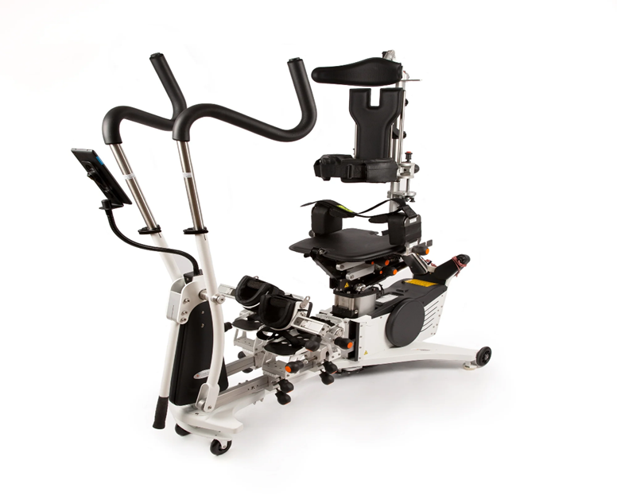
Diary instructions
Diary instructions for WEBS study
This record is where you can write down anything that you think relates to your child or young person’s well-being in relation to using the Innowalk at Ysgol Y Deri. You can write the date and anything you have observed such as their level of stiffness, comfort, enjoyment that you think has changed since using the Innowalk. I will collect the diary at school, and it will help to inform the questions we can chat about in your interview, after I have observed your child or young person using the Innowalk three times in school. Any questions please get in touch. Contact: pickeringdm@cf.ac.uk
An exploration of well-being with children and young people with complex disabilities, and their families, from using the Innowalk (WEBS study)

Slide 16
Work in Progress
Participants/ chosen name | Age | Gender | Condition
1 Charlie | 18 | Male | Cerebral Palsy
2 Star | 14 | Female | Spina Bifida
3 Fran | 8 | Female | Spina Bifida
4 Joey | 8 | Male | Cerebral Palsy
5 Zelia | 17 | Female | Cerebral Palsy
6 Judy | 4 | Female | Rett's Syndrome
7 Barney | 18 | Male | Cerebral Palsy
8 | 11 | Male | Cerebral Palsy
9 | 8 | Female | Cerebral Palsy
10 | 13 | Female | Cerebral Palsy
 | Mean 11.9 | 4 male; 6 female | 7 CP; 2 SB; 1 Rett’s

Slide 17
Mean data for 7 completed cases so far
 | Charlie | Star | Joey | Zelia | Barney | Judy | Fran
Mean Time (min) | 29.3 | 31.6 | 24.9 | 15.6 | 30 | 15 | 23.3
Mean Distance (KM) | 1.4 | 1.6 | 1.4 | 0.72 | 1.5 | 0.6 | 1.1
Mean Revolutions per minute | 39.3 | 42.6 | 39.6 | 34.3 | 41.6 | 35.6 | 43.6

Slide 18
Qualitative comments so far
Joey’s Mum:
“...so the first time he
went on the Innowalk
he slept all night, and
his sleep was really
bad”
Seren(14): “Feels like I’m flying”
Zelia (17): “My legs feel different, more relaxed”
Joey (8): “Feels like I’m walking… I like being taller than you”

Slide 19
Diary entry Barney (19)
“ My son is 19 years old, he stopped using a standing frame at 10 years old due to hip surgery. When school had the Innowalk, physio suggested we try it…for over a year my son has been using the Innowalk once a week for 30-45 minutes…..I feel the Innowalker has made a massive difference for my son…he is happier, has better bowel movements , longer muscle release on his hamstrings, his whole posture is more relaxed…..I would highly recommend this equipment for anyone with disabilities to try”

Slide 20
Questions
Twitter @DawnMPickering
pickeringdm@cf.ac.uk

