Slide 1
Catering for Diverse Needs - Future Care Planning in Wales
Prof Mark Taubert FRCP FRCGP
Consultant Palliative Medicine & Lead of Advance & Future Care Planning Strategy Group, NHS Wales Collaborative

Slide 2
My role:
Palliative Care Consultant in Cardiff
Lived in Wales since 2004.
Chair of Advance & Future Care Planning (AFCP) Strategy Group since 2018
Lead role for DNACPR in Wales
Cardiff University Diploma & MSc in Palliative Care
Harvard Medical School Medical Writers Faculty
Teaching/academic role
BMJ Supportive & Palliative Care Associate Editor (incl Blog)

Slide 3
My role:

Slide 4
Advance & Future Care Planning Strategy Group Wales
Established in 2018
TOR available on request
Answerable to Deputy CMO for Wales and End of Life Care Board NHS Wales
Patients, carers, clinicians, charities (incl elderly care, disabilities), Welsh Government representatives, etc
Meet every 2-3 months, more often during Covid-19
Create national documents, policies, definitions and guidelines, and also review existing resources
National DNACPR, ADRT, RBID, RACPAP (sorry, acronyms will be explained!)
National Conference in 2019 (just before Covid hit) to plan ACP and FCP. Lots of patient representation incl dementia and renal network

Slide 6
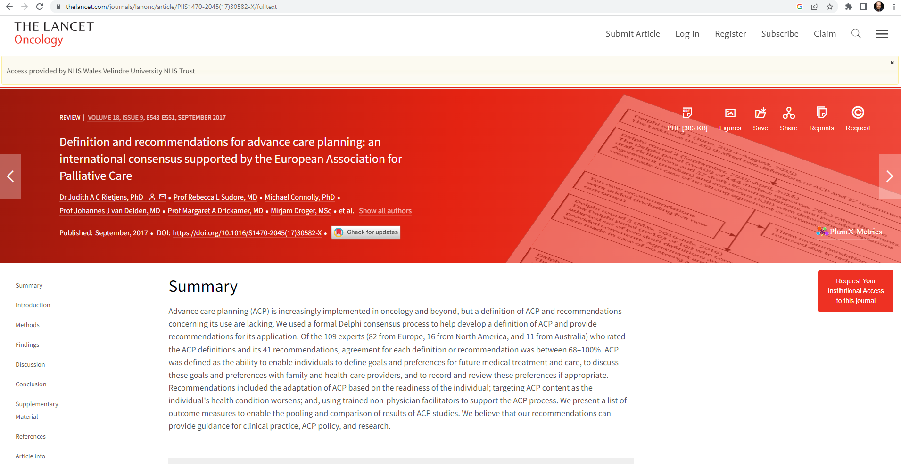

Slide 8
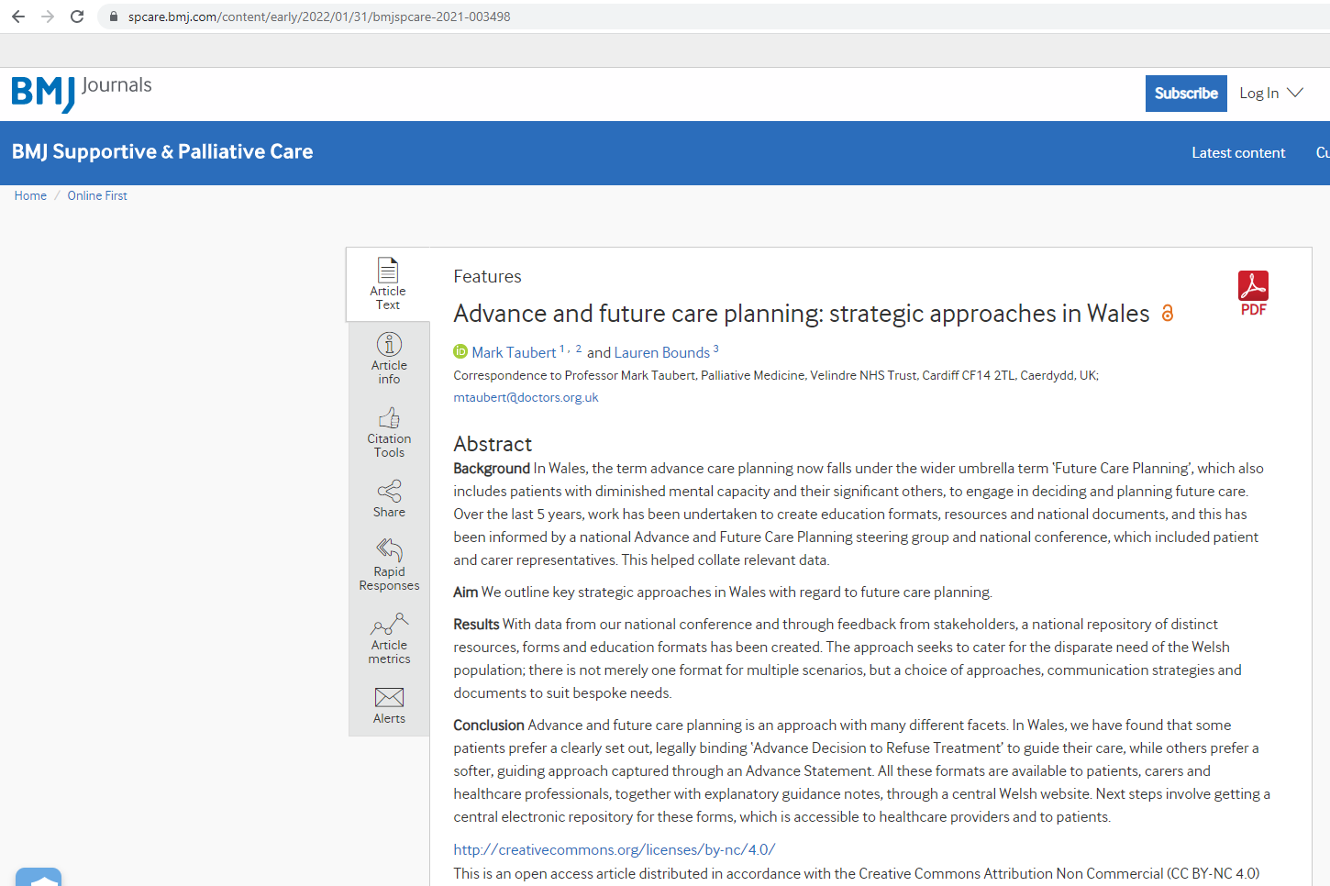

Slide 10
DNACPR interest Started in 2015 (critical friend)

Slide 11
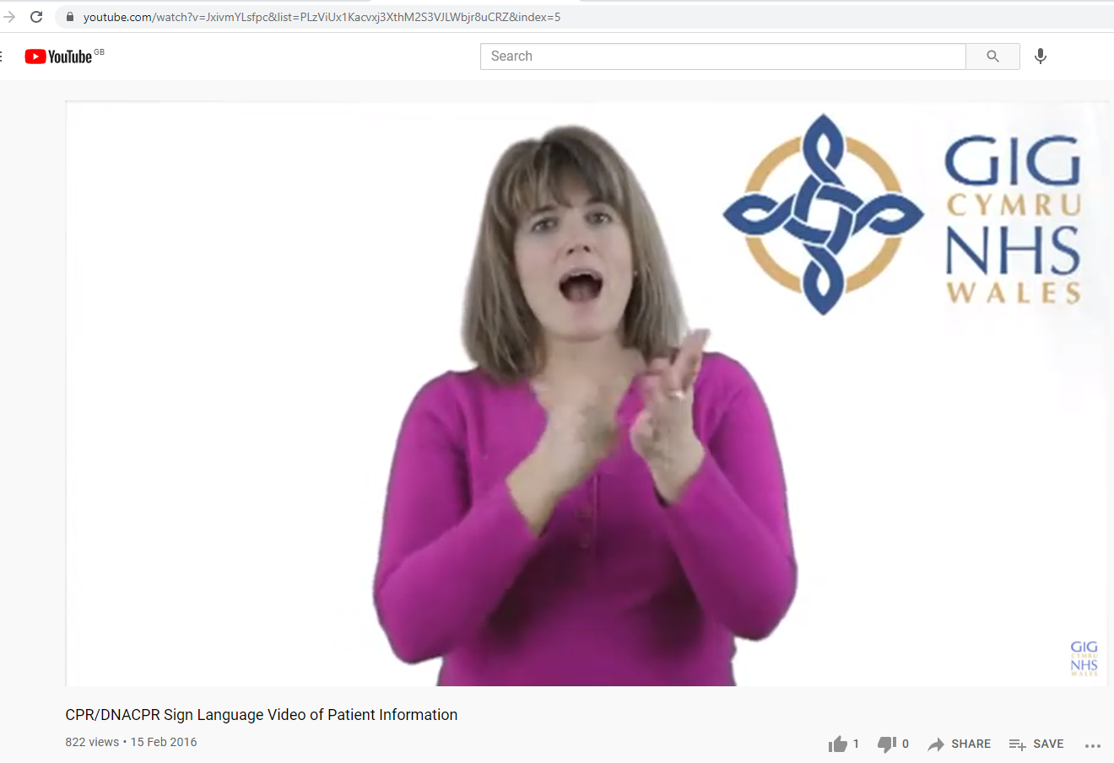
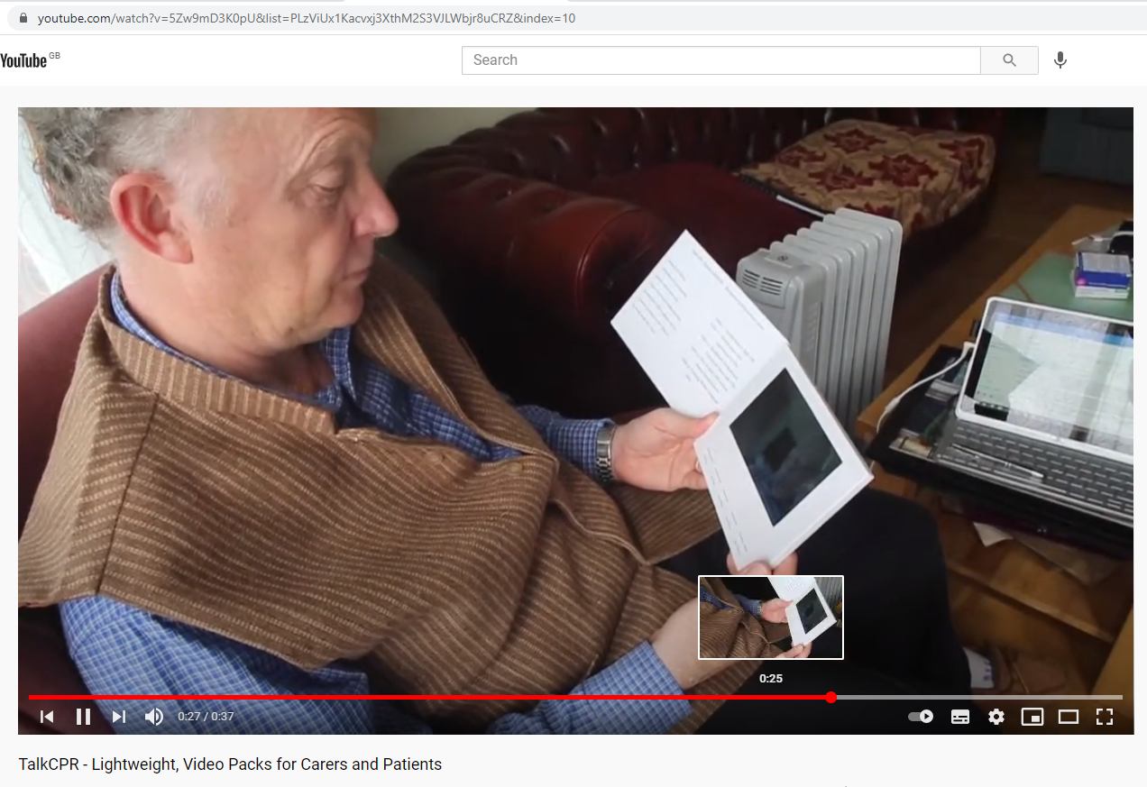
2023

Slide 12
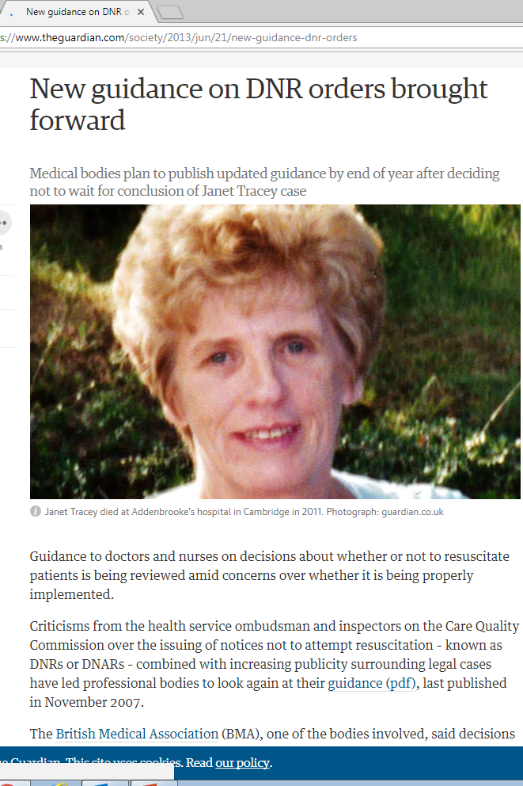
Where our all Wales DNACPR policy started (2011)

Slide 13
Key findings in Tracey ruling:
The Court of Appeal ruled that “patients should be consulted in relation to advance DNACPR decisions save in exceptional circumstances and that Article 8 of the European Convention on Human Rights, (the right to respect for private and family life), is engaged by the decision to impose a DNACPR.”
“There needs to be a convincing reason not to involve a patient in a DNACPR decision. For a patient not to be consulted about a DNACPR decision, the clinician would have to consider that to do so is likely to cause a patient to suffer physical or psychological harm. Distress alone would not be sufficient. The clinical view that treatment will be futile is not a sufficient ground not to consult.”
In addition, an advance DNACPR decision must be made in accordance with a “clear and accessible policy”. This means that local policies should be available and clearly directed and disseminated to patients.

Slide 14
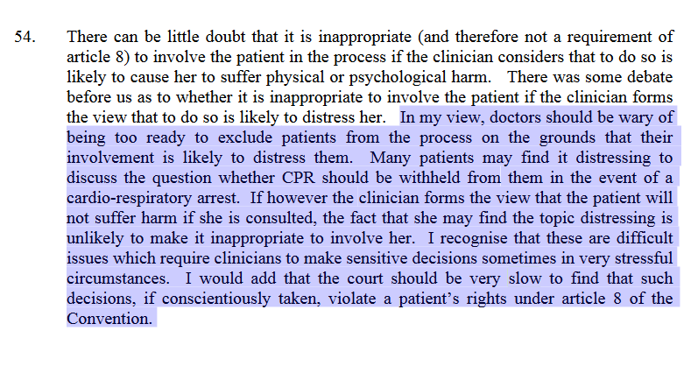

Slide 15
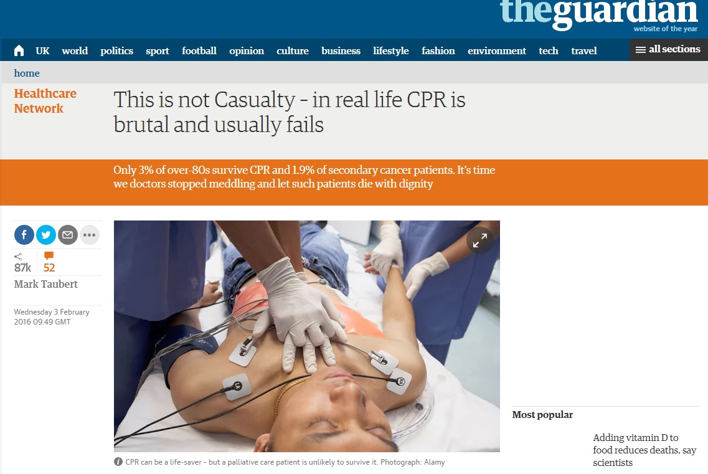
This started a big info and education campaign :
Resources for the public

Slide 16
Teaching the merits and the pitfalls of CPR since 2016 incl Patient resources
In acute hospital environments survival can be as high as 15-20% whilst in the community environment it is less than 5%.
But a meta-analysis which incorporated data from nearly 100,000 patients across 35 studies, demonstrated characteristics of those patients who do less well and not survive to discharge from hospital after CPR.
Patients with metastatic cancer, for instance had survival rates of 1.9% , as did patients with impaired renal function (1.9%).
Patients with an admission for pneumonia who went on to have CPR only left hospital alive in 1.7% of cases. [Reference: Ebell MH, Afonso AM. Pre-arrest predictors of failure to survive after in-hospital cardiopulmonary resuscitation: a meta-analysis. Fam Pract. 2011;505–15(19):28. ]
By contrast, television tends to portray a survival rate following attempted CPR of over 80%, giving false information and generating false hope. "

Slide 17
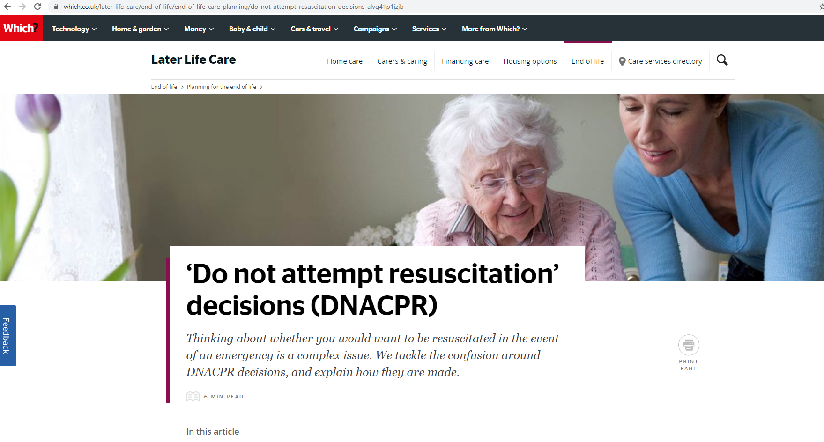

Slide 18
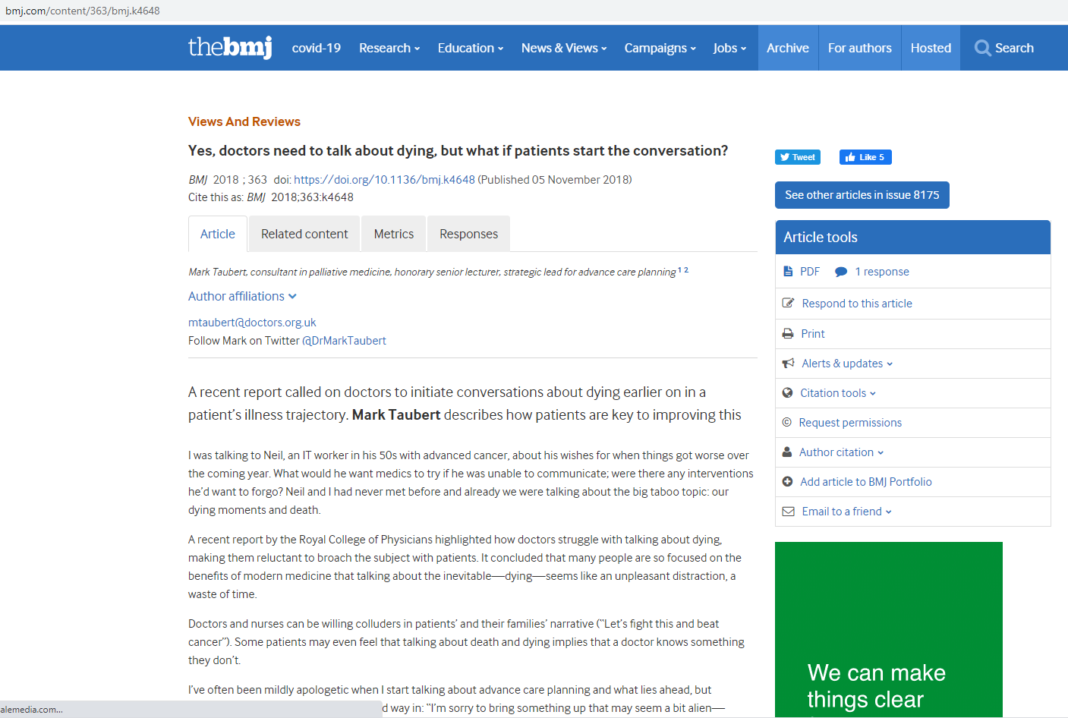

Slide 19
Important Points
Open-access All Wales DNACPR policy and form, recognised across all settings, borders in Wales
Anyone involved in DNACPR discussions should have read the policy
New forms and policy make it explicit that free text needs to be filled in to explain extent to which patients and NOK have been engaged
Our Policy also deals with forms from elsewhere incl All Scotland DNACPR form, and different forms from England (essentially all accepted and can be adopted onto care records)

Slide 20
Important Points
Attempts to communicate with family members/proxy (even if you cannot get hold of them) should be clearly documented
Welsh TalkCPR approach: Elicit views on ceilings of treatment - start small (blood transfusion?), end big (ITU/intubation?) .
Remember you are not asking patient to decide, merely conveying your (MDT’s) clinically realistic review
And finding out if they have views that may clash with medical view, make it a consultation
Welsh policy has concept of Natural Accepted and Anticipated or NAAD (within 6-12 months) in DNACPR policy as a trigger for such discussions
All NHS Wales HB’s / Trusts provide an easily accessible DNACPR policy www.wales.nhs.uk/DNACPR
and link to policy is on DNACPR form itself that patient’s take with them

Slide 21
Duty To consult versus Not discussing at all
Types of complaints these days:
“Why did you burden my poor mother with such a big discussion on CPR, when she only came in for Radiotherapy?!”
“Ah, DNR, so you are trying to euthanise my father!?”
“Why was ceiling of treatment NOT discussed with me/my family?”
“Why did my husband receive CPR and was transferred to hospital when we had said that we did not want this? And I told the paramedics that!”
Overconsulting/burdening --------------------------------------------------- Not Telling/Withholding

Slide 22
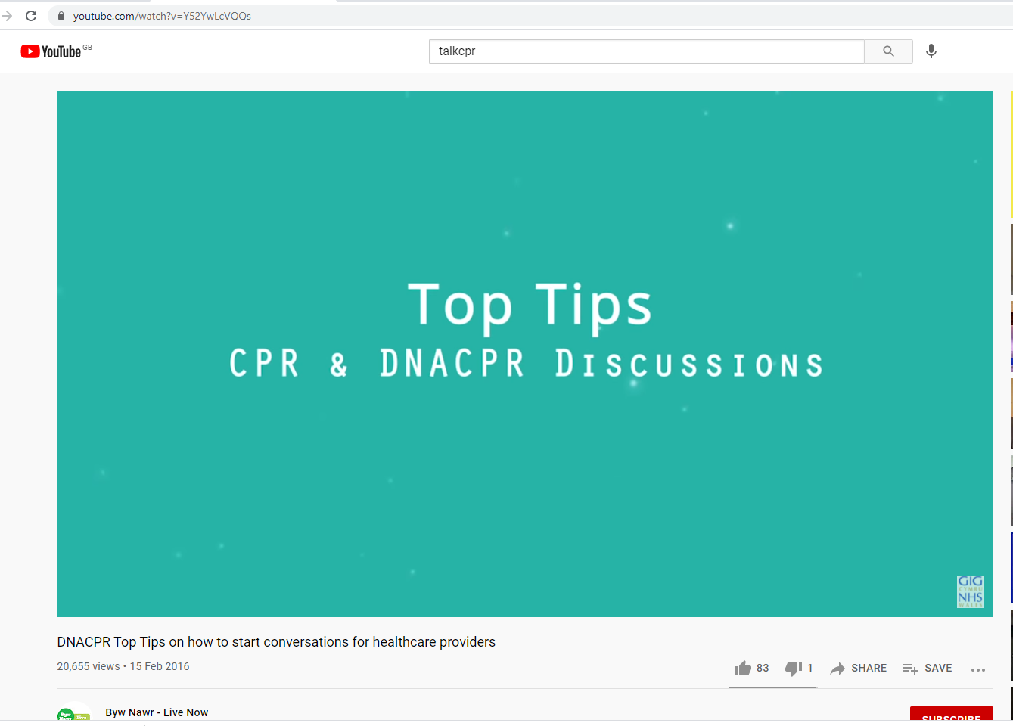

Slide 23
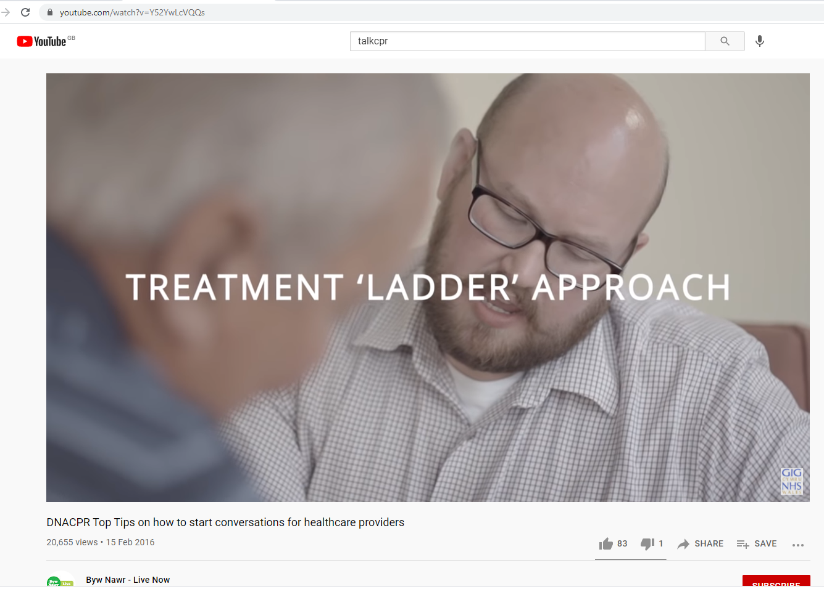

Slide 24
QR code for Patient/NOK TalkCPR videos on YouTube

Slide 25
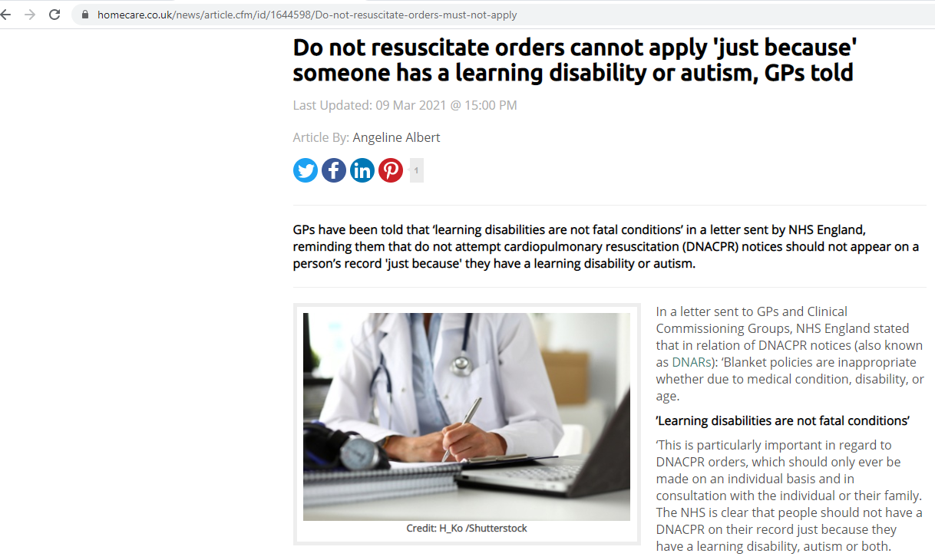

Slide 26
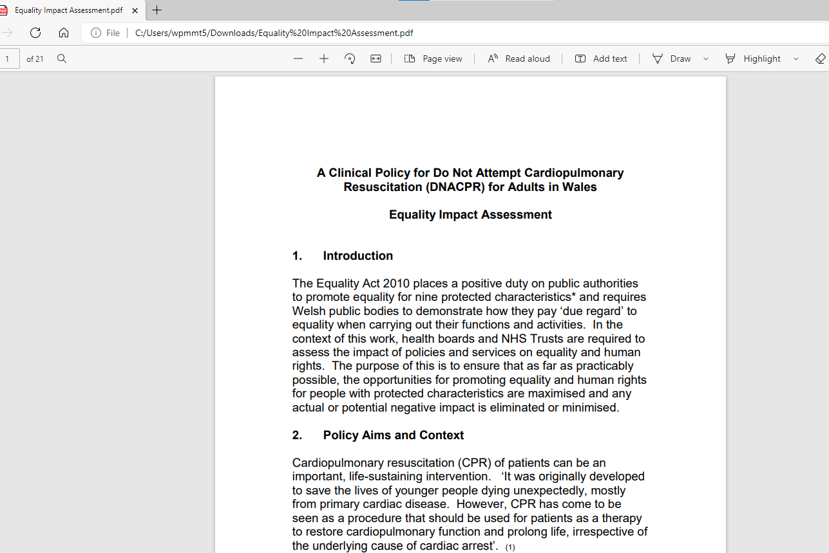

Slide 27
Conversation approaches incl “What Matters Most to you?”
Work at UK level with What Matters Most Charter and at regional level with Compassionate Cymru.
Goal of finding out what sort of person they are and what level of intervention they think is acceptable
“What matters most to you, especially towards the end of life?”
What goals do they have. Any opinions on treatments they wouldn’t want?
“It may seem strange for me to bring this up now that you are feeling better, but what do you want us to do differently next time you get admitted?”
How about appointing an Lasting Power of Attorney for Health and Welfare, and/or writing an Advance Decision to Refuse Treatment (ADRT)?

Slide 29
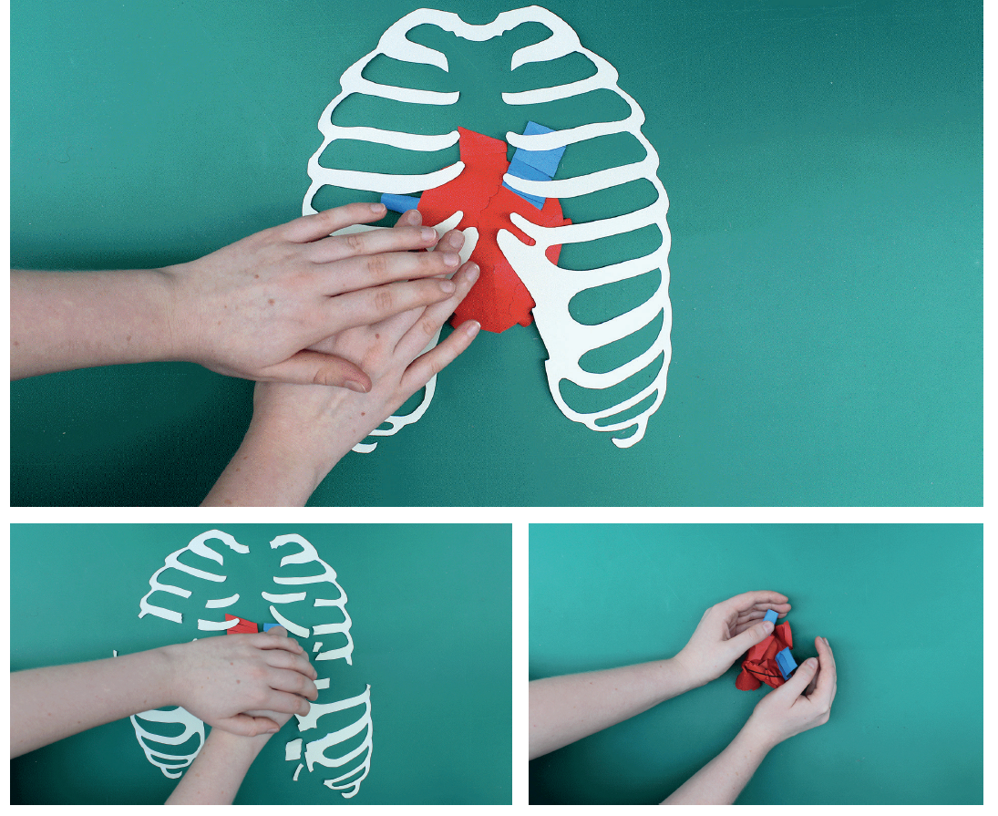

Slide 30
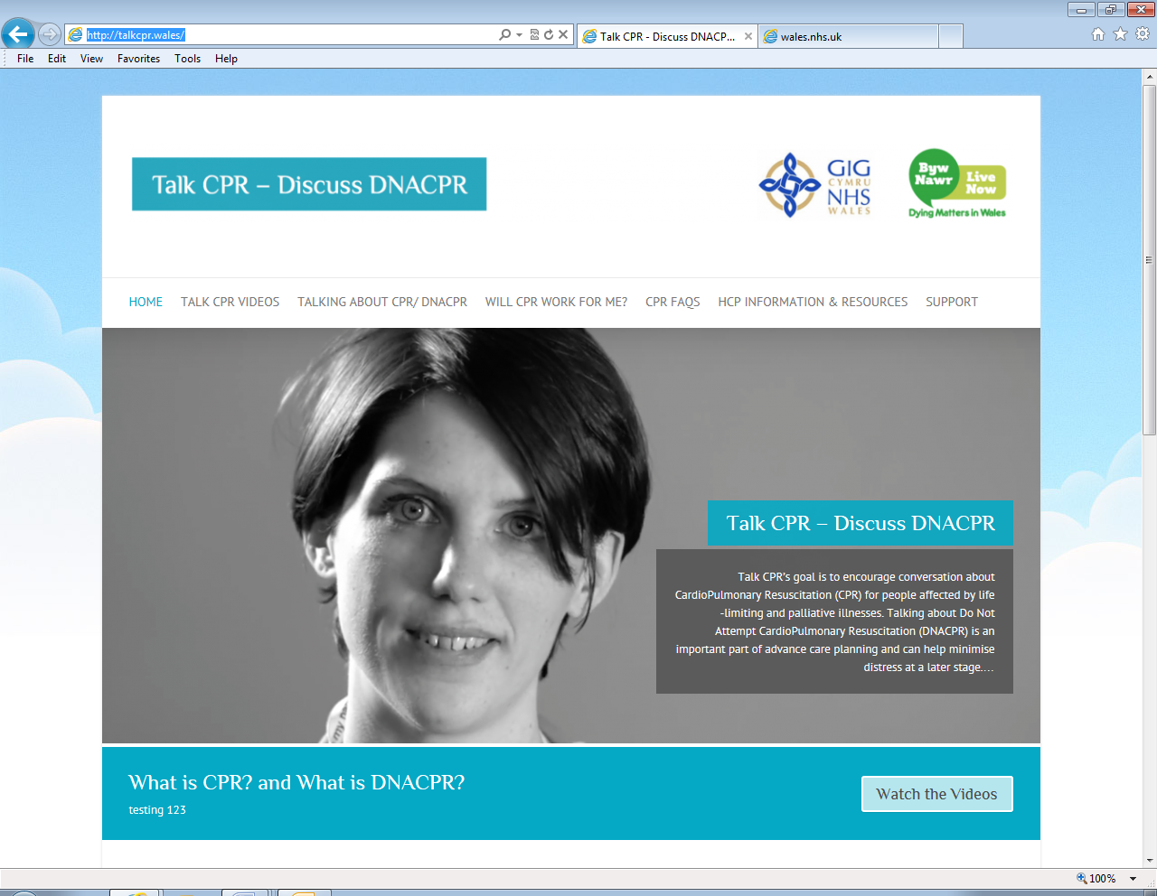
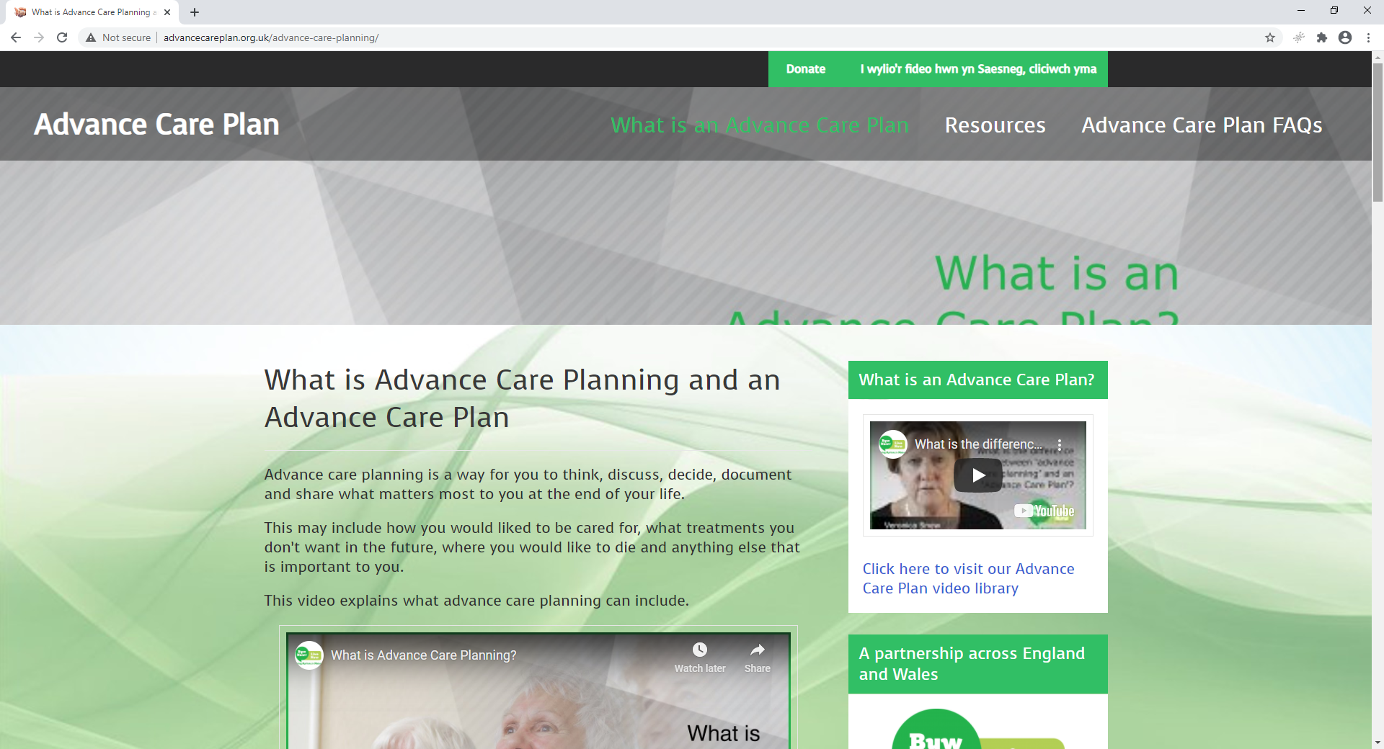
‘Conversation starters’:
http://talkcpr.wales
#TalkCPR
http://advancecareplan.org.uk
#TalkCPR
Notes:
SUMMARY
It is hoped that the use of video and website information for healthcare students, staff and patients around difficult areas such as CPR wishes can inform part of a more sharing and involving approach, allowing patients and their proxy to understand key decisions and providing good quality information. The TalkCPR website and videos are open source http://talkcpr.wales There is also a social media campaign to promote this work. The hashtag is #TalkCPR
We are currently trialling small video catalogues, which we have with us today which you could be in with a chance of winning if you are willing to fill in a short evaluation and leave your email address.

Slide 31
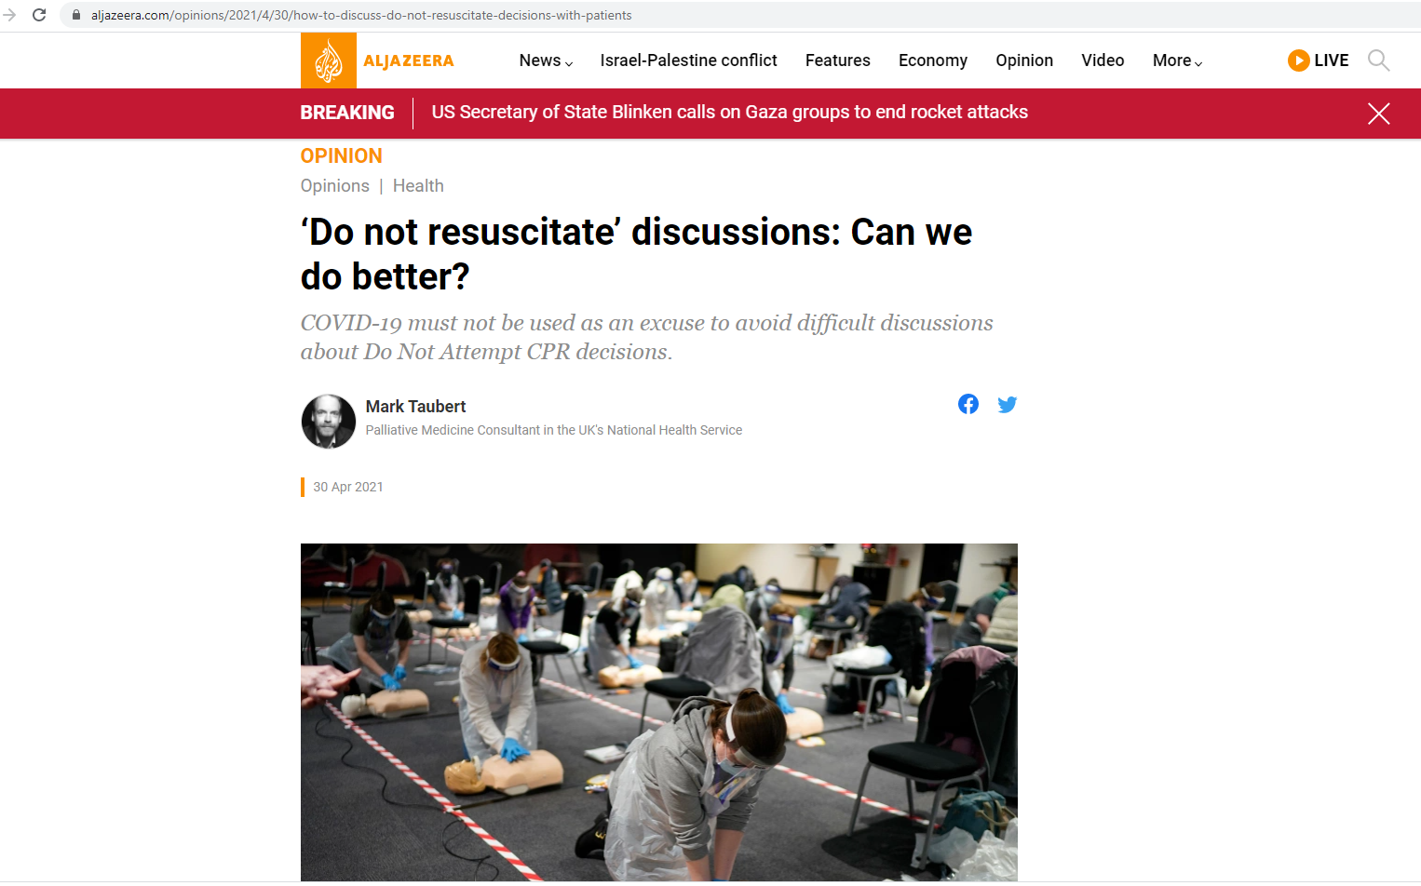
Cultural differences and approaches

Slide 32
Cultural differences and approaches

Slide 33
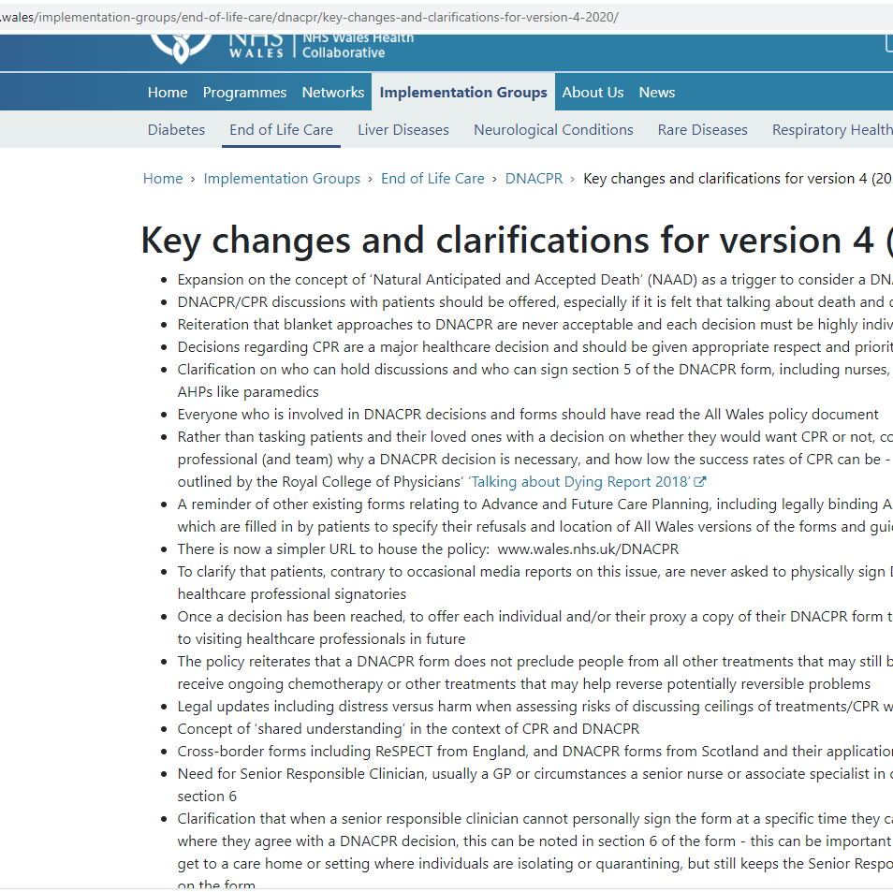
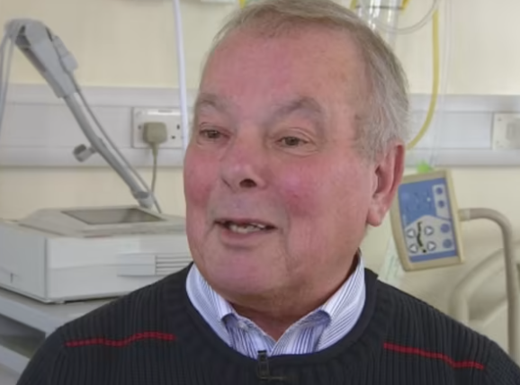

Slide 34
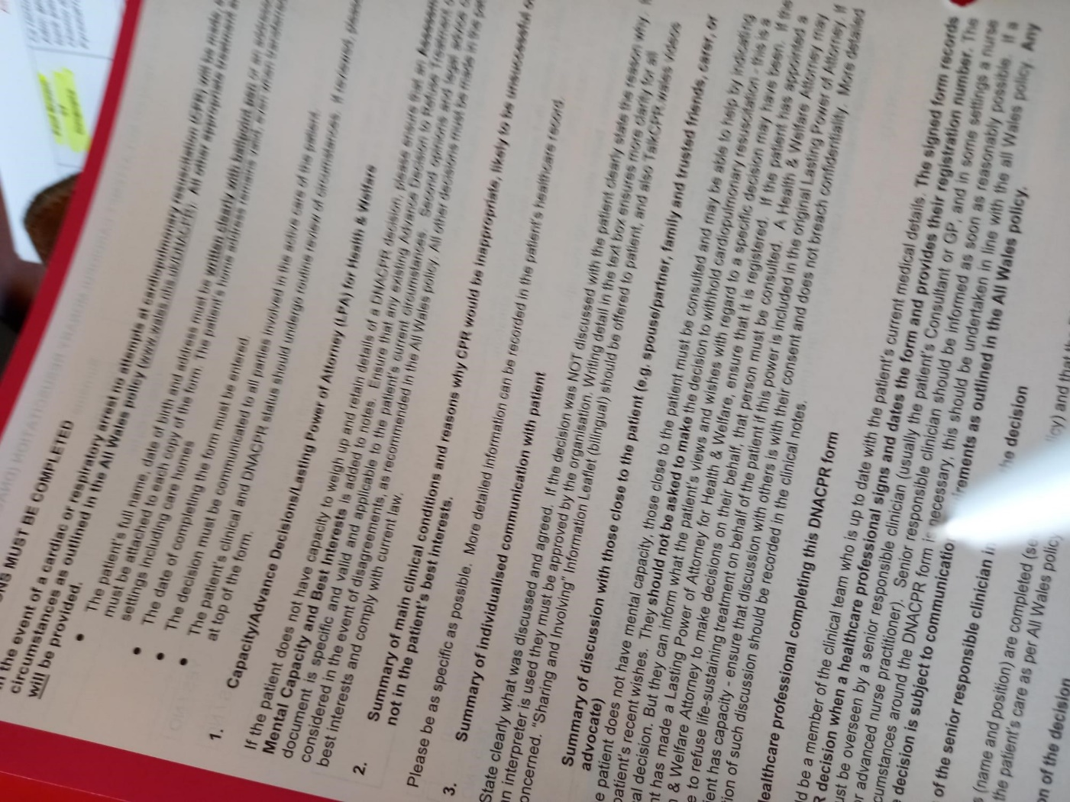
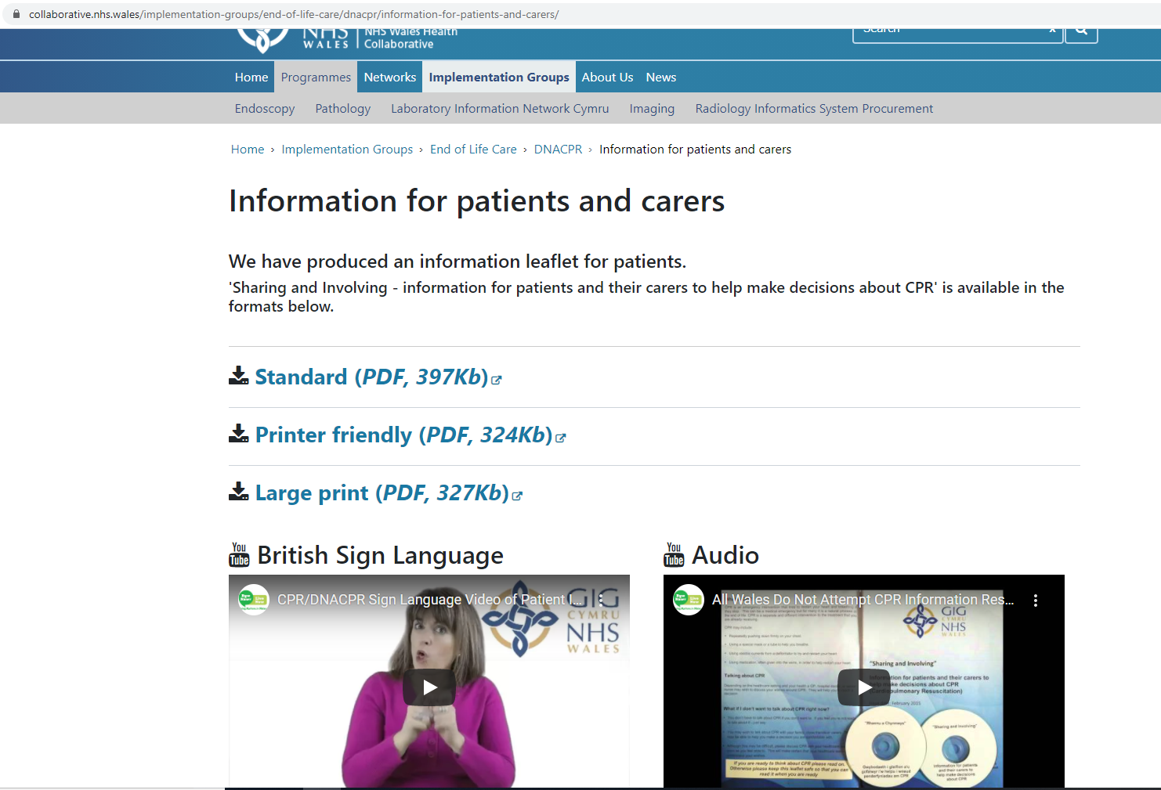

Slide 35
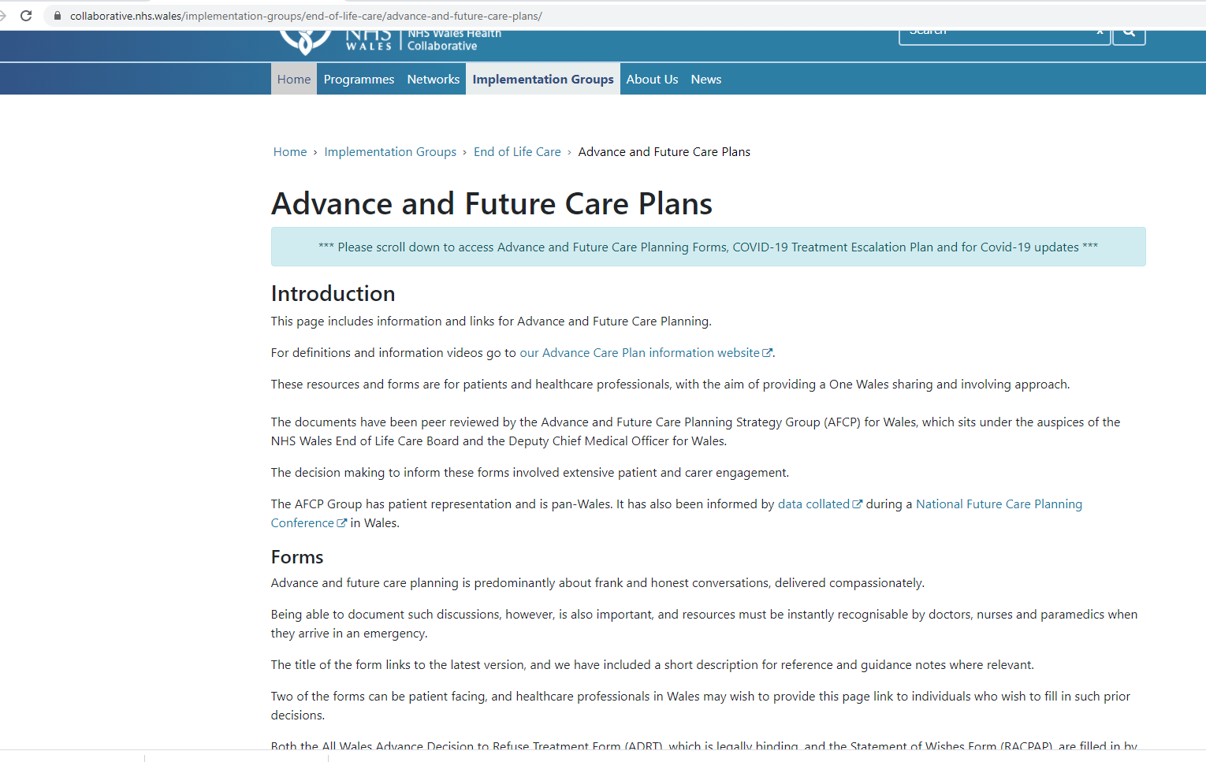
Advance & Future Care Planning (AFCP) Resources for Wales www.wales.nhs.uk/afcp
Memorable MND patient of mine who in 2010 lamented the fact that there was no All NHS Wales Advance decision to Refuse Treatment Form (ADRT)
Due to work of AFCP Strategy Group, we now have one (NHS Wales)
Plus an all Wales Record of Best Interests Form, a softer Advance Care Planning Statement (RACPAC)

Slide 36
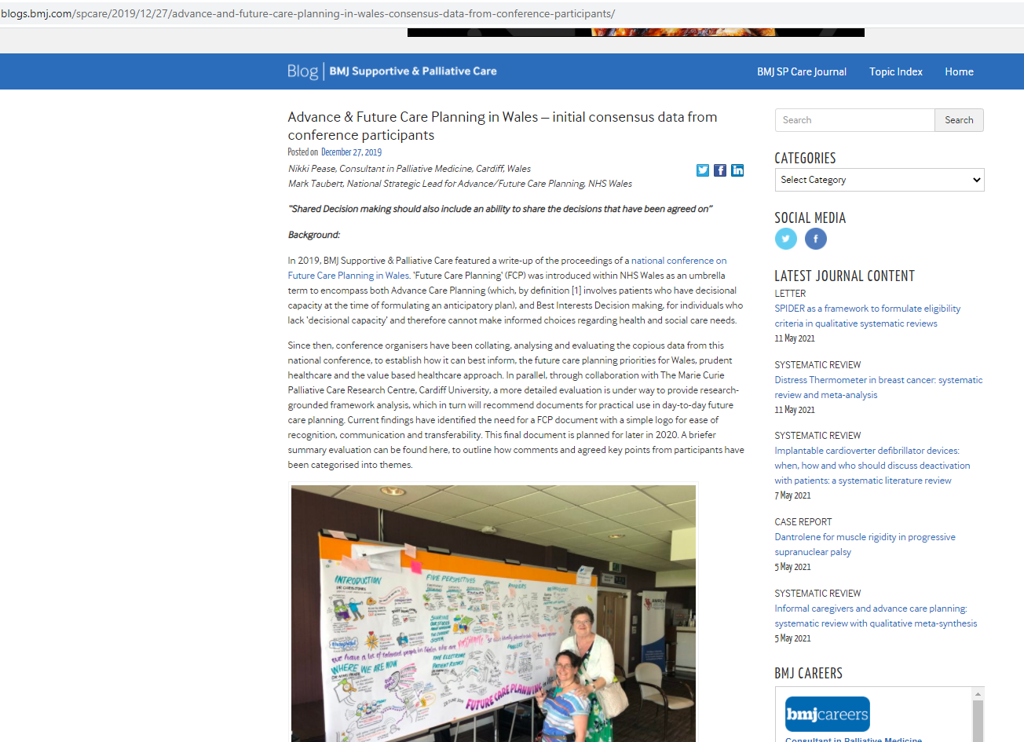

Slide 37
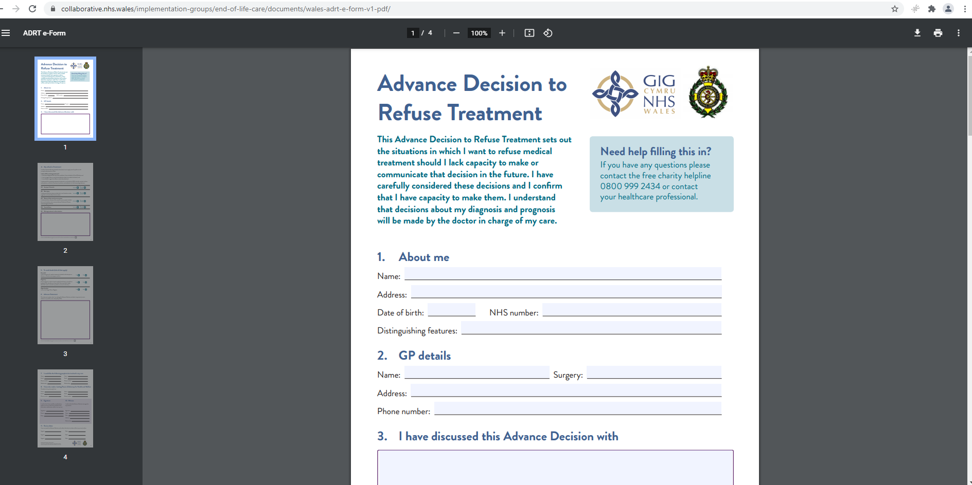

Slide 38
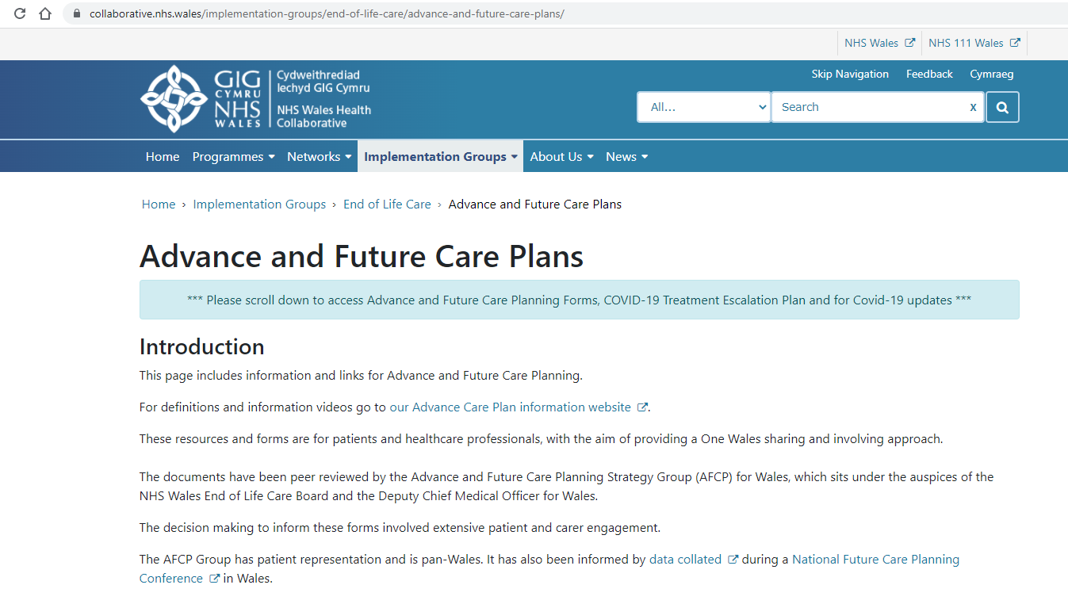
AFCP Resources via www.wales.nhs.uk/AFCP

Slide 39
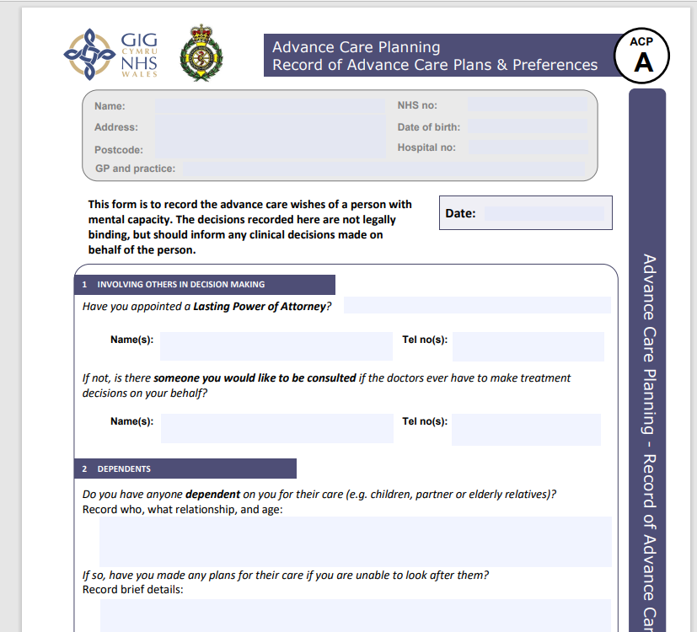

Slide 41
