Slide 1
Terrorism financing, fraud and organised crime – time for a joined-up approach?
‘Organised Crime: the present and the future’
University College London, June 19th 2023
Professor Nic Ryder
Cardiff University
rydern@cardiff.ac.uk

Slide 2
Research Funding
This work has been conducted under funding provided by InnovateUK (Activist Financing, Organised Crime/Fraud and Suspicious Activity Reports) Synalogik and RUSI

Slide 3
Abstract
The aim of this paper is to identify the link between fraud, terrorism and organised criminal gangs considering the publication of the Economic Crime Plan (2) and the United Kingdom’s (UKs) counter fraud strategy. In particular, the presentation focuses the UKs counter terrorism financing, fraud and organised crime strategies and advocates that a more joined up approach is necessary.

Slide 4
Contents
The paper is divided into six parts:
Part 1 – Financial Action Task Force (FATF) Recommendations
Part 2 – Typologies
Terrorism Financing and Fraud
Oragansied Crime and Fraud
Part 3 – Disparate Policies
Fraud
Terrorism Financing
Organised Crime
Part 4 – Findings and Recommendations

Slide 5
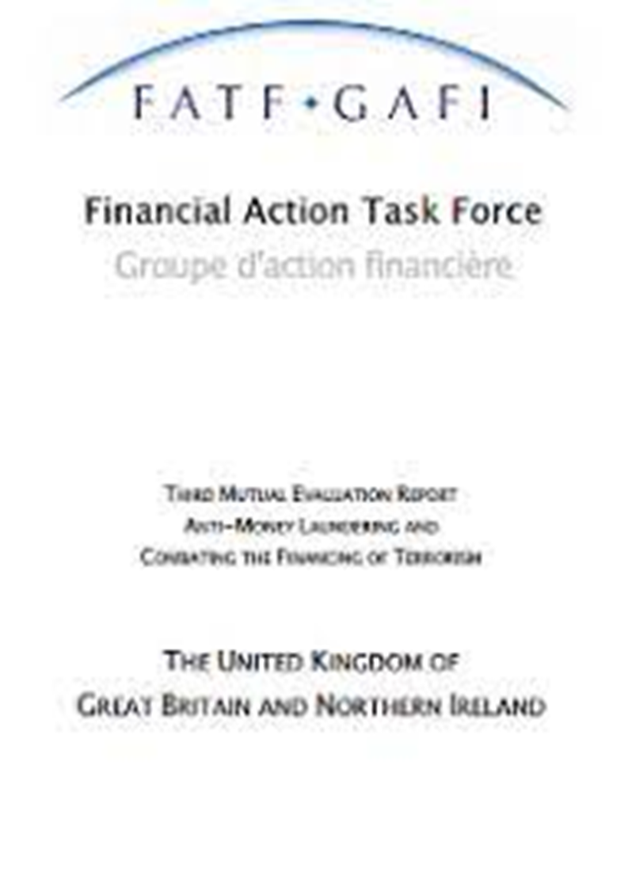
Part 1 – Financial Action Task Force
Mutual Evaluation Report (2007)
Money laundering regime strengthened by Proceeds of Crime Act (2002)
Deficiencies in fraud legislation addressed by Fraud Act (2006)
Bribery Act (2010),
Financial Services Act (2012)
Financial Services (Banking Reform) Act (2013)
The Criminal Finances Act (2017)
Sanctions and Anti-Money Laundering Act (2018)
Law Commission SARs report (2019)

Slide 6
Part 1 – Financial Action Task Force
National Risk Assessments (2015, 2017 and 2020)
Economic Crime Plan (2019)
Law Commission Asset Recovery (2020)
Law Commission Corporate Economic Crime (2020)
Economic Crime (Transparency and Enforcement) Act (2022)
Law Commission Corporate Criminal Liability Options Paper (2022)
Economic Crime and Corporate Transparency Bill (2022-2023)
Economic Crime Plan 2 (2023)
Fraud Strategy (2023)

Slide 7
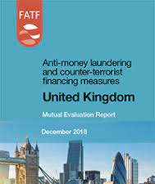
Part 1 – Financial Action Task Force
‘The United Kingdom has a well-developed and robust regime to effectively combat … terrorist financing’ (FATF, 2018)
FATF gave the UK its highest possible rating
‘Out of 60 countries assesses, the UK has one of the toughest AML/CTF regimes in the world’ (HM Government, 2018)

Slide 8
Part 2 – Typologies
‘Typologies provide a contemporary snapshot of the ways in which terrorists raise, move and use funds’ (FATF, 2009, 18)
Typologies have focused on identifying the different types of fraudulent activity and are often victim centric:
Financial Conduct Authority (FCA, 2014, 36-45),
National Fraud Authority (NFA, n/d),
Home Office (2018),
KPMG (2019, 6) and
Levi (2008, 389-419).
No focus on terrorism financing and fraud.

Slide 9
Part 2 – Typologies
Perri and Brody (2011)
Freeman (2011)
Irwin et al. (2012)
Vittori (2011)
Wood et al. (2021)
Is there a need for a new typology?
‘particular concern was expressed [by HM Government] that the linkages of some types of fraud with … terrorist funding were being missed ’ (Fraud Review, 2006, 134)

Slide 10
Part 2 – Terrorism Financing Fraud Typology
Passport Fraud
Immigration Fraud
Identity Fraud
Financial Fraud
Public Funding and Grant Fraud
Benefit Fraud
Student Loan Fraud
Non-Profit Organisation Fraud
Tax Fraud
Counterfeiting
Insurance Fraud
Mortgage Fraud
Trade Based Fraud (Ryder, 2023)

Slide 11
Part 2 – Organised Crime Fraud Typology
Waste management fraud
Counterfeiting
Procurement fraud
Covid: 19 fraud
Identity fraud
Tax fraud
Labor fraud
Intellectual property fraud
“two-thirds of organised crime groups focused on frauds” (Levi, 2014)

Slide 12
Part 3 – Disparate Policies Fraud
The Government established the independent Fraud Trials Committee (1983)
The ‘Roskill Report’ (Fraud Trials Committee Report, 1986)
Criminal Justice Act (1987) – Serious Fraud Office
The Fraud Review (2006)
UK has been subjected to large-scale instances of fraud
Fraud accounts for 42% of all crime against individuals (2021)

Slide 13
Part 3 – Disparate Policies Fraud
Economic Crime Plan (2019-2022)
Beating Crime Plan (2021)
Economic Crime Plan 2 (2023)
Fraud categorised as a threat to national security (February, 2023)
Fraud has been added to the Strategic Policing Requirement (2023) which means that police forces are required to treat the threat presented by fraud as a top priority
Fraud Strategy (2023)

Slide 14
Part 3 – Disparate Policies Terrorism Financing
Long history of tackling domestic terrorism
Initial focus on domestic terrorism, extended to international terrorism by Terrorism Act (2000)
Impact of 9/11 terrorist attacks:
Anti-terrorism, Crime and Security Act (2001)
Combating the financing of terrorism – a report of on UK action (2002)
The financial challenge to crime and terrorism (2007).
The United Kingdom’s Strategy for Countering International Terrorism (2009)
CONTEST – The United Kingdom’s Strategy for Countering Terrorism (2014)
UK CTF Strategy (2021)

Slide 15
Part 3 – Disparate Policies Serious Organised Crime
Serious and Organised Crime Strategy (2013)
Anti-Money Laundering and Counter-Terrorist Financing Action Plan (2016)
Anti-Corruption Strategy (2017)
Serious and Organised Crime Strategy (2018)
National Risk Assessment (2020)
Economic Crime Plan (2019-2022)
Integrated Review of Security, Defence, Development and Foreign Policy (2021)
National Crime Agency Annual Plan (2022-2023)
Integrated Review Refresh (2023)

Slide 16
Part 3 – Disparate Policies Serious Organised Crime
Regional Organised Crime Units (ROCU)
ROCUs form a crucial part of the UKs Serious and Organised Crime Strategy
Effectiveness of ROCUs is heavily dependent on HMG funding
Effectiveness of ROCU is heavily dependent on HMG funding (Public Accounts Committee, 2019 and National Audit Office, 2019)
‘Unless the government addresses these issues [funding] there will continue to be a mismatch between its ambitious plans to respond to serious and organised crime and its ability to deliver on them’ (ibid).

Slide 17
Part 4 – Findings and Recommendations
Fraud is the funding mechanism of choice for terrorists
Terrorism financiers have created a ‘fraud dossier’ or ‘black book’
The UKs fraud strategy does not refer to terrorism financing
The CTF strategy does not make any reference to fraud
The merger of the fraud, CTF and OCG strategies would represent an improvement on the current disjointed policies

Slide 18
Part 4 – Findings and Recommendations
The disconnection between the counter fraud, CTF and OCG strategies
This could be addressed by the creation of regional fraud units
They would work with ROCUs and CTIUs
Regional fraud units would handle all fraud investigations and work with ROCUs and CTIUs if required
A single Economic Crime Agency, managed by the Home Office

