Slide 1

“Voices” from children and young people with cerebral palsy about participation in recreational activities
Authentic methods to explore their health and well-being effects from participation in recreational activities, with non-verbal and non-ambulant children with cerebral palsy-a case series design.
Dr Dawn Pickering,
Children’s Physiotherapist, Senior Lecturer,
School of Healthcare Sciences,
Cardiff University at
In Cork, Ireland, 20th June 2023
Notes:
How many of you have children or grandchildren who participate in recreational activities?
What choices do they have?
If you have a disability requires reasonable adjustments- that is what I am exploring in CP

Slide 2
Aim of paper
This paper authentically represents the voices of non-verbal children with cerebral palsy using a case series design.
Policy suggests that children should have the right to play and leisure opportunities, however non-verbal and non-ambulant children with cerebral palsy have fewer choices. Additionally, children with communication, learning and mobility limitations are usually excluded from research.
The aim of this research was to capture the ‘voices’ of participants by exploring their well-being impact in terms of their experiences and choices about their level of participation in recreational activities.

Slide 3
VOCAL study
PhD : ‘VOCAL’ study title- “Beyond Physiotherapy: Voices of children and young people with cerebral palsy and their parents about ‘Participation’ in recreational activities.”
My position as a former children’s physiotherapist- voices of disabled children often missing in treatment choices-‘Rights’.
Case study series design using creative, visual and participatory approaches with disabled children and young people, aged 9-16 years, with walking, communication and learning disabilities.
7 Case studies, divided into 2 groups, 4 who participated a lot in recreational activities (PG) and 3 who had limited participation (LPG).

Slide 4
Emotional well-being of non-verbal children and young people
Future Generations and Well-being Act (Wales) 2015:
“For you to be able to have fun, you need lots of chances to play sport, read books, go to the theatre and go to museums” pg 2.
Facial expression sometimes missing, other cues from interaction with equipment and environments: Intentional behaviours.
Well-being scales that are valid and reliable for this group?
No straightforward data collection tool

Slide 5
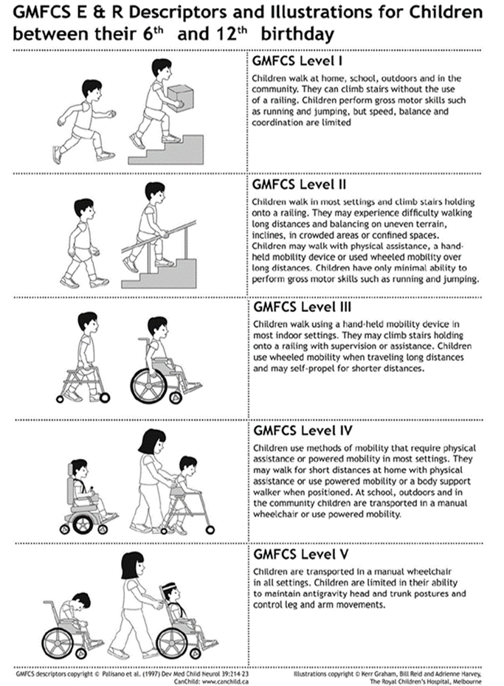
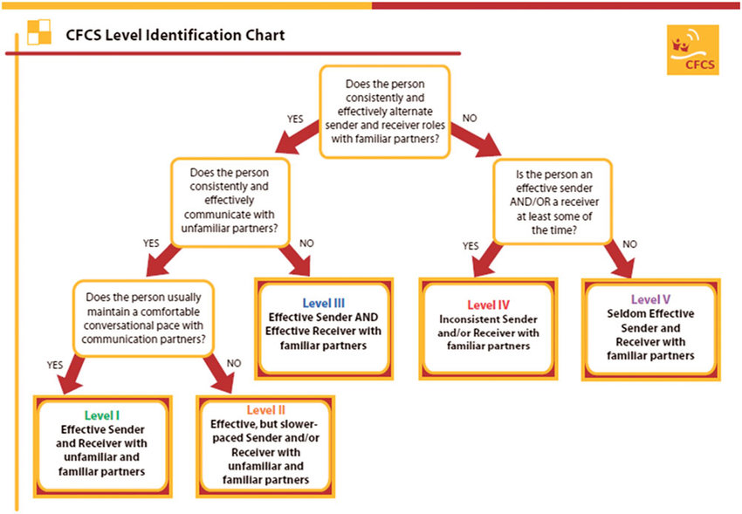
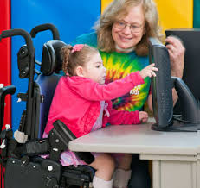
Cerebral palsy-functional classification systems

Slide 6
Research Question and Aims:
Research question
  How do children and young people with cerebral palsy and their carer’s view, experience and choose their level of participation in recreational activities?
Study Aims
The 2 aims of this study were to explore participants’:
  Views, experiences and choices for their level of participation in recreational activities, including barriers and facilitators.
  Perceptions of the effect of their level of participation upon their emotional well-being.

Slide 7
Construction of each case study (Yin 2014)
Each case included:
2 interviews (some with children and young people who could use AAC, some with parents) 12 weeks apart.
A written diary of recreational activities recorded by them which included some photographs sent to the researcher or printed in the diary
An observation of an activity during this period where non identifiable photographs were taken by the researcher as well as field notes.

Slide 8
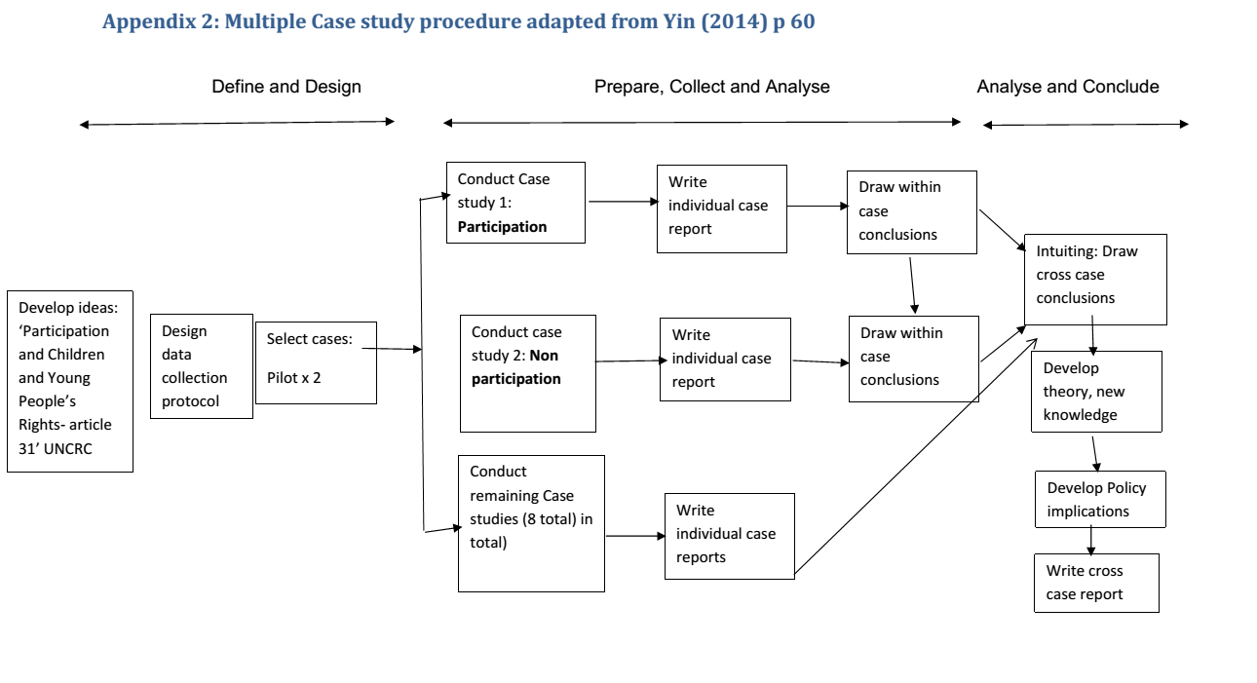
Case study flow chart

Slide 9
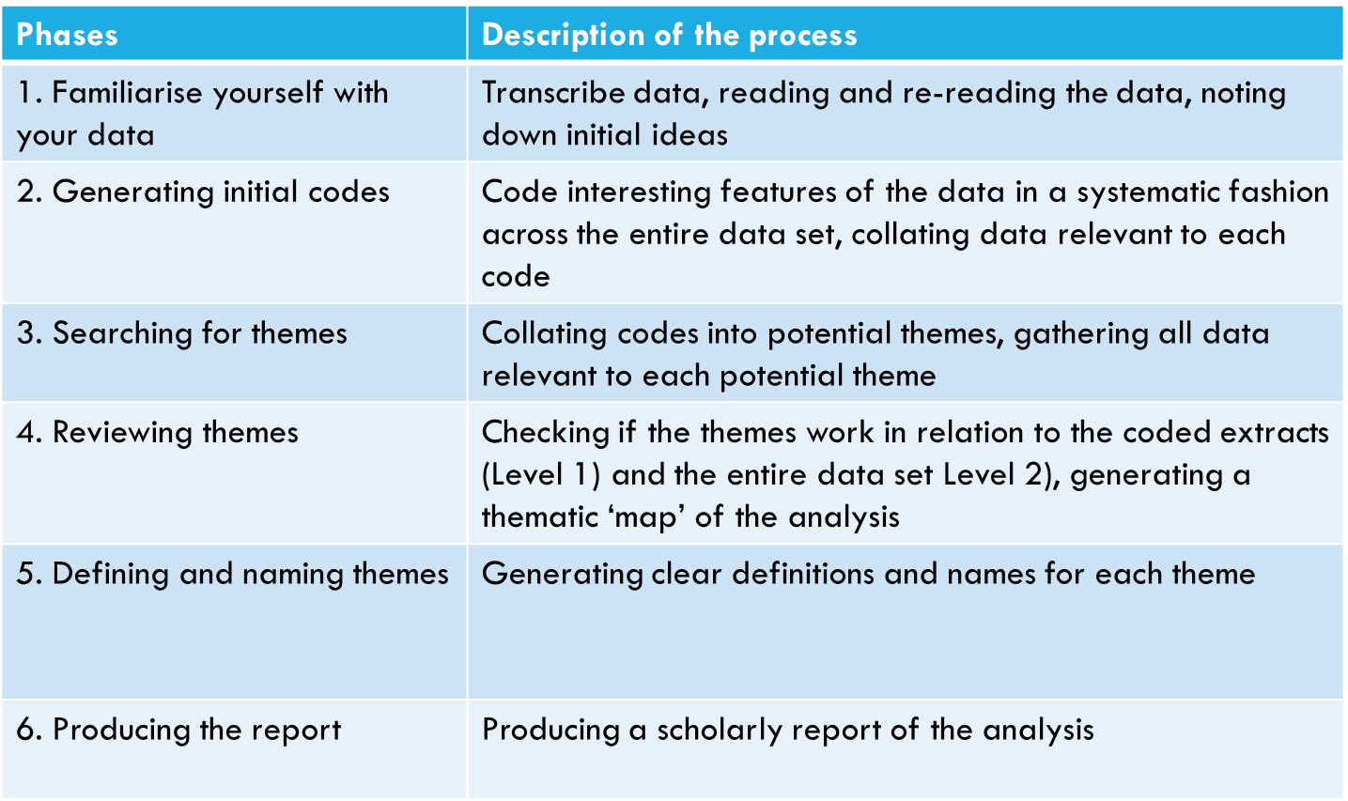
Analysis: Braun and Clark’s (2013) stages of analysis

Slide 10
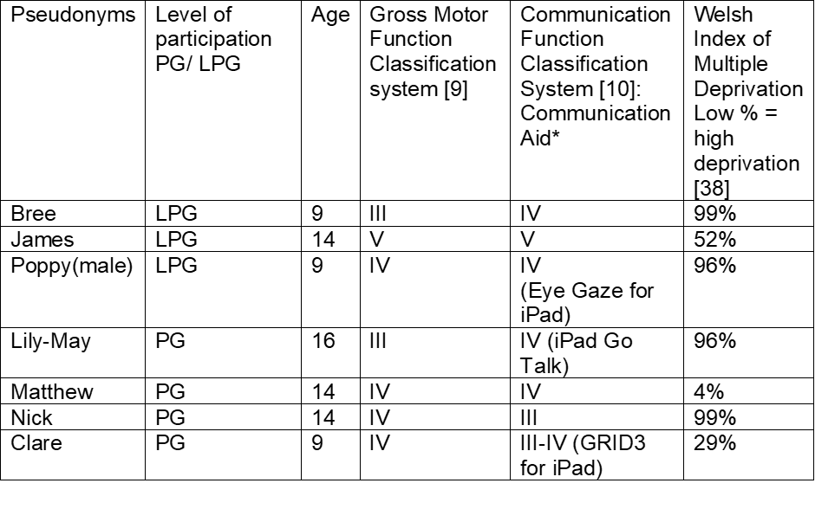
Demographics of 7 participants aged between 9-16 years

Slide 11
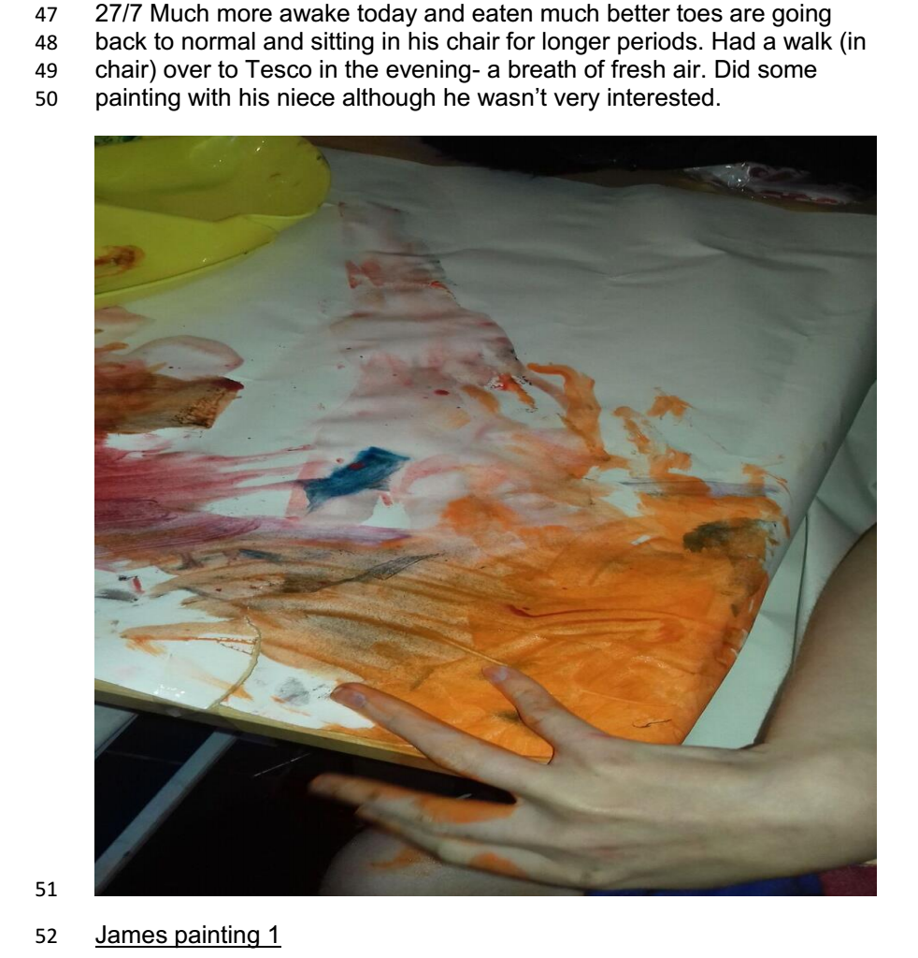
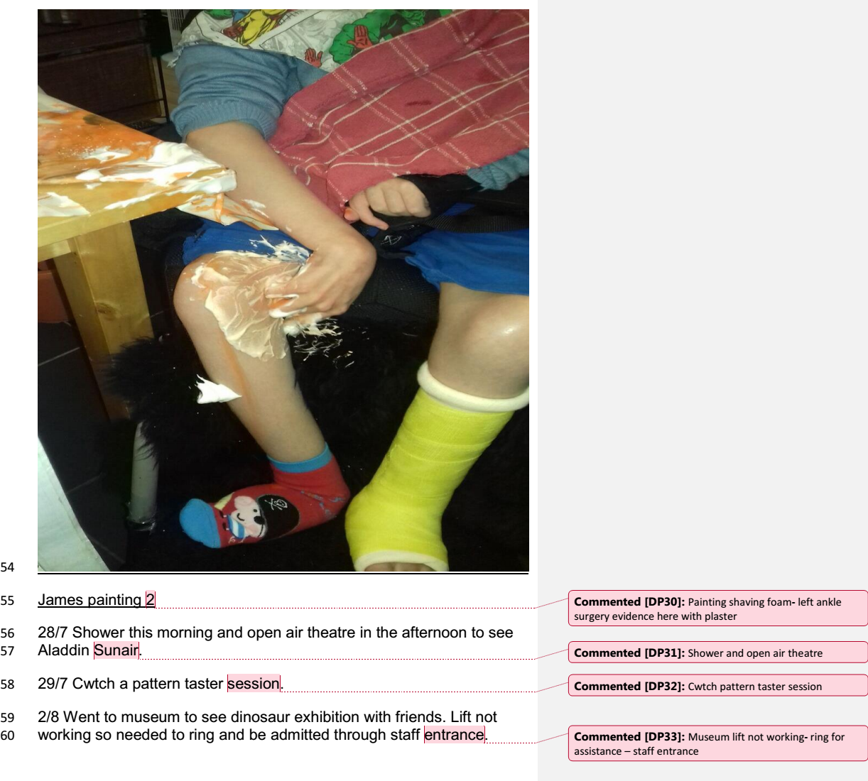
Diary data – Stage 2 coding James

Slide 12
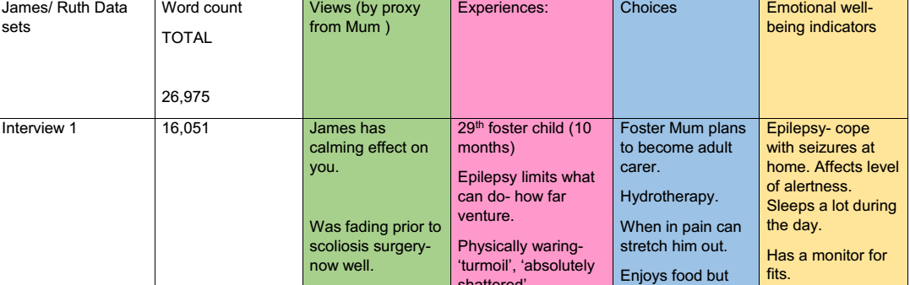
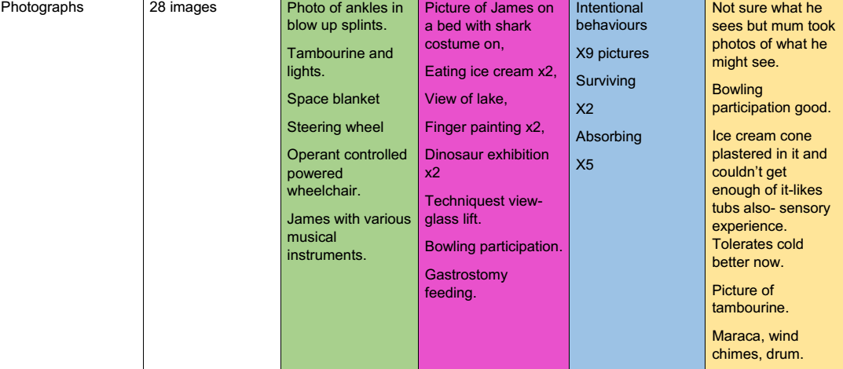
Data management: Stage 3 Coding/Ideas Table

Slide 13
James: Stage 3: Themes and Subthemes

Slide 14
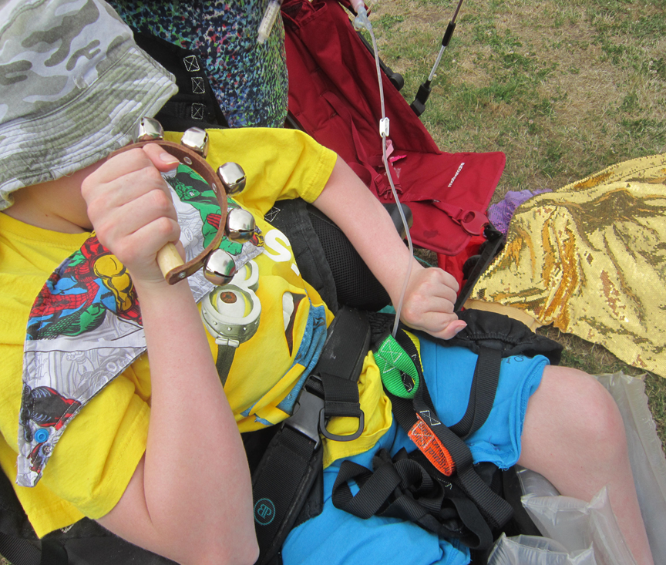

James (14 years):‘Behaviours in public spaces’
Gastrostomy feeding observation-
Field notes:
  Play scheme ‘normalised’ this behaviour as other parents carrying out feeds outside
Pickering D, Gill P. and Reagon C. A kaleidoscope of well-being to authentically represent the voices of children and young people with complex cerebral palsy: a case study series Disability and Rehabilitation Online https://www.tandfonline.com/eprint/CWZNSAXMCIAQNQKREMJD/full?target=10.1080/09638288.2023.2194680

Slide 15
Extract from James’s case study: Behaviours in public spaces

Slide 16
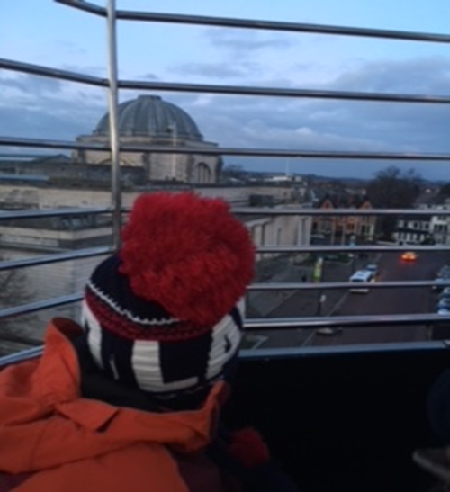
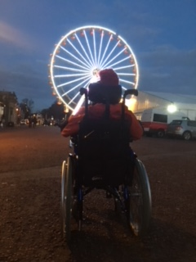
Poppy: Visual views of what participant’s could see
Diary entry: Big Wheel, Winter Wonderland

Slide 17
Messy data
Where I chose to use an image, I wrote text in the paragraph and gave a heading to guide the reader

Slide 18
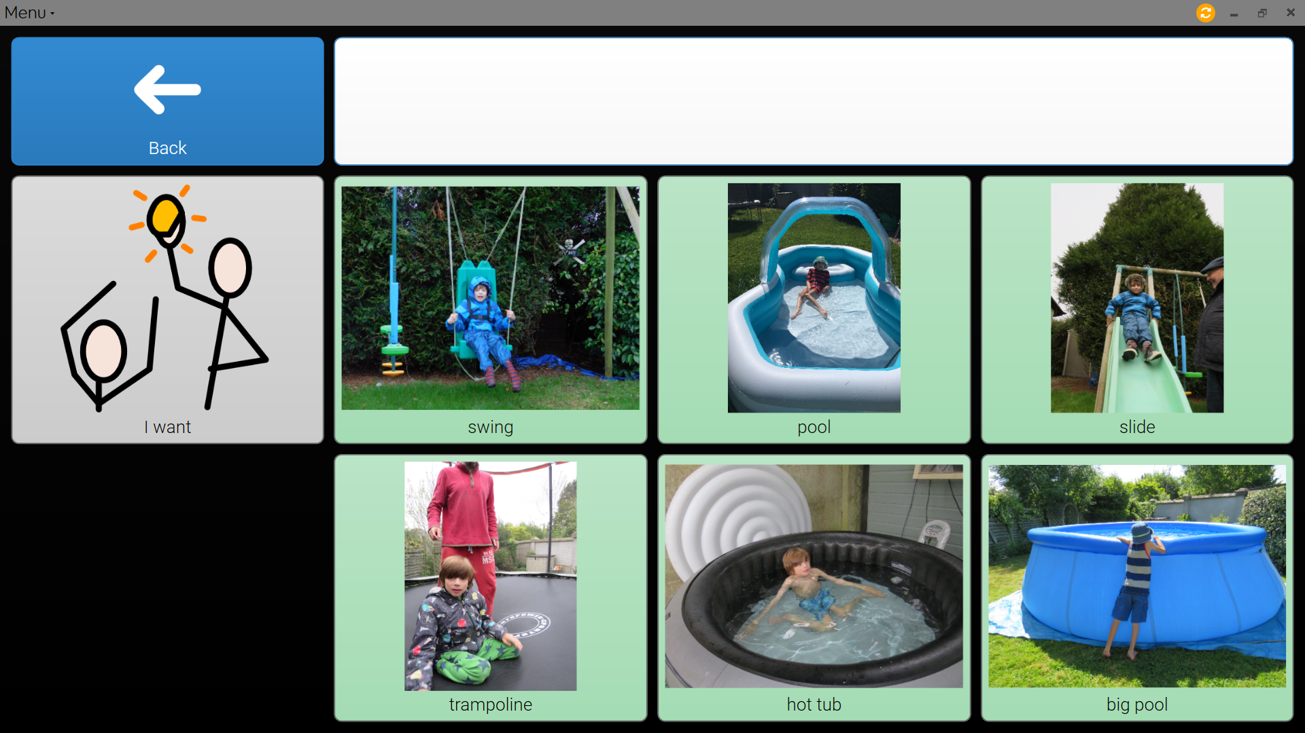

Technology Assistance: Eye Gaze technology –pre-linguistic choices ‘Poppy’ (9 years) Observational visit to school/ Diary entry 14th Jan 2018

Slide 19
Themes within case stage 3
Example of Poppy’s themes

Slide 20
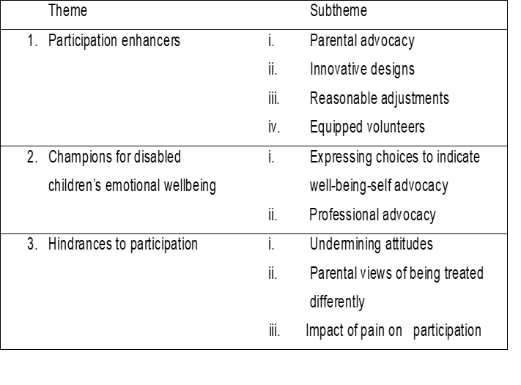
Across case analysis led to three overall themes stages 4

Slide 21
How have the visual methods added value to my data?
Helped me with the context and recall during analysis
Provided evidence of emotional well-being for me to analyse
Provided discussion around the myth of excluding disabled children
Triangulation of different data sources added to the rigour/ trustworthiness of the study

Slide 22
Case study flow chart – Braun and Clark’s 6 stages highlighted in red
Stage 2
Stage 3
Stage 4
Stage 1
Stage 5
Stage 6

Slide 23
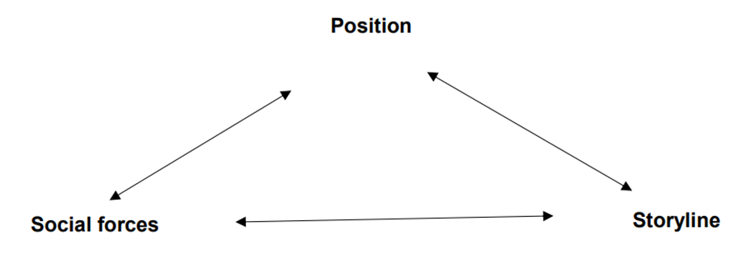
Positioning theory applied post data analysis
Mutually determining triad from Harré and Langenhove 1999 pg.18
Harré́, R., Langenhove, L. 1999. Positioning theory: moral contexts of intentional action. Malden, Mass.: Oxford

Slide 24
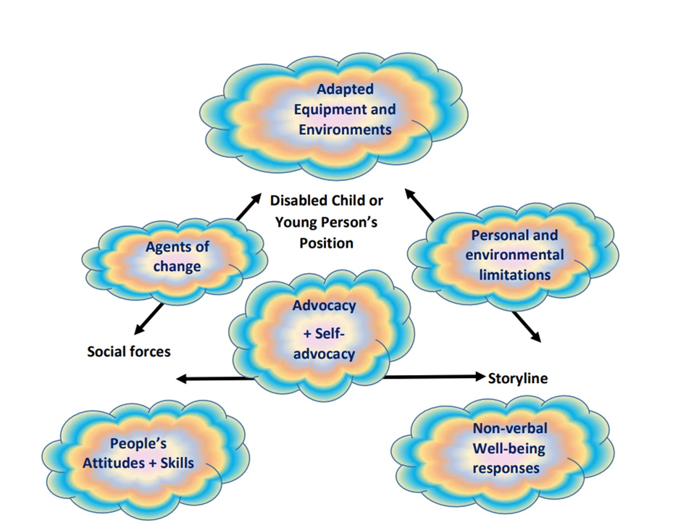
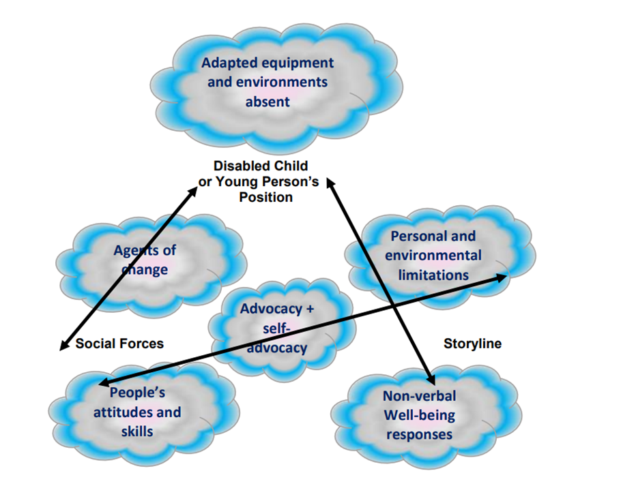
Kaleidoscope of Well-being represented by adapting positioning theory
Skewed Kaleidoscope

Slide 25
Authenticity of method
I have socially constructed their stories by including the visual to provide context of equipment and environments that affected their level of participation. This rich observational data has added value to the interviews, field notes and written diaries.
It remains a challenge how to understand and represent their emotional well-being as their cues are not always the same as typically developing children.
It is essential to also have someone who knows them well, to give evidence on their behalf-in my case this was their parents and a foster parent.

Slide 26
Summary
The findings demonstrate how these children were able to self-advocate, demonstrating their well-being by their intentional behaviours from their level of participation in a recreational activity.
Powtoon created for the children: https://www.powtoon.com/s/eh8O41X6xP1/1/m

Slide 27

Questions/ Comments ?
Acknowledgments to the School of Healthcare Sciences and
The Chartered Society of Physiotherapy’s Charitable Trust for part funding this PhD: NP/15/03
International Standard Registered Clinical/soCial sTudy Number (lSTCRN):42717948
Supervisory team: Dr Paul Gill, Dr Carly Reagon and Dr Jane Davies
Dr Dawn Pickering, Cardiff University’s School of Healthcare Sciences, pickeringdm@cf.ac.uk
Twitter:@DawnMPickering

