Slide 1
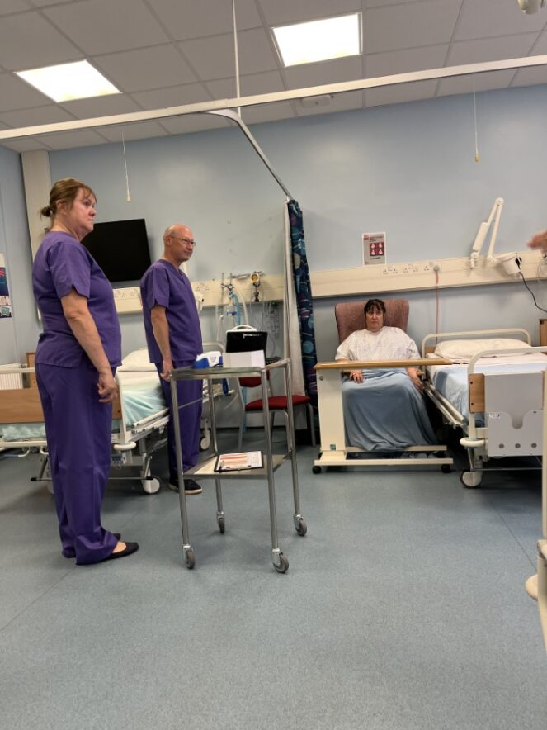
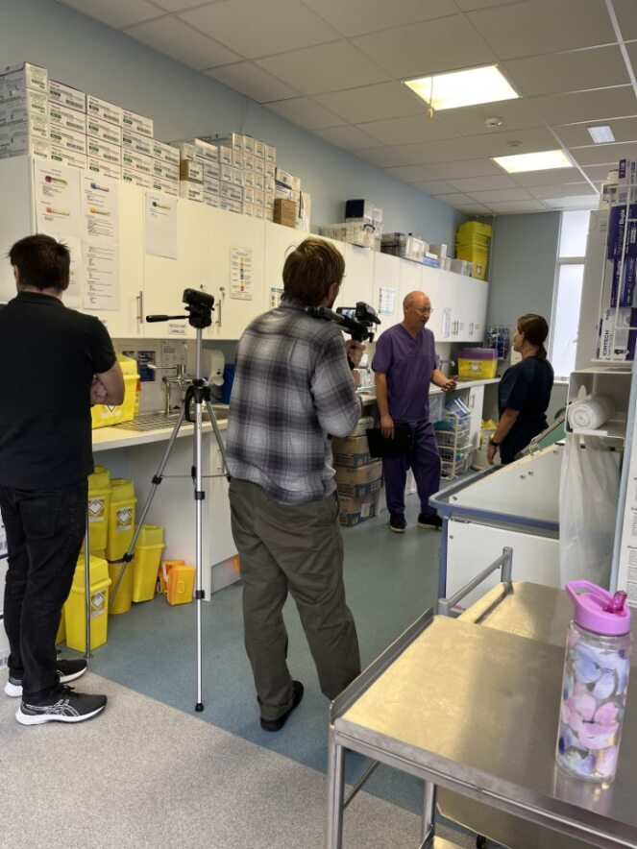
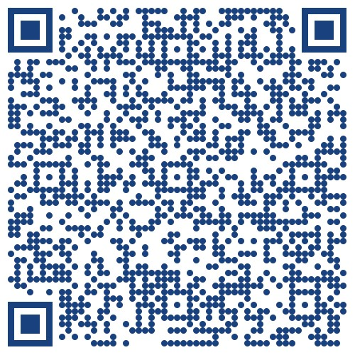
In-Point assessment: Evaluating authentic simulated role play, as a pedagogical approach to assist adult nursing students with clinical practice assessments
Nelson Selvaraj (Lecturer, Adult Nursing)
Jayne Hancock (Lecturer, Adult Nursing)
Chris Munro (Lecturer, Adult Nursing)
Sandra Fender (Lecturer, Adult Nursing)
Suzanne Hughes (Senior Lecturer, Adult Nursing)
Anthony Pritchard (Lecturer, Adult Nursing)
Karen Pritchard (Clinical Skills Tutor)
Peter Smith (Senior technician,
Simulation & Clinical Skills)
Wayne Cole (Senior technician,
Simulation & Clinical Skills)
Background
Aim
Approved Education Institutions, together with practice learning partners, are responsible for ensuring that assessments are fair, objective and evidence-based (Nursing and Midwifery Council, 2018). The new assessments like In-Point Assessment (IPA), however, can cause stress and anxiety among students and clinical assessors, leading to inconsistent assessment practices and poor student experience.
Authentic simulated role play videos can enhance assessors’ understanding of the IPA, reduce stress and enhance consistency in assessment practices.
To report undergraduate student nurses’ learning experiences with the In-Point Assessment authentic simulated role play video learning package.
Methods
A series of 20-minute role play videos. Application of the principles of Compassionate Leadership
Improvements & Suggestions
“Different scenarios on the different types of clinical settings: a medical, surgical, community and specialty setting might help some students”
(Year 3 student)
Inclusive, innovative & authentic design
Linked to NMC standards
Co-production between academics and professional staff
“Found it helpful, so no improvements needed for me”
(Year 2 student)
Mentimeter & Microsoft online survey forms
Qualitative data
Project
“Could have been shorter as I lost attention”
(Year 1 student)
Academic and professional staff in the Simulation Team collaborated to develop a series of four 20-minute role play video resources related to IPA that nursing students must achieve across the UG programme.
Year 1
Assessing, planning, implementing and evaluating care
Year 2
Medicines management
Year 3
Supervising and supporting learning; and Leading, Managing and coordinating care
Series of questions linked to
Understanding of IPA
Student expectations
Confidence to complete assessment
“Perhaps, an overlay where you can see which area of the IPA video has been completed. Example: Student gains informed consent and explains procedure, then on the screen you can see highlighted which part of the assessment is being ticked off”.
(Year 2 student)
Results
Preliminary evaluations suggest that IPA videos improved students’ confidence level and provided an understanding of the structure of the IPA assessment.
“More scenarios”
(Year 3 student)
Conclusion
“Scenario gave me a better understanding on what was expected from me”
“Allowed me to feel confident I was on the right path and had interpreted the requirements of the assessment correctly”
IPA videos were valued as an effective way of learning and understanding the criteria associated with in-point assessments. They offered an inclusive learning experience that enabled students to meet their clinical proficiencies.
“Step by step instruction what we should include in assessment; helped to plan and structure”
“It was the ability to see the requirement in a practical way”
“Clear exemplars that give context to the IPAs and make it easy to see how to plan to implement them in practice ”
“Provides comprehensive examples of ”
References

