Slide 1
Immersive digital story intervention on empathy in nursing students: findings and reflection
Dr Juping Yu, Faculty of Life Sciences and Education, University of South Wales juping.yu@southwales.ac.uk
Dr Gareth Parsons, School of Healthcare Sciences, Cardiff University ParsonsG4@cardiff.ac.uk

Slide 2
Objectives
Present findings from the “Walking in Their Shoes” (WITS) research project around storytelling and empathy
Reflection on the project
Development of further research ideas

Slide 3
Development of the “Walking in Their Shoes’ project

Slide 4
Overview of the research (Phase 1)
Aim: to test the effects of the “Walking in Their Shoes” empathy intervention for nursing students
Design: cluster randomised controlled trial
Participants
2nd year Bachelor of Nursing (Adult) students (N=238)
3 cohorts of full-time students and 2 cohorts of part-time students
Intervention: Lecture + Story Walk
Control: Lecture only
Outcome: Empathy level

Slide 5
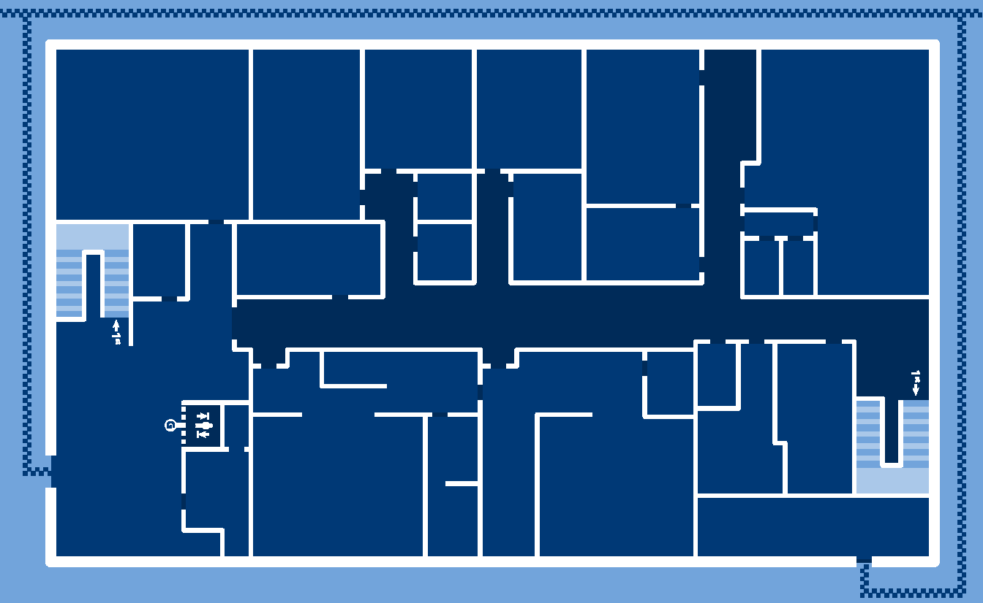
Walking in their Shoes
- ‘Story Walk’ map
2. Letter / outpatient reception
3. Diagnosis / consultant room
6. Talking / corridor
1. Arriving / entrance
7. Toilet / ward
9. Leaving / exit
8. Waiting / seating area
5. Beep / ward
4. Surgery / ward

Slide 6
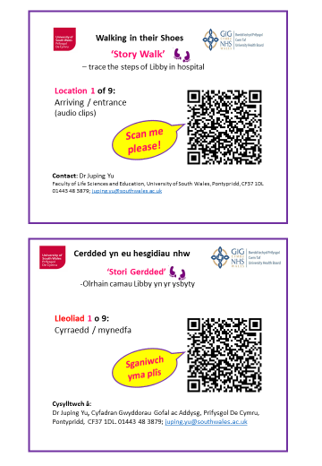

Slide 7
Participant information (N=238)
Variables | Grouping | Control group | Intervention group | Total
Age (years) | < 21 | 21 (15.2) | 12 (12.0) | 33 (14.2)
 | 21-30 | 65 (47.1) | 42 (42.0) | 107 (45.9)
 | 31-40 | 28 (20.3) | 30 (30.0) | 58 (24.9)
 | 41-60 | 22 (15.9) | 13 (13.0) | 35 (15.0)
Gender | Male | 14 (10.1) | 5 (5.0) | 19 (8.0)
 | Female | 124 (89.9) | 95 (95.0) | 219 (92.0)
Ethnicity | White | 125 (92.6) | 88 (92.6) | 213 (92.6)
 | Other | 10 (7.4) | 7 (7.4) | 17 (7.4)
Previous care experience | Yes | 88 (65.2) | 74 (77.9) | 162 (70.4)
 | No | 47 (34.8) | 21 (22.1) | 68 (29.6)
Current care experience | Yes | 101 (74.8) | 75 (78.9) | 176 (76.5)
 | No | 34 (25.2) | 20 (21.1) | 54 (23.5)

Slide 8
Data collection and analysis
Data collection: three times (pre-test; post-test; follow-up) between May 2018 and December 2019
Jefferson Scale of Empathy (20 items; 7-point Likert Scale)
Descriptive statistics: means, frequencies, and percentages
Inferential statistics: Mixed between-within units Analysis of Variance (ANOVA) on empathy scores; Transformations and permutation tests; Post-hoc multiple comparison tests

Slide 9
Results
Empathy scores
114.6
112.13
113.66
111.97
Time

Slide 10
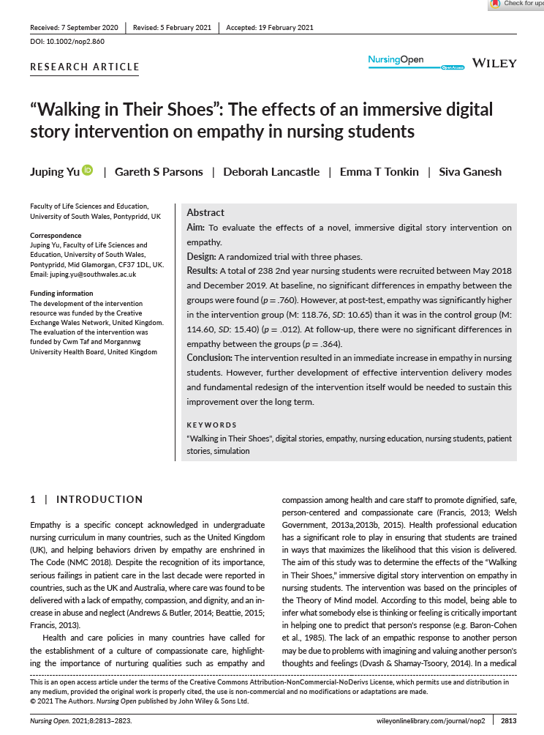
Yu J, Parsons GS, Lancastle D, Tonkin ET, Ganesh S (2021) "Walking in Their Shoes": The effects of an immersive digital story intervention on empathy in nursing students. Nursing Open. 8(5):2813-2823.
Yu J, Ganesh S, Lancastle D (2023) Psychometric evaluation of the “Jefferson Scale of Empathy” in a sample of nursing students in the United Kingdom. Nursing Open. In press

Slide 11
Conclusion (Phase 1)
Immediate increase in empathy in nursing students in the intervention group compared to those in the control group
The increase wasn’t sustained over time (3 months)
The need for reviewing and redesigning the intervention to sustain improvement

Slide 12
Fidelity evaluation
Involves five key elements:
adherence
exposure
quality of delivery
participant responsiveness
programme differentiation
Carroll C, Patterson M, Wood S, Booth A, Rick J & Balain S (2007) A conceptual framework for implementation fidelity. Implementation Science, 2(1):40.

Slide 13
Fidelity evaluation: design
Students were organised into small groups and each group was guided by a student leader for the Story Walk in USW clinic simulation centre.
Student leaders received instructions and a copy of the map and guided other students in their groups for the Story Walk along the desired path.
All students had a feedback sheet listing each clip by name and number and were asked to write down ‘What grabs your attention mostly as you listen to each clip?’
139 feedback sheets were evaluated to check whether students entered anything against each clip and to evaluate the quality of the students’ feedback.

Slide 14
1. Adherence
Refers to content, coverage, frequency and duration
In this study, content of the video clips and frequency (number of clips) remained constant.
Each group left at 10-minute intervals to start the Story Walk.
Feedback sheets were evaluated to check whether students had entered information against each clip.
Retrospective analysis of feedback data
For the purposes of this study, absence of entry is viewed as non-adherence to the study protocol.
We relied upon participants’ note making, but not observation
Notes:
Adherence to a study protocol

Slide 15
Adherence by clip
Clip | 1 | 2 | 3 | 4 | 5 | 6 | 7 | 8 | 9
Count | 133 | 133 | 134 | 133 | 139 | 135 | 133 | 131 | 133
% | 97.73 | 97.73 | 98.48 | 97.73 | 99.24 | 96.21 | 98.484 | 97.73 | 97.73
Overall adherence was 96.24%
This was evenly distributed across all clips, showing that most participants listened to each clip

Slide 16
2. Exposure
Equates to drug dosage
In the Story Walk, we have equated exposure to how students were guided to each location and the time taken at each location.
We did not measure the exact time taken by each group for their Story Walk, although we did ensure that each group started the Story Walk at 10-minute intervals and that it took around 30-minutes to complete the Story Walk
Each group leader confirmed that all nine locations were visited by his/her group.

Slide 17
3. Quality of delivery
Refers to the way the intervention was delivered
Prior to each run of Story Walk, we ensured that all signs containing the clips were correctly located.
All student leaders had the same instructions from two of the research team (GP and JY).
The same Story Walk map was provided to each group leader.
All students received the same feedback sheet at the beginning of the Story Walk.

Slide 18
4. Participant responsiveness
Measures participants’ engagement with an intervention, also known as reaction evaluation
In this intervention where we expect participants to be engaged with the Story Walk, the degree of reaction to each clip is important and may indicate the degree of ‘connection’ with the story and thus have an impact on the degree, durability and nature of empathy elicited.

Slide 19
Participant responsiveness (each clip)
0 | no comment
1 | short description - briefly describes aspect of clip
2 | long description - detailed description of event but does not comment on thoughts and feelings
3 | connected - comments on Libby's thoughts and feelings beyond what is described in the clip
Each feedback sheet was graded by a member of the research team (GP). A sample were independently graded by two other team members (JY and ET) and grades adjusted.

Slide 20
Examples of coding (1)
Clip 1 – Arriving at hospital
Score | Notes on participant feedback sheet
1 | Anxiety
2 | Walks through main entrance, not relaxed, nervous, worrying about dates
3 | Patient is anxious about going into hospital. Every time she feels ‘edgy’ and how feeling this doesn’t change

Slide 21
Examples of coding (2)
Clip 4 – Surgery/Ward
Score | Participant notes on worksheet
1 | Emotional No sleep night before
2 | The anxiety the night before, distress she felt whilst on trolley going to theatre, relief at not having a colostomy
3 | How upset and alone she felt after hearing what could happen (consent process), being on her own, feeling angry with staff for talking among themselves and not giving her attention. Upset in tears, felt like she was on her own, relieved at not having a colostomy but annoyed with staff (talking to each other) felt isolated and small.

Slide 22
Participant responsiveness (all clips)
0 | no comment
1 | short description - briefly describes aspect of clip
2 | long description - detailed description of event but does not comment on thoughts and feelings
3 | connected - comments on Libby's thoughts and feelings beyond what is described in the clip
While almost all participants commented on each clip, the degree of connection was weak with only 20.54% written words indicating an emotional connection with Liby’s story.

Slide 23
5. Programme differentiation
Refers to differences in delivery between each group
This was controlled by location and time.
Each Story Walk took place in the same clinical simulation centre.
All participants had sufficient time to take part in the Story Walk as scheduled teaching and learning in their programme of study.

Slide 24
Study redesign
Problem
Evidence of immediate impact on empathy, but not sustained
Good adherence to protocol, but poor responsiveness
Only one fifth of participants showed a good connection to Liby’s story in their note making

Slide 25
Solution?
Improve engagement through applying:
“Level of Processing” theory (Craig & Lockheart 1972)
The level of mental processing through deeper analysis to enable more elaborate, longer-lasting and stronger memory recall
“Theory of Mind” (Premack & Woodruff 1978)
The ability to understand and take into account of another person’s mental state.
Engage participants in deeper reflection that encourages identification with Libby and her story will provide opportunities for connection.

Slide 26
Improve connection through deeper reflection
Used USW Clinical Simulation Reflection Form (adapted by a colleague BJ 7/4/22)
Adapted from Husebo SE et al. (2015) Reflective practice and its role in simulation. Clinical Simulation in Nursing 11(8):368-375.
Empathy domains were used to shape questions based upon:
Batson CD (2009) These Things Called Empathy: Eight related but distinct phenomena. in Decety, J and Icke, W. (ed) The Social Neuroscience of Empathy, The MIT Press

Slide 27
Empathy reflections
Based upon Batson (2009) “These things called empathy”, questions were devised to encourage reflexivity across the following areas or phenomena.
understanding thoughts and feelings
being caught up in the event
putting yourself in their shoes
feeling vicariously
recognising similar situations
generalising ideas to other contexts
motivation or intention to act

Slide 28
Reflection on Libby’s story
Describe Libby’s story walk. How did the story walk unfold? What were you asked to do? | Fidelity of the simulation
Did you have any problems following the story walk? Did you visit every station, and could you hear Libby’s story? | Fidelity of the simulation
Can you describe the thoughts and feelings Libby had as her story progressed? What do you think she is thinking and feeling based upon what Libby said and her actions? | Understanding thoughts and feelings
Is there a particular part of the story that stands out for you? Was there a station where you found yourself caught up in what was happening to Libby or her description of events? | Being caught up in the event
If you were in Libby’s shoes, how would you feel when faced with her situation? Do you think your story would be like Libby’s, if so, why is this? If not, how would your story differ? | Putting yourself in their shoes

Slide 29
Was there anything you found upsetting or distressing in Libby’s story? If so, what was this? | Feeling vicariously
Do you think that Libby’s experience is a typical one for patients to go through? If so, why do you think this? If you do not think that is typical, then how do you think or feel that it differs from experiences you have encountered? | Recognising similar situations
What have you learnt from following Libby’s story? | Generalising ideas to other contexts
Will you use what you have learned from this experience in the future? If so, what is it that you intend to do? | Motivation or intention to act

Slide 30
References
Batson CD (2009) These Things Called Empathy: Eight related but distinct phenomena. in Decety, J and Icke, W. (ed) The Social Neuroscience of Empathy, The MIT Press
Carroll C, Patterson M, Wood S, Booth A, Rick J & Balain S (2007) A conceptual framework for implementation fidelity. Implementation Science, 2(1): 40.
Craik FIM Lockhart RS (1972) Level of processing: A framework for memory research. Journal of Verbal Learning and Verbal Behavior, 11: 671-684.
Husebo SE, O’Regan S & Nestel D (2015) Reflective practice and its role in simulation. Clinical Simulation in Nursing, 11(8):368-375.
Premack D & Woodruff G (1978) Does the chimpanzee have a theory of mind? Behavioral and Brain Sciences, 1(4):515-526.
Yu J, Ganesh S & Lancastle D (2023) Psychometric evaluation of the “Jefferson Scale of Empathy” in a sample of nursing students in the United Kingdom. Nursing Open, In press
Yu J, Parsons GS, Lancastle D, Tonkin ET & Ganesh S (2021) "Walking in Their Shoes": The effects of an immersive digital story intervention on empathy in nursing students. Nursing Open, 8(5):2813-2823.

