Slide 1
A little bit of advice’: Working creatively with children and their foster cares to explore how they would like to share their experiences
Dawn Mannay Cardiff University
mannaydi@cardiff.ac.uk
@dawnmannay
International Creative Research Methods Conference
12 September 2023

Slide 2
Background
Walking Tall – TFN
Maria Boffey, Charlotte Wooders - TFN
Rachael Vaughan – CASCADE
Experts by experience
Dedicated space for children to act as the designers for future projects
Methodological and practical question of how children want to share their views

Slide 3
PROJECT PLAN
All day workshops with children – lots of creative activities – no foster carers
Drawing on models in previous projects (Mannay et al 2019)
COVID19
Posting activities to children
Activity reviews
Online interviews with children and foster carers
Children’s advisory group

Slide 4
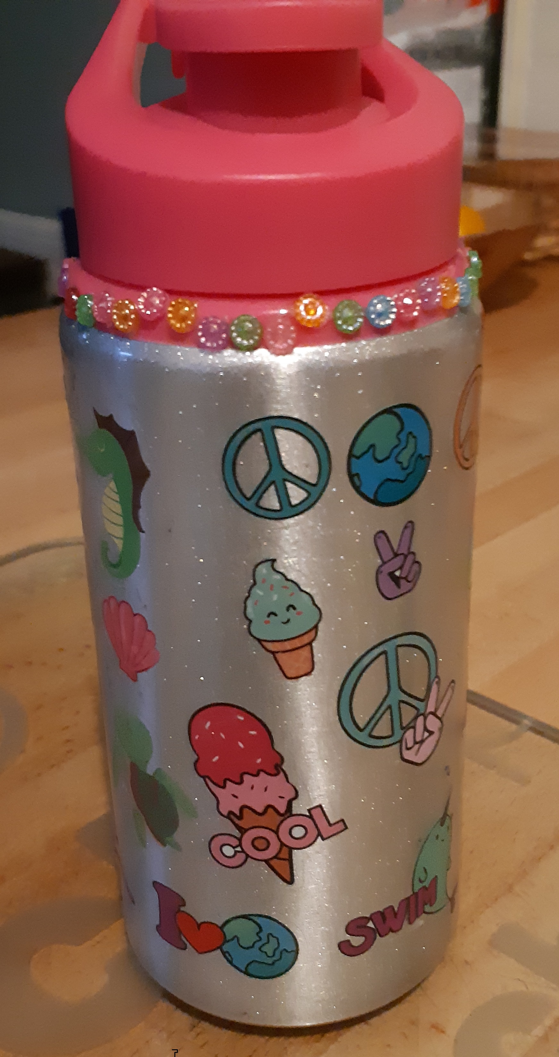
Rockstars and a message in a bottle
‘Do you want me to read what did you feel when you were doing this activity. Excited and a smiley face’ (Richard - age 9)
‘I liked doing the bottle because I don’t normally get my name on anything’ (Erin - age 10)

Slide 5
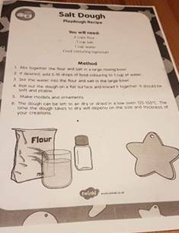
Recipes for success
Children as advisors
‘what works - what ‘may not work’
Advice of foster carers
‘It was quite difficult … We got there in the end’ (Erin - age 10)
‘Little bit of advice, the needle for the cotton… was too thin’ (Rebecca – foster carer)
‘Stickers were hard. We had some help’ (Rees - age 8)

Slide 6
Adapting and refining
‘We just found the paint was quite hard to get the detail… if there was some sort of pen that would be great’ (Robert – foster carer)
‘It might be confusing because you don’t know where it is going to end up and how they are going to get it back to me’ (Lewis – age 10)
‘I would recommend it to most of my friends who are girls… If it doesn’t go out to boys… I thought it could be a unicorn thing… And there could be another board game for boys… astronauts or football people’ (Bella - age 9)
‘I do have a friend who is fostered. So, I think [girl’s name] would like to do that. She likes painting… Maybe not so much the boys. Maybe stuff like football stuff’ (Erin - age 10)
‘Do you know what would be good to tell [project team member], what you think are good games for boys’ (David – foster carer)

Slide 7
Who steps in when you step out
‘intrusive voices’ who bring unwelcome interference?
But excluding adults negates the potential for them to contribute to furthering understandings and experience positive creative activities together
‘We did them together, read through them and did each exercise... It was nice to sit there and do them. Although we do home learning… it was nice to do more fun stuff like this’ (Robert – foster carer)
‘Kind of brings everyone together. It was really lovely and enjoyable’ (Rebecca – foster carer)

Slide 8
Unexpected outcomes
‘It is important that the parent participates, it is learning as well. Like him wanting a motorbike, never heard that before, but it is good to know… It is definite a benefit if the parent plays a part in the exercise. Very important’ (Robert – foster carer)
‘This is good for her [Erin] really. She has only been here six-weeks’ (Edward – foster carer)
Project led to the development of packs for foster carers and children who are new to each other as part of the getting to know you process
Project activities developed in Walking Tall also being used in other projects and research studies with children (Tyrie et al 2023)

Slide 9
Privileges and preventers
No strict agenda to answer set topic-based questions
Exploratory project with time and resources built in to support an understanding of which activities and materials children like to work with to share their perspectives
But…
This can be problematic for the ‘time pressured… researcher in the neoliberal academy’ (Leigh 2021, p. 72) or the busy practitioner who has competing demands on their capacity
Projects often need to be completed quickly within tight frameworks and deadlines

Slide 10
Moving forward
It is the responsibility of those who fund projects and the organisations that host them to make changes so that there is time for practitioners, researchers, and advocates to listen to and act on ‘a little bit of advice’ from the communities they work with about how they would like to share their experiences

Slide 11
Diolch yn FAWR

Slide 12
references
Boffey, M., Mannay, D., Vaughan, R. and Wooders, C. 2021. The Fostering Communities programme - Walking tall: stage two evaluation. Project Report. Cardiff: The Fostering Network in Wales.
Leigh, J. 2021. What would a Rhythmanalysis of Qualitative Researcher’s Life Look Like? In B. Clift, J. Gore, S, Gustafsson, S. Bekker, I. Costas Batlle and J. Hatchard (eds), Temporality in Qualitative Inquiry: Theories, Methods and Practices, 72-92, Abingdon: Routledge.
Mannay, D., Staples, E., Hallett, S., Roberts, L., Rees, A., Evans, R. and Andrews, D. 2019. Enabling talk and reframing messages: working creatively with care experienced children and young people to recount and re-represent their everyday experiences. Child Care in Practice 25(1), pp. 51-63.
Mannay, D., Vaughan, R., Boffey, M. and Wooders, C. 2023. 'A little bit of advice': Working creatively with children and their foster carers to explore how they would like to share their experiences. In: Kara, H. ed. The Bloomsbury Handbook of Creative Research Methods. Bloomsbury Handbooks London: Bloomsbury, pp. 251-261.
Tyrie, J. et al. 2023. COVID–19, education and learning: Amplifying young children’s voices. Project Report. [Online]. The Welsh Government. Available at: https://hwb.gov.wales/api/storage/0b6492be-c863-4168-b301-6f3fef4eade5/cen-18-report-eng-final.pdf

