Slide 1
An overview of the international review evidence on factors that affect resilience
in nurses and midwives
Dr Deborah Edwards
Senior Research Fellow
The Wales Centre For Evidence Based Care
23rd May 2024

Slide 2
Introduction
There are an estimated 29 million nurses and 2.2 million midwives worldwide
The WHO predicts a shortage of 4.5 million nurses and 310,000 midwives by 2030
Current and future shortages are adversely impacting global health systems

Slide 3
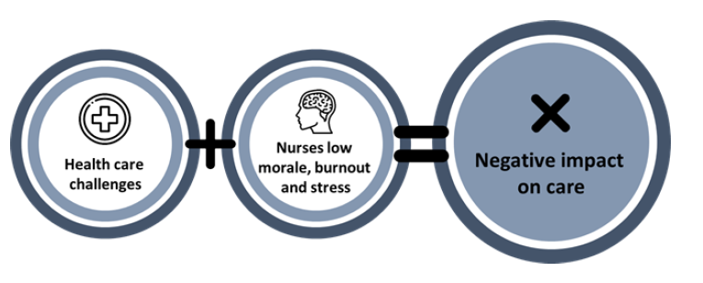
Introduction
The shortage of nurses and midwives leads to increased workloads which places undue pressure on existing staff

Slide 4
Resilience
Research suggests that resilience may serve as a mitigating factor to such workplace challenges or adversity
By promoting resilience among nurses and midwives, healthcare organisations can potentially alleviate the negative impacts of workplace adversity, enhance nurses’ and midwives' well-being, and improve patient care outcomes

Slide 5
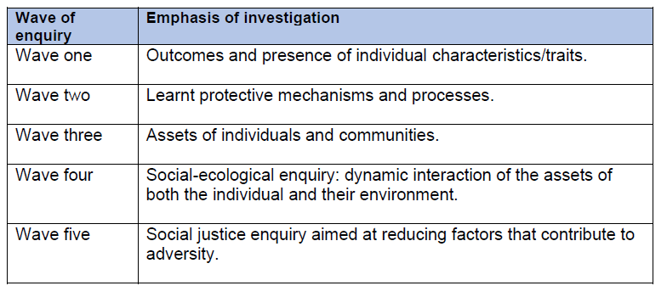
Resilience

Slide 6
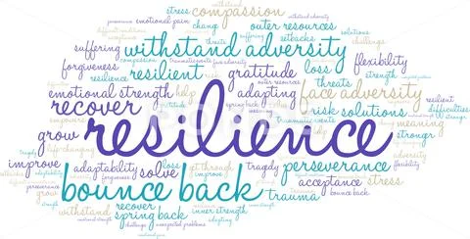
.

Slide 7
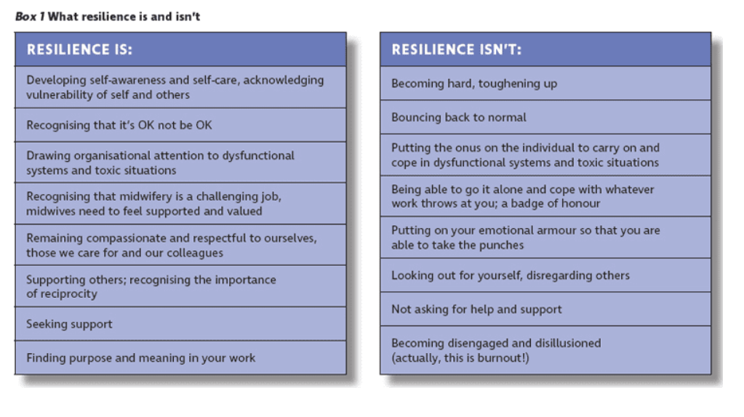
Revisiting Resilience
Billie Hunter – Professor of Midwifery and Director, WHO Collaborating Centre for Midwifery Development, School of Healthcare Sciences, Cardiff University, Cardiff, Wales
Lucie Warren – Professional Head: Midwifery, School of Healthcare Sciences, Cardiff University, Cardiff, Wales
The Practising Midwife Volume 25 Issue 05 May 2022, Pages 08-13 / https://www.all4maternity.com/revisiting-resilience/

Slide 8
International review evidence in nursing and midwifery
Searches conducted Cinahl, PsycINFO and Medline
2014 to 2024
Doctoral thesis
Benbow J. 2022. Exploring resilience in contemporary nursing roles in Wales: a mixed methods study. https://orca.cardiff.ac.uk/id/eprint/150378/

Slide 9
International review evidence in nursing and midwifery
Majority of research comes from USA, Australia, China
Specific groups of nurses
Mental health
Oncology and palliative care
Emergency and critical care
Acute care
Care home

Slide 10
International review evidence in nursing and midwifery
Emotional impact of working within certain settings
Risk factors and protective factors
Interventions for enhancing resilience

Slide 11
International review evidence in nursing and midwifery
Many studies draw on outdated concepts of resilience
Definitions of resilience often focus on individual traits like self-efficacy and internal motivation
Terms such as recovery, personal strength, and 'bounce-backability' are commonly used to describe resilient nurses
Measures used to assess resilience are inconsistent with theoretical underpinnings

Slide 12
Risk factors and adversity
Organisational and systematic factors
Workplace culture
The inherent nature of working in a particular setting

Slide 13
Protective factors and resilience
Personal protective factors and resilience strategies
External protective factors
Individual level
Work unit or team level
Organisational level
Professional level

Slide 14
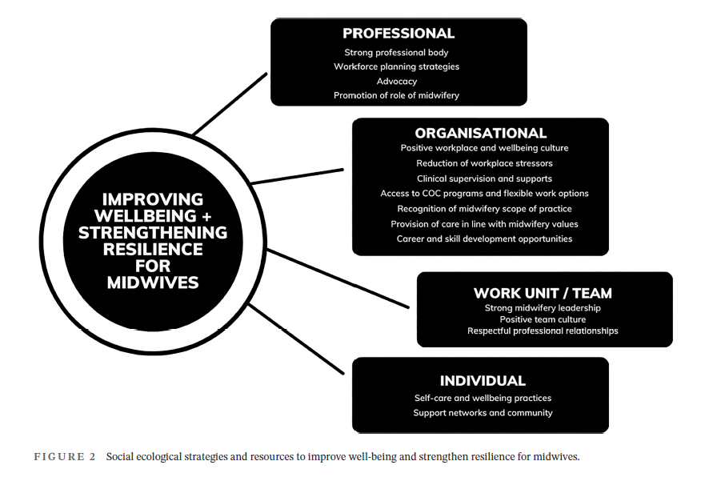
Taken from Moran et al. 2023
https://pubmed.ncbi.nlm.nih.gov/37551623/

Slide 15
Interventions for enhancing resilience
Educational approaches
Psychological interventions

Slide 16
Interventions for enhancing resilience
Support mechanisms
Team resilience
Work-based programmes

Slide 17
Summary
Resilience is more than individual in nature
To develop effective interventions promoting nurse resilience, understanding the impact of external factors on their well-being and retention is essential
Positive workplace factors can help resilience: resources, education, and support are key, which are underpinned by strong supportive relationships

Slide 18
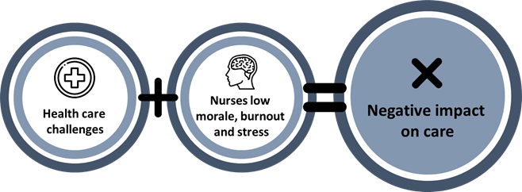
Resilience:
from problems to enablers

Slide 19
Thank you for listening
Email: edwardsdj@cardiff.ac.uk
Twitter: @MrsDeborahE
Web profile page:

