Slide 1
A Moral Compass for Machine Minds: Cultivating Ethical Decision-Making in Generative AI for Marketing
Dr Ahmed Almoraish and Dr Joyce Costello
Marketing and Strategy Department
Cardiff Metropolitan University

Slide 2
Understanding AI vs Generative-AI
Artificial Intelligence
AI Robotics
AI Service Robotics
AI Industrial Robotics
Autonomous & Sensor Technology
Computer Vision
Speech Recognition
Image Recognition
Facial Recognition
Generative AI
Machine Learning
Natural Language Processing
Text-based NLP
Speech-based NLP
Language translation NLP
…a form of artificial intelligence that can create new content, such as text, images, and videos as well as carry on conversations, answer questions, and create code in such a manner that one might think the content was produced by a human (Euchner, 2023).
Generative AI has the capability to create content mimicking human production
It is a large language model and is reliant on data input

Slide 3
AI-Driven Content Generation
Diverse applications: text, image, audio, 3D animations, videos
Text to text
Text to image
Text to audio
Text to video
Text to 3D world
Text to task
Photo to video
Combo of all

Slide 4
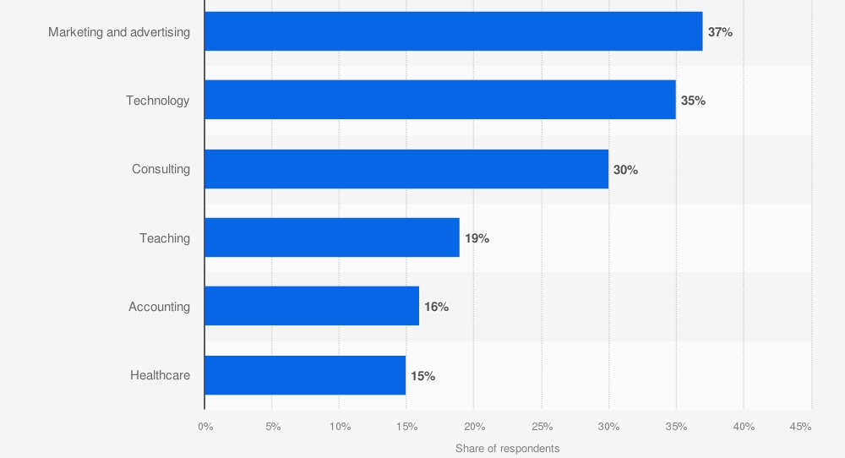
Global Adoption: By industry in US 2023

Slide 5
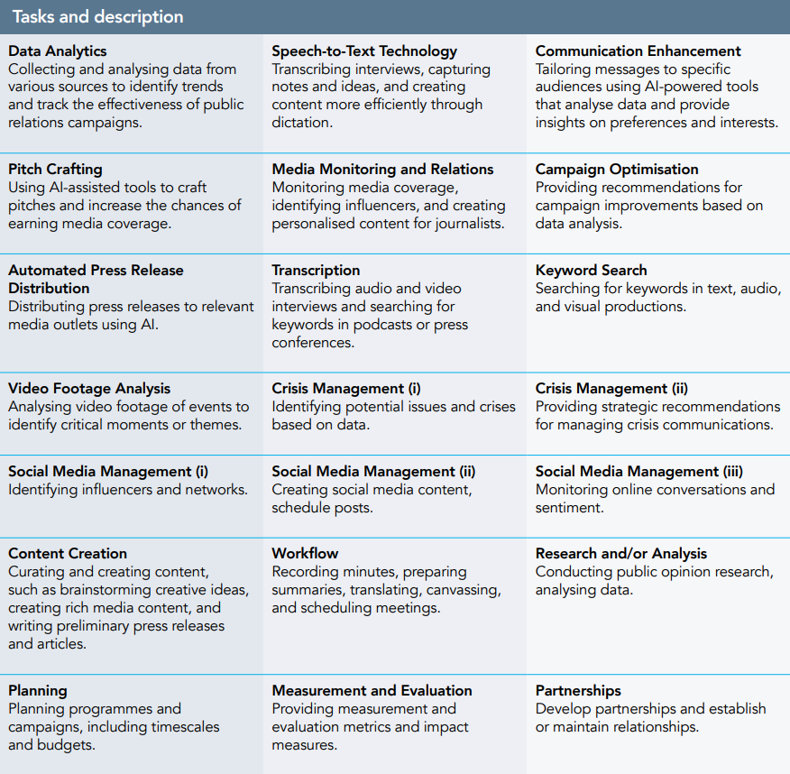
How are UK Marketing practitioners using Generative-AI
(CIPR, 2023- More Humans needed)

Slide 6
Ethical Considerations of Generative-AI
Transparency
How AI system makes decision
Predicting failure and un-intended harms
Unfair Bias
Exposes bias in existing social systems
Amplified problem with scale!
Security
Potential to exploit with greater scale for faster attack
Deepfake/biometrics
Privacy
Analyse and combine data for data exploitation
Unwanted identification and tracking and Intrusive voice and facial recognition

Slide 7
Ethical Considerations- Generative-AI
AI pseudoscience
Issues with analysing faces to identify criminal intent or emotions
Accountability to people
Operating parameters
Allowing people to influencer
AI driven unemployment and de-skilling
Labour market adaptation
Hallucinations, factuality, and anthropomorphization
Unrealistic, Fictional and fabricated content
Issues with truthfulness and accuracy
Human like traits to non-human
Creating new jobs

Slide 8
Research gap
Problem
Lack of ethics research on generative AI among marketing agencies
Research Question
How are marketing agencies actively addressing and implementing ethical frameworks to mitigate concerns associated with the use of generative AI in their campaigns, and what are the outcomes of these ethical practices?

Slide 9
Generative-AI and Ethical Models

Slide 10
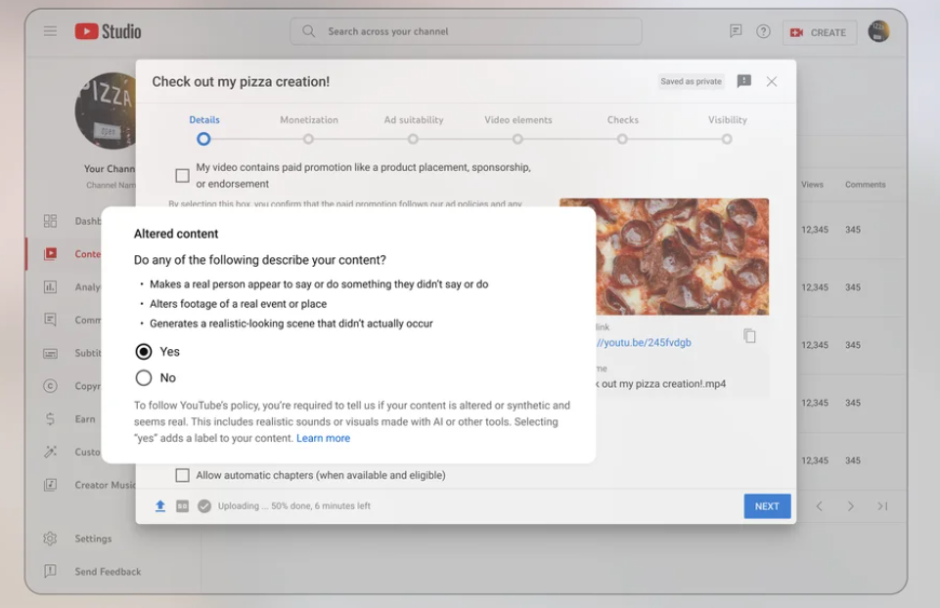
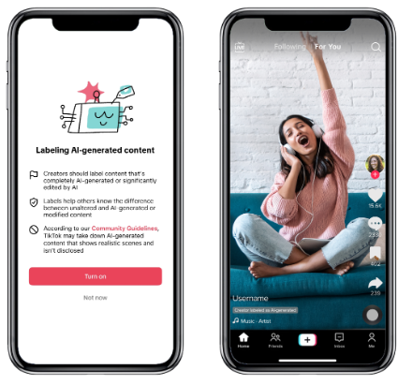
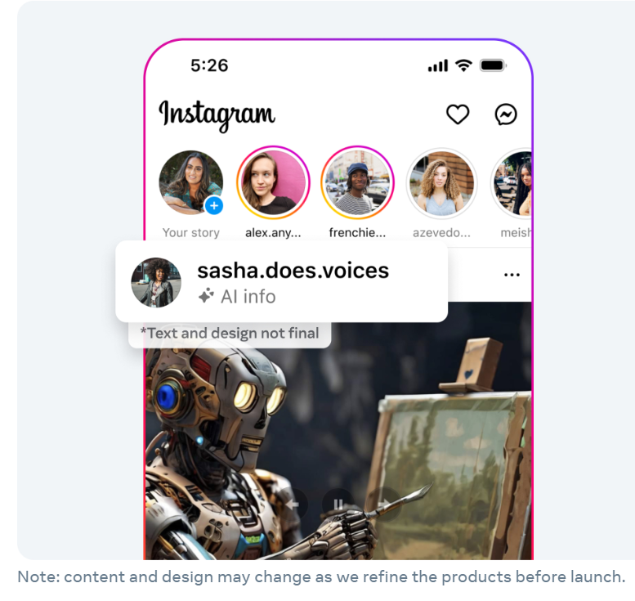
Social Media Platform Attitudes to Generative-AI Content

Slide 11
Initial findings from influencers and generative-AI
Cognitive
“I think that's very scary. You don’t know if what your seeing is real right” Participant C
Behavioural
“I used it on TikTok for audio and there was no problem, but when I used it for photos and videos, I lost my creator status. It was really unfair, cause TikTok keeps switching the rules.” Participant J
Ethical Understanding
“I mean technically it is you, but is it not you? Do you know what I mean? Like like? Is it a bit unethical because it is it a bit misleading?” Participant M

Slide 12
What’s next: Mixed-methods Agency and Brand Attitudes

Slide 13
Questions and Feedback

Slide 14
Background practitioner policy on ethics and generative AI

Slide 15
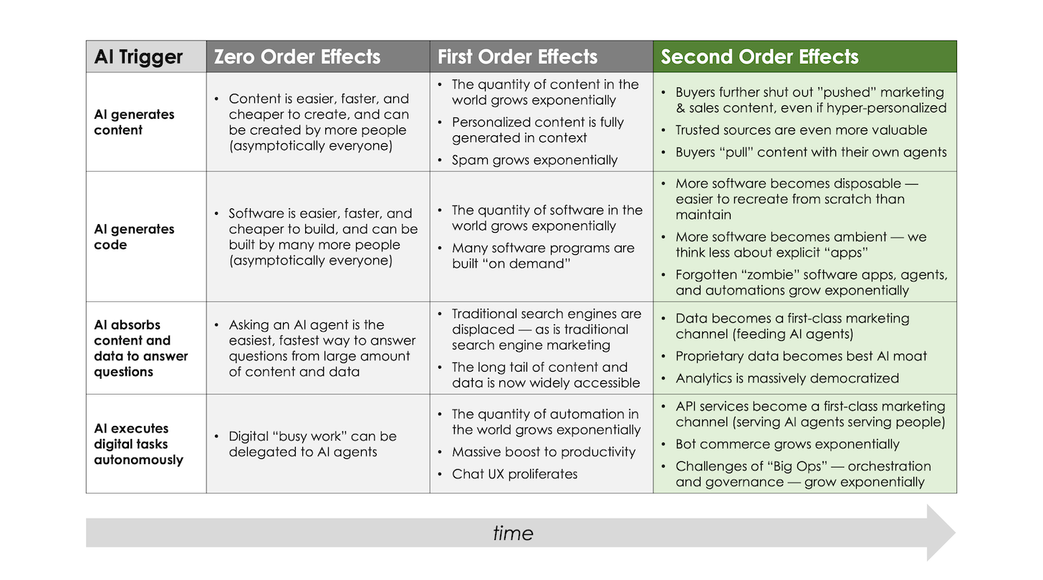

Slide 16
PRSA (2023) ethical recommendations

Slide 17
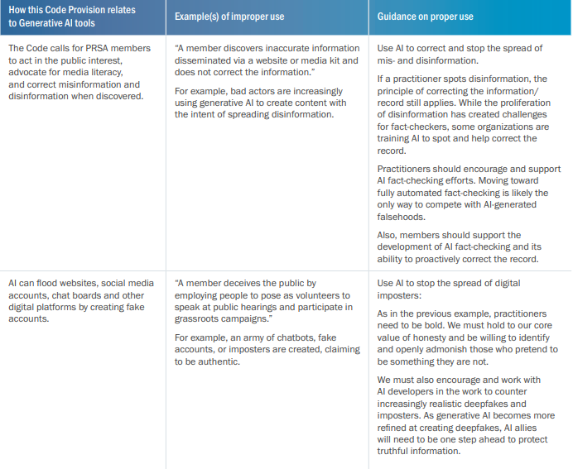
PRSA (2023) ethical recommendations

Slide 18
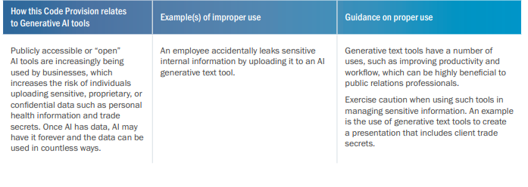
PRSA (2023) ethical recommendations

Slide 19
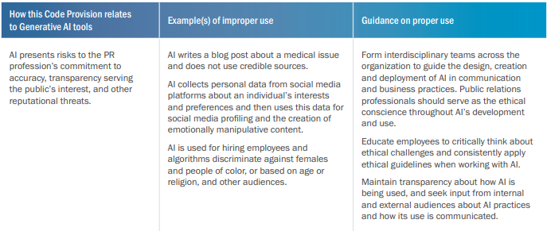
PRSA (2023) ethical recommendations

