Slide 1
Cultural adaptations of group CBT for depressed clients from diverse backgrounds
Taf Kunorubwe
CBT Therapist, Supervisors and Trainer – Mindfulness in Reading, Berkshire
Honorary Research Associate – Cardiff University
Sessional CBT Lecturer – University of Reading
Contact: info@mindfulnessinreading.co.uk or @MindfulRdngBerk
BPS Welsh Branch Conference - 28 September 2024

Slide 2
An important note
The terminology used when talking about race, ethnicity, religion and even nationality in research can have a real-world impact (Kunorubwe et al., 2024).
Therefore, due consideration has been given to the language and terminology used

Slide 3
Depression (Major depressive disorder)
A common mental health problem characterised by persistent feelings of sadness, hopelessness, and loss of interest in activities that were once enjoyable.
Approximately 280 million people in the world have depression (IHME, 2023)
Associated with significant burdens including decreased quality of life, functional impairment, suicide, cardio/cerebral mortality, disability, and economic and family burdens (Lepine and Briley, 2011).

Slide 4
CBT
Cognitive Behavioural Therapy (CBT) is a structured, time-limited, evidence-based psychotherapy focused on helping people change patterns of behaviour and thoughts
In randomised control trials CBT has demonstrated efficacy as a treatment for Depression (Beltman et al., 2010; Van Straten et al., 2010; Barth et al., 2013; Cuijpers et al., 2010; Cuijpers et al., 2013; Hofmann et al., 2012)
A network meta-analysis by Cuijpers et al. 2019 highlighted the efficacy of individual, group, telephone, or guided self-help CBT formats.

Slide 5
Culturally Adapting CBT
Adjusts therapy delivery while preserving CBT's theoretical foundation (Kunorubwe, 2023)
Adjustments are informed and achieved through developing awareness, knowledge, and skills related to a given culture (Naeem, 2012)
Integrating the distinctive and culturally influenced aspects of how mental health issues are expressed and comprehended (Beck, 2016).
Considers the complex and multi-dimensional ways in which people conceptualise their identities (Hays, 2016).
Goal: Enhance treatment effectiveness, acceptability and applicability for individuals from diverse backgrounds.

Slide 6
Why consider adapting group CBT
Influence of culture on the presentation and treatment of depression
Poorer access and outcomes for clients from diverse backgrounds
Acknowledge the implicit cultural assumptions within the CBT and all psychological therapies
Culturally adapted therapy is more accessible, beneficial and acceptable to clients from diverse backgrounds

Slide 7
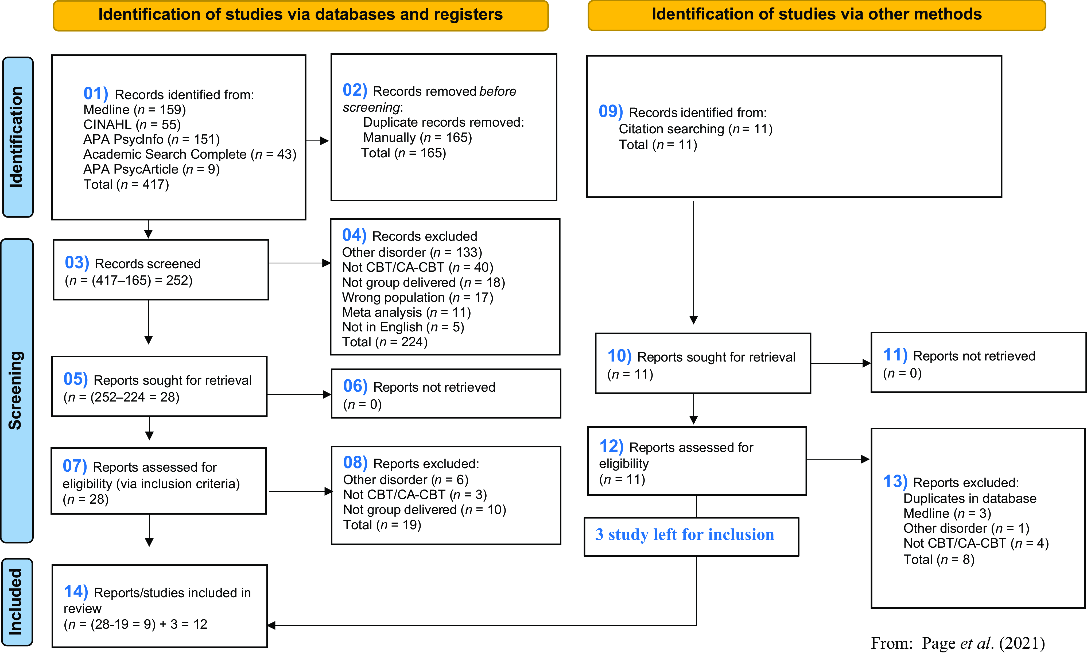
Kunorubwe, 2023

Slide 8
Results
All found culturally adapted group CBT was beneficial. Statistically significant reduction in depressive symptoms in 9 out of 10 studies, remaining one study providing descriptive results.
Positive outcomes in other measures related to dysfunctional beliefs, functioning, and quality of life ratings.
A narrative synthesis was completed and identified the focus for culturally adapting group CBT focused on:
Delivery
Process
Content
Staffing
Client-specific factors.

Slide 9
Focused of adaptation
Delivery
Process
Content
Staffing-specific factors
Client-specific factors
Kunorubwe, 2023

Slide 10
Conclusion
Overall, culturally adapted group CBT shows promise as a treatment for depressed clients from diverse backgrounds
Allow clinicians and services to build a case for trialling culturally adapted group CBT in the communities they serve.
Reflect on whether the delivery, client factors, staffing, process, or content of the group need to be adapted
Further evaluation is necessary to establish its efficacy in clinical practice more robustly.
Also, we need to identify which adaptations are most effective for specific populations and to explore the experiences of implementing or attending such group interventions.

Slide 11
Questions

Slide 12
Barth, J., Munder, T., Gerger, H., Nüesch, E., Trelle, S., Znoj, H., Jüni, P., & Cuijpers, P. (2013). Comparative efficacy of seven psychotherapeutic interventions for patients with depression: a network meta-analysis. PloS Medicine, 10, e1001454. https://doi.org/10.1371/journal.pmed.1001454
Beck, A. (2016). Transcultural Cognitive Behaviour Therapy for Anxiety and Depression: A Practical Guide. Routledge.
Beltman, M. W., Voshaar, R. C. O., & Speckens, A. E. (2010). Cognitive-behavioural therapy for depression in people with a somatic disease: meta-analysis of randomised controlled trials. British Journal of Psychiatry, 197, 11–19. https://doi.org/10.1192/bjp.bp.109.064675
Cuijpers, P., Berking, M., Andersson, G., Quigley, L., Kleiboer, A., & Dobson, K. S. (2013). A meta-analysis of cognitive-behavioural therapy for adult depression, alone and in comparison, with other treatments. Canadian Journal of Psychiatry, 58, 376–385. https://doi.org/10.1177/0706743713058007
Cuijpers, P., Muñoz, R. F., Clarke, G. N., & Lewinsohn, P. M. (2010). Psychoeducational treatment and prevention of depression: the ‘Coping with Depression’ course thirty years later. Clinical Psychology Review, 29, 449–458. https://doi.org/10.1016/j.cpr.2009.04.005
Cuijpers, P., Noma, H., Karyotaki, E., Cipriani, A., & Furukawa, T. A. (2019). Effectiveness and acceptability of cognitive behavior therapy delivery formats in adults with depression: a network meta-analysis. JAMA Psychiatry, 76, 700–707. https://doi.org/10.1001/jamapsychiatry.2019.0268
Hays, P. A. (2016). The new reality: Diversity and complexity. In P. A. Hays (eds.), Addressing Cultural Complexities in Practice: Assessment, Diagnosis, and Therapy (pp. 3–18). American Psychological Association. https://doi.org/10.1037/14801-001
Hofmann, S. G., Asnaani, A., Vonk, I. J. J., Sawyer, A. T., & Fang, A. (2012). The efficacy of cognitive behavioral therapy: a review of meta-analyses. Cognitive Therapy and Research, 36, 427–440. https://doi.org/10.1007/s10608-012-9476-1
Institute of Health Metrics and Evaluation. (2023). Global Health Data Exchange (GHDx). https://vizhub.healthdata.org/gbd-results/
Kunorubwe, T. (2023). Cultural adaptations of group CBT for depressed clients from diverse backgrounds: A systematic review. The Cognitive Behaviour Therapist, 16, e35. doi:10.1017/S1754470X23000302
Kunorubwe. T., John, P., Molina, P., Davies, P., Gait, S., John, B., Roderique-Davies, G., & Lancastle, D. ( 2024). Summary report of a rapid review: Guidance and an associated action plan to improve access to, and provision of, psychological interventions for people from Black, Asian and minority ethnic communities. NHS Wales. https://executive.nhs.wales/functions/quality-safety-and-improvement/improvement-cymru/our-work/mental-health/psychological-therapies/resources-psychological-therapies/summary-report-of-a-rapid-review/
Lepine, J.-P., & Briley, M. (2011). The increasing burden of depression. Neuropsychiatric Disease and Treatment, 7, 3–7. https://doi.org/10.2147/NDT.S19617
Naeem, F. (2012). Adaptation of Cognitive Behaviour Therapy for Depression in Pakistan. Doctoral dissertation, University of Southampton
Van Straten, A., Geraedts, A., Verdonck-de Leeuw, I., Andersson, G., & Cuijpers, P. (2010). Psychological treatment of depressive symptoms in patients with medical disorders: a meta-analysis. Journal of Psychosomatic Research, 69, 23–32. https://doi.org/10.1016/j.jpsychores.2010.01.019

