Slide 1



MIND THE GAP
A new conversation starter tool for EDI practitioners
Presented by Dr Riccardo Maddalena, Dr Sarju Patel, Dr Kathryn Jones and
Deborah Syrop
Scan the QR code for more info or visit:
www.mindthegap-edi.com

Slide 2
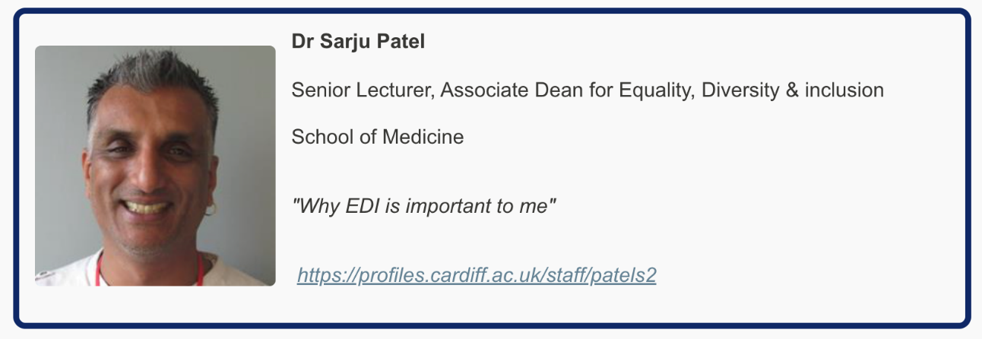
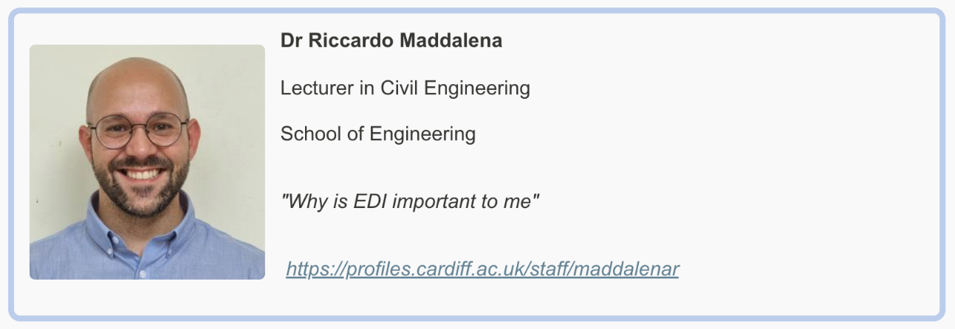

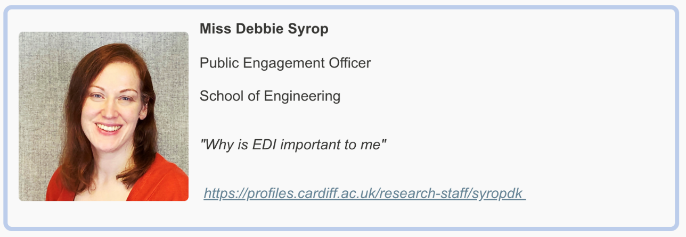

The Team
Senior Lecturer in Medical education, Year 2 Director MBBCH
Senior Lecturer in Civil Engineering
Senior Lecturer, Head of School

Slide 3

The EDI Challenge
There exist barriers or challenges that prevent open EDI conversations
Cardiff University are committed to supporting, developing, and promoting these three topics throughout all their practices and activities, and we believe that there is a need for addressing the fears behind discussing these topics, due to their sensitivity

Slide 4

Bridging Conversational Barriers
Mind the Gap is a set of playing cards that provide discussion prompts covering a range of potentially sensitive equality, diversity and inclusion topics
These cards were designed with the support and advise from marginalised individuals, and they aim to provide a way for people to overcome their nervousness when discussing these topics
The aim of the TOOL is to encourage conversations about EDI

Slide 5
The Cards – objective
“Our fears of mislabelling or offending often impedes inclusivity and these cards, shaped with input from marginalized voices are designed to guide EDI discussions and reduce concerns”

Slide 6
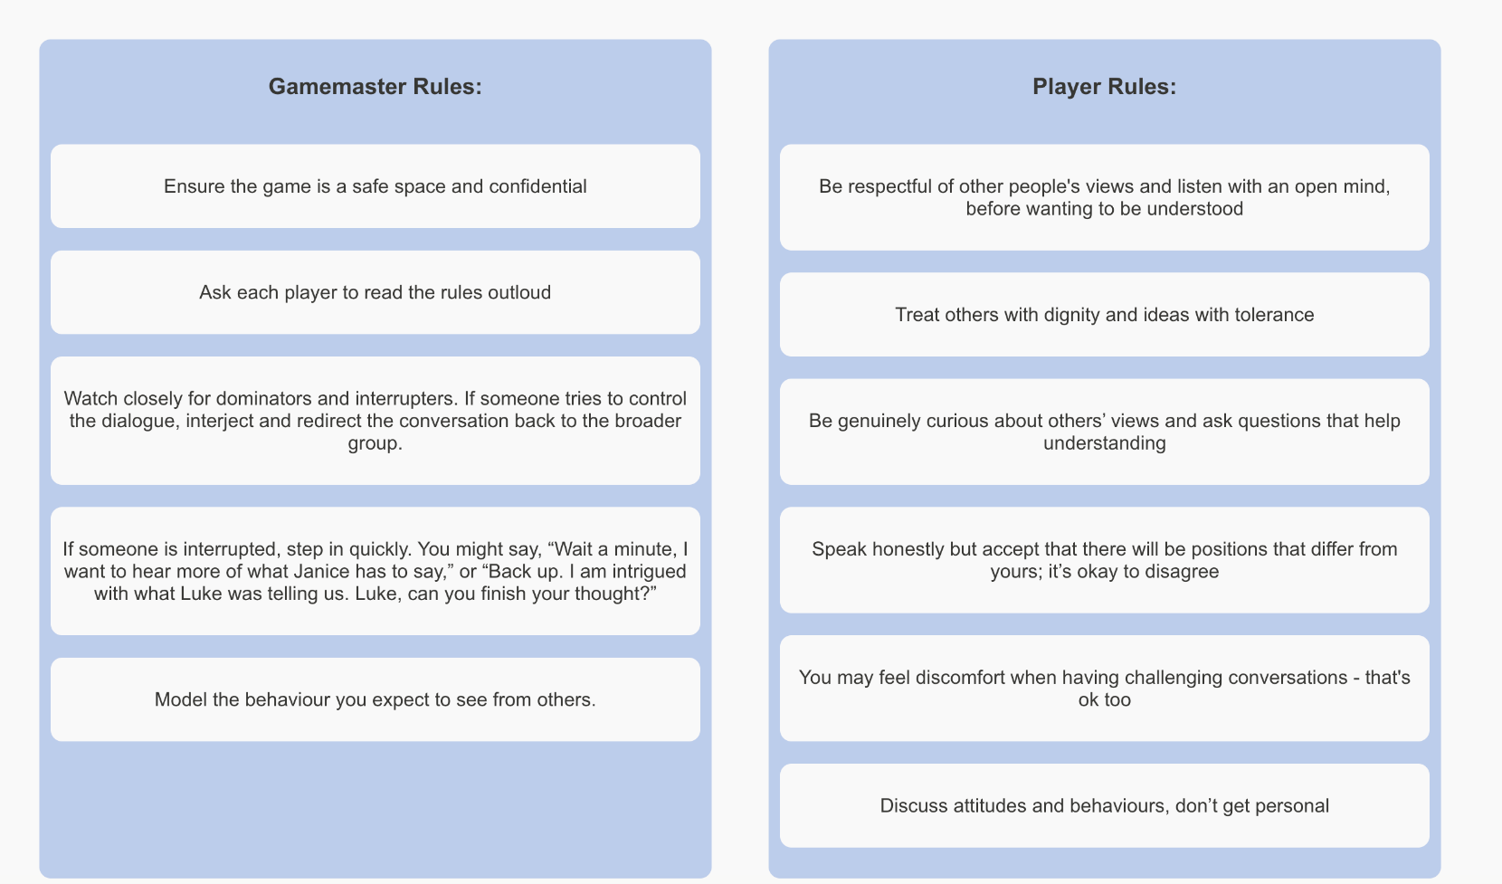
How "Mind the Gap" Works
  target audience (university staff and students)
  One by one, each player will pick a card and present it to the room.
  The player reads out the instructions on the card and then the room may discuss the topic that was randomly selected

Slide 7
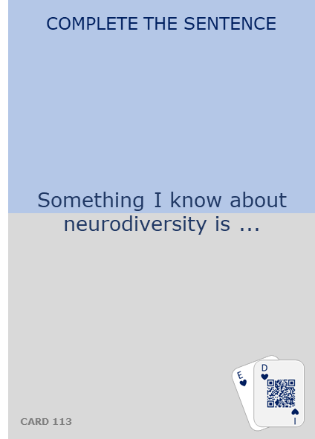
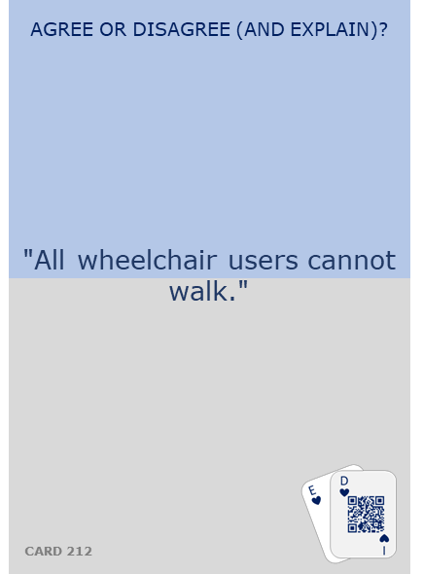
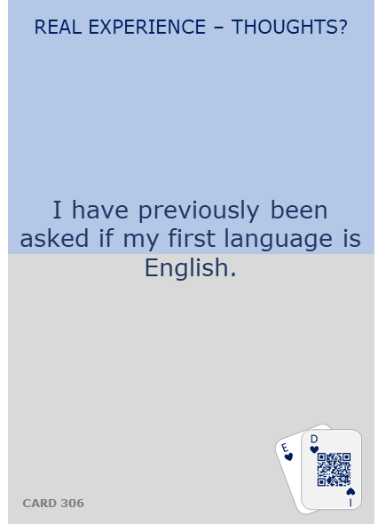
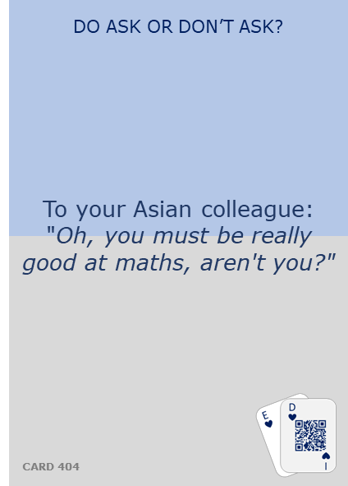
The Cards – some examples

Slide 8
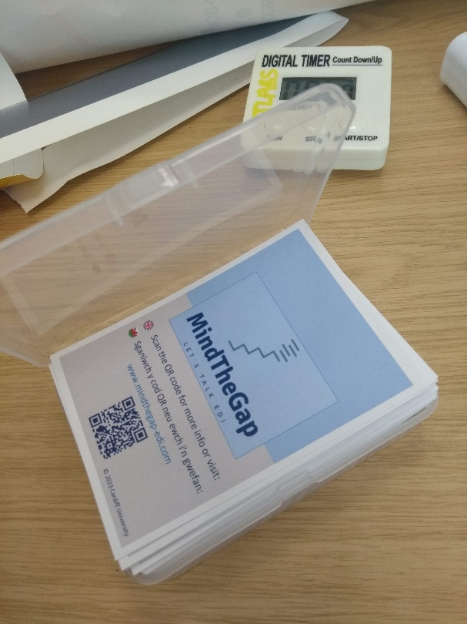
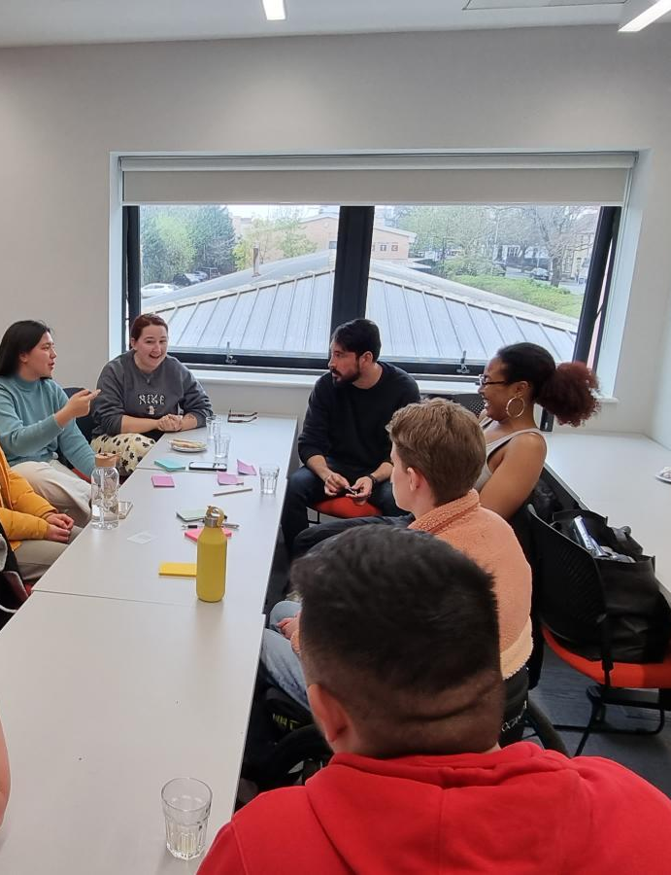
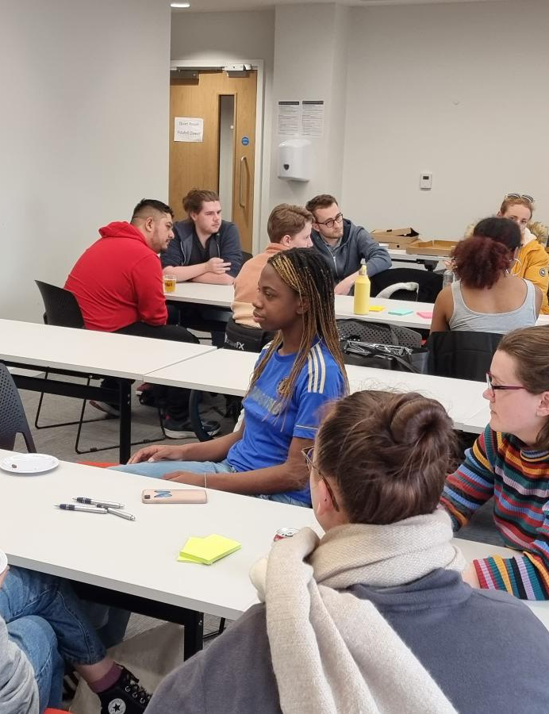
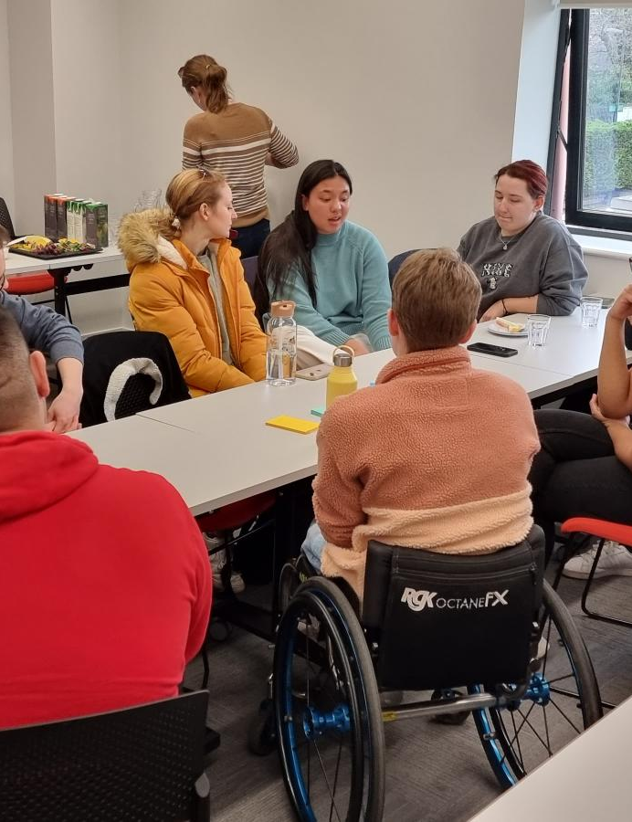
Focus Groups
Focus groups with students and staff have been conducted to design and tailor the game with end-users in mind.
The team engaged with the University EDI network, and the students distemm network.

Slide 9
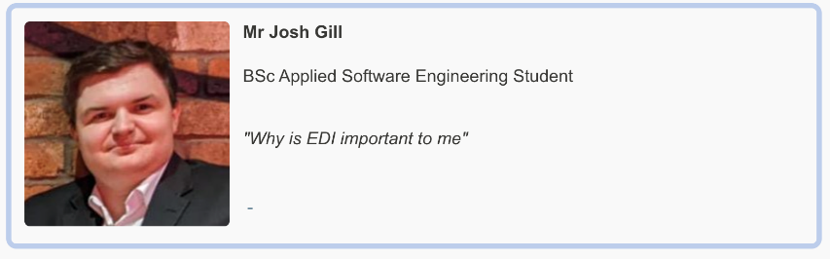


Mind The Gap – Web site
Developers
This website is an additional resource to the game, providing supplementary guidance notes and background information around each card to further guide the discussion topics. We also want to gather more feedback from the wider community regarding the cards, so this website also allows user feedback that’ll allow us to improve the prompts, guidance notes and background information surrounding existing cards.

Slide 10
Mind The Gap – your turn to play
  INSTRUCTIONS
  Form 4 separate groups, and one of us will explain the game in each group.
  One by one, each player will pick a card and present it to the room.
  The player reads out the instructions on the card and then the room may discuss the topic that was randomly selected.
  the group discuss the topic that was randomly selected with a clock timer.
  Each group will play the game for 20 min.

Slide 11
Mind The Gap
Questions / feedback

