Slide 1
Ecological balance
Achieving sustainability and resilience in a work-driven world

Slide 2
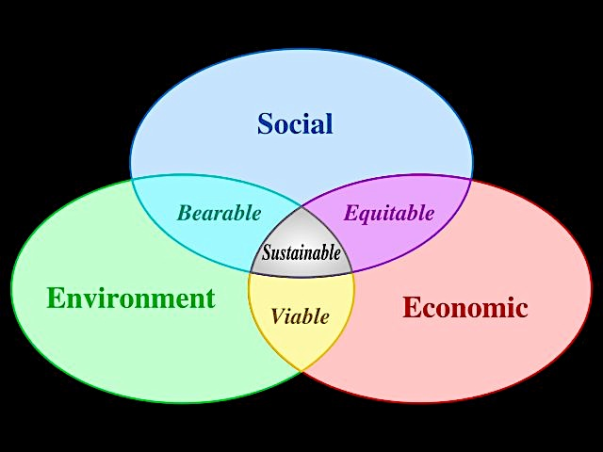
Interesting words - what do they mean?
Sustainability….Maintaining ecological balance; avoiding depletion of natural resources – wellbeing of individuals, families communities, societies, environment and economy……
Resilience ’..refers to the ability of a system, from individual people to whole economies, to hold together and maintain their ability to function in the face of change and shocks from outside’ (Hopkins 2008:12).
‘A resilient system is adaptable and diverse. It has some redundancy built in…[it] acknowledges that change is constant and prediction difficult in a world that is complex and dynamic. It understands that when you manipulate the individual pieces of a system, you change the system in unintended ways. Resilience thinking is a lens for looking at the natural world we are embedded in and the man-made world we have imposed upon it.’ (Ward 2007)

Slide 3
What did the research identify
Four levels of awareness emerged:
People were over busy; they did too much and had too little time to do it in
People also seemed to put paid work first in their plan for things to do everyday
The implications of this was stress and strain not only to the individual but to that of the family, the community, the social, and I posit natural environments, because people could not or did not participate fully in that world or activities it offers
This challenged me to think about how we live our everyday lives…There appears to be an absence of awareness about how that way of being-in-the-world is eroding personal, family, social and natural sustainability and resilience…..

Slide 4
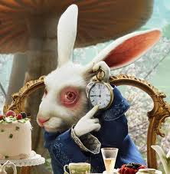
Busy lives
Participants clearly evidenced they had no time to engage meaningfully with others. They were perpetually busy…..or ‘in motion’ (Gergen 2000:175)
Busyness is the ‘opiate of the masses’ (Hochschild 2008:89)
In particular paid work keeps us busy – not time to think or reflect or just to be in the world in everyday patterns of life
This lead me to question:
Why didn’t anyone talk about the lack of time to participate meaningfully with the social and natural worlds? Had they even noticed that absence in their everyday doing and discourses?
Where is the time to care for others, for ourselves and and for our communities in our daily time and activity programme?
I’m late I’m late for a very important date….no time to say hullo; goodbye…

Slide 5
The ‘everyday’ In terms of Paid work
Capitalism is a cycle of production in modern societies. It drives the focus on the importance paid work and utilises human energy for profit as opposed to well-being. People are resources ‘to enhance global competiveness' (Lister 2003:437).
Corrosive effects on self, society and natural environment (Dickens 2004; Sennet 1998)
Along with many industrialised countries the UK Government appeared to support this approach for all adults of working age, including those with caring responsibilities:
‘A more effective use of human resources within the economy, including the better utilisation of skills of those with caring responsibilities, is likely to have a beneficial impact on the UK’s productivity. It is clear that an efficient labour-market—one where the pool of labour is maximised and utilised to its full—is essential to the UK’s competitiveness’ (HM Treasury 2003: 3.29).

Slide 6
In the overwork society
“Just as the late twentieth century grasped the fact that there was a crisis in environmental sustainability so the twenty-first century is beginning to grasp the dimensions of a comparable crisis – this time of human sustainability – a scarcity of conditions which nurture resilient, secure individuals, families, friendships, and communities. Who has time to care for whom in the overwork culture?’ (Bunting 2004:xxi)
Stress was a common theme in the research not only because of the immense time and pressures demands of paid work but because it meant people had to make choices between family and paid work time…that was ethically and morally challenging…..And there was no notion of time for anything else outside the two main activities.……leisure, social and recreational pastimes were invariably traded-off in order to maintain work and family commitments…..
There was no sense in the research that people could change the drives in their social worlds that resulted in this quandary and whilst there was a notion that to live differently would help there was no actual changes taking place and no sense of a link of human sustainability and well-being to greater participation in the social and natural environments and natural cycles of everyday life

Slide 7
What has happened to time?
Participants described time as compressed, pressured, ‘a do more with less resources culture’ in both settings and these resources were fiscal and human. People felt “shackled by work”; “exhausted”; “spent”: well-being and biological, circadian cycles disrupted
Industrialisation has utilised time and ‘spends’ it on paid work. It sets our cultural and social values and standards about how we spend our time:
“Time is our window on the world. With time we create, order and shape the kind of world we live in…Every culture has its unique set of temporal fingerprints. To know people is to know the time values they live by” (Rifkin 1987:1).
The world has been ‘colonised’ by time and capitalism. Several writers argue this has alienated us from natural world and natural, seasonal cycles of which we are a part (e.g Adam 2004)
There are other ways of being but these are on the fringe or in indigenous patterns of living. Seeing time in terms of events or natural cycles e.g. seasons and not ‘that tick-tock, tick-tock rhythm’ (Yalmambirra 2000:134) ….Seconds, minutes, hours, schedules…..no time to say hullo; goodbye….I’m late; I’m late; I’m late

Slide 8
We get Lost in how things are
Participants evidenced that they prioritised paid work and were subject to its value, even with families :
“This is the basis of the crunch, isn’t it [laugh]. Like, well before having my child, I probably did do a lot more work outside of work. But since having him I've just not got time. And I feel very guilty about that as well. Because finding the time in work is near impossible to do the little bit of extra that I’d like to do for my own personal development really. And to do a better job. You know, to keep really up-to-date. I do keep up-to-date to a standard. But I would like to, you know, to fly a bit more. And be a little bit above that standard level. But I find that very hard” (River)
‘Our industrialism has created the false, because onesided, idea of success in production to the point of overproduction…instead of sound economics of a fair and sane distribution of the goods of this world according to need…The man of today has lost the capacity and pride of workmanship and has substituted for it a measure in terms of money; and now money proves to be of uncertain value (Meyer 1922:8)
In simple terms Meyer highlights the line between circadian, social and natural rhythms of life. He suggests paid work should appreciate the ‘the true religion of work [is when it is] fitted rightly into the rhythms of individual and social and cosmic nature’ (Meyer 1922:9)
But where in our present way of being are the rest of life activities required for well-being?

Slide 9
What does this mean?
“Work is only one part of life. An important part; but non-the-less only one part” (Anwen)
“It’s really about getting the balance right between the challenges, the rewards, the everyday balancing; the roles, balance in routines …and making sure that there’s not too much of one or too little of another. But that’s hard cos there’s always the pressure of work” (Jamie)
“Occupational balance....It’s getting the balance right between things you have to do and the things you enjoy doing: which I’m sure in this day and age is balanced more toward the things you have to do; I think we should be doing this” (Maya)
Activities that are ‘…unrelated to any economic goal: communication, giving, creating and aesthetic enjoyment, the production and reproduction of life, tenderness, the realisation of physical, sensuous and intellectual capacities, the creation of…shared goods or services that could not be produced as commodities because of their unprofitability’ are not valued as highly as those that are (Gorz 1980: 80-81).

Slide 10
Questioning the way things are
“The human organism can never exist without its setting in the world. All we are and do is of the world and is the world” (Meyer 1921/1952:2-3)
Make connections between different life worlds not just the social but the natural world on which we depend
“I think it’s about finding something that suits you. For want of being trite I was told a while back, the words of a wise drummer, that you can do whatever you want as long as you’re on the beat. I think that’s really important”(Jamie).
The question is what is the right beat or rhythm? And its that knowledge we have lost….

Slide 11
Living in Balance
Requires balance in social activities but also between the social and natural worlds
Wilcock (1998:248) has suggested we need a balance between active ‘doing’ and a reflexive or integrative sense of ‘being’ in the natural and social worlds and time for self-actualising or ‘becoming’ as a salient means to capture a sense of well-being in everyday life
‘Time, rhythm, activity are beacon lights of the philosophy of the occupation worker….. Rhythm operates throughout nature. The healthy human organism pulsates rhythmically between rest and activity, using and living and acting its time in harmony with its own nature and the nature about it, and feeling itself to be a self-guiding energy-transformer in the real world of living things’ (Franklin 1922:422).
We should appreciate the ‘sacredness of the moment – when fitted rightly into the rhythms of individual and social and cosmic nature’ (Meyer 1922:9)
Time to find an ecological balance…

Slide 12
references
Adam B (2004) Time, Cambridge, Polity Press
Brannen J (2005) Time and the Negotiation of Work-Family Boundaries: Autonomy or Illusion, Time & Society, 14, 1, 113-131
Dickens P (2004) Nature & Society, Cambridge, Polity
Franklin M (1922) The philosophy of occupational therapy, (Arch. of Occupational Therapy, February, 1922) Meyer, Adolf, British Journal of Psychiatry, 68,421-423
HM Treasury (2003), Balancing Work and Family Life: Enhancing Choice and Support for Parents, London, HM Treasury and Department of Trade and Industry
Hopkins R (2008) The Transition Handbook, Totnes, Devon, Green Books
Levitas R (2001) Against work: a utopian excursion into social policy, Critical Social Policy, 12,4,449-465

Slide 13
References cont.
Lister R 2003) Investing in the citizen-workers of the future: Transformations in the citizenship and the State under New Labour, Social Policy & Administration, 37,5, 427-443
Meyer A (1922) The philosophy of occupation therapy, Archives of Occupational Therapy 1,1, 1-10
Putnam RD (2000) Bowling Alone. The collapse and revival of American community, New York, Simon and Schuster
Sennett R (1998) Corrosion of Character, London, WW Norton & Wells Co
Ward C (2007) Diesel-driven bee slums and impotent turkeys: The case for resilience; www.tomsdispatch.com
Yalmambirra (2000) Black time…white time: My time…your time, Journal of Occupational Science, 7,3, 133-137

