Slide 1
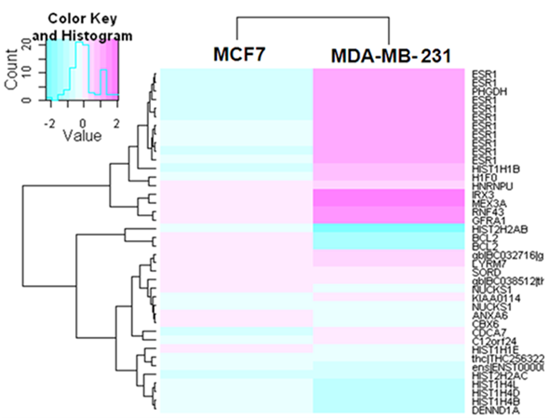
ESR1
Histones
Notes:
Additional file 2: Figure S1: The heatmap shows the relative protein expression of very highly expressed genes in MCF7 cells (n = 40 genes) that are downregulated after DAC treatment, compared to DAC-treated MDA-MB-231 cells from two publically available datasets (gse10613 and gse13733). Pink indicates upregulation, while blue indicates downregulation. The changes in ESR1 expression levels are in accordance with the findings from our current in vitro studies.

Slide 2
Notes:
Additional file 2: Figure S2: Average delta-CT values for each cell line (control vs. DAC-treated), which demonstrates that DAC treatment caused significant increases in expression in ER-neg cell lines (SKBR3, BT549 and MDA-MB-231).

