Slide 1
Sand, stickers and superheroes: Applying visual and creative methodologies to understand participants' worlds and negotiate positive changes
British Psychological Society Seminar Series Exploring the potential for creative and arts-based methods for applied psychological research
Visualising and storying applied psychology
21st May 2019 - University of Bath
Dawn Mannay
mannaydi@cardiff.ac.uk @dawnmannay

Slide 2
Overview
Reflections on visual journeys
Fighting familiarity
Negotiating closed doors and constraining deadlines
Media messages
Temporality
Different ways of asking
What happens next?
Re-visualisation

Slide 3
The problem of familiarity
‘I was bored by the thought of studying undergraduates … I had memories of my own college days in which I appeared as a child’ (Greer 1964)
‘seeing only the things that are conventionally “there” to be seen’ (Becker 1971)
Desire to make the familiar strange has ‘almost the status of a mantra among ethnographers’ (Sikes 2006)
Fighting familiarity (Delamont and Atkinson 1995)

Slide 4
Fighting Familiarity Visually
Introducing a visual element to the process of data collection can potentially provide different ways of knowing and understanding (Gauntlett 2007)
Defamiliarisation - over time our perceptions of familiar, everyday situations become veiled by a web of taken for granted meanings - art can address this automization by forcing us to slowdown our perception, to linger and to notice
Art, therefore, may be an element that can overcome the confines of language, open up experience and make the familiar strange
Mothers and daughters on the margins
‘overshadowed by the enclosed, self-contained world of common understanding’

Slide 5
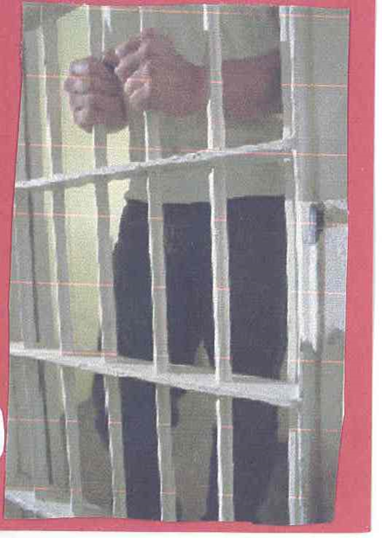
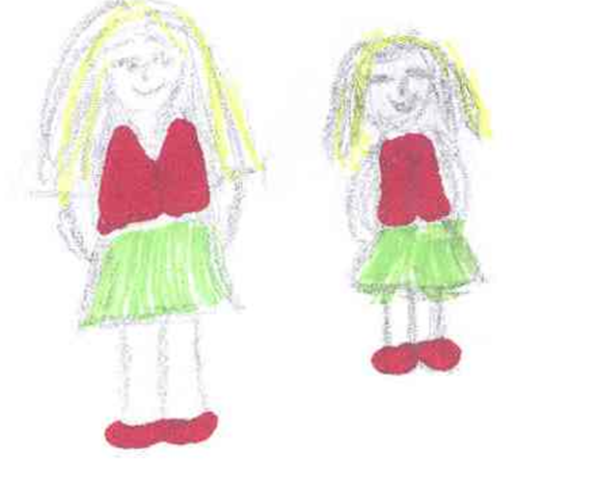
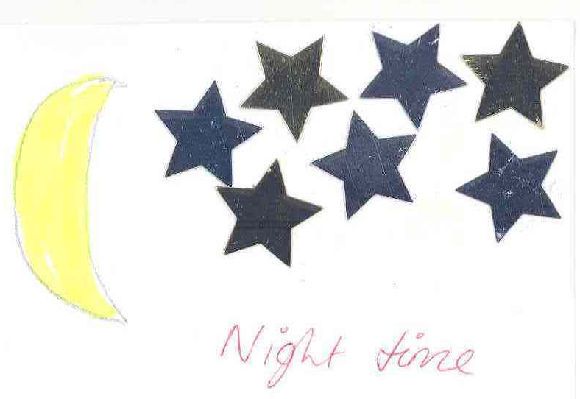
Making the familiar strange

Slide 6
Can visual methods render the familiar setting more perceptible?
‘the technique acted to counter the tacit and normalizing effect of knowledge, which operates by taking ones group experiences and assuming these to be paradigmatic of all. Employing these methods, then, gave me a new insight in to my participant’s worlds; thus, the application of self-directed visual data production provided a gateway to destinations that lay beyond my repertoire of preconceived understandings of place and space; unravelling the diversity of urban experience and making the familiar strange and interesting again’ (Mannay 2010)
Participants lifeworlds and spaces (Richardson 2013)

Slide 7
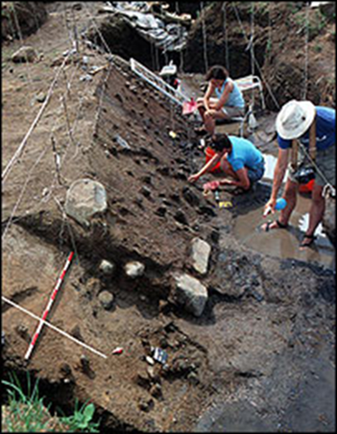
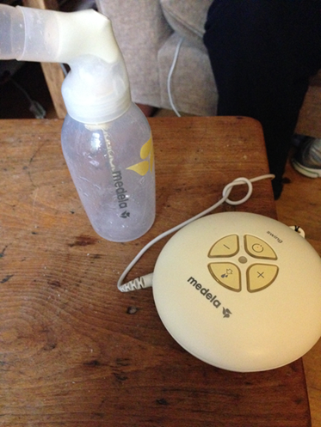
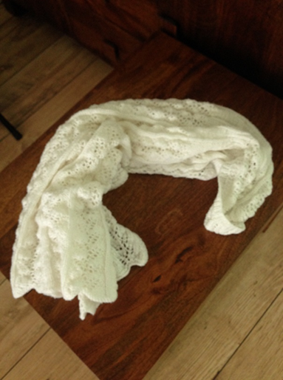
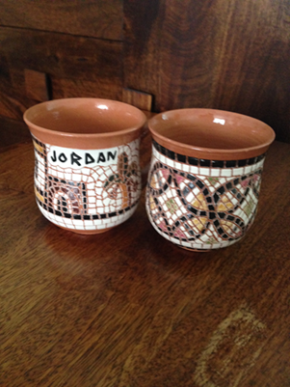
Negotiating closed doors and constraining deadlines
Artefacts can tell how a particular aspect of material culture is entangled in our everyday lives (Chapman 2000)
‘Narratives and objects inhabit the intersection of the personal and the social’ (Hurdley 2006, p. 717)
Visual Artefacts (Grant, Mannay and Marzella 2017)
Unseen elements - introduced to mundane (but important artefacts) located in areas beyond the space selected for the interview

Slide 8
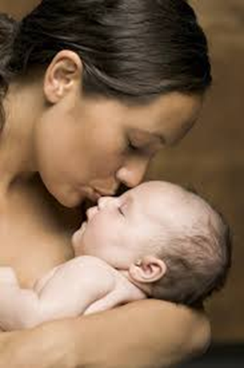
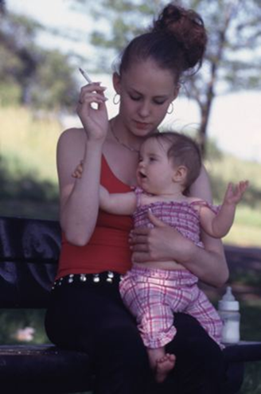
Media messages Stigma, class and motherhood
Moral maze motherhood – experienced by many BUT…
Figure of chav mum circulates within a wide range of media…Through the figure of chav a new publicly sanctioned wave of middle-class contempt for the lower classes is bodied forth (Tyler 2008) (see also Brady and Brown 2013)
Class not a protected characteristic - impacts on public perceptions and social policy – ‘otherhood’ (Mannay et al 2018)
Photoelicitation
Analysis of 167 online images
Failed maternal subject - photographs that attempted to classify mothers ‘like them’

Slide 9
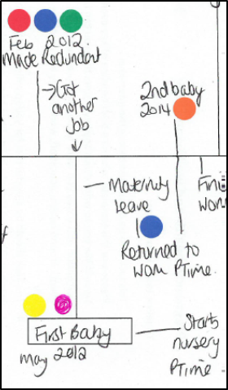
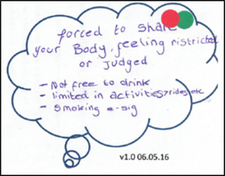
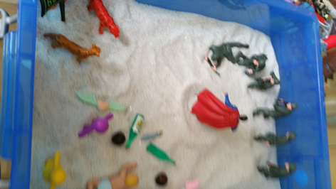
Temporality – past, present, future
Possible selves
Mothers and daughters (Mannay 2014)
Timelines (Adriansen 2012; Berends 2011; Mannay and Creaghan 2016)
Emotion stickers (Gabb and Fink 2015)
Bubble activity
Collage (Awan 2007; Mannay 2010)
Sandboxing – adapted from The World Technique (Lowenfeld 1939)
Motherhood (Mannay et al 2017)

Slide 10
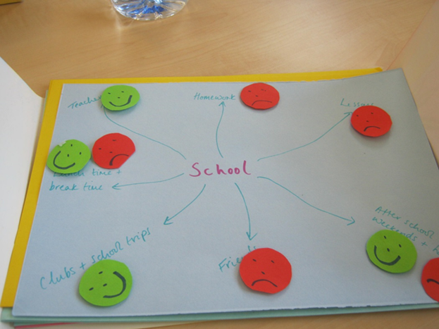
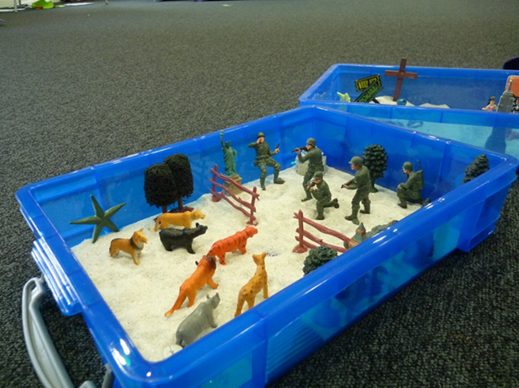
Different ways of asking
‘Effective ways to address increasingly complex questions in social science’ (Kara 2015, p. 3)
Moving away from the ‘social work interview’
Embedded event days and activities - choice
Empowering young people to lead and direct the conversations (Lomax et al. 2011)
Peer led (Lushey and Monroe 2014)
Care experienced children and young people (Mannay et al. 2017)

Slide 11
Enabling ethical engagement, impact and change?
Reports, books, journal articles
Informing policy
Academic conferences
How much impact do they have? Can they negotiate change?
What other options do we have?
What are the issues of ethics, representation, time immemorial (Brady and Brown 2013), voice and visibility?
What opportunities can be gained from the impact agenda?
Useful to consider the ways in which creative narrative forms can replace visual images and detailed, identifying, biographical accounts, yet still retain impact; and ethically, yet powerfully, communicate the stories that participants have shared in the research process (Mannay 2016)

Slide 12
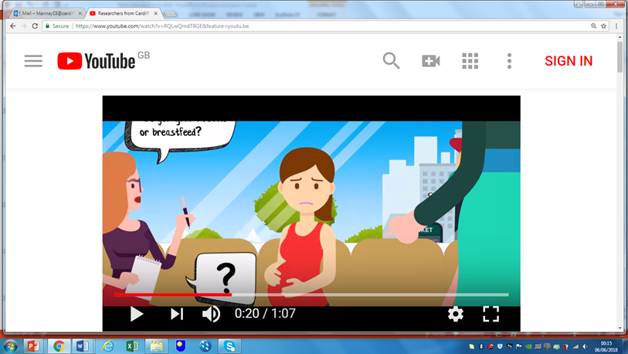
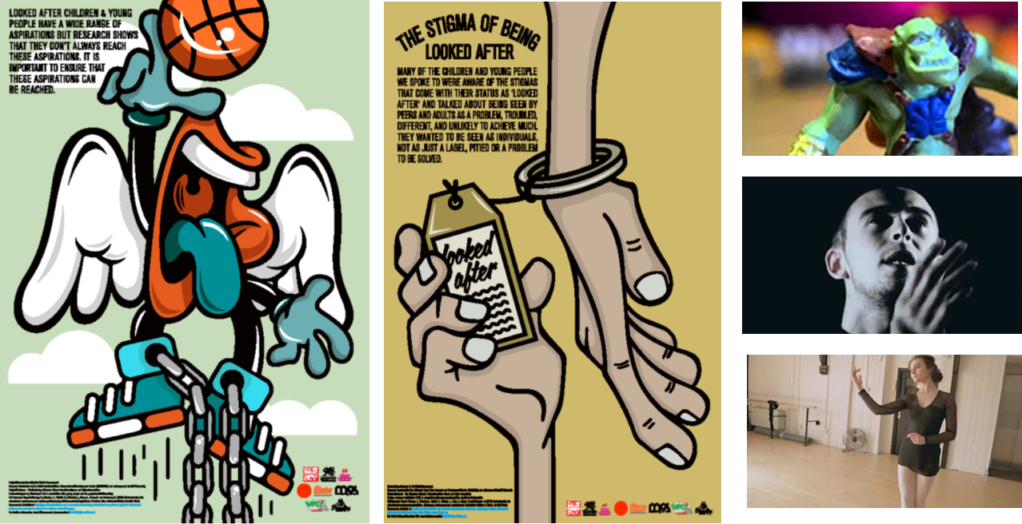
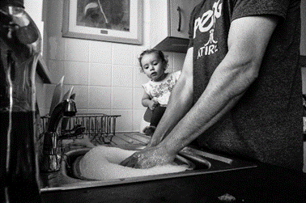
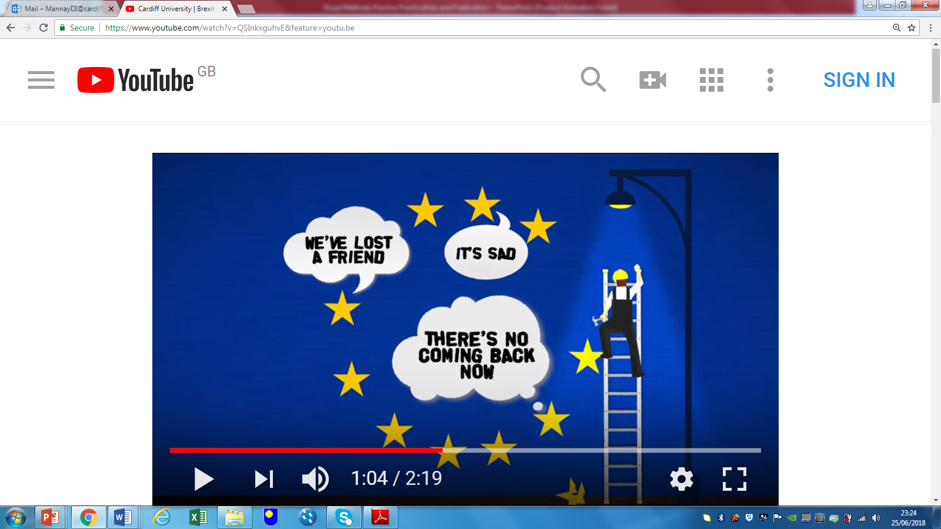
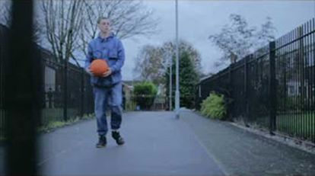
Revisualisation - Anonymising, reframing and re-representing accounts
http://www.exchangewales.org/laceproject

Slide 14
References
Adriansen, H. K. 2012. Timeline interviews: A tool for conducting life history research. Qualitative Studies, 3(1), 40-55.
Awan, F. 2007. Published PhD Thesis. Young people identity and the media: a study of conceptions of self-identity among youth in southern England. Bournemouth University [available on line www.artlab.org.uk]
Berends, L. 2011. Embracing the visual: Using timelines with in-depth interviews on substance misuse and treatment. The Qualitative Report, 16(1), 1-9.
Brady, G., and Brown, G. 2013. Rewarding but let’s talk about the challenges: using arts based methods in research with young mothers. Methodological Innovations Online, 8(1), 99-112.Chapman, J. 2000. Fragmentation in Archaeology: People, Places and Broken Objects in the Prehistory of South-eastern Europe. London: Routledge.
Delamont, S. and Atkinson, P. 1995. Fighting familiarity: Essays on education and ethnography. Cresskill, NJ: Hampton Press.
Gauntlett, D. 2007. Creative Explorations: New Approaches to Identities and Audiences. London: Routledge.
Grant, A., Mannay, D. and Marzella, R. 2017. 'People try and police your behaviour': The impact of surveillance on mothers' and grandmothers' perceptions and experiences of infant feeding. Families, Relationships and Societies - http://www.ingentaconnect.com/content/tpp/frs/pre-prints/content-ppfrsd1600032r3
Hurdley, R. 2006. ‘Dismantling Mantelpieces: Narrating Identities and Materializing Culture in the Home’, Sociology 40(4): 717-733.
Kara, H. 2015. Creative research methods in the social sciences: A practical guide. Bristol: Policy Press.
Lomax, H., Fink, J., Singh, N. & High, C. 2011. The politics of performance: Methodological challenges of researching children’s experiences of childhood through the lens of participatory video, International Journal of Social Research Methodology, 14(3), 231–243.
Lowenfeld, M. 1939. The World Pictures of Children. British Journal of Medical Psychology 18: 65–101.
Lushey and Monroe, R. 2014 Participatory peer research methodology: An effective method for obtaining young people’s perspectives on transitions from care to adulthood, Qualitative Social Work, doi:(10.1177/1473325014559282).
Mannay, D. 2010. Making the familiar strange: Can visual research methods render the familiar setting more perceptible? Qualitative Research, 10 (1), 91-111.
Mannay, D. 2014. Mother and daughter ‘homebirds’ and possible selves: generational (dis)connections to locality and spatial identity in South Wales. In: Vanderbeck, R. M. and Worth, N. eds. Intergenerational Space. Routledge Studies in Human Geography London: Routledge, pp. 100-122.
Mannay, D. 2016. Visual, narrative and creative research methods: application, reflection and ethics. London: Routledge.
Mannay, D. and Creaghan, J. 2016. Similarity and familiarity: reflections on indigenous ethnography with mothers, daughters and school teachers on the margins of contemporary Wales. In: Ward, M. ed. Gender, Power and Subjectivity: Reflections on Research Relationships in the Field. Studies in Qualitative Methods Bingley: Emerald, pp. 85-103.
Mannay, D., Creaghan, J., Gallagher, D., Marzella, R., Mason, S., Morgan, M. and Grant, A. 2017. Negotiating closed doors and constraining deadlines: the potential of visual ethnography to effectually explore private and public spaces of motherhood and parenting. Journal of Contemporary Ethnography http://journals.sagepub.com/doi/full/10.1177/0891241617744858
Mannay, D., Staples, E. and Edwards, V. 2017. Visual methodologies, sand and psychoanalysis: employing creative participatory techniques to explore the educational experiences of mature students and children in care. Visual Studies 32, pp. 345-358.
Mannay, D.et al. 2017. The consequences of being labelled ‘looked-after’: Exploring the educational experiences of looked-after children and young people in Wales. British Educational Research Journal 43(4), pp. 683-699.
Mannay, D.et al. 2018. ‘Watching what I’m doing, watching how I’m doing it’: Exploring the everyday experiences of surveillance and silenced voices among marginalised mothers in Welsh low-income locales. In: Taylor, T. and Bloch, K. eds. Marginalized Mothers, Mothering from the Margins. Advances in Gender Research, Vol. 25. Bingley: Emerald.
Mannay, D.et al. 2019. Enabling talk and reframing messages: Working creatively with care experienced children and young people to recount and re-represent their everyday experiences. Child Care in Practice 25, pp. 51-63.
Richardson, M. 2013. Embodied intergenerational: family position, place and masculinity. Gender, Place and Culture, ifist edition http://dx.doi.org/10.1080/0966369X.2013.855710
Tyler, I. 2008. Chav Mum Chav Scum. Feminist Media Studies, 8(1), 17-34. and Tyler, I. 2013. Revolting Subjects. London: Zed Books.

