Slide 1
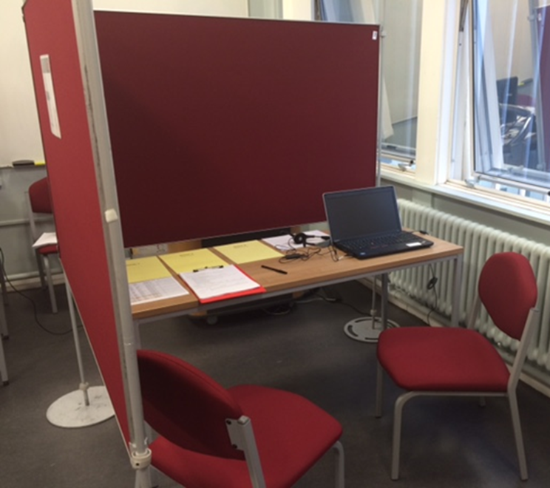
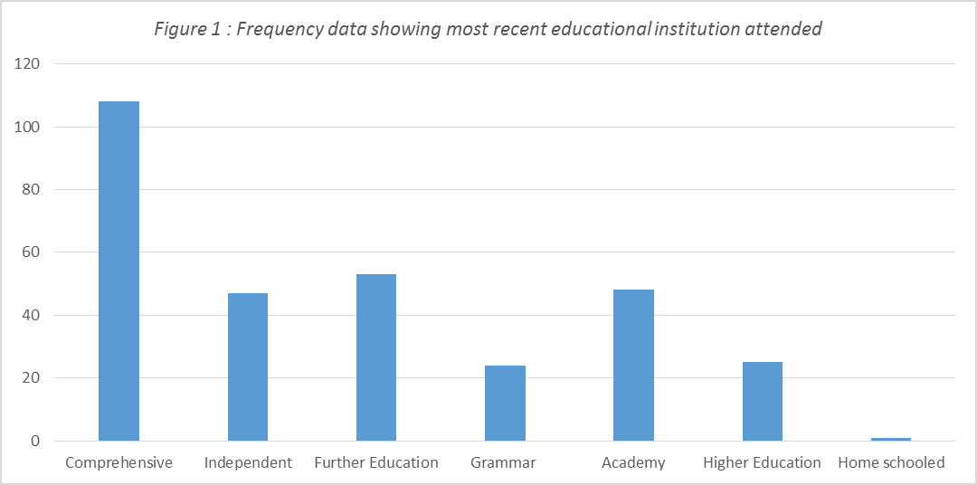
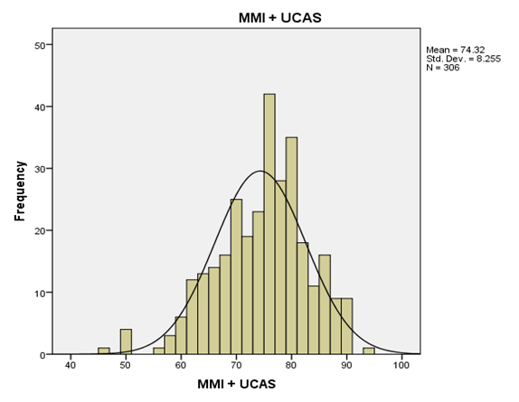
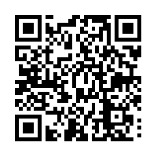
School of Healthcare Sciences / Ysgol Gwyddorau Gofal Iechyd
Higher Education admissions interviews with inclusivity at the heart of their design foster diversity in Physiotherapy cohorts
Background
Multiple Mini Interviews (MMIs) have been in use for several years in Medical and Dental education and are seen as reliable method of assessing candidates. The many opportunities to make a first impression during an MMI suggest a fairer and more consistent method of assessment when compared to a traditional panel interview. The MMI structure adopted by the Physiotherapy programme at Cardiff University uses 8 stations of between 2 and 5 minutes duration during which candidates are given questions, scenarios and tasks to respond to so that interviewers can make judgements on their suitability to enter the profession. Reasonable adjustments have been made to account for those with disability; including the use of written as well as audible instructions, not assuming experience in healthcare environments and using gender-neutral examples in scenarios.
However, if MMIs are designed to select for specific attributes and personalities, do they result in a homogenous student population and thus reduce the diversity of experiences, thoughts and behaviours within that group? If this is the case, then the process which is thought to be ‘fair’ may actually be fraught with bias – do we recruit in our own image, and are we not really aware of how this happens?
If the interview station has been designed by someone who is mature, white, middle class and female, how will a young black male who originates from a poor socio-economic area relate to the scenario and indeed would this impact on his performance? Similarly, if all of the interviewers share similar characteristics to each other but not the individual candidate, how (if at all) will that influence their decision making during assessment of the candidate’s performance? Recruitment procedures into Physiotherapy therefore need analysing to examine any potential forms of exclusion, unconscious bias or discrimination.
Physiotherapy in the UK has long been a profession dominated by the white, female practitioner and as a result often negatively affected by stereotype. Since healthcare professionals have contact with all members of society then to better address the needs of this diverse group the profession’s membership should be reflective of the population it serves. A lack of understanding of other cultures (through an absence of exposure in the profession itself) may lead to a lack of empathy and a failure to meet the needs of those particular groups.
The 2013 government review and subsequent recommendations suggested that those institutions who recruit into healthcare professions had an obligation to screen for suitable candidates who possess the appropriate attributes for the caring profession therefore Cardiff University took the decision to interview all candidates prior to offering a place to study. These interviews have effectively become a ‘gateway’ to the profession therefore it was imperative to design a structure which would lack bias and promote inclusivity and widening access agendas.
Aims of Project
This project aimed to investigate for signs of bias within the MMI structure for Physiotherapy recruitment at Cardiff University. It considered the inclusivity of design and scoring processes of the interview stations through the monitoring of performance at each station by applicants who have differing characteristics. Characteristics of age, gender, disability, socio-economic and educational background were compared against the overall scores and individual station scores in a retrospective review of the applicants who were interviewed in the 2015/16 admissions cycle. Data regarding the ethnicity of candidates was unfortunately not available for the analysis. All decisions regarding the success of each applicant had already been made and the project did not influence this in any way. Ethical approval for the study was gained via the School of Healthcare Sciences review committee.
Sample
306 candidates were included in the analysis, with 73.5% female and 26.5% male. Ages ranged from 18-50 years (mean 20.1, SD 4.51), with the majority of candidates in the 18-20year age bracket (n=245). 59 of the candidates had a contextual flag, meaning they resided in socially deprived areas of the UK. Only 10% of candidates disclosed any form of disability and the majority of these identified as having a learning disability, such as dyslexia. Figure 1 shows the previous educational background of the candidates.
Analysis
More detailed scrutiny of the data in respect to scores and characteristics was performed using Mann Whitney U, Kruskal-Wallis tests and pairwise comparisons. The significant findings are as follows:
26-29 year olds perform significantly better than 18-21 year olds
POLAR and Contextual candidates perform better than their non-POLAR and non-contextual counterparts, however it should be noted that the group sizes are not equal and may skew the results slightly
There were no significant differences between the performances at any point in the process with regards to disability type. Those with or without a disability performed equally well.
Previous education appeared to have some influence on performance with those applicants who had already attended higher education scoring significantly higher than those who had been schooled in further education, comprehensive, independent and academy environments. Interestingly though this was not borne out when just the ‘gut feeling scores’ were analysed – here all candidates performed equally.
Male candidates from Academy school backgrounds show the lowest mean overall scores (68.81) whereas female candidates who have been in Higher Education have the highest (80.75).
Females in the 18-21year group significantly out perform their counterparts, but the other age groups show a much more even spread of scores between the genders at each stage of the process
The MMI stations are scored on a 7-level Likert scale (0-6) where candidate’s performance is rated as unsatisfactory/ poor/ borderline/ satisfactory/ good/ very good/ excellent. Each interviewer is also asked to rate their ‘gut feeling’ about how well suited a candidate may be to the profession; rated as excellent (4), acceptable (2) or poor (0). Overall the maximum score for the MMI is 60. Candidates’ UCAS applications are also scored out of 40 so a grand total of 100 would equate to full marks. The graph above depicts the overall spread of candidate scores.
Discussion Points
Key Considerations
Applicants applying to the Cardiff University Physiotherapy programme are similar to those enrolled across the UK (CSP, 2015); predominately female.
It is hypothesised that contextual applicants demonstrated a real drive and passion to succeed, maybe showing more evidence of robustness and resilience because of their background which led them to out-score their counterparts. The contextual flag however, may be an example of unconscious bias in an administrative system where the domiciliary postcode has led to a stereotypical label being applied, questioning its reliability.
Applicants who had disclosed a disability (dyslexia in most cases) were not different to the mean, suggesting that reasonable adjustments (having instructions read out and printed in comic sans font on coloured paper) ensured no disadvantage occurred.
It could be argued that those who had already been in higher education had been exposed to more life experiences and as a result have more capacity to contextualise and relate to the scenarios, facilitating higher scores. This may also explain why males seem to ‘catch up’ to females in the older age groups.
The design and scoring of interview stations could be shaped by experiences and unconscious biases of academic staff- were we guilty of judging applicants against our own views and lowering our expectations accordingly to give a score? Efforts were made however, to ensure that the interview stations assessed the CSP and NHS core values, and scenarios were designed to address inclusivity. For example, scenarios were gender neutral and used generic locations, not overtly healthcare related so that those with less exposure to actual healthcare environments were not disadvantaged. There were also opportunities to moderate scores between interviewers/designers.
MMIs offer the opportunity for applicants to meet multiple interviewers, each with their own experiences and expectations, potentially reducing bias
Careful design of interview stations/questions can ensure inclusivity in the process – consultation during design is key
Young male applicants do not perform as well as their female counterparts – why is this?
There is still a lack of diversity in the initial applicant pot – can the physiotherapy profession do more to encourage diversity within it’s ranks?
Does the design of physiotherapy education lead to exclusion for certain groups even before the application stage?
Jill Morgan morganj63@Cardiff.ac.uk
School of Healthcare Sciences, Cardiff University

