Slide 1
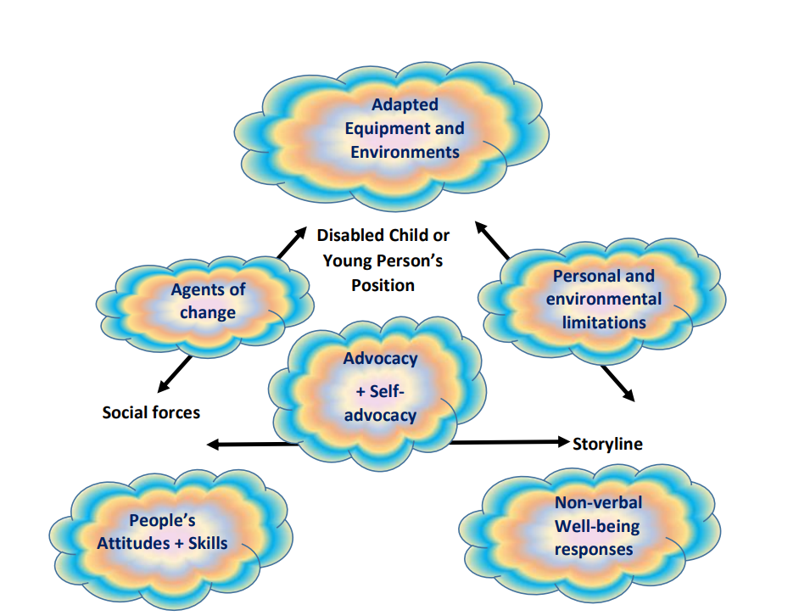
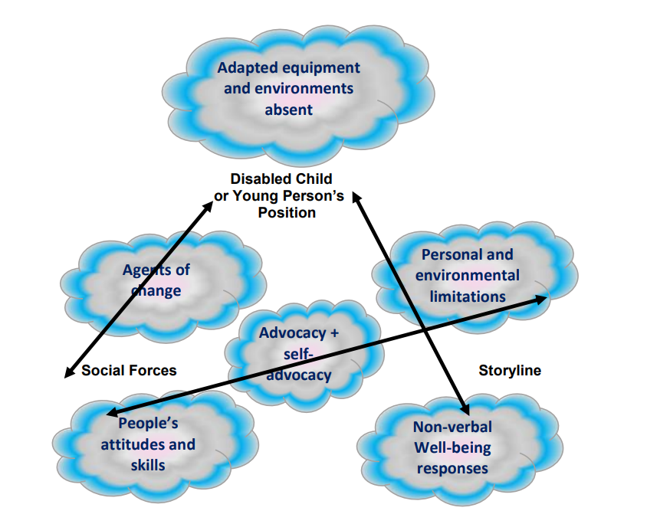
Theme: Digital transformation
86
Disabled children and young people's voices about the well-being effects
from their level of participation in recreational activities-comparative case study
Dr Dawn M Pickering, School of Healthcare Sciences, Cardiff University:
pickeringdm@cf.ac.uk Twitter: @DawnMPickering
Purpose: A literature review highlighted a gap in knowledge for non-verbal disabled children with limited mobility¹. The research question was: How do children and young people with cerebral palsy and their parents view, experience, and choose their level of participation in recreational activities, to benefit their well-being?
The two aims were to explore:
1. The views, experiences and choices for children and young people’s level of participation in recreational activities, including barriers and facilitators.
2. Their perceptions of the effect of their level of participation upon children and young people’s emotional well-being.
Results (continued)
Positioning theory has been further adapted to include the non-verbal children’s storylines, represented by a ‘Kaleidoscope of Well-being’(Figure 1). This suggests that well-being can fluctuate in different environments, influenced by the social forces of advocates who promoted their needs, with specialist equipment. Participants also showed they could choose not to participate, to determine their own storylines, showing their own agency as self-advcoates³. When activites, environments and attitudes were not adapted, this showed as a skewed Kaleidoscope (Figure 2).
Conclusions: Policy makers and designers of equipment and environments should consider how to increase the choices of recreational activities for disabled children. Due to the current COVID restrictions the opportunity to develop digital games where disabled children and young people see themselves affirmed and represented is proposed post doc, if further funding is secured. There is a need to explore how health and social care professionals perceive the role of advocacy with disabled children and young people, to enhance their participatory opportunities.
Methods: A qualitative approach was developed using an exploratory comparative case study design using visual methods. There were two groups, a Participatory Group (N=4) and a Limited Participatory Group (N=3). The participants were aged nine to sixteen years and were supported by their parents in the data collection. Each case included two interviews at the beginning and end of twelve weeks, during which time the parents also kept a hand-written diary. Observations were also carried out at one of their usual activities during this time. Photographs were taken by the parent or the researcher, which were used to elicit discussion in the second interview. Positioning theory was applied, which included a triad of their position, social forces, and their own stories². The storylines of the participants were socially constructed from the evidence of the social forces at play, at the activities where they were positioned.
Figure 1: Kaleidoscope of Well-being
Impact: The impact of my PhD will develop from publications in both academic journals, parental networks and policy statements. I created a three minute Powtoon for the participants to listen and see what my dissemination plans are which you can view here: https://www.powtoon.com/c/eh8O41X6xP1/0/m
Results: Seven cases were analysed using Braun and Clark’s six stages of thematic analysis. Three overall themes were identified from the findings:
1. Participation Enhancers;
2. Champions for disabled children and young people's well-being- Self advocacy;
3. Hindrances to participation.
References: 1. Shikako-Thomas, K. et al. 2014. Promoting leisure participation as part of health and well-being in children and youth with cerebral palsy. J Child Neurol 29(8), pp. 1125-1133.
2. Langenhove LV, Harré R. Cultural stereotypes and positioning theory. Journal for the Theory of Social Behaviour. 1994 Dec;24(4):359-72.
3. Devakumar et al 2016. The role of advocacy in promoting better child health Arch Dis Child July 2016 Vol 101 No 7
Figure 2: Skewed Kaleidoscope of Well-being

