Slide 1
Enhancing the Student Experience:​
Inclusive and Accessible Approaches within Blackboard Ultra​
Dewi Parry, Tony Lancaster, Geraint Evans
Cardiff University
DigEdSupport@cardiff.ac.uk

Slide 2
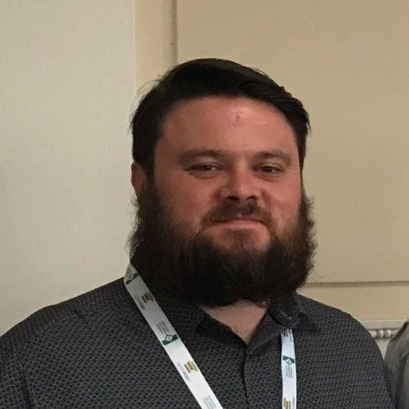
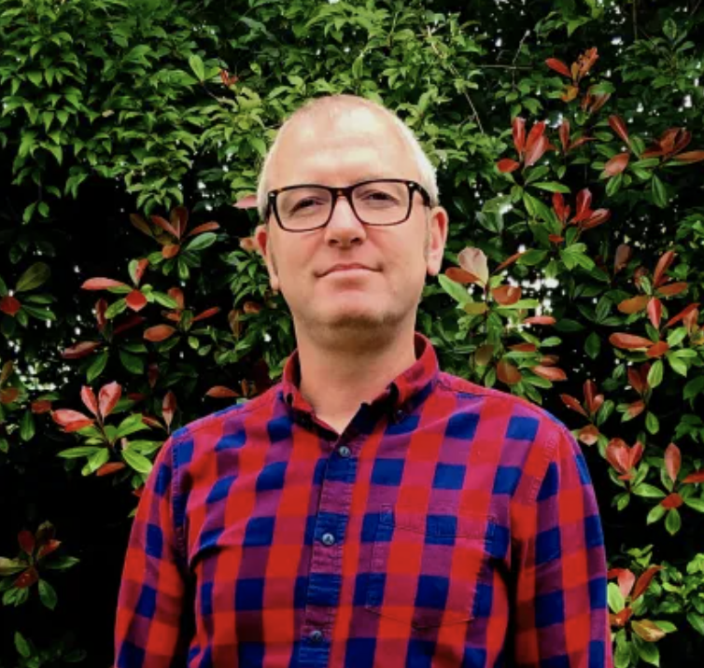
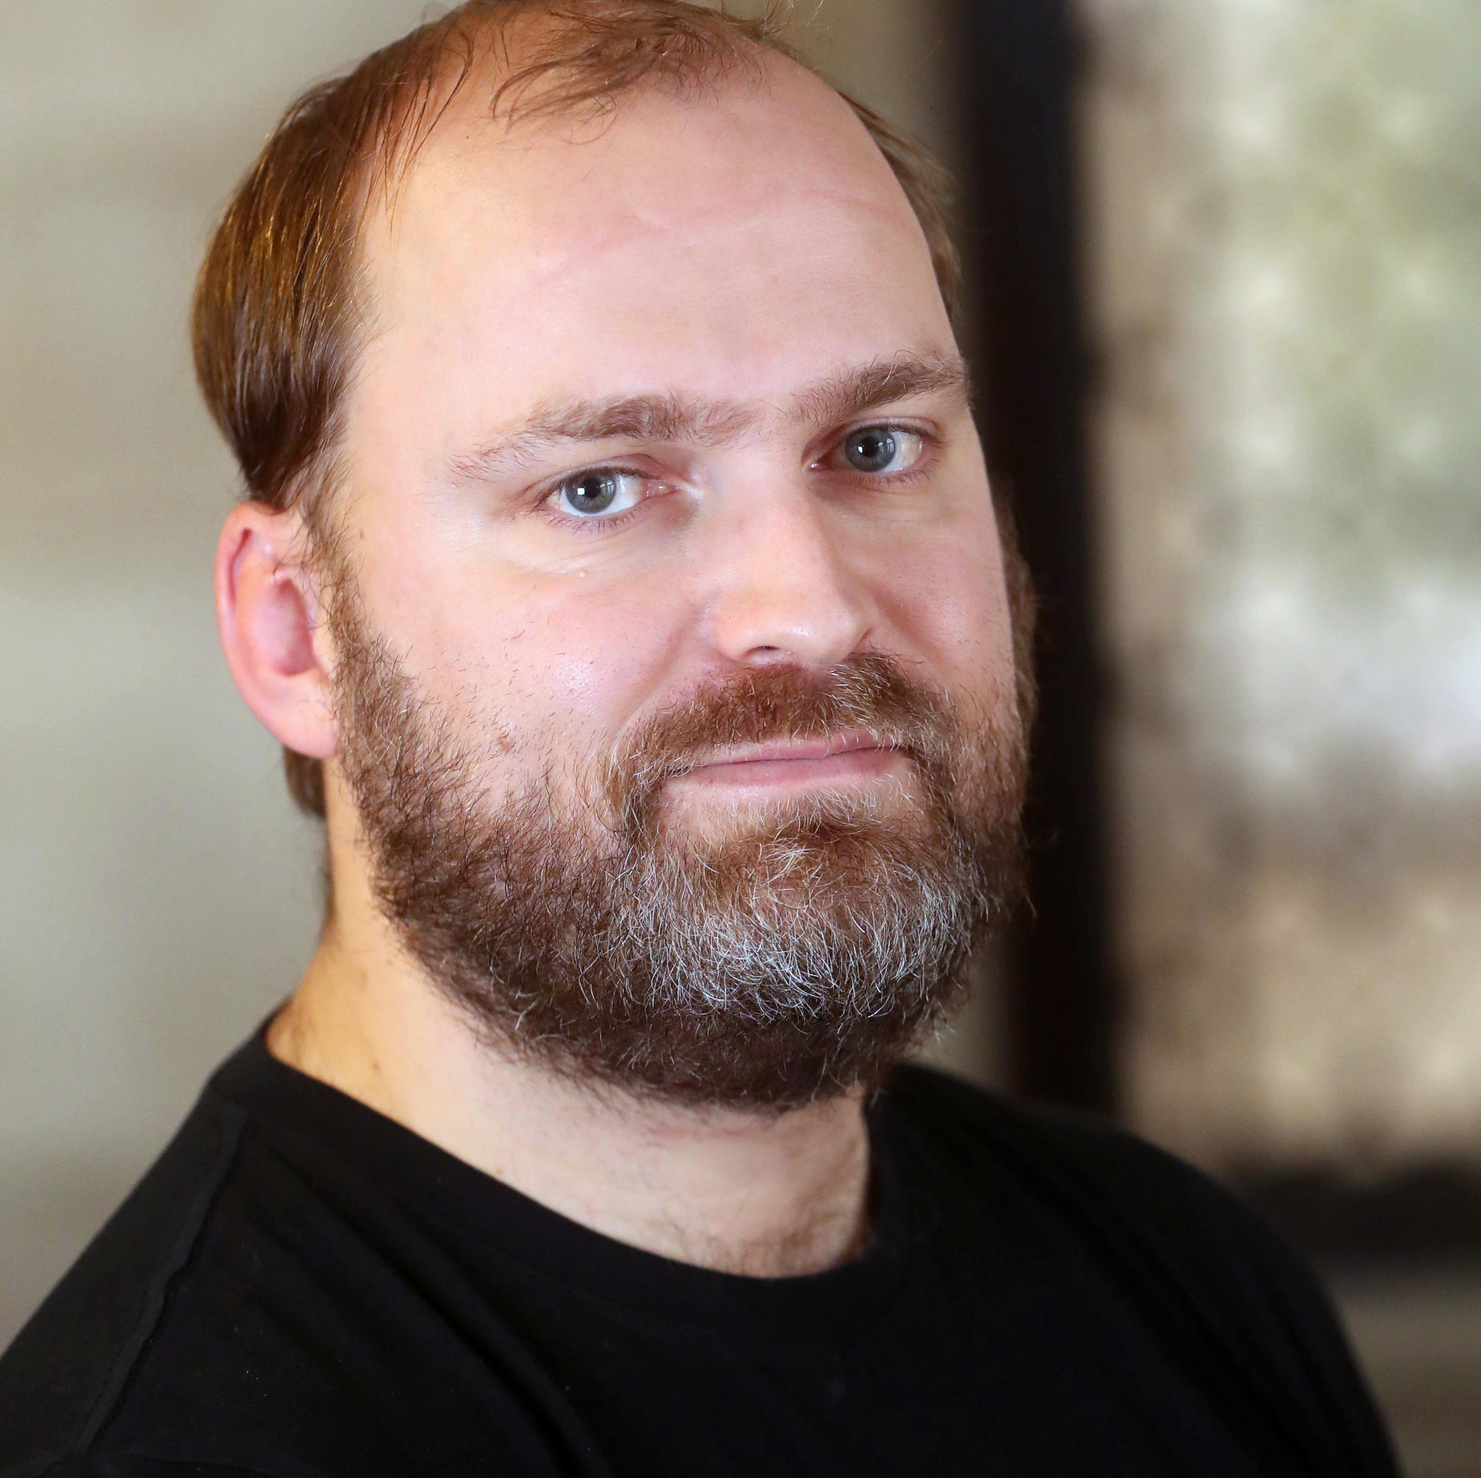
Croeso / Welcome
Dewi Parry
  Digital Learning Manager
  Cardiff University
Tony Lancaster
  Digital Education Manager
  Cardiff University
Geraint Evans
  Digital Learning Manager
  Cardiff University

Slide 3
Workshop
Agenda
Background
  Ultra rollout
  Drivers for change
Group Task
  Strategic principles
  Embedding practice
  Developing capabilities
Next Steps
  Sharing feedback
  Anthology community

Slide 4
Background

Slide 5
Background: Phased Rollout of Blackboard Ultra Courses
Academic Year | Description of Phase
2021/22 | Semester 2 Pilot – 6 modules across 6 (of 23) Schools
2022/23 | Targeted rollout – 253 modules across 7 Schools plus Semester 2 Pilot – 31 modules across a further 14 Schools
2023/24 | University-wide roll-out – over 5000 modules and organisations across all 23 Schools

Slide 6
Where are we now?
  A key element of the 'Innovative and Inclusive Environment' theme of our Education and Students change programme (November 2021).
  Focus on a significantly improved student experience, including accessible, consistent, and intuitive learning environment.
  Over 5000 modules now benefiting from a modern, streamlined and mobile-first platform.
  However, full benefits can only be fully realised when modules designed with inclusivity and accessibility at their core.

Slide 7
Early thinking on digital accessibility (Enhancement model)
Current
Foundational
Optimal
Transformational
Developing an understanding of current practice through the roll-out of Blackboard Ultra Courses
Legacy Blackboard Learn Original with multiple custom templates and significant inconsistencies across modules
High variability in accessible content
Clear focus on capabilities related to digital accessibility
Utilising templates for greater consistency and parity of experience
Distinct learning modules aligned to learning outcomes
Content and resources fully accessible
Mainstreaming digital accessibility as a driver for improving practice and enhancing student learning
Module content that anticipates a variety of learning needs and perspectives
Content includes a variety of media with alternative formats provided as appropriate
Pedagogical and inclusive excellence reflecting sector best practice
Following Universal Design for Learning principles to provide multiple means of representation, engagement, action and expression
Students actively involved in shaping module design and delivery

Slide 8
Workshop

Slide 9
Workshop opportunities
For those who HAVE NOT yet taken an institutional approach to digital accessibility and inclusivity
For those who have taken an institutional approach to digital accessibility and inclusivity
This is an opportunity for you to learn from those who have done this already
Consider the decisions other institutions have made and the outcomes for students and staff
Pick up ideas and tips around strategic approaches, embedding practices in the curriculum and developing staff capabilities
This is your opportunity to share your work and approaches with others in the sector
Reflect on your decisions and the outcomes for your students and staff (what has worked, what hasn't worked and what would you do differently)
Learn from the approaches of others, compare approaches and pick up new ideas to embed within your institution

Slide 10


Text with Two Phone Screenshots
Group | If you already have an institutional approach... | For those considering an institutional approach…
1 – Strategic Principles | Does your approach align with institutional strategy, and if so, which theme? | How can you align the approach to inclusivity and accessibility within your institution?
2 – Embedding Practice | What has been the high-level messaging in this area? (experience, disability, parity etc.) How has your messaging been embedded within practice? (into the curriculum, via learning design approaches, through UDL principles etc.) | What are the avenues for you to embed strategic principles within your institution? (curriculum development / digital education / learning development / IT teams, roll- out etc.) What are the barriers for you?
3 – Developing Capabilities | What approaches have you taken towards staff development? (guidance, training, courses, awareness campaign etc.) Do you have any examples to share with the community? | What guidance you would like around developing an inclusive and accessible approach within ULTRA? Would a community approach to inclusivity and accessibility help you on your journey?
Padlet board...
bit.ly/CU-AT23

Slide 11
Next Steps
  Feedback from groups
    Strategic principles
    Embedding practice
    Developing capabilities
  Anthology community
    Where do we go next?

Slide 12
Diolch yn fawr
Thank you

