Slide 1
THE BRYAN C CLIFT KEYNOTE LECTURE ‘Thoughtful practice can be more ethical than an ethical code’: Reflections on the lessons learnt in qualitative journeys
The Eighth Annual Qualitative Research Symposium
Ethics and Power
31 January 2024
Dawn Mannay
mannaydi@cardiff.ac.uk
@dawnmannay

Slide 2
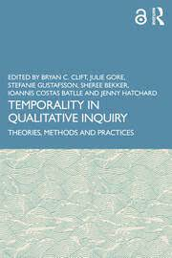
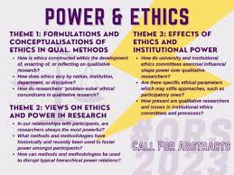
Thank you

Slide 3
Overview – ethics and power
Before we begin
Within studies
Beyond endings
‘Appropriate thoughtful practice can be more ethical than an ethical code’ (Del Loewenthal 2023, p. 134)
Situated ethics and the responsibilities of both practitioners and of researchers
Loewenthal, D. 2023. The handbook of phototherapy and therapeutic photography. Abingdon: Routledge.

Slide 4
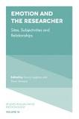
The ‘I am’ and thoughtful practice
As Berger (1972, p.370) contends ‘the present tense of the verb to be refers only to the present: but nevertheless, with the first-person singular in front of it, it absorbs the past, which is inseparable from it. ‘I am’ includes all that has made me so. It is more than a statement of immediate fact: it is already biographical’.
Absent ‘I’ claims authority and silences the presence of the researcher
Rather than projecting our own worldview as ‘objective’, and in this way to naturalising it, we should reflect on and make clear the presence of the ‘I’
Engaging with our positionality and the emotionality of qualitative relationships
Open up space for new questions, ideas and interpretations
Loughran, T. and Mannay, D. (Eds.) 2018. Emotion and the researcher: Sites, subjectivities and relationships (Vol. 17). Studies in Qualitative Methodology (pp. x-x). Bingley: Emerald.

Slide 5
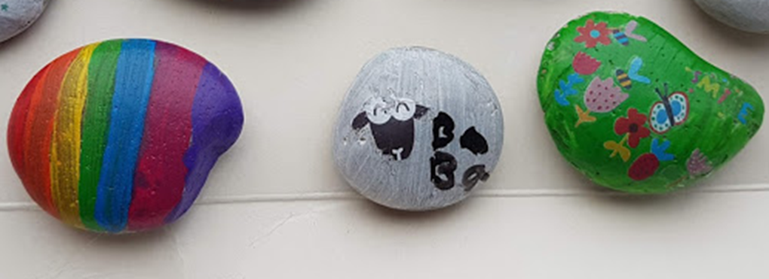
Before we begin…
Experts by experience
CASCADE Voices
Community consultation
Co-production
Research training
Participatory
Or partially participatory

Slide 6
Limits of co-design and participatory potential
Squandering their time when there is no immediate tangible outcome… Activities, such as building trust with communities, are an essential aspect of qualitative research (Costas Batlle and Carr 2021)
‘It is the responsibility of those who fund projects and the organisations that host them to make changes so that there is time for practitioners, researchers, and advocates to listen to and act on ‘a little bit of advice’ from the communities they work with about how they would like to share their experiences’ (Mannay et al 2023, p. 260)
Costas Batlle, I. and Carr, S. 2021. Trust and relationships in qualitative research. In B. Clift, J. Gore, S, Gustafsson, S. Bekker, I. Costas Batlle and J. Hatchard (Eds). Temporality in qualitative inquiry: theories, methods and practices (pp. 158-171). Abingdon: Routledge.
Mannay, D., Vaughan, R., Boffey, M. and Wooders, C. 2023. 'A little bit of advice': Working creatively with children and their foster carers to explore how they would like to share their experiences. In: Kara, H. ed. The Bloomsbury Handbook of Creative Research Methods. Bloomsbury Handbooks London: Bloomsbury, pp. 251-261.

Slide 7
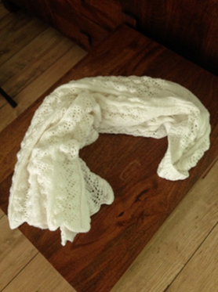
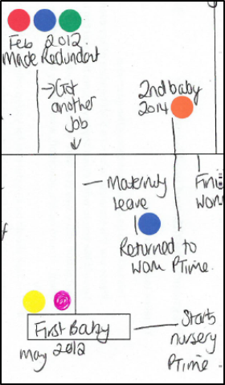
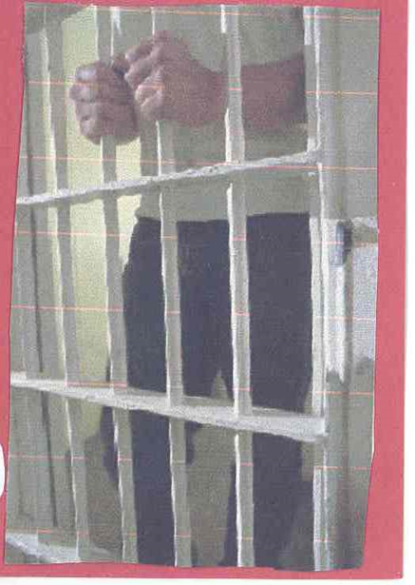
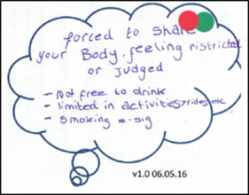
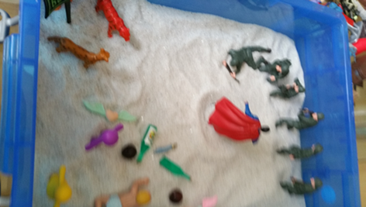
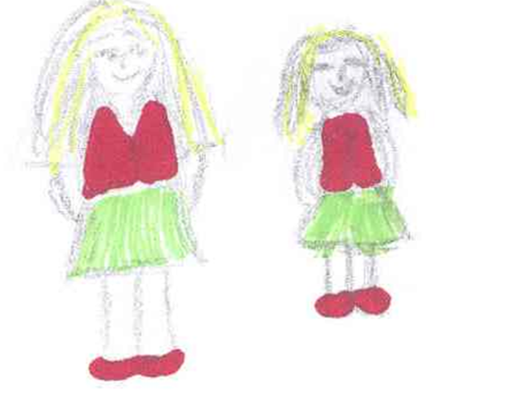
Within studies… creative qualitative research
Reflection and reflexivity
Imagination and freedom
Fighting familiarity and defamiliarization
Quietening the researcher voice
Participant led
Choice and Comfortableness
Power and ethics
Kara, H., Lemon, N., Mannay, D. and McPherson, M. 2021. Creative research methods in education: Principles and practices. Bristol: Policy Press.
Mannay, D. 2015. Visual, narrative and creative research methods: application, reflection and ethics. Abingdon: Routledge.
Mannay, D. 2019. Artefacts, third objects, sandboxing and figurines in the doll’s house. In: Pauwels, L. and Mannay, D. eds. The SAGE Handbook of Visual Research Methods (2nd Edition). London: SAGE Publications

Slide 8
Unexpected and unintended
But where does the journey take you…
The impacts of being involved in research can be ‘minimal, or significant, or even transformative… in good and bad ways’ (Braun and Clarke 2021, p. 26)
Sharp tools (Pam Burnard)
Trauma and vicarious responses - ‘the field never entirely leaves the researcher’ (Pole and Hillyard 2017, p. 109)
Speaking and silencing
Powerful and powerless
Braun, V. and Clarke, V. 2021. The ebbs and flows of qualitative research. Time, change, and the slow wheel of interpretation. In B. Clift, J. Gore, S, Gustafsson, S. Bekker, I. Costas Batlle and J. Hatchard (Eds). Temporality in qualitative inquiry: theories, methods and practices (pp. 22-38). Abingdon: Routledge.
Mannay, D. 2011. Taking refuge in the branches of a guava tree: the difficulty of retaining consenting and non-consenting participants’ confidentiality as an indigenous researcher. Qualitative Inquiry 17(10), pp. 962-964.
Pole, C. and Hillyard, S. 2017. When it’s time to go. In C. Pole & S. Hillyard (Eds.) Doing fieldwork. London: Sage, pp. 107-122.

Slide 9
Qualitative research – what for? ‘nothing ever changes’

Slide 10
Enabling Ethical Impact
Reports, books, journal articles
How much impact do they have?
Can they negotiate change?
Much academic dissemination is positioned as passive and designed to accrue the most significant benefits to the researcher, rather than engendering wider value (Groundwater-Smith et al. 2015).
What other options do we have?
Groundwater-Smith, S., Dockett, S. and Bottrell, D. 2015. Participatory research with children and young people. Los Angeles: Sage.

Slide 11
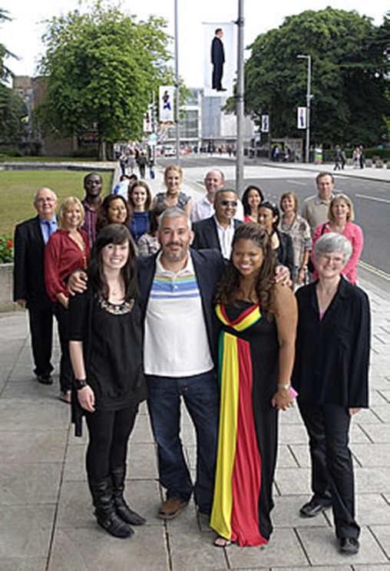
Ethics of recognition
Is the consent informed?
Do participants understand how their data will be used – what is a conference, journal article?
Ethics of recognition – being seen
Best practice cases Paul Sweetman (City Portraits) Jessica Mannion (co-inquirers)
But sensitive topics, time immemorial (Brady and Brown 2013), un-consenting others, manipulation, wider visibility
Images cannot speak – whose voice?
Brady, G. and Brown, G. 2013. Rewarding but let’s talk about the challenges: using arts-based methods in research with young mothers. Methodological Innovations Online, 8(1), pp. 99-112.

Slide 12
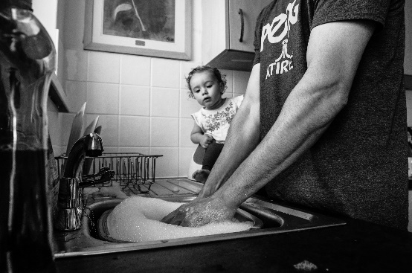
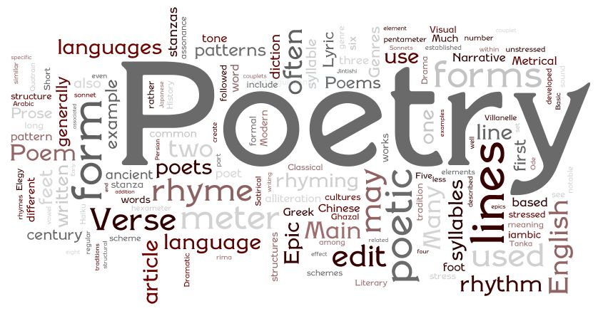
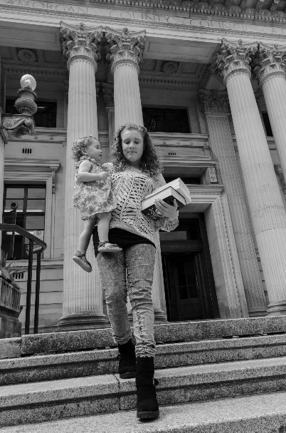
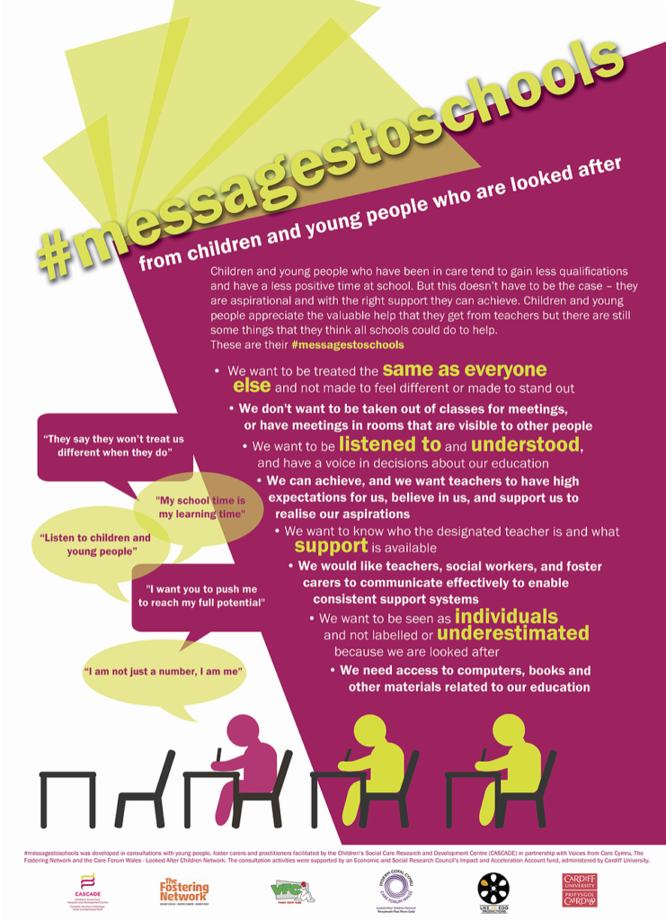
Visual Re-representations
Mannay, D. 2019. Revisualizing data: engagement, impact and multimodal dissemination. In: Pauwels, L. and Mannay, D. eds. The Sage Handbook of Visual Research Methods (2nd Edition). London: SAGE Publications- Films https://www.exchangewales.org/lace/

Slide 13
The shape of impact
Impact ranged from developing new technologies and spinouts to changing policies, legislation, and international regulations; from reviving regional and local economies to preserving and expanding a rich cultural, literary and artistic heritage. Public knowledge was increased, perceptions and behaviours were changed, and regulations and policies were introduced across a range of settings, including teachers employing better pedagogical tools, improvement of consumer protection in diverse markets, encouraging communities to celebrate their heritage, and reduction of energy costs through better grid management and environmentally sound buildings and behaviour (p. 7).
Wagner, S. et al. 2024. The SHAPE of Research Impact. London: The British Academy.

Slide 14
The cost of impact
This can be problematic for the ‘time pressured… researcher in the neoliberal academy’ (Leigh 2021, p. 72) or the busy practitioner who has competing demands on their capacity
Expectations to research, publish, teach, and demonstrate measurable impact that can again position researchers as vulnerable if they are unable to keep up with these competing pressures and demonstrate excellence (Mannay 2023)
Leigh, J. 2021. What would a Rhythmanalysis of Qualitative Researcher’s Life Look Like? In B. Clift, J. Gore, S, Gustafsson, S. Bekker, I. Costas Batlle and J. Hatchard (eds), Temporality in Qualitative Inquiry: Theories, Methods and Practices, 72-92, Abingdon: Routledge.
Mannay, D. 2023. ‘Please explain to me how I’m vulnerable’: Learning how to rework experiences of researcher vulnerability by listening carefully to care experienced young people. In: Clift, B. C. et al. eds. Qualitative Research Vulnerability: Negotiating, Experiencing and Embracing. Abingdon: Routledge, pp. 222-237.

Slide 15
Beyond endings…
‘ethic of friendship’ (Wilson 2021, p. 72)
‘collegial support’ (Lisiak and Krzyżowski 2018)
‘no exit’ (Mannay 2023)
New learning about ethics and power - ‘appropriate thoughtful practice can be more ethical than an ethical code’ (Loewenthal 2023, p. 134)
But need to recognise that power, and its ethical tensions, resides in the structure of academia not simply in the hands of researchers
Lisiak, A. and Krzyżowski, L. 2018. With a little help from my colleagues: Notes on emotional support in a qualitative longitudinal research project. In: Loughran, T. and Mannay, D. (eds) Emotion and the researcher: sites, subjectivities, and relationships. Vol. 16. Studies in Qualitative Methodology Bingley: Emerald, pp. 197-212.
Mannay, D. 2023. Déjà vu et jamais vu: What happens when the field expands in ways that mean there is no exit?. In: Smith, R. and Delamont, S. eds. Leaving the Field: Methodological Insights from Ethnographic Exits. Manchester: Manchester University Press
Wilson, A. 2021. Reading and resisting racialised misrecognition: An exploration of race scripts, epiphany moments and racialised selfhood. PhD Thesis, Cardiff University.

