Slide 1
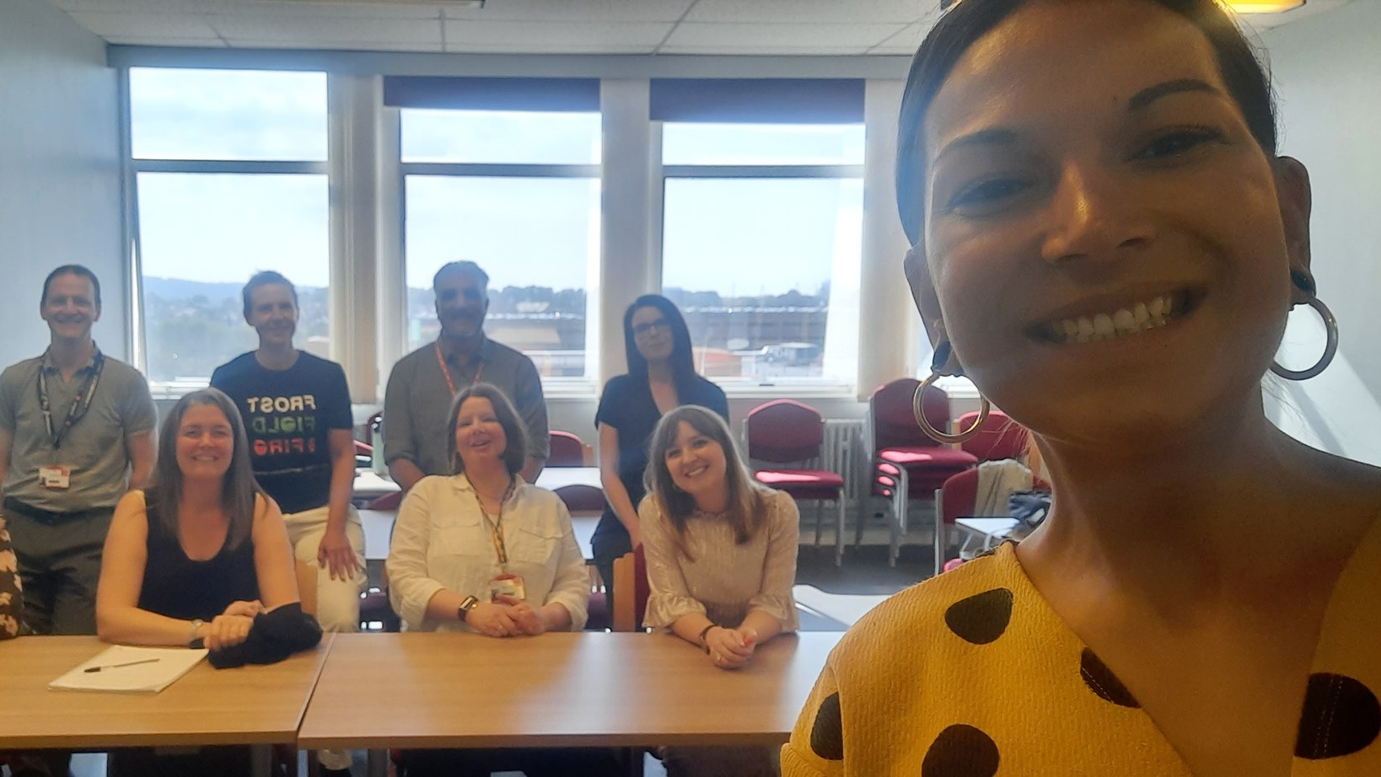
Developing an eLearning Module on Critically Appraising Antiracism: A Collaboration between Cardiff University and Ramona Naicker
Ramona Naicker, Sarju Patel, Lindsay Roberts and Delyth Morris
@Bakedbeanpizza, @SarjuPatel1969, @lkp75, @DelMorris
Notes:
Ramona to perform Acknowledgement of Country: I respectfully acknowledge the Wurundjeri People of the Kulin Nation, who are the Traditional Owners of the land on which I am located, and pay my respect to their Elders past, present and emerging.

Slide 2
Introduction
Background of Ramona’s work
Project aim
Rationale
Explanation of how the tutorial fits in with Year 1 MBBCh teaching
Development process
Tutorial content
Challenges/reflection
Student/staff impact
Next steps
Questions
Notes:
Ramona

Slide 3
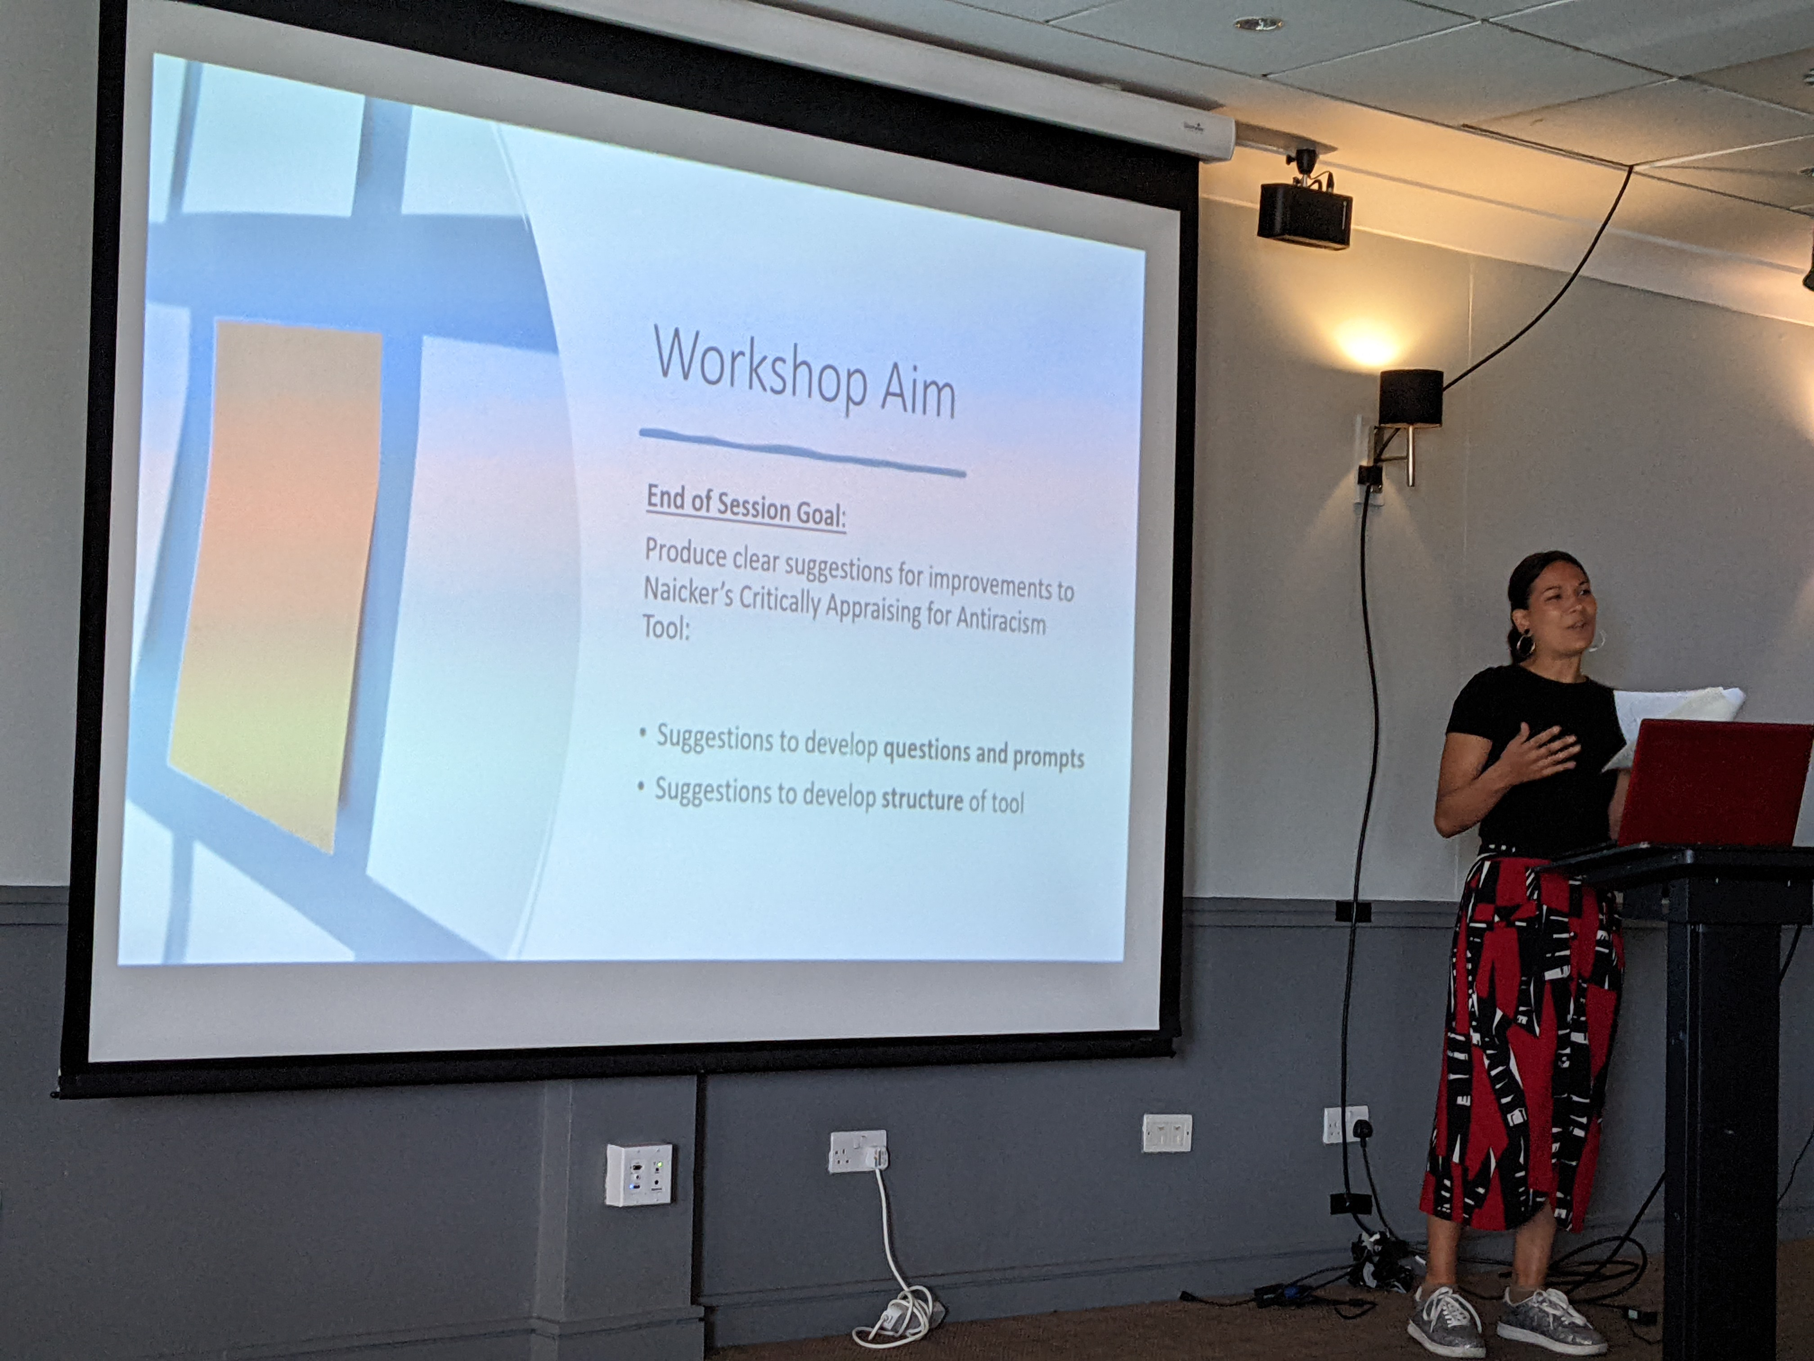
Background of Ramona’s work
Research into how racial bias impacts study validity and outcomes
Presented at UHMLG 2022 (incl. Train-the-trainer and tool workshop)
Created Naicker's Critically Appraising for Antiracism Tool
Approached by Cardiff University to develop eLearning module
www.criticallyappraisingantiracism.org/
Notes:
Ramona

Slide 4
Project aim
Create an eLearning module around Critically Appraising for Antiracism, aimed at 1st year UG medical students
Encourage students to go beyond the simplified view of race
Help medical students develop an understanding of the impact of race v genetic heritage on health outcomes
Notes:
Ramona

Slide 5
Rationale
We are a function of our environment
Institutional views
Impact on my research
Impact on my teaching
Impact on students
Notes:
Sarj

Slide 6
Explanation of how the tutorial fits in with Year 1 MBBCh teaching
Year 1
Literature projects
Year 2
Year 3
Year 4
Experience and themed projects
Scientific and clinical research skills
Year 5
Advanced senior research projects
Pathology project
Practical Research Experience: PhD Tutors
Evidence-based writing
Medical education
Audit
Service evaluation
Elective
Consolidate learning on improved patient care
Yr 2/5 Integrated conference
Yr ¾ SSC showcase
Yr ¾ SSC showcase
Yr 2/5 integrated conference
Phase 1
Year 5
Year 4
Year 3
Phase 2
CBL
Placements
Year 2
Year 1
Harmonisation
Notes:
Sarj

Slide 7
Development process
Ramona came to Cardiff for 2 days (thanks to UHMLG for providing financial assistance for this)
Began work developing storyboard for the tutorial
Ran session with academic staff to explain the ideas and the ideas for the tutorial
Continued to work remotely on developing the tutorial – meeting to discuss details and to discuss how we felt about the process
Discussed the storyboard with relevant people within the University including University Librarian, Head of Inclusive Curriculum, EDI Lead
Discussed specific papers to be used with relevant academics from psychiatry and pharmacology
Created draft xerte tutorial
Went live with version of tutorial to Year 1 MBBCh students in February
Amended public version of tutorial and went live in March
Notes:
Lindsay

Slide 8
Content of the tutorial
Tried to add as many activities as possible to make it interactive
Starts with a reflection – to introduce the idea that race is a social construct
“Race is not a biological category that naturally produces these health disparities because of genetic difference. Race is a social category that has biological consequences… because of the impact of social inequality on people’s health.”
3 main areas:
under-representation in research,
health disparities
biology as a proxy for genetic ancestry
Give the explanation, show example in a paper and then show real world consequences
Notes:
Lindsay

Slide 9
Challenges / reflection
Fantastic experience of cross-sectoral working and working with academic
Steep learning curve for University Librarians – lots of reading and reflection
For University Librarians uncomfortable moments including whether it was right for us to do this work (but fantastically supported by the other members of the project)
Under-estimated the amount of time it would take to complete
Very useful opportunity to talk to different people across the University
Notes:
Lindsay

Slide 10
Student / Staff Impact
really important to consider race and ethnicity when conducting research. we ought to be open minded and well versed in the healthcare of all types of patients as future clinicians
Teaches how to look at each literary piece from a third person perspective and look for bias within texts.
I think as a new generation of medics we should be very aware that race alone is not enough to have an increased or decreased risk factor for a disease.
I thought it was interesting to think about the effect of racism/prejudice/bias on different ethnic groups as this may not be highlighted and taught in a hospital setting or in person during medical school.
This tutorial made me think about the standard of treatment that I may receive compared to other people in society and has made me realise the importance of accurate representation of minoritised ethnic populations in research.
Notes:
Sarj

Slide 11
Next steps
Public version:
https://xerte.cardiff.ac.uk/play_19619
'Advanced' version
Publication
Notes:
Ramona

