Slide 1
3rd International Congress of Health Education and Research & AoME Annual Academic Meeting: INHWE/AoME
"RAISING AWARENESS OF VITAMIN D: THE ROLE OF PUBLIC HEALTH INITIATIVES IN THE PROMOTION OF INTERDISCIPLINARY LEARNING” Date: Tuesday 27 June 2023. Abstract: 25. Theme: Health Improvement.
S/L Diana De, Medical Student Kendra-Jean Nwamadi, S/L Sarju Patel, Professor Paul Brennan, Cardiff University
Notes:
Who can tell me what the importance of Vitamin D is?

Slide 2
Background: Vitamin D
Global variations in Vitamin D status (National Library Medicine 2020)
1 out of 3 UK adults tested for Vitamin D were deficient (Crowe et al 2019)
Low levels in certain ethnic groups (Lin et al 2021)
British Nutrition Foundation 2021 revealed that 29% of UK adults were unaware of UK Government Guidelines for Vitamin D
Everyone >1yr in the UK should consider a daily supplement of vitamin D (10mcg/IU/day) especially during the autumn and winter months (Public Health England 2016, NICE 2020)
Maintenance of strong bones and teeth
Optimises calcium absorption
The role of Vitamin D
Promotes a healthy immune system
Supports normal muscle function
Produced naturally in the skin in response to sunlight

Slide 3
Groups who are at risk of Vitamin D deficiency are advised by UK Department of Health to take a supplement all year round!
Vitamin D can also be sourced and supplemented by foods.
Vitamin D: The sunshine vitamin

Slide 4
Food sources of vitamin D
Oily fish such as salmon, sardines and mackerel. Cod liver oil also contains a lot of vitamin D.
Egg yolks
Chicken
Lamb
Some foods are fortified with vitamin D, such as breakfast cereals, margarine spreads, yoghurts and juices.
Look out for the ‘fortified with vitamin D’ label next time you go to the supermarket.
Vitamin D: The sunshine vitamin
Notes:
Explain to the audience that vitamin D is found in oily fish such as salmon, sardines and mackerel, chicken, lamb and egg yolks. Also mushrooms and honey.

Slide 5
Background
During the pandemic, and the push towards online learning, the African-Caribbean Medical Association (ACMA) Cardiff noticed there had been limited opportunities for:
1
Students to learn inter-professionally
2
Students to engage in public health activities

Slide 6
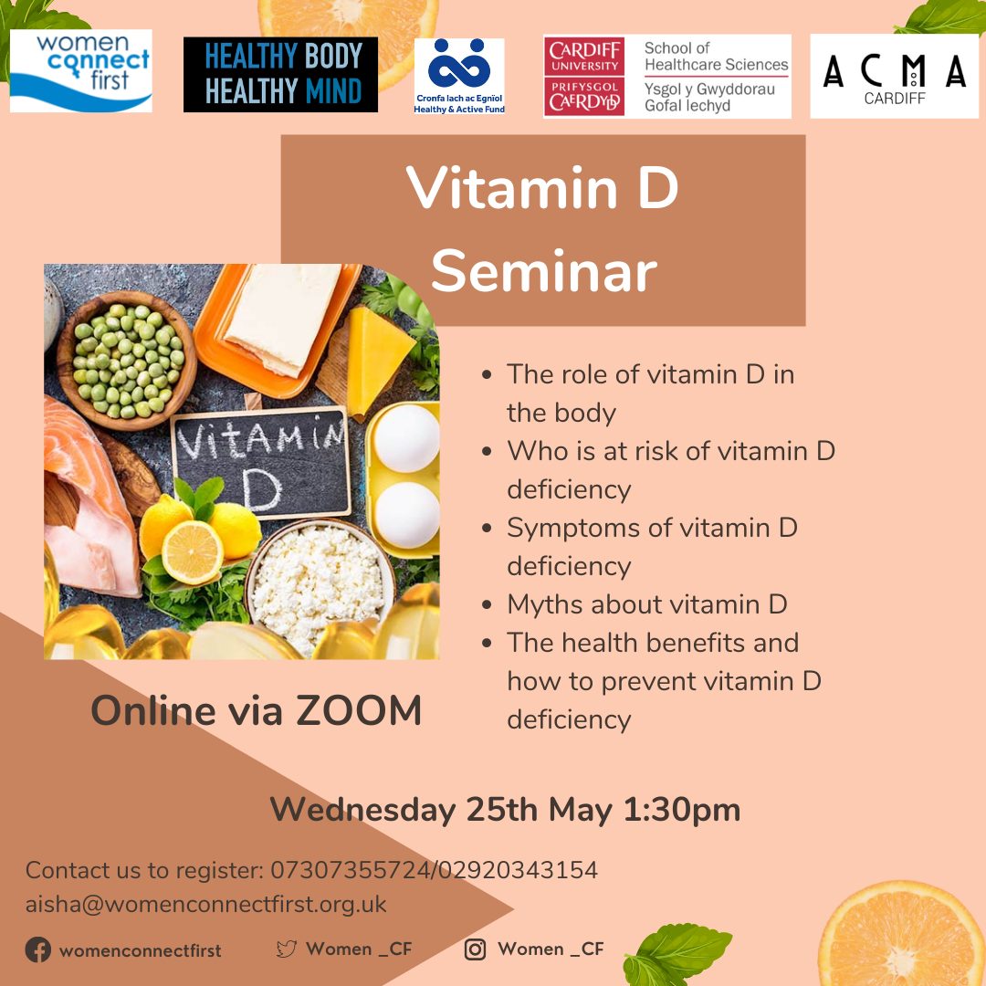
Two IPE Events
Public health involves every healthcare professional

Slide 7
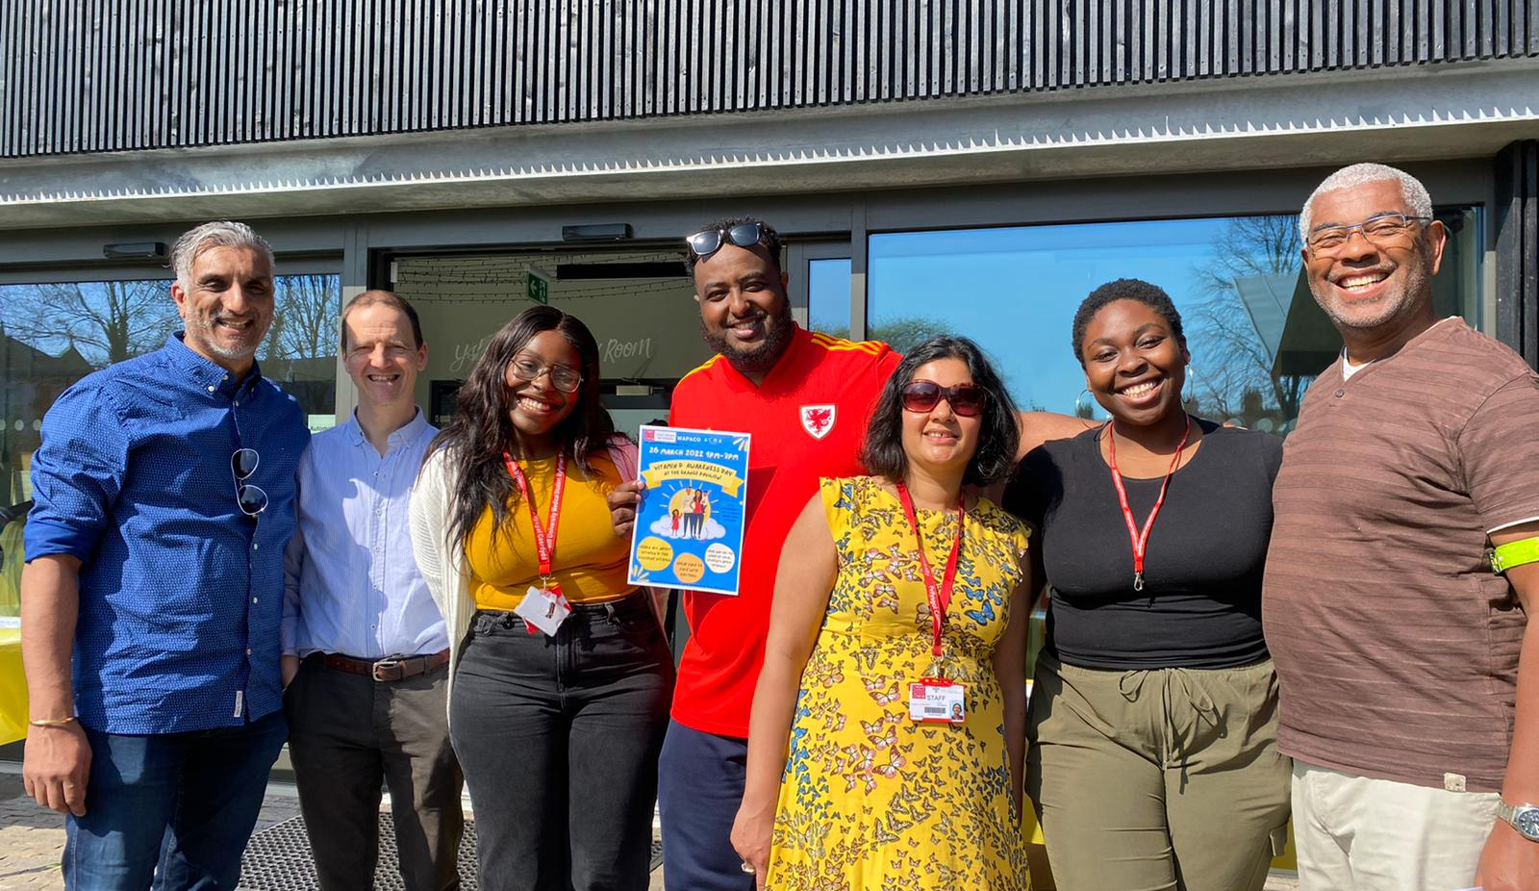
Meet the interdisciplinary planning committee!
Ali Abdi
Prof. Paul Brennan
Chiamaka Dibigbo
Dr. Sarju Patel
Kendra-Jean Nwamadi
Dr. Jeff Allen
Diana De

Slide 8
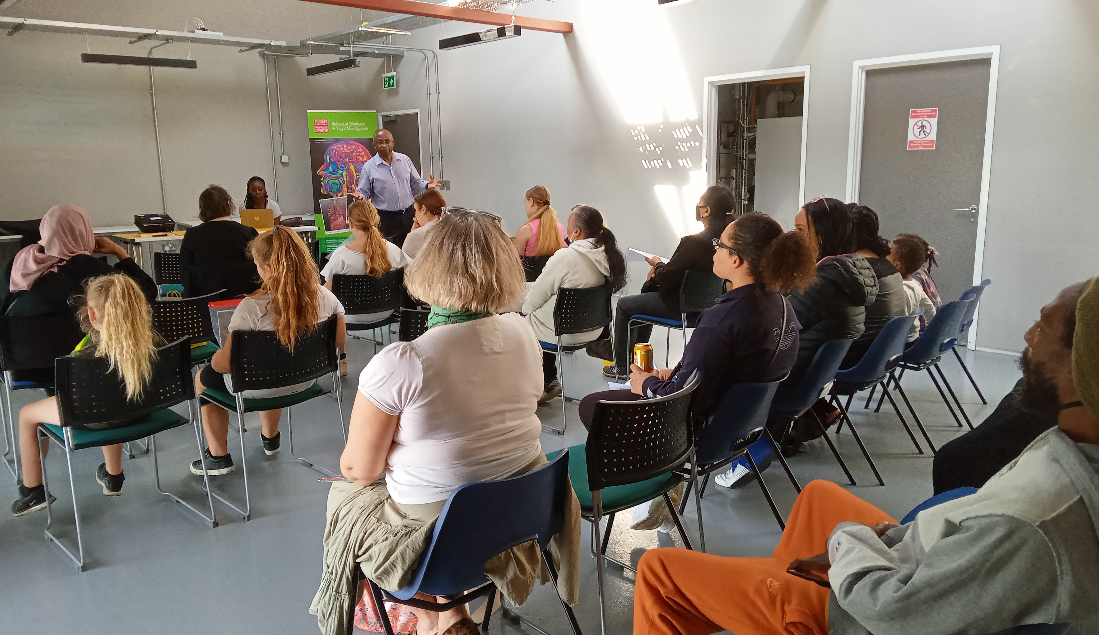
Sixth-Form students
Journalism students
Nursing students
Clinical experts
Medic and nurse educators
Inter-professional Learning
IPL opportunities are thought to assist health students to work in a more collaborative, patient focused manner during their career (Wakely et al, 2013)
There are barriers to community-based IPL
(Lueberrs et al , 2016).
Medical and Biomedical students

Slide 9
Student Feedback
“I spoke to several people who understood very little English. It made me reflect on how these patients are able to access healthcare services and communicate with healthcare professionals, with and without a translator being present.”
“The event opened my eyes to the greater scale of medicine as a means of disease prevention and the steps I will need to take in future in supporting minority groups.”
“I now have first-hand insight about the importance of understanding the barriers people face when accessing healthcare.”
“As a uni student you don’t get to be involved much with the local communities. I think we should definitely do more events like this!”

Slide 10
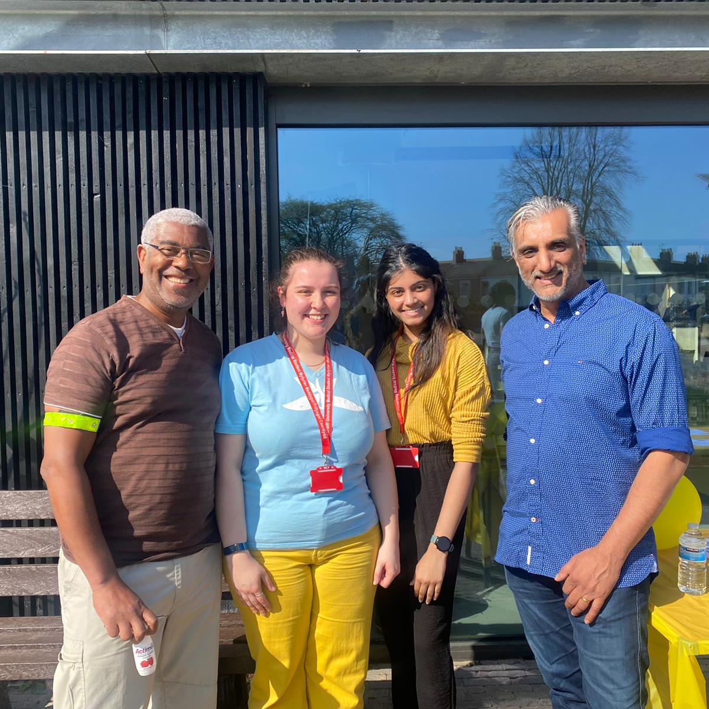
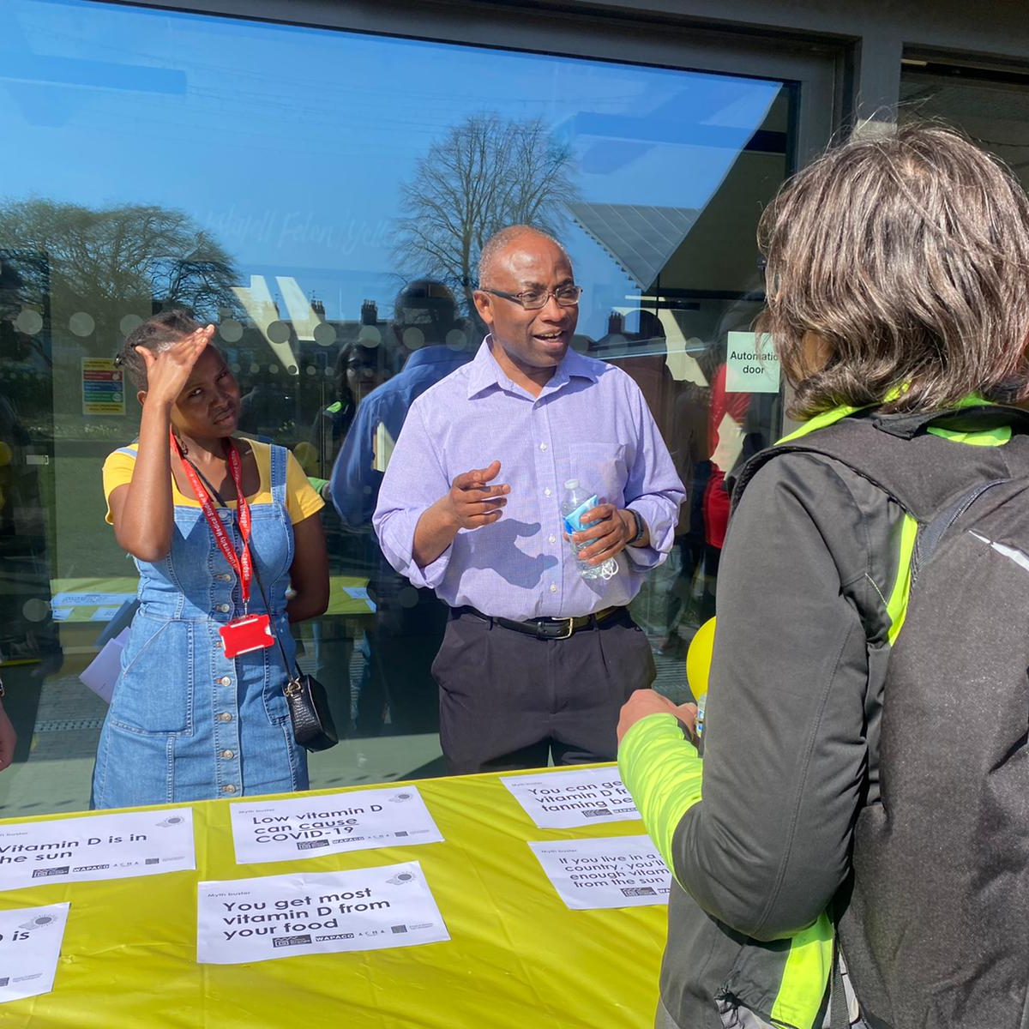
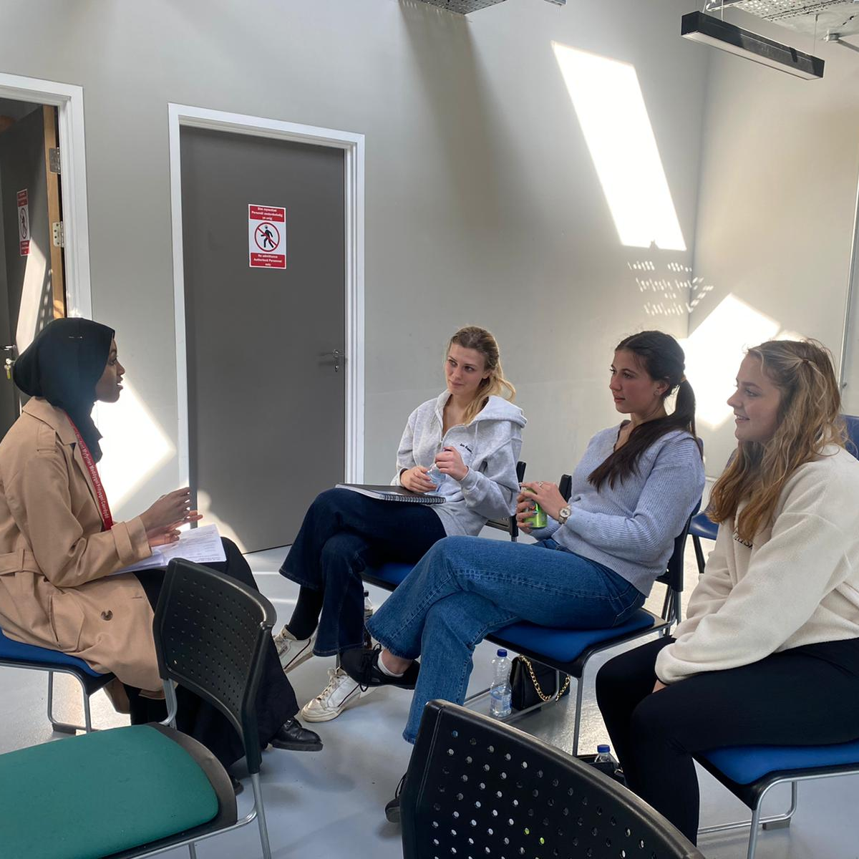
Student Feedback
“I was amazed at the interprofessional engagement between students. There is nothing like this at my university.”
Community Response
A lot of my family have vitamin D deficiency
"I used to get dizzy really quickly, I had really pale skin and my hair was falling out. I went to the doctor.
Now that I take vitamin D supplements, I have more energy.”
“We learn about vitamin D in my country, Eritrea. I’m not sure about taking supplements yet but I will certainly work on my diet. But, coming to this event, I now know I can get vitamin D from supplements."

Slide 11
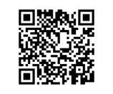
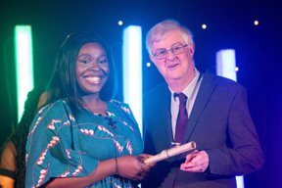
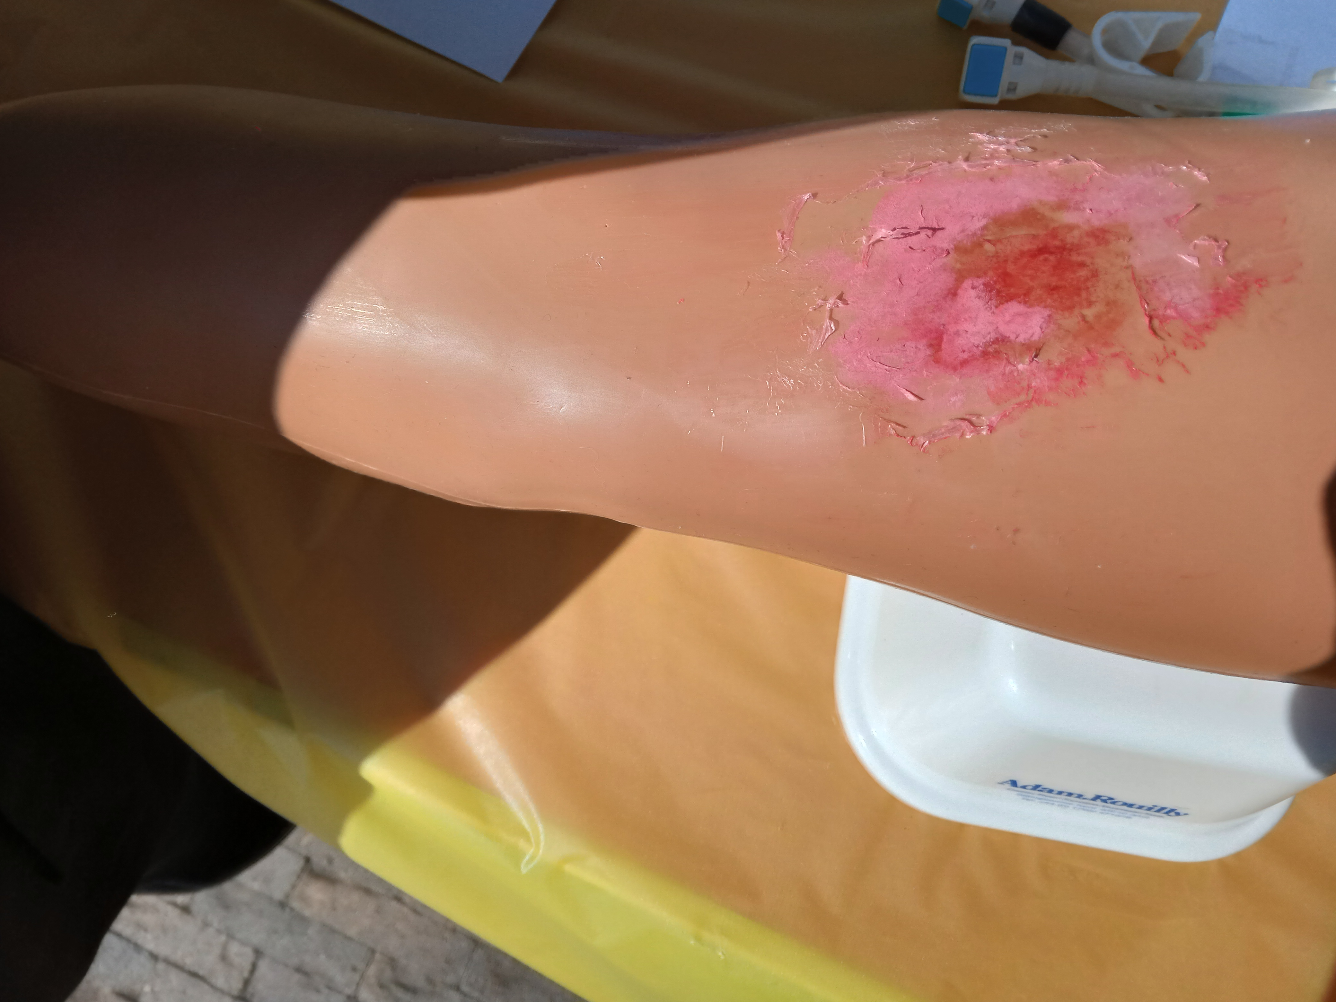
Our Journey 22/23..
Prison Health
Recognition of the value of Inter- professional community engagement activities and in widening participation reach (Forte & Fowler, 2009)
Enriching pedagogy and citizenship
Continuing Professional Development
Power of Mentorship in Leadership
Ethnic Minority Welsh Women in Healthcare Association Mentorship
EMWWAA Rising Star Finalist 2022
HEIW Showcase 2023
The Gwella Project 2023
Learning and teaching conference 2022
Moulage

Slide 12
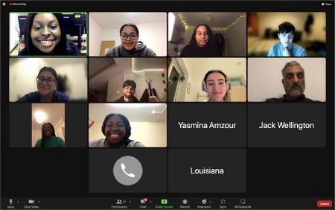
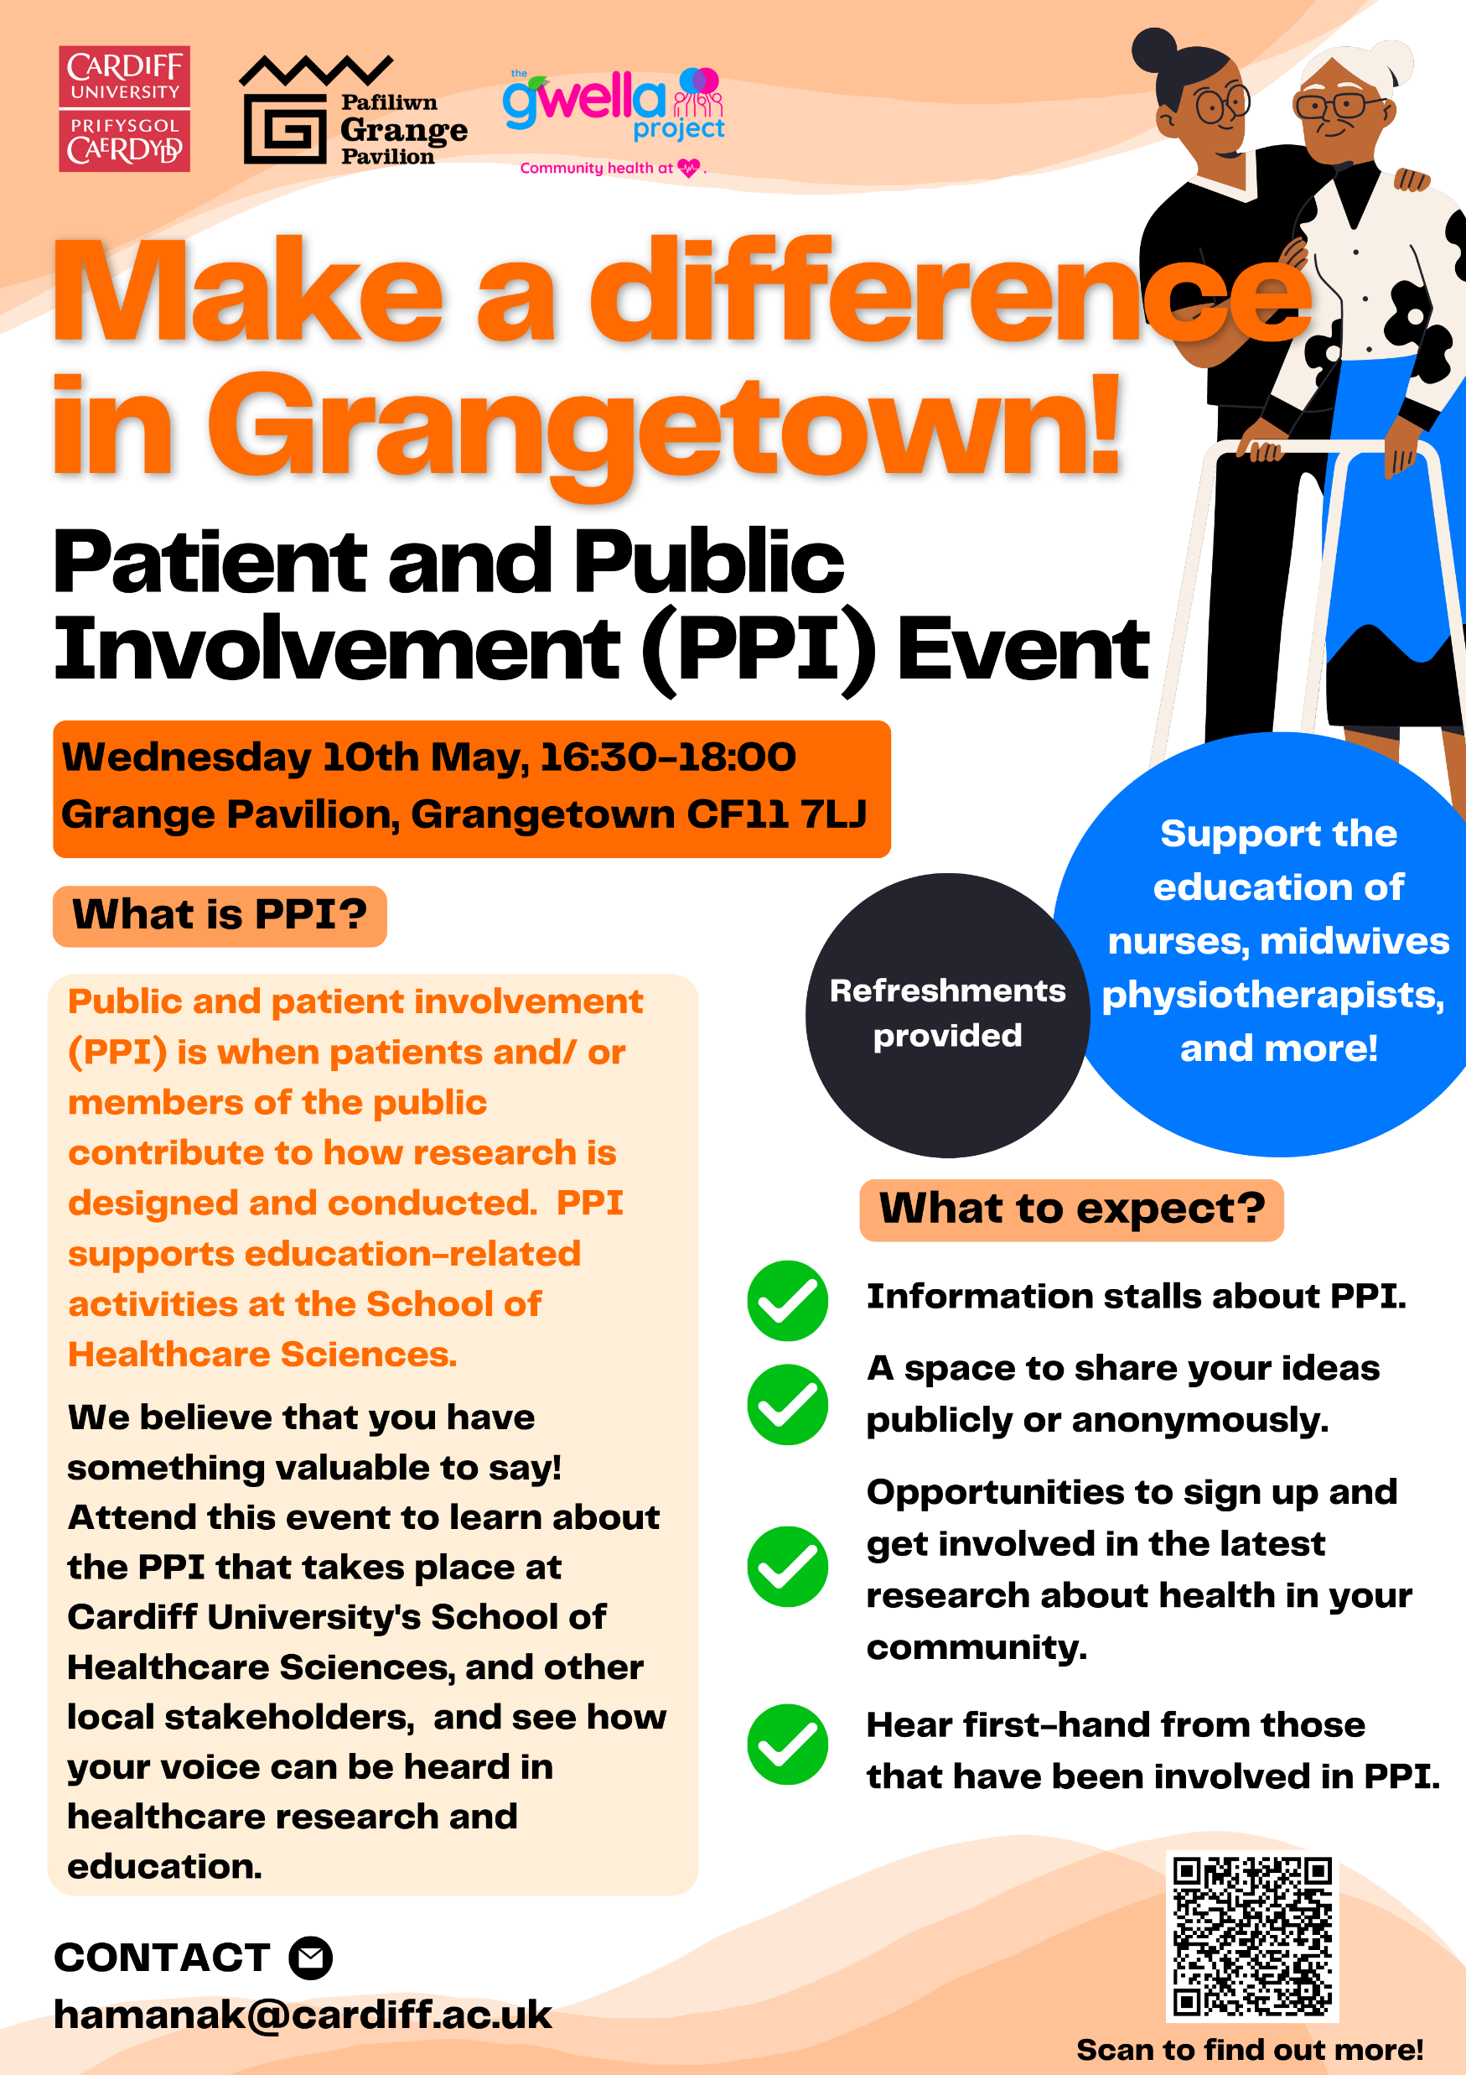
Our journey: 2022/23 and beyond

Slide 13
Empowering all students forms part of our civic mission…
IMPACT: It feels good when your ideas are validated!.
Vitamin D PODCAST Email: DeD@cardiff.ac.uk Email: nwamadikj@cardiff.ac.uk

