Slide 1
Mind The Gap
Scan the QR code for more info or visit:
www.mindthegap-edi.com
A Cardiff Futures Initiative
Scan the QR code for more info or visit:
www.mindthegap-edi.com

Slide 2
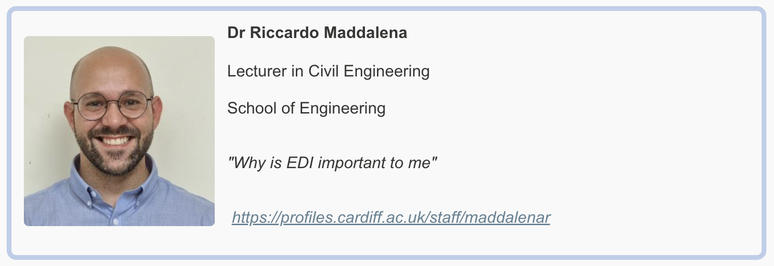
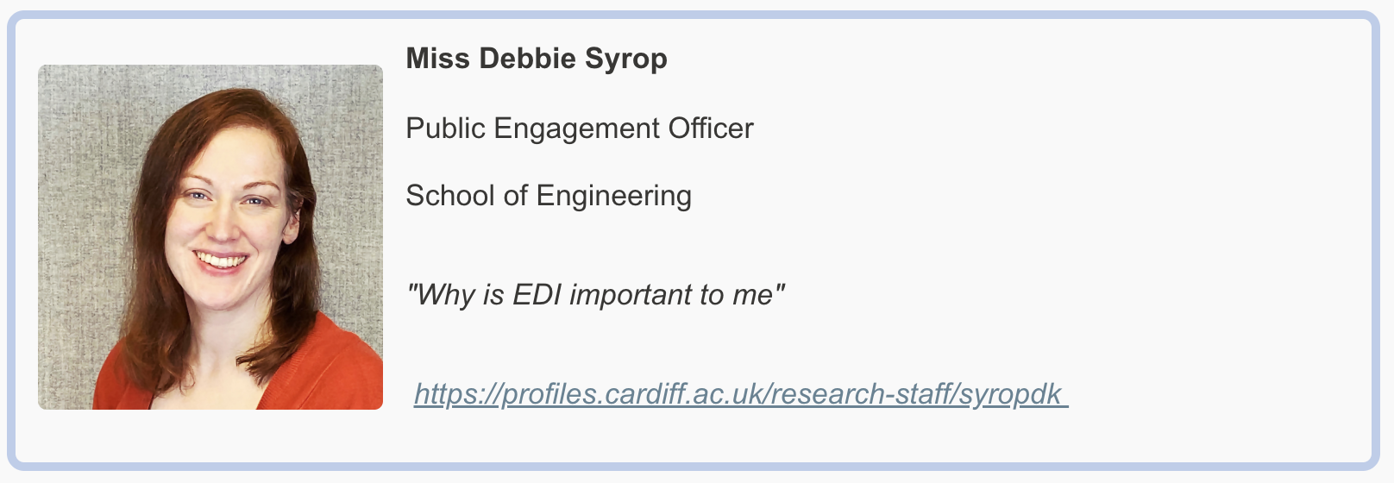
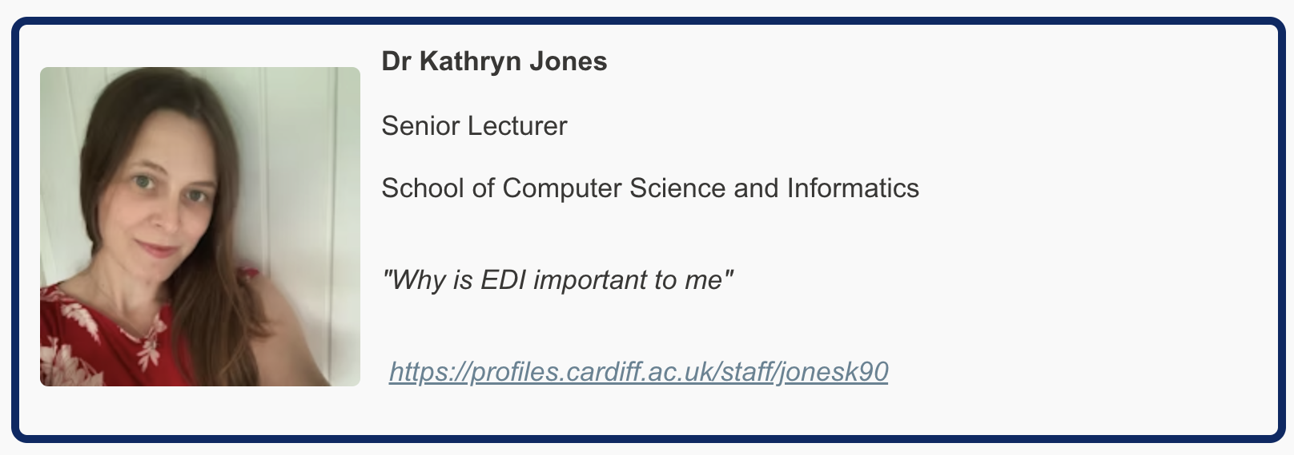
The Team

Slide 3
The EDI Challenge
There exist barriers or challenges that prevent open EDI conversations
Cardiff University are committed to supporting, developing, and promoting these three topics throughout all their practices and activities, and we believe that there is a need for addressing the fears behind discussing these topics, due to their sensitivity

Slide 4
Bridging Conversational Barriers
Mind the Gap is a set of playing cards that provide discussion prompts covering a range of potentially sensitive equality, diversity and inclusion topics
These cards were designed with the support and advise from marginalised individuals, and they aim to provide a way for people to overcome their nervousness when discussing these topics
The aim of the game is to encourage conversations about EDI

Slide 5
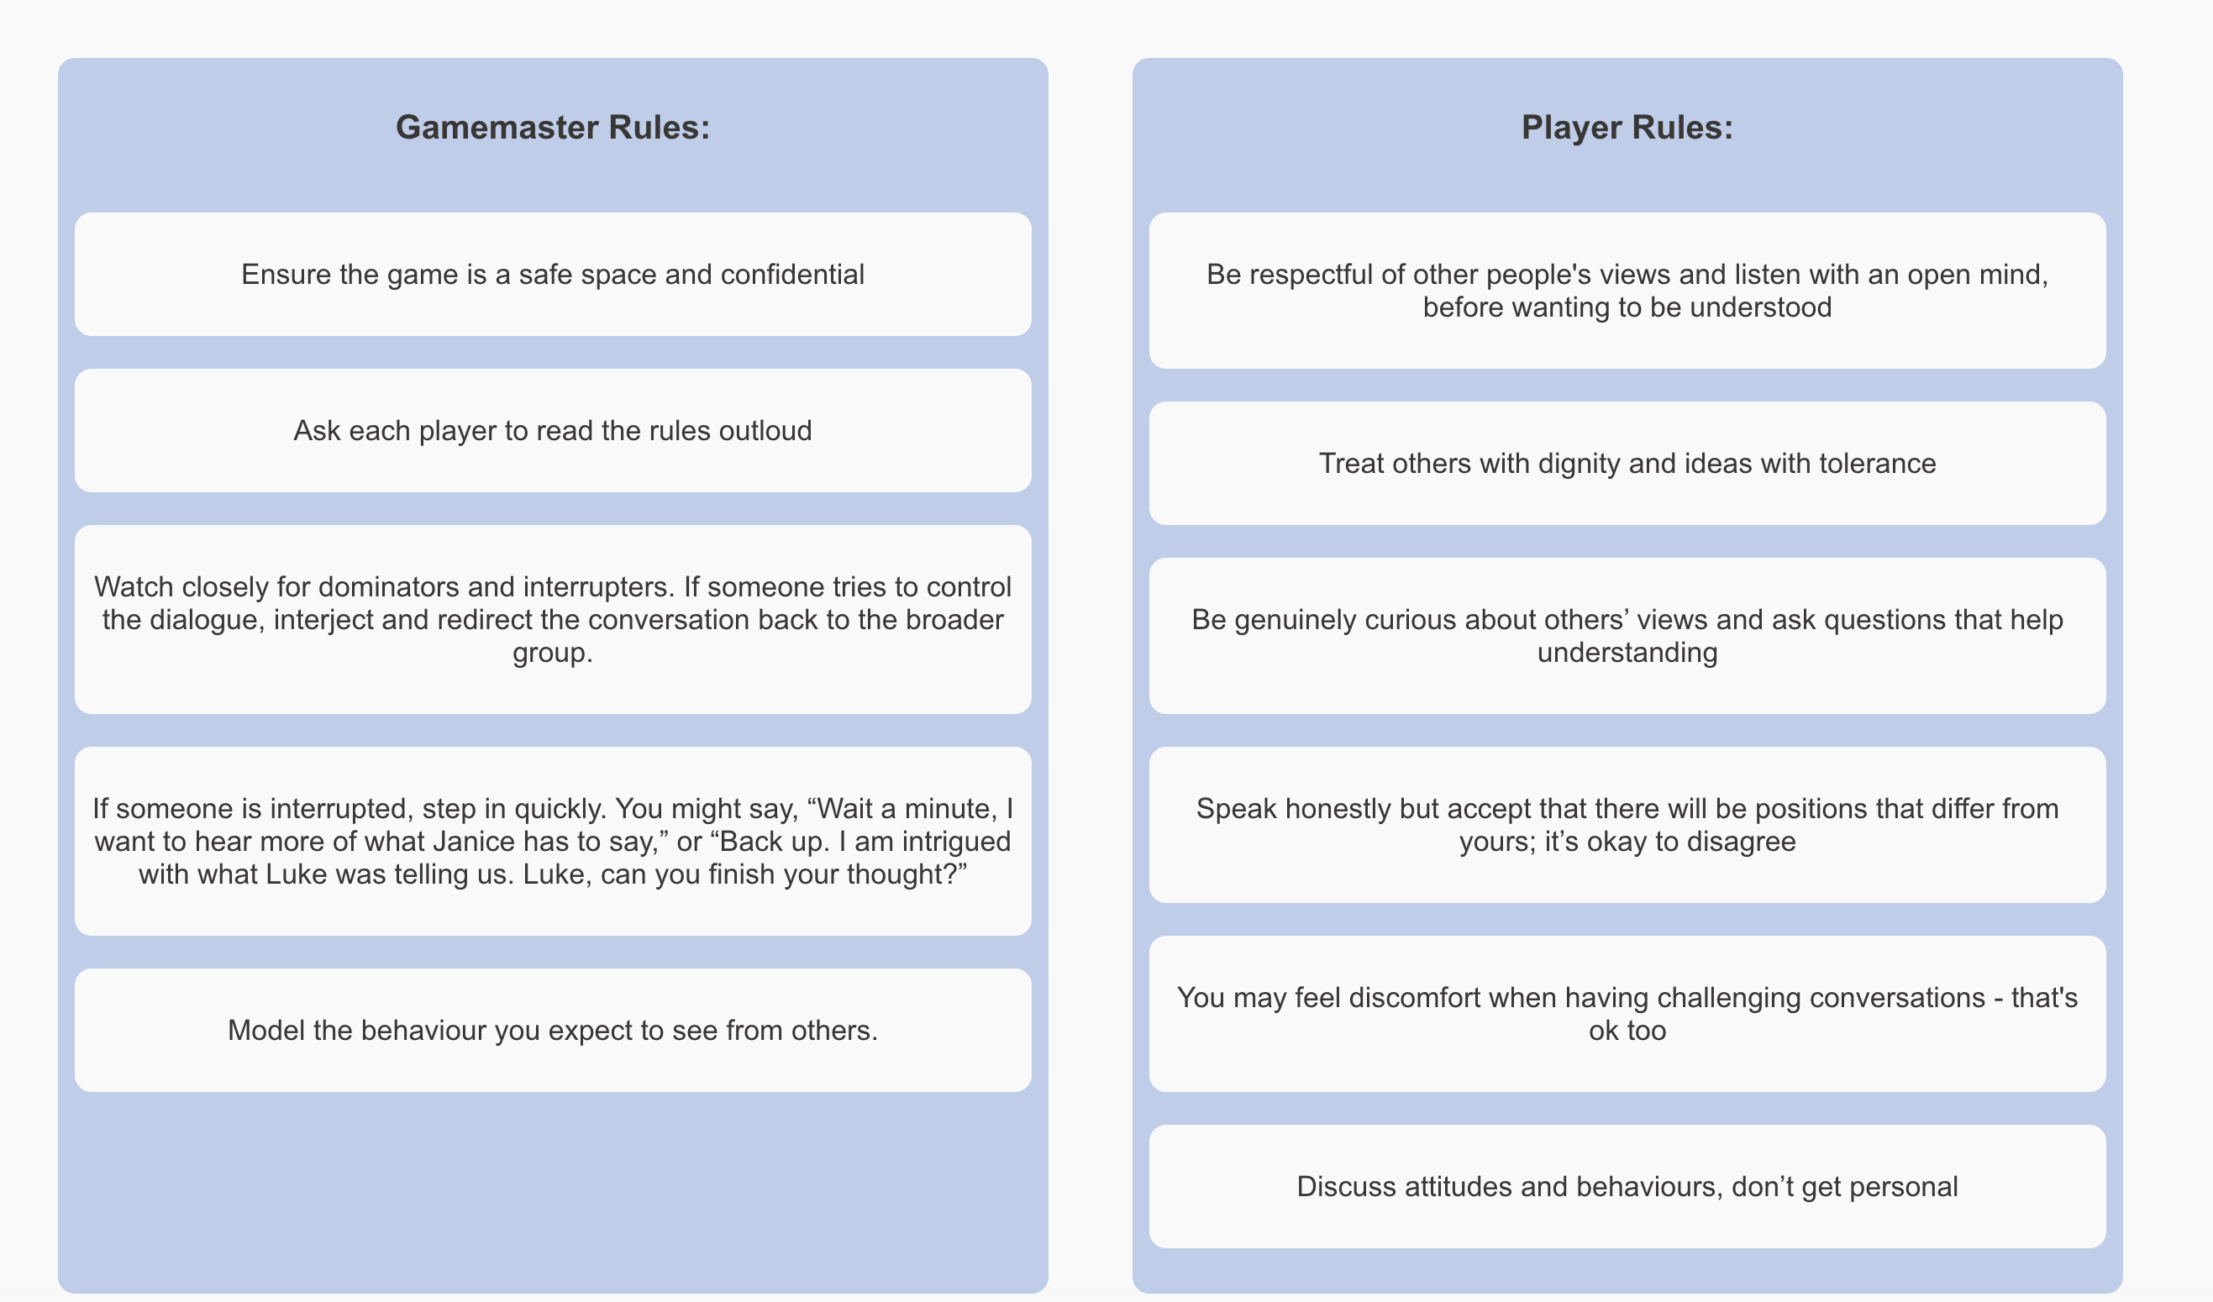
How "Mind the Gap" Works
target audience (university staff and students)
One by one, each player will pick a card and present it to to the room.
The player reads out the instructions on the card and then the room may discuss the topic that was randomly selected

Slide 6
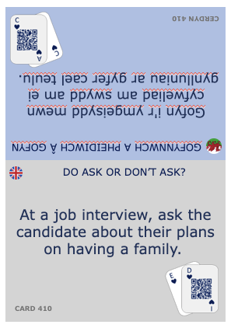
The Cards – some examples

Slide 7
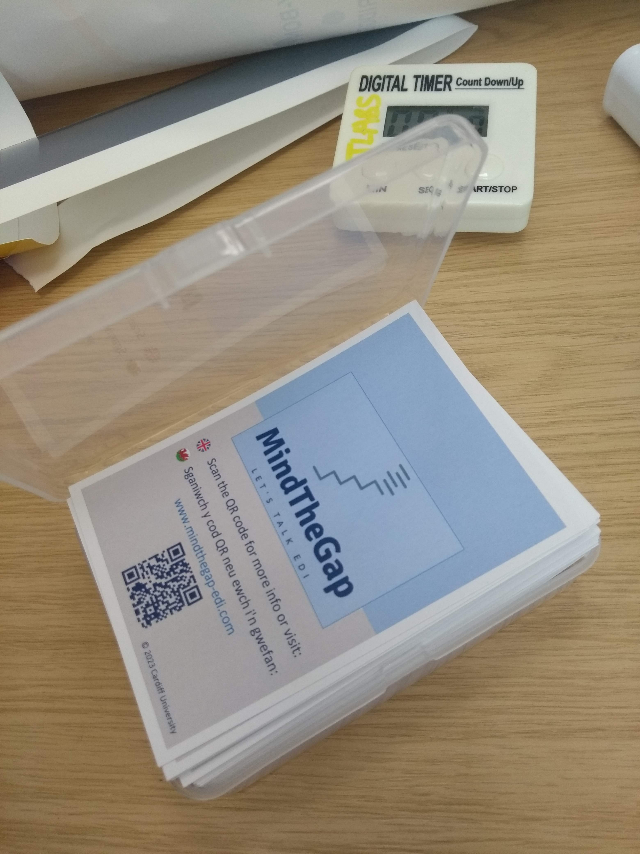
Focus Groups

Slide 8
Mind The Gap – Web site
Developers
This website is an additional resource to the game, providing supplementary guidance notes and background information around each card to further guide the discussion topics. We also want to gather more feedback from the wider community regarding the cards, so this website also allows user feedback that’ll allow us to improve the prompts, guidance notes and background information surrounding existing cards.

Slide 9
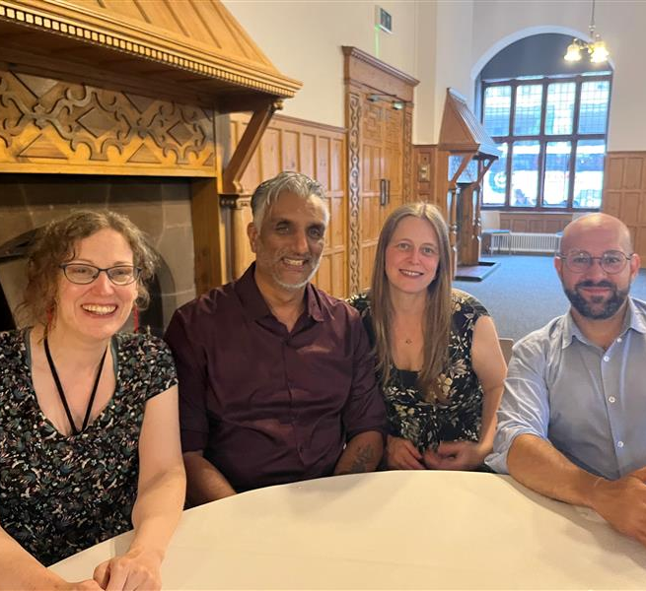
Next Steps…
It is important to foster EDI conversations
Talking to the EDI Hub about how this can be used at Cardiff University
Possible workshop at the Advance HE EDI Conference

