Slide 1
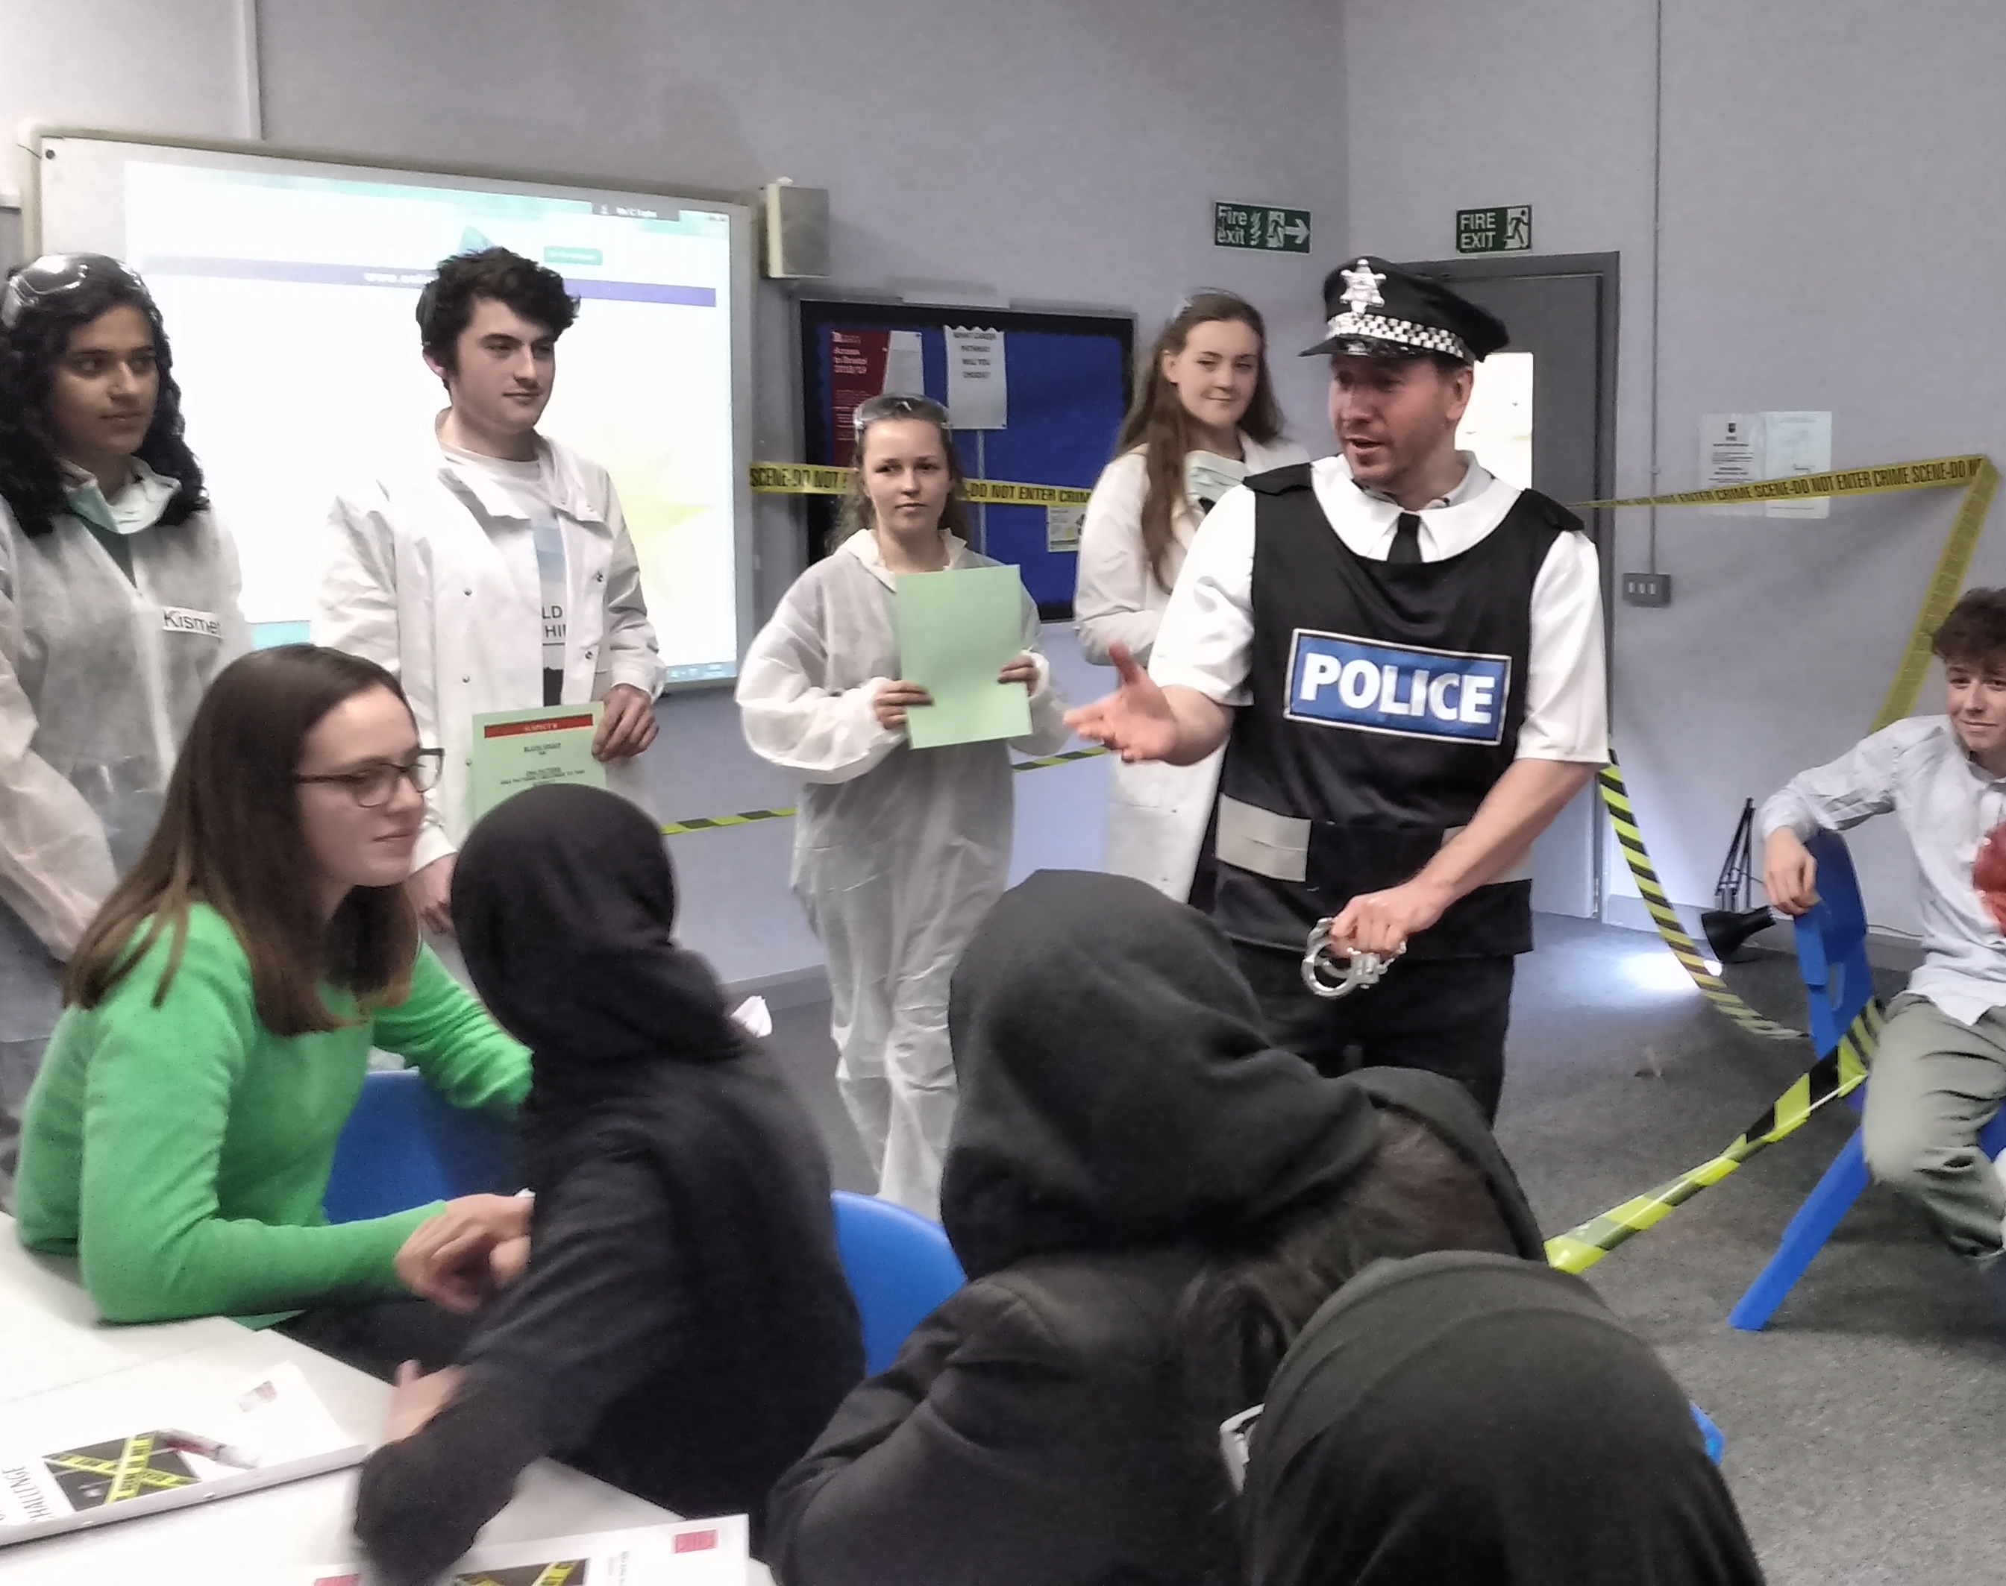
Promoting Academic and Community Excellence: Grangetown Project
Dr. Sarju Patel, Dr. Jeff Allen, Dr Jui Vyas, Dr Katja Umla-Runge ​

Slide 2
Our aims
1. Inspire pupils to see University as a possibility
2. Help pupils to gain entry to University
3. Recruit role models to help inspire pupils
4. Supplement the teaching in schools with medical students acting as tutors to raise grades
5. Mentor pupils through the University application process

Slide 3
Project Overview
Intervene during pre-GCSE/GCSE years to support and stimulate academic development and encourage aspirations
Inspire pupils from minority/disadvantaged backgrounds to see University as an option
Mentor, be tutors, light the path ahead
Teach, working with schools to achieve a common goal

Slide 4
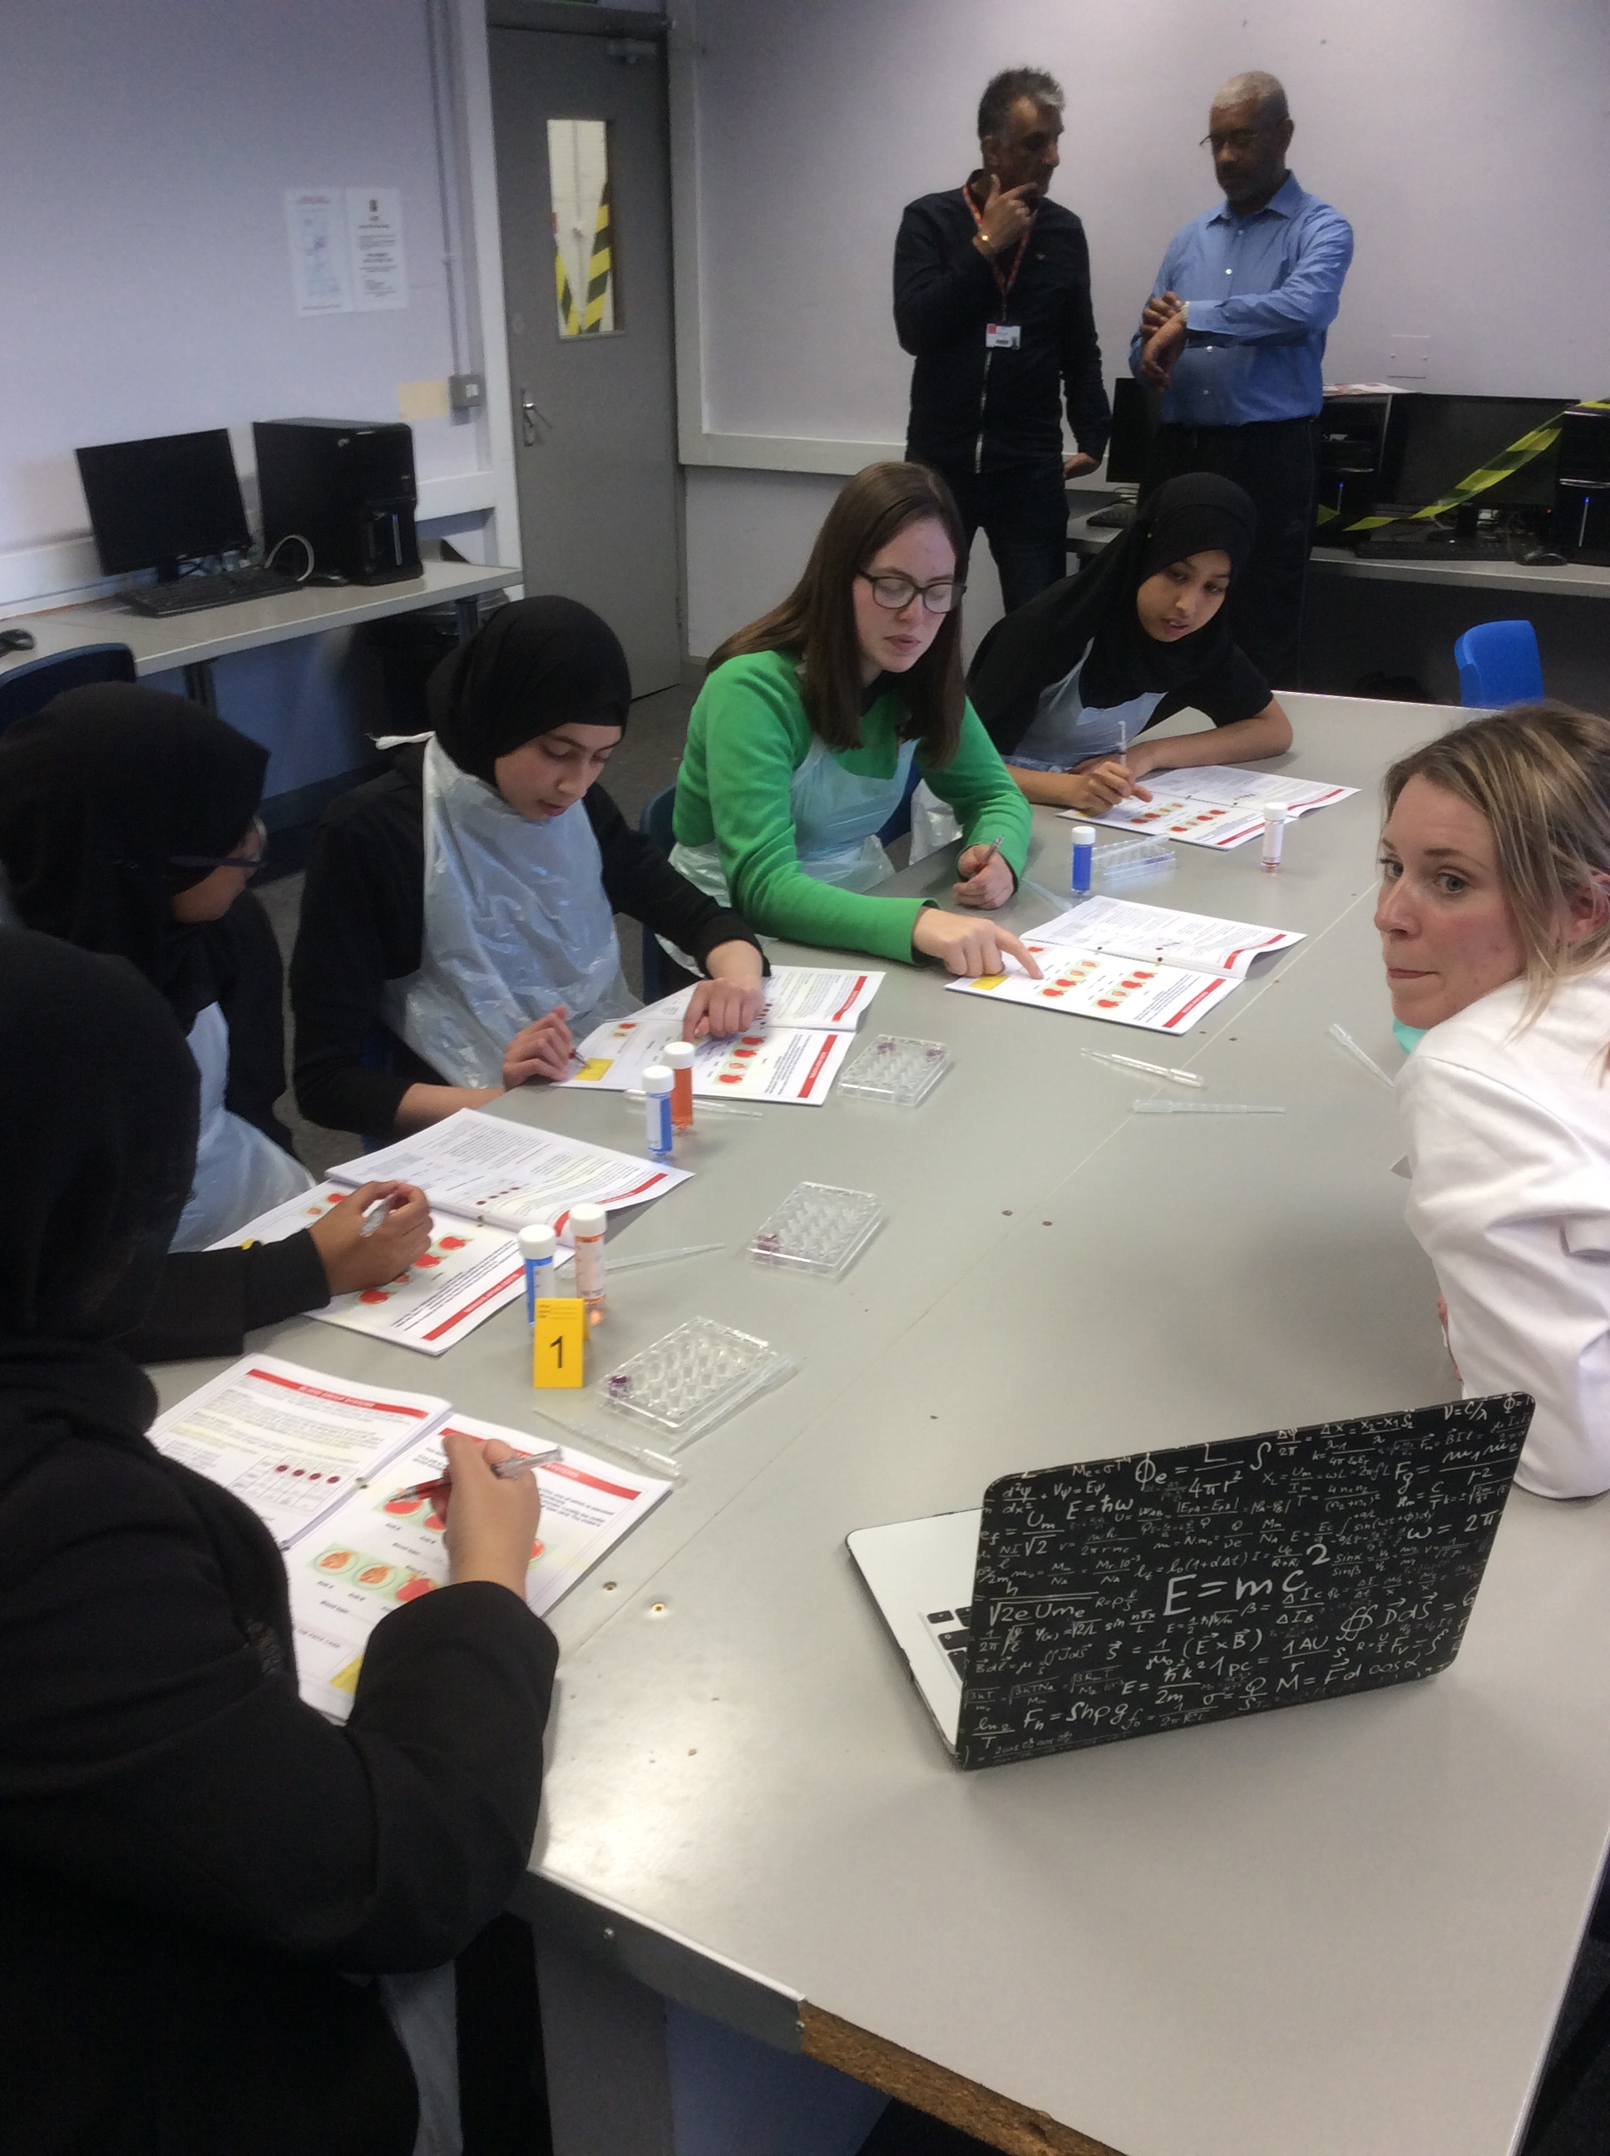
Key roles: SCHOOLS
Monitor school students,
Provide topic area guidance – work streams,
Provide focus on STEM areas,

Slide 5
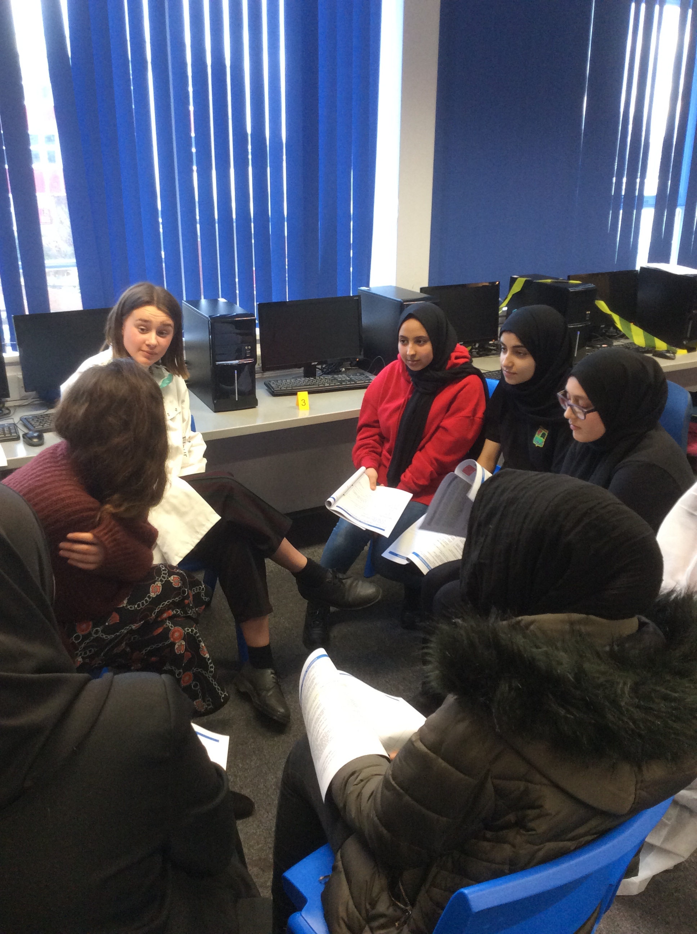
Key roles: MEDIC
Monitor our undergraduates’ engagement /workloads,
Develop teams for undergraduate support,
Monitor wellbeing,
Provide support eg with STEM focus
Support with, for example, campus visit sessions,

Slide 6
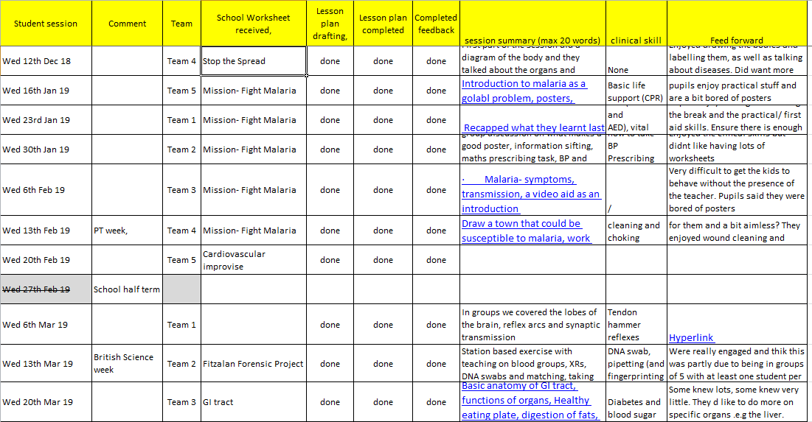
Session themes
Topics we have covered:

Slide 7
Feedback
What do you enjoy most about the sessions?
Discussing and learning The practicals Presenting our ideas to everyone Socialising and learning new things Socialising with other people Learning things in great detail Learning about the volunteers and university Learning with my friends The drinks Meeting the university students and learning about the world of medicine Learning about medicine and meeting new people The games The tea Group work and games Working with my friends
What do you enjoy the least?
Sometimes boring when discussing Location Everything is just right I enjoy everything Everything is good Not having Harry and Tyler every week as our tutors I don’t like presenting in front of everyone Working in a group
1. From pupils
2. From students
3. From school
4. From parents
Notes:
From school – comments from Fitzalan Curriculum Access Team Leader (Ms Carol Taylor) and the Fitzalan Science lead (Ms Steph Bevan).
From parents – comment about the admissions evening
ALSO - Clinical Skills Team (Ms Sian Williams Clinical Procedures Lead & Dr Anna Sillars Clinical Skills Tutor).

Slide 8
What’s in it for me?
Notes:
From school – comments from Fitzalan Curriculum Access Team Leader (Ms Carol Taylor) and the Fitzalan Science lead (Ms Steph Bevan).
From parents – comment about the admissions evening
ALSO - Clinical Skills Team (Ms Sian Williams Clinical Procedures Lead & Dr Anna Sillars Clinical Skills Tutor).

Slide 9
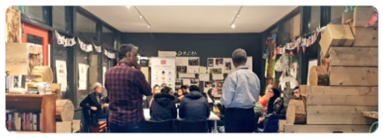
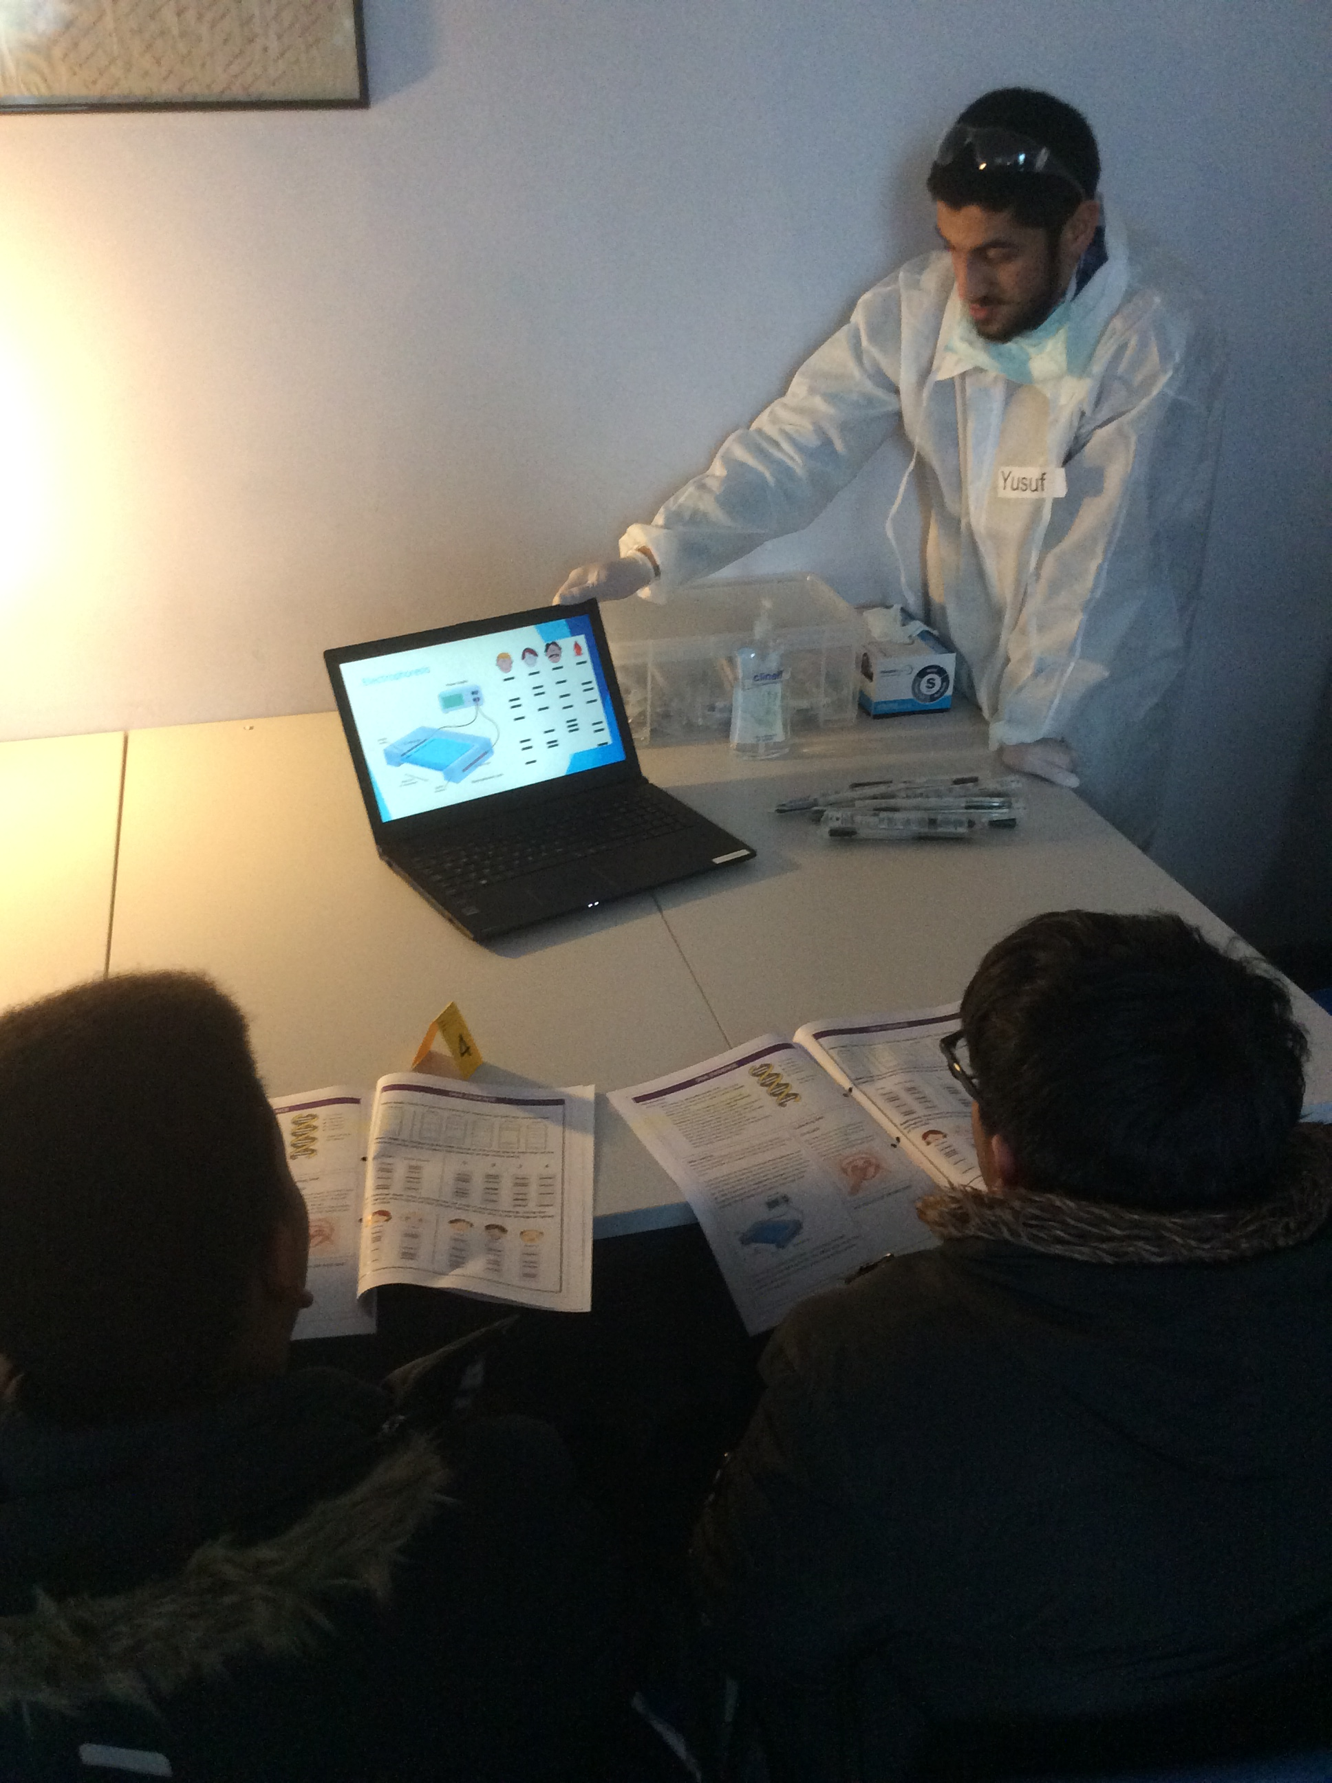
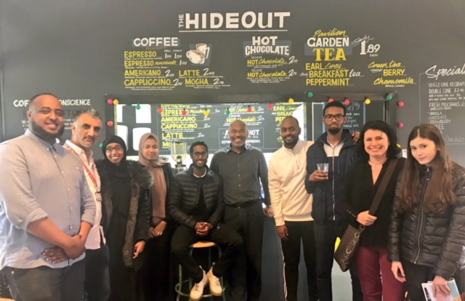
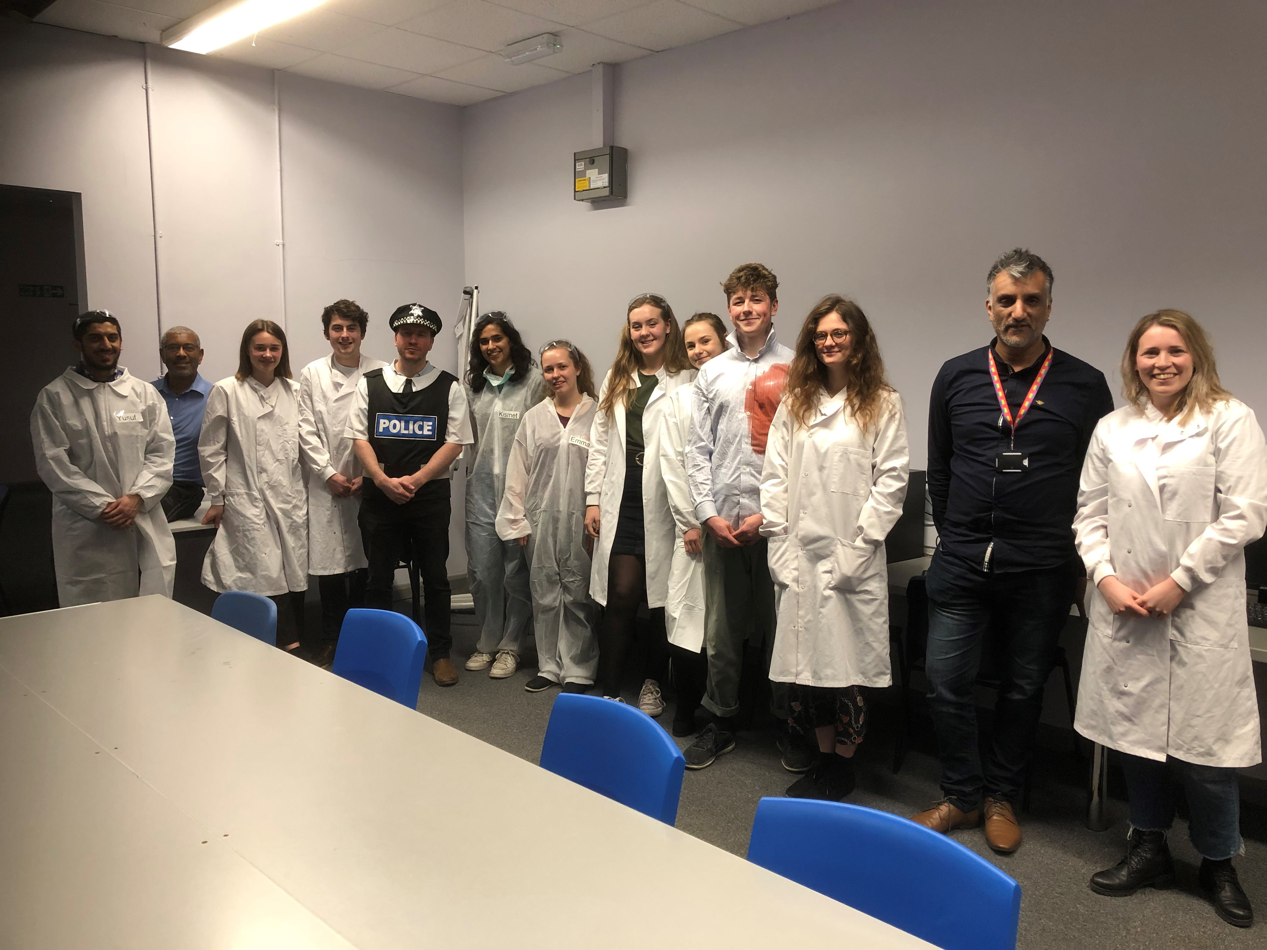
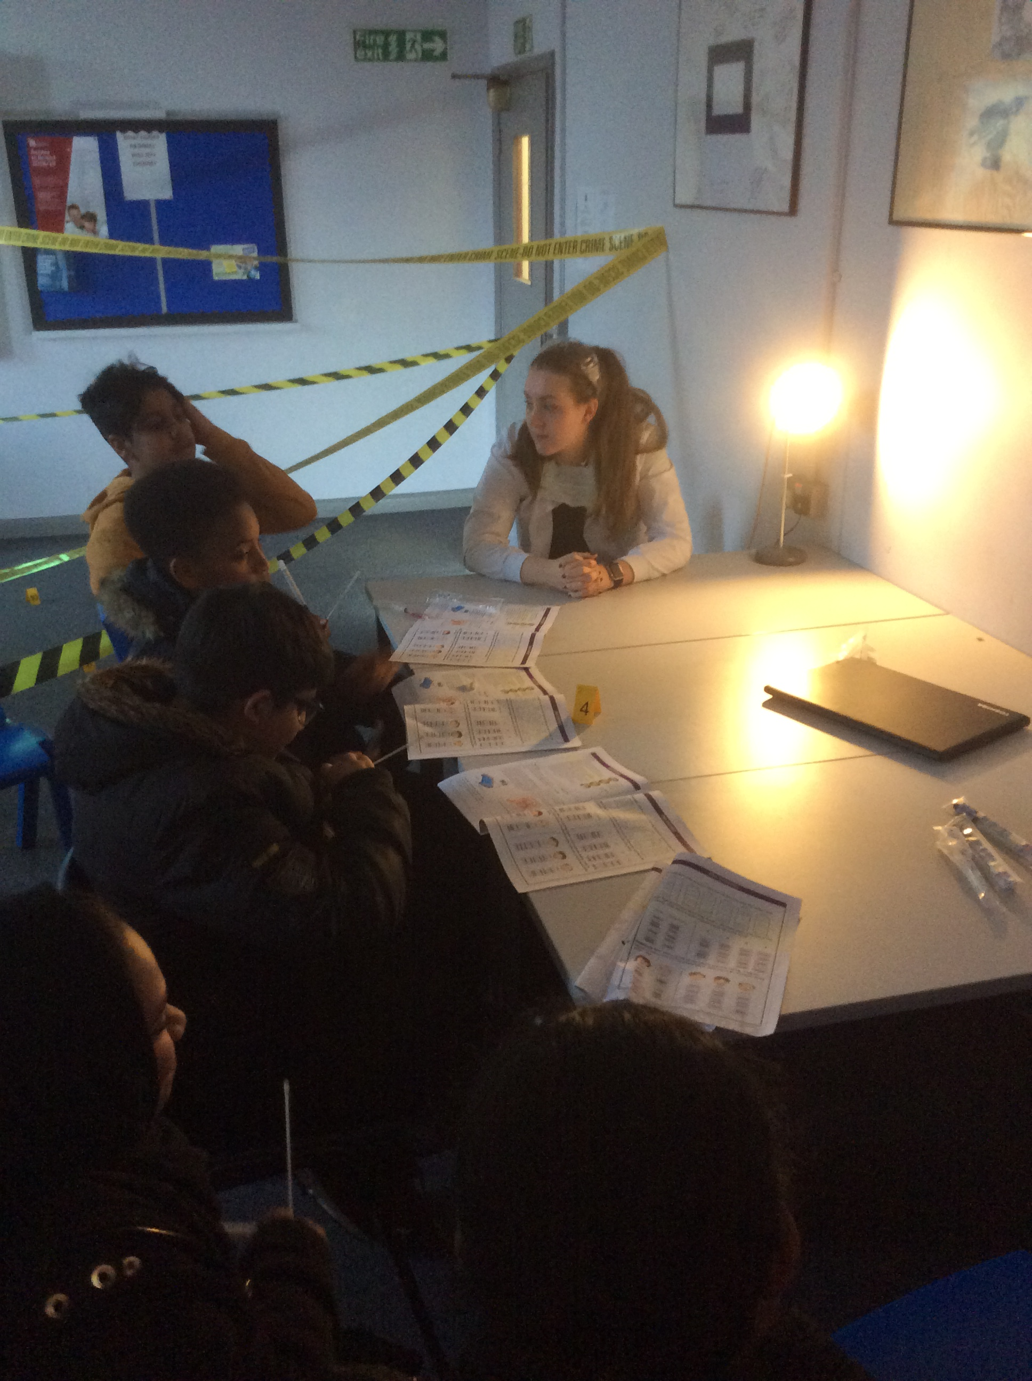
Images
1. From sessions

Slide 10
Feedback/Questions
?

Slide 11
Data Protection
For the purposes of this survey Cardiff University is the data controller. We are collecting this data to acknowledge your wish to participate in the PACE project. All data collected in this survey will be held securely by and retained by the Cardiff University School of Medicine in accordance with the Data Protection legislation. Data from the survey, including answers to questions where personal details are requested, will only be used by PACE project management group. For further information on how the University collects and uses your data, including your rights, can be found in the Student Data Protection notice at:
https://www.cardiff.ac.uk/public-information/policies-and-procedures/data-protection/student-data-protection-notice
Cookies, personal data stored by your Web browser, are not used in this survey.

Slide 12
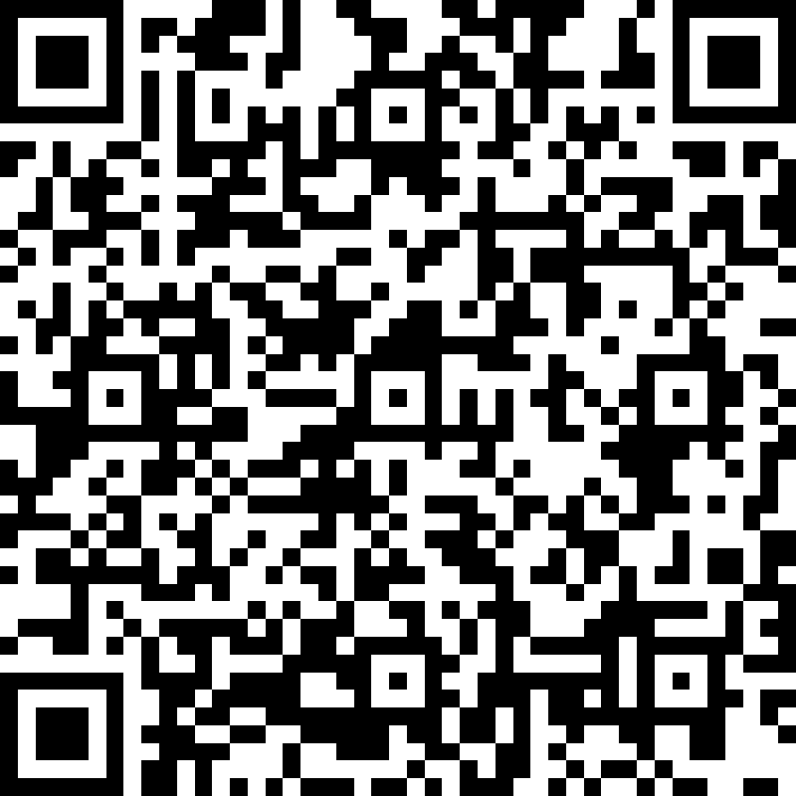
Sign up

