Slide 1
You can’t be it if you can’t see it. The success story of the PACE project
Dr Sarju Patel
Dr Hannah West
Dr Katja Umla-Runge
Dr Jui Vyas
Dr Karen Reed (She/her)
Notes:
Good afternoon everyone, and thank you to organisers for offering the chance for this work, undertaken with Cardiff University Medical school, to be presented.
I am Dr Karen Reed, I use she/her pronouns, and I am a Biomedical science lecturer at Cardiff University within the medical school, teaching 1st and 2nd year medical students.
Today I am here to present the PACE project, and I am the newest member of the group of academics who run this project, so all credit must go to my colleagues.

Slide 2
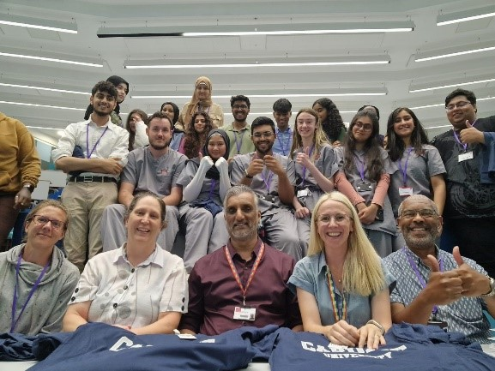
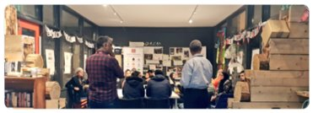
Presentation structure
Overview of the project
Aims and objectives
Project Delivery
Outputs and results
Looking at the future
All images shared with permission
Notes:
Must name check Dr Sarju Patel and Dr Jeff Allen, who set up this project, back in 2018
Talk to slide for presentation structure.

Slide 3
PACE Project
The Promoting Academic and Community Excellence Project.
Community Gateway initiative Focusing on Grangetown.
Notes:
PACE stands for Promoting Academic and Community Excellence : It is Part of Cardiff University’s Widening Accesses programme: Community Gateway initiative
Focus on Grangetown, a diverse and multiracial community within Cardiff which is included in the top 10% most deprived areas of Wales

Slide 4
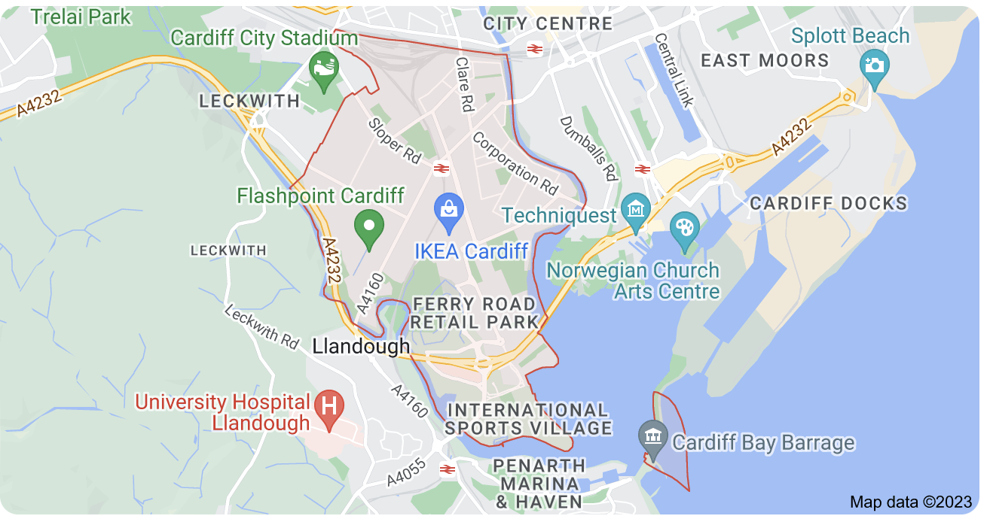
Grangetown
Nearly 20,000 people live in Grangetown.
Is a vibrant and multicultural community, with a significant population of Somali, Asian and mixed-race residents.
Is one of the largest and most diverse districts in the south of Cardiff.
Is included in the top 10% most deprived areas of Wales.
Image from google maps
Notes:
Grangetown.
Why this matters -
To have a health service that understands the needs our society, our healthcare professionals need to be representative of society. Historically, this has not been the case particularly for individuals from socio-economically deprived backgrounds who are less inclined to perceive university as a viable option and are consequently less likely to pursue a career in medicine. As such, Widening access to medicine must be a key goal for all Medical Schools, and the PACE project was established at Cardiff to meet this need.

Slide 5
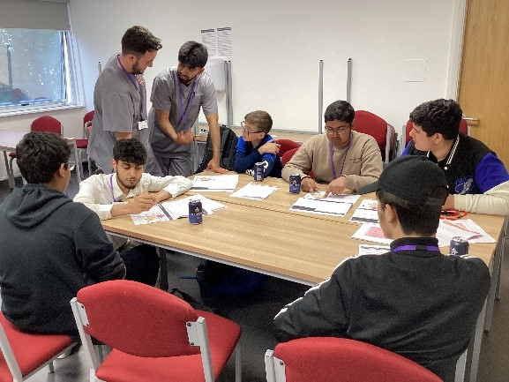
PACE Project Overview
Intervene during pre-GCSE & GCSE years to support and stimulate academic development and encourage aspirations
Notes:
Medical students recruited from years 2 and 3 to deliver weekly interactive sessions from October to March to pupils in year 9, 10 and 11 within a secondary school in Grangetown. Sessions include groupwork, plenaries, quizzes and non-invasive clinical skills.

Slide 6
PACE Project Aims
Medical students acting as tutors – relatable role models to raise aspirations
Supplement the teaching in schools
Mentor pupils
Inspire pupils to see University as a possibility
Help pupils gain entry to University
Notes:
There are many benefits of having our medical students deliver the session in school, including the chance for them to act as role models to the pupils and acts as a chance for the pupils to discuss career options with our students. But also for our students it; Embeds learned content from their course and improves their teamworking skills.
Beyond this the project also aims to (talk through bullet points 2 to 5).

Slide 7
Aims
Relatable.
Raise aspirations.
Show what can be achieved.
HELP
ROLE
MODELS
Work with schools.
Tutor pupils.
Light the path ahead.
Weekly sessions contextualize the schools’ science teaching.
Clinical content supplements learning.
Advise with support.
Make University less daunting.
MENTOR
INSPIRE
Notes:
Through this project Cardiff University medical students works with schools tutor pupils and light the path ahead for them. In doing so, as already mentioned the medical students act as relatable role modules to raise aspirations and show what can be achieved. The provision of weekly sessions helps to contextualize the school curriculum that is taught in schools, and the content is supplemented by the simple addition of clinical context. This helps inspire the school pupils. Added to that, our medical students provide advice and support to the school pupils, and in doing so they can hep make university less daunting. Our students are relatable to the school pupils.

Slide 8
PACE Project Delivery 2021/22 & 22/23
digestion and nutrition
First aid
neurology
One-day
summer school
in university
Weekly sessions
in school
common health conditions
October to March
July
cardiovascular system and heart disease
respiratory system
Notes:
As mentioned, the medical students ran weekly interactive sessions from October to March to pupils in year 9, 10 and 11 on topics including cardiovascular system and heart disease, digestion and nutrition which inform pupils about poor nutrition and health outcomes, neurology, respiratory system and common health conditions.
The project culminated in a one-day summer school which introduced pupils to a university teaching environment through a taster of case-based learning.

Slide 9
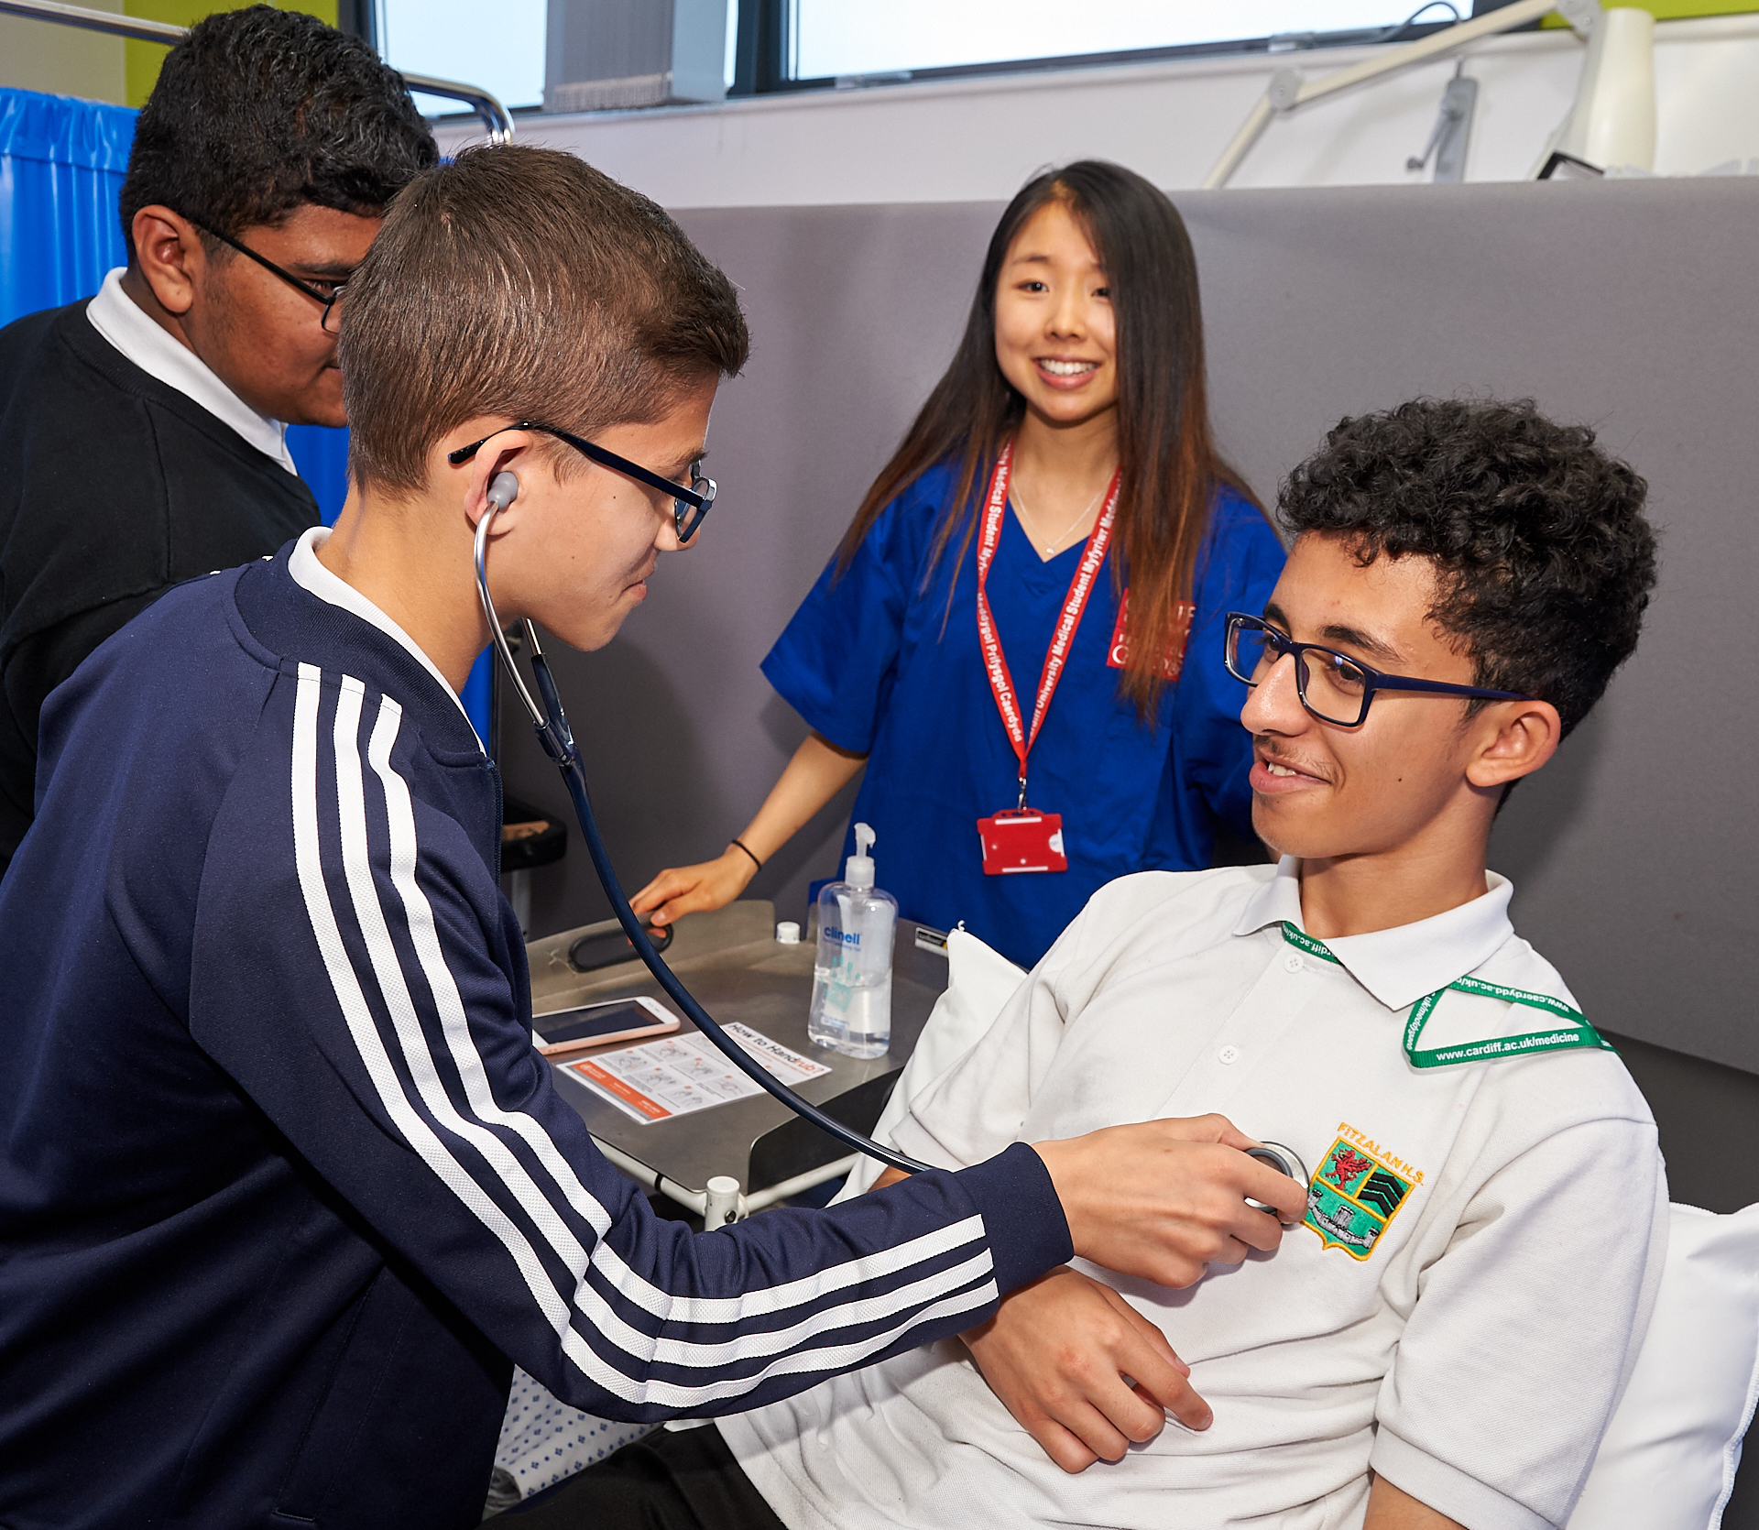
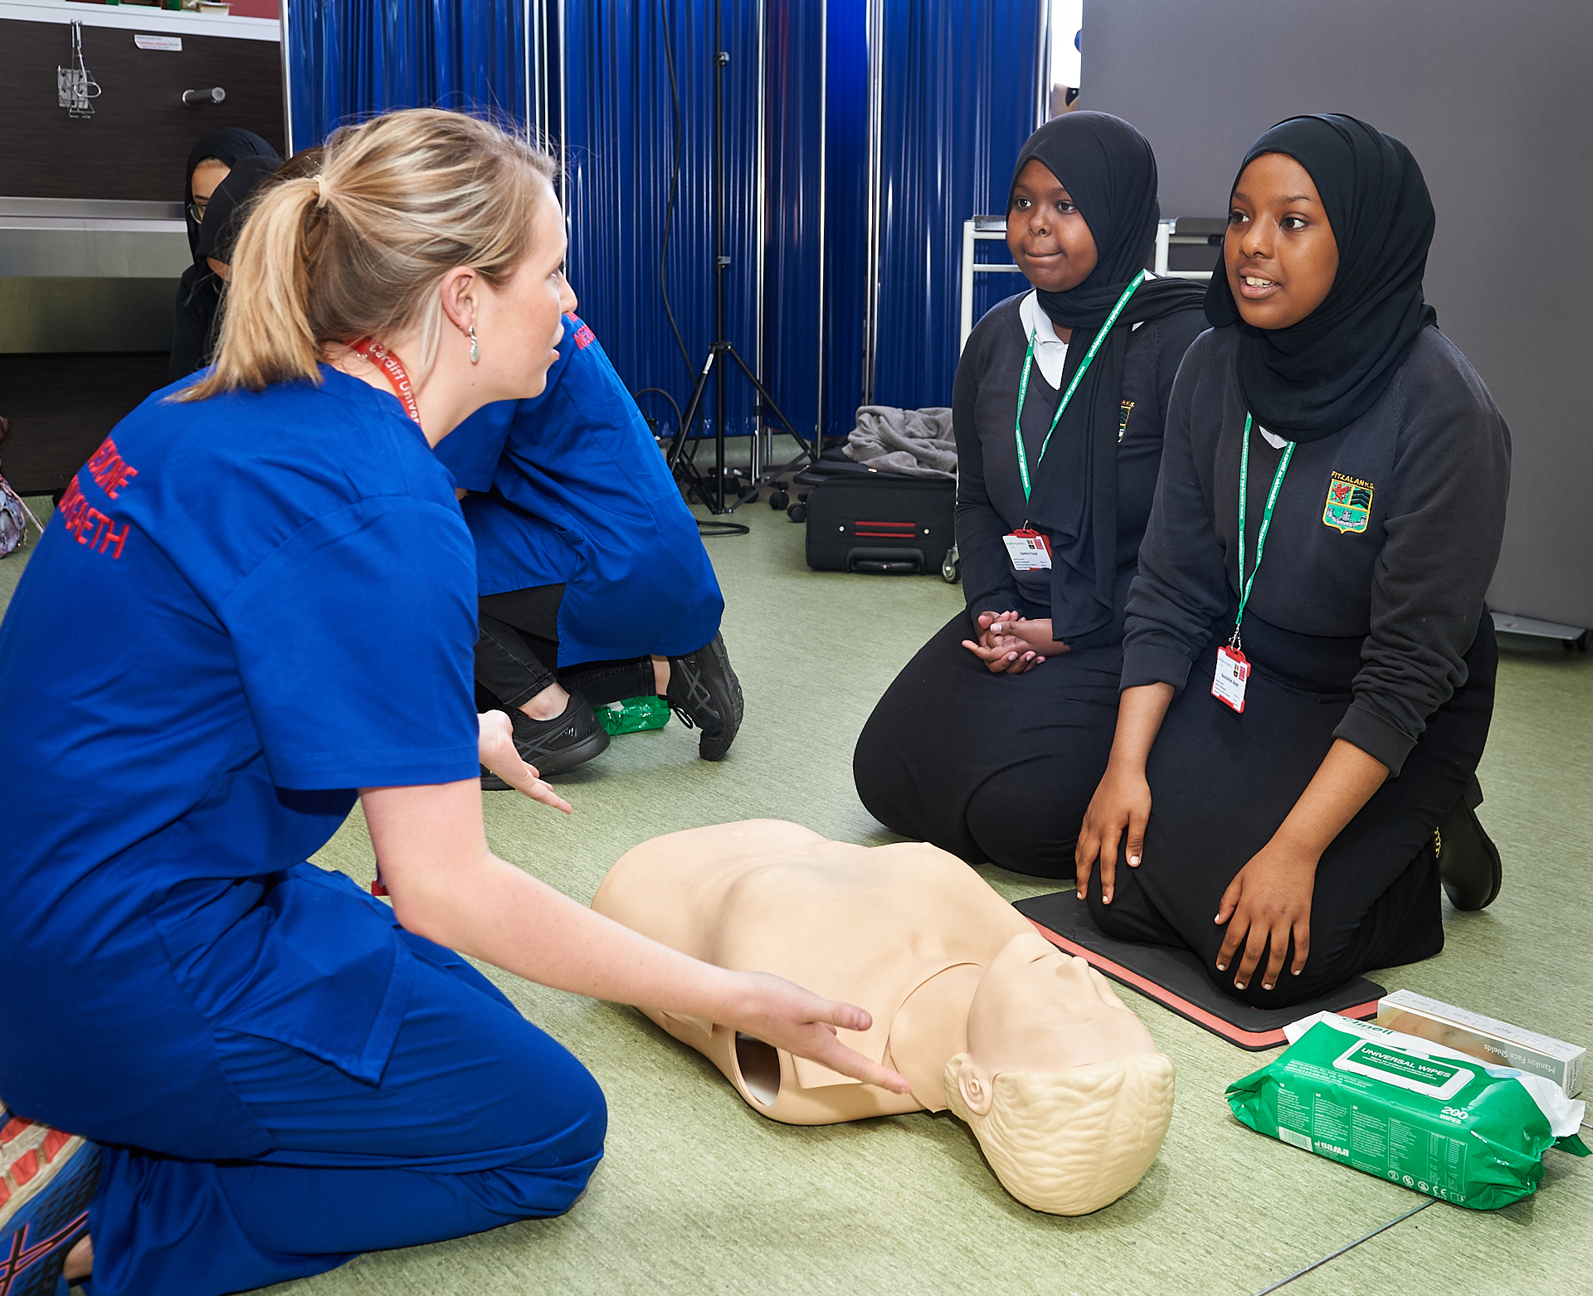
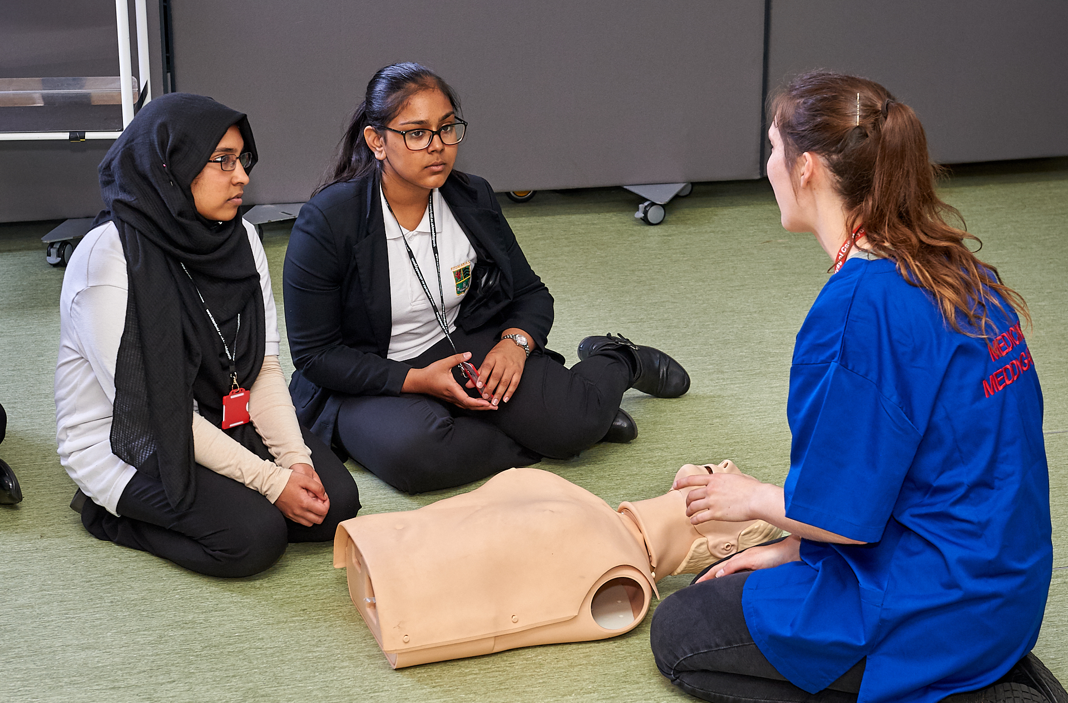
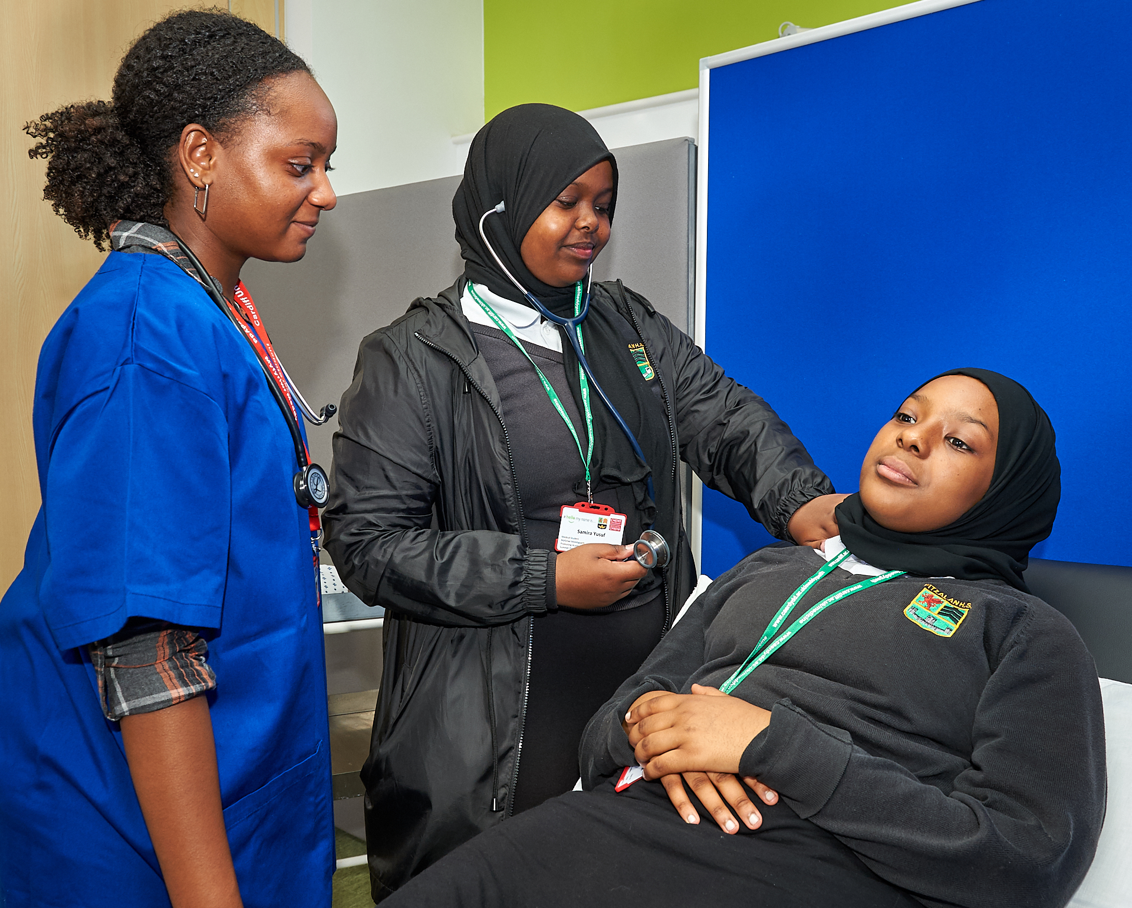
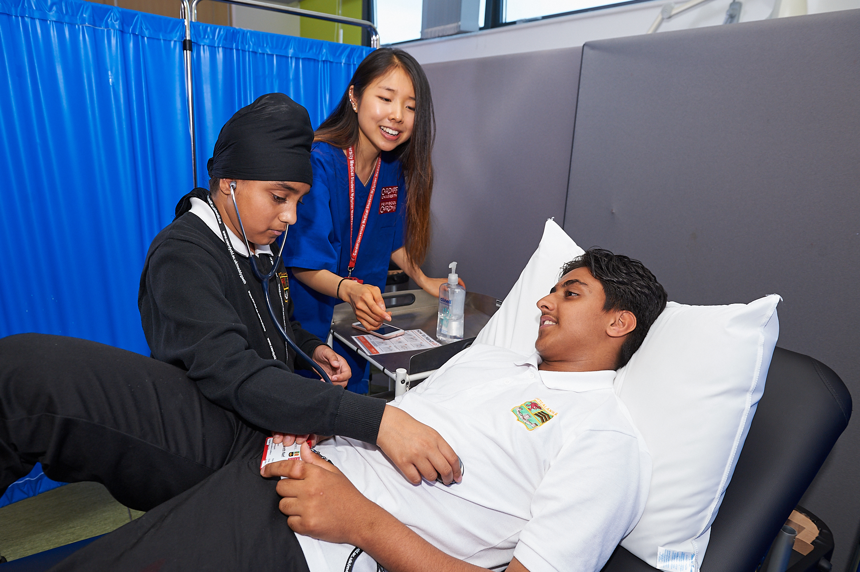
Representative Images
Notes:
41 pupils participated in the project in 2022-23 and 35 pupils attended the summer school. Here are some representative images showing medical students interacting with the school pupils. a pre- and post-survey was distributed to school pupils. Perceptions and evaluations of pupils participating in the project in the academic year 2021-2022 were gathered and used to evaluate the project.

Slide 10
Outputs and results
Core Funding
‘I have enjoyed this trip and it opened a huge gate for me, a new world to explore the medicine world and this makes me excited to see more of this.
Notes:
Results from evaluation showed that the project was fulfilling our aims. One example is how many pupils record that they are really interested in studying medicine after attending PACE compared to before completing the PACE project. The amount that were just thinking about medicine dropped from 14 to 7 pupils in 2021/22 and after attending PACE. This increased the amount of pupils who were really interested from just four to 11

Slide 11
Teamworking
Medical students work in teams to develop and deliver the sessions
Embeds learned content
Promoted communication skills, and wellbeing seeing pupils discuss career options to make informed decisions
Notes:
Our medical students developed teamworking skills, and delivery of the sessions helped them to embed their learning.

Slide 12
Where is PACE going in the future?
Expanding the project to include other secondary schools in Cardiff.
Working with Cardiff Commitment to include primary schools
Recruit other healthcare student role models to help inspire pupils
Develop health literacy events covering topics suggested by the community
Notes:
We will be considering funding streams in order to support these

Slide 13
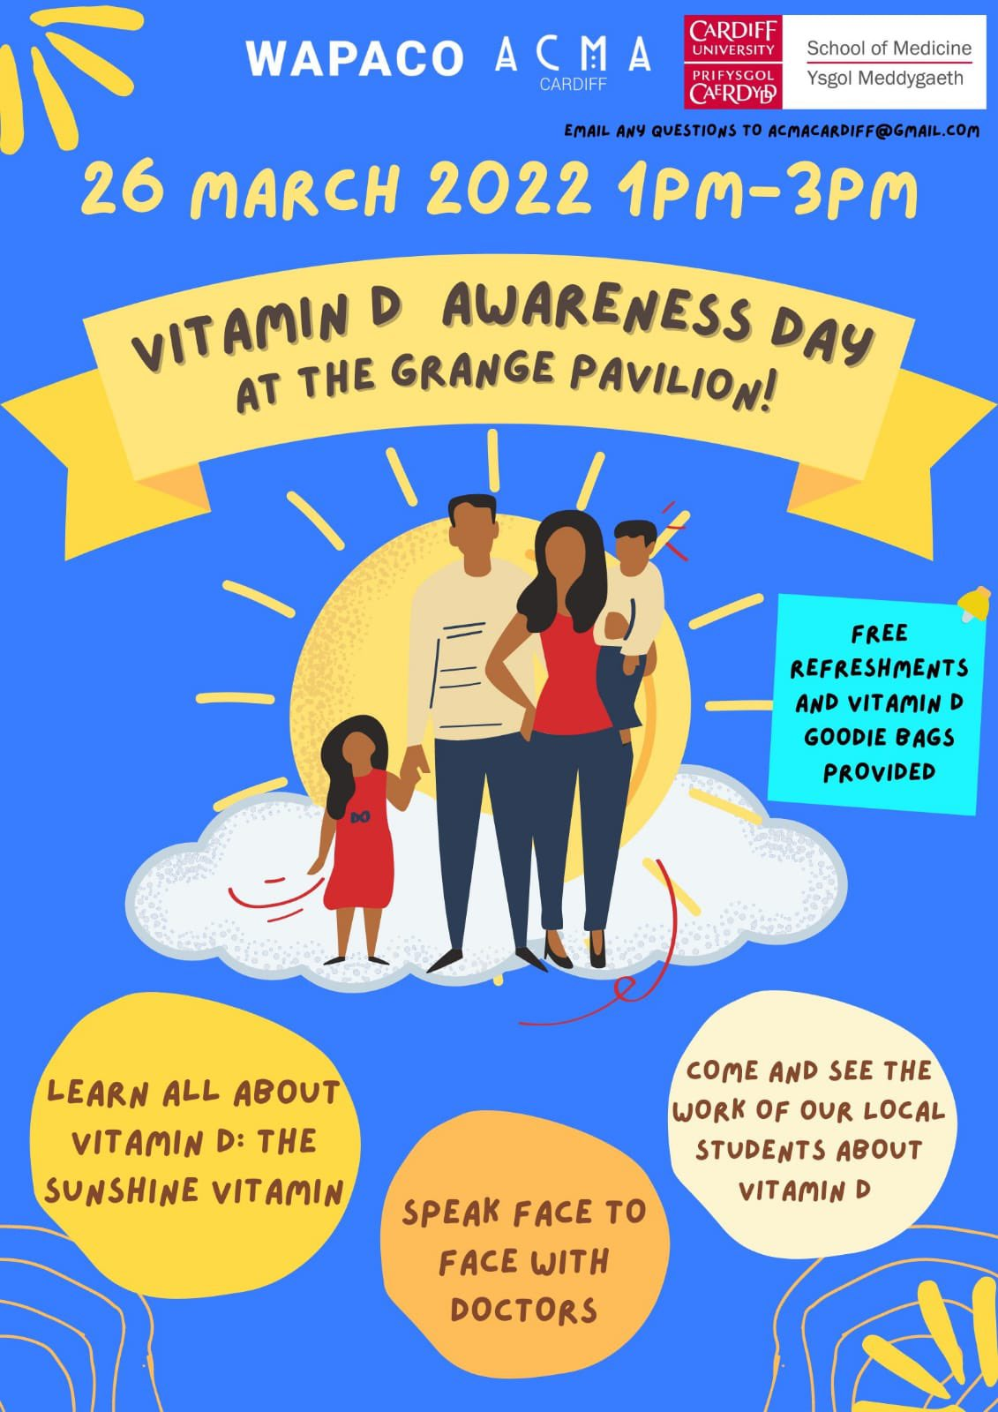
Health literacy events
A successful community engagement event ‘Vitamin D day’ was held in Grangetown pavilion.
Plans to develop further health literacy events covering topics suggested by the community:
Diabetes
Cancer
Obesity
Hypertension
Mental Health
Heart Disease
Smoking
Notes:
We will be considering funding streams in order to support these

Slide 14
Conclusions
Established in 2018, PACE project has proven to inspire pupils from a socioeconomic deprived area to consider University, and medicine, as an option.
Pupils have enjoyed “learning with friends” and “meeting the university students and learning about the world of medicine”.
Medical students find it equally rewarding, enhancing their teaching and communication skills.

Slide 15
Diolch yn fawr
Contact: ReedKR@cardiff.ac.uk

