Slide 1



Strategies for improving race equality in healthcare institutions
Cardiff School of Medicine
Lara Akinnawonu, Dr Paul Brennan, Linn Mensouh, Ellen Nelson Rowe, Sarju Patel

Slide 2
Aims & Objectives
Part 1: Recognize need for change for positive and sustainable transformation
Part 2: Identify barrier to facilitating conversations about race in healthcare institutions
Part 3: Explore a collaborative process of student and staff necessary for implementing sustainable frameworks for change
Notes:
These are aims for our session
We wil be interacting via online chat and we will be leaving times for answers and repsonses to be given through the chat
This is a ineracive session
We ask that this is a safe space for coversatin
Answer question the best way that we can
Aim is to give you thigns to htin about ahead of your own conversations
Reflecting
Q and A
Sharing good practice

Slide 3
Definitions
Diversifying the curriculum
race
Ethnicity
microaggression
Decolonizing the curriculum
BAME
Cultural competency
Power structures
Cultural humility
Notes:
wider conversation on race in the cirricum
What is mean by de
Malone Mukwende shows lakc of diversity
Decolonising curriculum is dismantling the powers structures who have controlled who has benfited for research and practice of medicine
Terminology is so important in these discussing and I want use to brainstorm what they ters eans and when it is appropriate to use these terms
Take 5 mins to talk a botu the difference between race and ethinicity
Terminolgy
Difference between diverisy and decolonize the cirriclum
What I meant by cultural competency or cultural sensitivity
What is the differne ce between cultural competency and cultural humility
Cultural competency is the behavioru of HCP in the context of population , valuescommunitites and tethinc groups with the aim to build bridges aross and different humility . Culutral humility is self refletion of ones biases ihtitn the system in which the ywork in –First nation health authority
Decolonsng – The Father of modern day obsestrics who operated and eained the odie without anesthetics, which researchinforms clincal practice diea – seeps to ideas from HCP that balck women don’t feel pain and don’t feel pain the same way

Slide 4
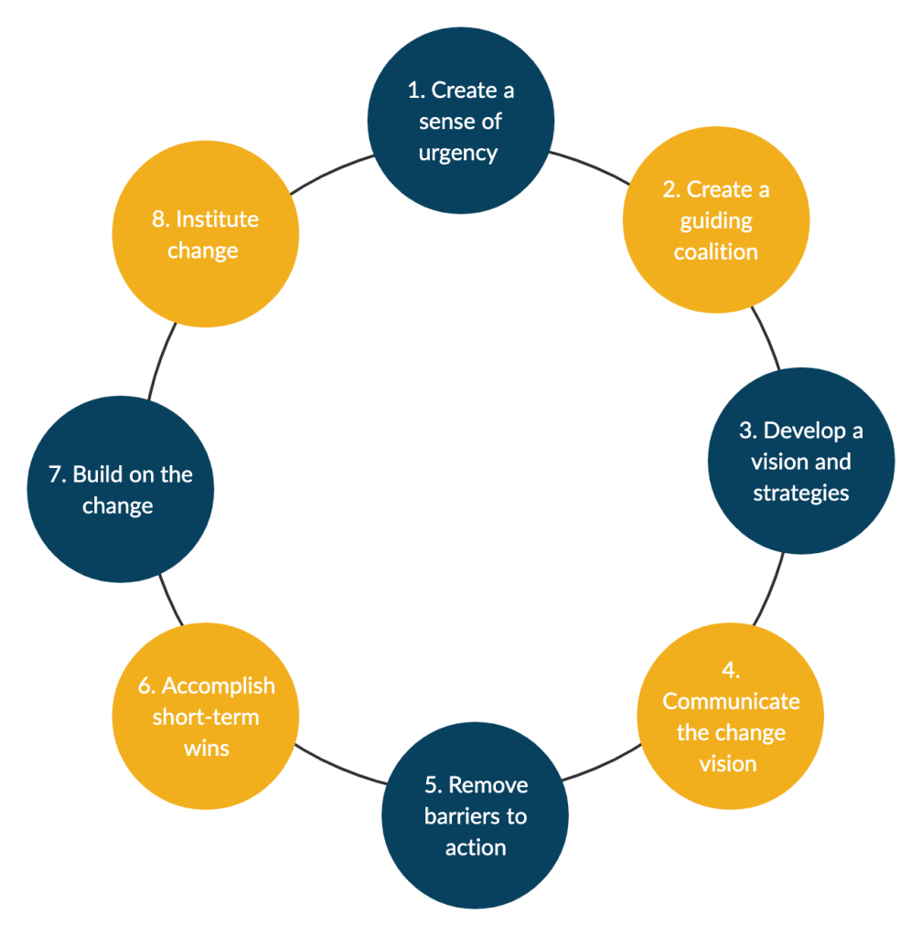
Kotter’s 8 step change model (1)
Notes:
We referenced the Kotter 8 step model which looks at how to create sustainable change. and we used these structures to implement long lasting changes in our curriculum andm
We will be focusing on how we are able to facilitate a create a sense of urgency
Remove barriers to action
We will be looking at how we implemented these changes in relation to the work of the CU SSREWG but we want you to reflect on hwo these steps fit into changes made in your school ro hwo you can develop change to ensure it it sustainable
10 https://www.managementstudyguide.com/kotters-8-step-model-of-change.htm

Slide 5
Need for change
Internal pressure
Students
Staff
EDI lead
University EDI advisory
Individual
Collective groups
External pressure
Notes:
External pressures
Calls for insitutiions to provide publications on race
Racial harrasmnet charter produced by BMA 2019
The works of students such as Malone mukwende – Mind the Gap
Melanin Medics, students for global health calling for changes in the curriculum within their areas of influence
Create a surge of urgency - in this case the shocking statistics of the COVID-19 pandemic and the disproportiante affects on black minority ethnic groups
Reports on health outcomes for black women in pregnancy
Outcomes for lakc men with prostate cancer
The evidence. Of racial harassment in the workplace and experiences of medical students

Slide 6




  Student Staff Race Equality Task Group
BLM 2020
ACMA Advisory Document
Student
Open Letters
Bhurgara Report
A call for change
Notes:
BLM 2020 - the murdger of George floyed reingited what was a pre-existing black lives matter movement
ACMA – advisoy document – cam from africna carribena medical associatoi
This association was set-up after anf field by students and
student open letters – here we say a lot fo effective allyship from white non – black students
Burgra report – which was produed with recommednations for Cardiff medical to ensure it didn’t happen again

Slide 7

What were the drivers for change in your establishment?
Notes:
What can be a driver for change
Individuals – freedom to speak guardian
Edi role mandate that is meant to have an affect but hasn’t been worked on

Slide 8
Fear of getting it wrong
Uncomfortable conversations
Cultural assumptions
Power balance

Slide 9
Compassion
Effective communication
Education
Commitment
Engagement
Notes:
Compassion
Ignorance is not an excuse – in the intial dyas of conversation there was a lot of information sharing
This idea that BAME students can raise the issue but a re not expected to declosine their own medical cirriuclum
Engagment – being present , making time , priotising these zoom calls and meetings in what was already a busy time for eveyron e
Compassion – on both ends
Communciation swihtin ourselves but comuncatoin swith our students
- Perfomatism

Slide 10
Create space
Protected time
Reflection
Notes:
Create space
Protected time
Safe
Reflective experiences

Slide 11
Reflect on challenges in having conversations on racism?
Notes:
Ho reflect on how you have challenge race or how your organization has put out anti-racis statemnts
Have they been collaborative
Have th lead ot action whether it be to eudca
Have you even had these conversation
- I will be putting prompmpts in the chat secton and pausing for 5 mins to allow for time to disuss

Slide 12
Kotter’s 8 step change model (1)
Notes:
How to we develop these ideas and our desire for change into sustianble action points

Slide 13
Stakeholder mapping
Keep informed
Manage closely
Keep into account
Meet their needs

Slide 14



Student societies
Student Groups

Slide 15


External Stakeholders
EDI staff
Course directors
Case leads
Assessment coordinators
Clinical academics
Internal stakeholders

Slide 16
What steps have been made to create sustainable change ?

Slide 17
Kotter’s 8 step change model (1)
Notes:
How to we develop these ideas and our desire for change into sustianble action points

Slide 18
GP Tutors Conference
Collaborative leadership
Microaggressions & Being an Active Bystander
Becoming a White Ally
A leadership style which foster engagement from all members to drive the strategic vision of the team
White Saviourism
Cultural Competence

Slide 19
Challenges & Barriers
Time Constraints
Terminology
Workloads
Frustrations
BAME/people of Colour/ Black
Managing Expectations
Momentum
Staff
Students
Notes:
Fear of gettign wrong
Cultural understanding
Empathy
Corretion from a place of empathy
Students often the experts but should not be up to students to decolonize their own cirriculu m

Slide 20
Cultural change
Systemic change
What does change look like?
Key performance indicators
Strategic vision
Notes:
This is your why and what statement
The purpose of our organisaiotn , oru belifes and vision for success
Then understanding that there a different levels for change – cultural change which is harder to measur e
Systemic change at thedifferent lecels staf , student, dfferent groups that deliver change what does change in our direction of influence look like
Key perofmance indicators – measurement so
Engagmeent with EDI rsources, efficiency reporting sytem , and for schools thinking outside qualitative feedback from students, how else can we emareu the impact of our interventions, monitoring structures,

Slide 21
Raising concerns
EDI training for students/staff/facilitators
Racial harassment
Diversifying medical education

Slide 22
Dermatology
Diversifying the Curriculum
Obstertics & Gynaecology
Small changes within different aspect of curriculum whilst maintaining core structure
Integration of race and other protected characteristics in curriculum
Psychiatry

Slide 23
Steps to sustainable change
Handover
Terms of reference
Governance
Rewards
Notes:
Time constraints – real understanidn that it is everyon e repsonsbility
Having roles / paid roles in which it is expeted of yo to be a prt of this wrok
Terms of refence – guiding refernce explains what you do and how you aim to do it what your aims and bjectvs are and who you are accuotnabe too
Important pat of goverenace
Governanc – tranprency in dcison making , accounabel , inclusive,
Terms of reference definig your why
Governanceimportnat for accotnality , authority

Slide 24
Who are the key stakeholders for change?
What is your level of engagement and how do you engage them ?

Slide 25
Kotter’s 8 step change model (1)
Notes:
How to we develop these ideas and our desire for change into sustianble action points

Slide 26
MEDIC Race Awarness Day
What has been
accomplished?
2-day virtual event involving panel discussions, presentations and workshops hosted by staff and students
Decolonising the Curriculum
Ongoing project focusing on 3 specialities to make small practical changes
Welsh Government Consultation
Opporunity to engage with policy making and providefeedback to Welsh Government

Slide 27
GP Tutors Conference
MEDIC Race Awarness Day
Microaggressions & Being an Active Bystander
Becoming a White Ally
An opportunity for both staff and studnnts to learn, engage and share experiences
White Saviourism
Cultural Competence

Slide 28

How did your organisation respond to BLM 2020?
How did your organisation respond? Was it adequate?

Slide 29
Thank you!
Contact details
Lara Akinnawonu - AkinnawonuOO1@Cardiff.ac.uk
Ellen Nelson Rowe - Nelson-RoweE@cardiff.ac.uk
Sarju Patel - PatelS2@cardiff.ac.uk
Paul Brenan - BrennanP@cardiff.ac.uk>
Special thanks to Cardiff university
Student Staff racial quality working group
Linn Mensouh - MensuohLA@cardiff.ac.uk

