Slide 1
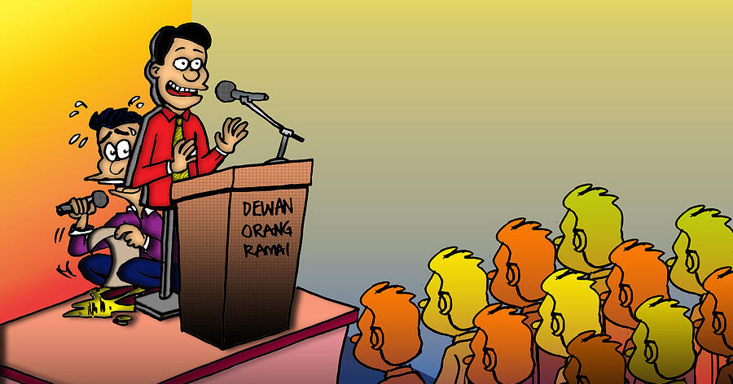
Public Speaking
Dr Sarju Patel
Senior Lecturer

Slide 2
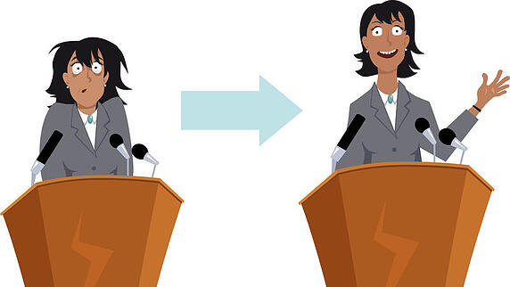

Slide 3

Barriers

Slide 4

Groupwork

Slide 5
Barriers
Self confidence/belief
Fear
Lack of preparation
Audience

Slide 6

Discussion

Slide 7
Tips
Choose a Topic You’re Passionate About
Get Organised
Practice Practice Practice
Work on Your Breath
Drink Water and Have It Available

Slide 8


Slide 9
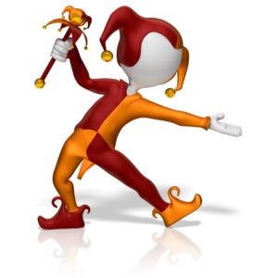
Presenting and the presentation

Slide 10
You have to work hard to develop the right skills
Keep things simple and to the point
Use a healthy dose of humor
Try to tell a story instead of ranting
Move around and use your hands
Engage the audience by making them relate
Use funny images in your slides

Slide 11

Thank you

