Slide 1
Beyond Conformance: Evaluating Policy Side Effects
Sina Shahab
School of Geography and Planning
Cardiff University

Slide 2
Decision-makers are required to evaluate policies to develop a better understanding of how they can improve their policy design and implementation processes.
They need to know the effects that different potential policies might bring about, especially considering the fact that resources are not infinite and decisions about the use of them should be made wisely.
Evaluations can provide crucial insights for learning and developing new policies. Evaluations are, also, important to ensure accountability (Mickwitz, 2013).
INTERNATIONAL ACADEMIC ASSOCIATION ON PLANNING, LAW, AND PROPERTY RIGHTS

Slide 3
Problem Definition
Policy Selection
Policy Design
Policy Implementation
Policy Evaluation
INTERNATIONAL ACADEMIC ASSOCIATION ON PLANNING, LAW, AND PROPERTY RIGHTS

Slide 4
How would you know a policy/plan/program is ‘good’ or ‘bad’?
We need evaluation criteria!
Policy-makers are required to develop a set of criteria which enable them to avoid evaluating plans and policies based on vague value judgments.
Moreover, adoption of evaluation criteria can assist policy-makers in decreasing the level of subjectivity in the evaluation process.
Evaluation criteria are strongly associated with evaluation questions (Oliveira and Pinho, 2010).
INTERNATIONAL ACADEMIC ASSOCIATION ON PLANNING, LAW, AND PROPERTY RIGHTS

Slide 5
“How would you know a good art [policies], if you saw one?
I don’t know much about arts [policies], but I know what I like” (Baer, 1997).
It is inevitable for decision-makers to answer to these fundamental and normative questions: what is a good policy and what makes it good?
Baer (1997) argues that decision-makers sometimes merely rely on some value judgments which tend to be vague and subjective.
They may avoid providing an answer, and instead focus on the methods and process of decision-making.
INTERNATIONAL ACADEMIC ASSOCIATION ON PLANNING, LAW, AND PROPERTY RIGHTS

Slide 6
Conformance-Based Evaluation
Performance-Based Evaluation
INTERNATIONAL ACADEMIC ASSOCIATION ON PLANNING, LAW, AND PROPERTY RIGHTS

Slide 7
Conformance-Based Evaluation
This approach assesses the success of a planning policy by measuring the degree to which its outcomes align with its stated objectives.
The central assumption here is that plans act as blueprints for development, and their effectiveness is judged based on how closely actual developments conform to the original policy intentions.
The extent to which the objectives formulated in the plan/policy were achieved or are expected to be achieved.
INTERNATIONAL ACADEMIC ASSOCIATION ON PLANNING, LAW, AND PROPERTY RIGHTS

Slide 8
Conformance-Based Evaluation
Narrow Focus on Initial Objectives: This approach assumes that the original objectives of a plan or policy are always relevant and sufficient for evaluating success. However, planning operates in dynamic environments where conditions change, making rigid adherence to predefined goals potentially outdated or inadequate.
Neglect of Unintended Effects: It fails to capture unintended consequences, both positive and negative. Policies often have unforeseen impacts that may be just as significant as their intended goals, but a strict conformance assessment ignores these broader effects.
Rigid and Static Evaluation, Limited Consideration of Implementation Complexities, Ignores Process and Learning, etc.
INTERNATIONAL ACADEMIC ASSOCIATION ON PLANNING, LAW, AND PROPERTY RIGHTS

Slide 9
Performance-Based Evaluation
Unlike the conformance approach, performance-based evaluation focuses on how a plan is used in decision-making rather than whether its outcomes strictly match its original objectives.
It treats plans as guiding frameworks for decision-making rather than rigid blueprints. This approach allows for adaptability and acknowledges the dynamic nature of planning but does not necessarily capture the full range of policy impacts.
INTERNATIONAL ACADEMIC ASSOCIATION ON PLANNING, LAW, AND PROPERTY RIGHTS

Slide 10
Performance-Based Evaluation
Lack of Clear Success Metrics: Unlike conformance-based evaluation, which has clear benchmarks (policy objectives), performance-based evaluation lacks a concrete definition of success. Measuring the influence of a policy on decision-making can be highly subjective and difficult to quantify.
Potential for Weak Accountability: Since this approach allows for deviation from original plans, it can lead to reduced accountability. Policymakers may justify ineffective or poorly implemented policies by arguing that they influenced decisions, even if they did not achieve tangible outcomes.
Overemphasis on Process over Outcomes: Performance-based evaluation focuses on whether policies are used in decision-making rather than their actual results. This can lead to situations where policies are frequently referenced but fail to deliver meaningful improvements in urban development or quality of life.
INTERNATIONAL ACADEMIC ASSOCIATION ON PLANNING, LAW, AND PROPERTY RIGHTS

Slide 11
Impact-Based Evaluation
To move beyond assessing whether a policy conforms to its initial objectives or whether it is simply referenced in decision-making processes.
Instead, it evaluates the full range of intended and unintended effects that a policy produces, regardless of whether those effects align with its original goals.
INTERNATIONAL ACADEMIC ASSOCIATION ON PLANNING, LAW, AND PROPERTY RIGHTS

Slide 12
- Assessment of All Policy Effects
Impact-based evaluation takes a broader view of policy outcomes. It recognises that policies often generate unintended side effects, both positive and negative, that may significantly influence urban environments, governance, and social equity. By systematically assessing these effects, impact-based evaluation provides a more realistic and comprehensive understanding of a policy’s actual influence.
- Recognition of Complexity in Policy Implementation
Planning policies do not operate in isolation; they interact with a complex web of stakeholders, regulations, market dynamics, and institutional structures. Unlike conformance-based evaluation, which assumes a linear relationship between policy intent and implementation, impact-based evaluation embraces the non-linearity and unpredictability of urban development processes.
INTERNATIONAL ACADEMIC ASSOCIATION ON PLANNING, LAW, AND PROPERTY RIGHTS

Slide 13
Efficiency
Equity
INTERNATIONAL ACADEMIC ASSOCIATION ON PLANNING, LAW, AND PROPERTY RIGHTS

Slide 14
Efficiency: Beyond Theoretical Optimisation
Traditional assessments of efficiency in land policy focus on the optimal allocation of resources, often using Pareto efficiency (where no one can be made better off without making someone worse off) or Kaldor-Hicks efficiency (where benefits outweigh losses, even if compensation is not provided).
Impact-based evaluation should shift the focus to how efficiency plays out in practice, recognising that real-world inefficiencies often emerge from policy design and implementation.
For example:
- Zoning laws, designed to efficiently allocate land for specific uses, can create unintended inefficiencies. In high-demand cities, restrictive zoning leads to housing shortages, driving up prices and reducing overall economic productivity.
- Land thrift policies aim to limit urban sprawl, but if demand for housing is high and land is constrained, they can inadvertently reduce affordability and force development into more environmentally sensitive areas.
Thus, an impact-based approach should not simply assume that policies enhance efficiency but evaluates whether they actually improve resource allocation without introducing new inefficiencies.
INTERNATIONAL ACADEMIC ASSOCIATION ON PLANNING, LAW, AND PROPERTY RIGHTS

Slide 15
Equity: Evaluating Distributive Consequences in Practice
Equity is often framed as ensuring fair access to land resources and distributing benefits and burdens more justly. Impact-based evaluation should assess whether policies achieve their intended redistributive effects or create new forms of inequality.
For example:
- Inclusionary zoning mandates affordable housing provisions, but in practice, it can increase land and housing prices if developers pass on the costs to buyers. This can make housing even less affordable, particularly in high-demand areas.
- Land value capture mechanisms, such as developer obligations or taxation on increased land values, can fund public infrastructure, but if poorly implemented, they may discourage development or be passed on to tenants in the form of higher rents.
Impact-based evaluation therefore questions whether policies designed for equity actually result in fairer land distribution or merely shift inequities elsewhere.
INTERNATIONAL ACADEMIC ASSOCIATION ON PLANNING, LAW, AND PROPERTY RIGHTS

Slide 16
The Trade-Off Between Efficiency and Equity: Avoiding Unnecessary Sacrifices
Land policy is often framed as a zero-sum game between efficiency and equity, where increasing one comes at the expense of the other. An impact-based evaluation should focus on minimising trade-offs and find synergies where both can be enhanced simultaneously.
For example:
- Land value capture can both enhance efficiency (by preventing speculative gains) and promote equity (by funding public goods like affordable housing or transport infrastructure). However, if applied too aggressively, it discourages investment and reduces land supply, undermining efficiency.
- Densification policies are intended to enhance efficiency by reducing urban sprawl, but they can also increase gentrification and displacement. Impact-based evaluation identifies how policies might be adjusted to preserve affordability while still achieving environmental benefits.
Rather than accepting trade-offs as inevitable, an impact-based approach examines how policies can be redesigned to achieve both efficiency and equity goals, reducing negative unintended consequences.
INTERNATIONAL ACADEMIC ASSOCIATION ON PLANNING, LAW, AND PROPERTY RIGHTS

Slide 17
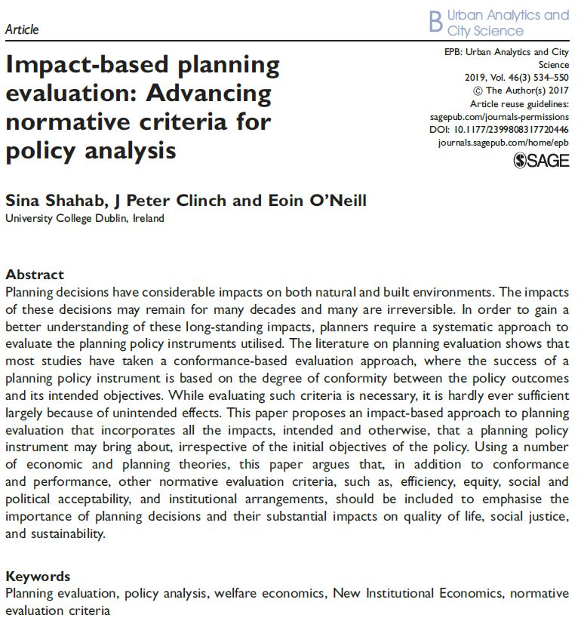
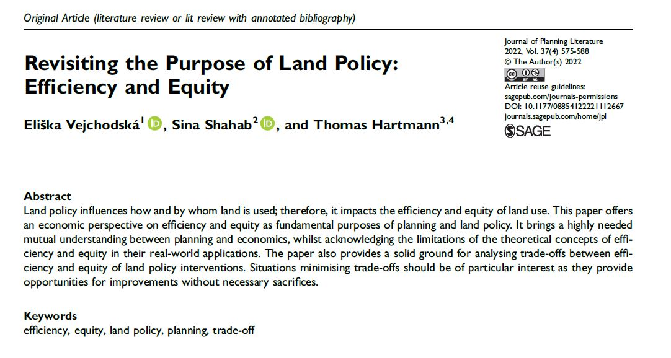
Diolch / Thank you
INTERNATIONAL ACADEMIC ASSOCIATION ON PLANNING, LAW, AND PROPERTY RIGHTS

