Slide 1
TRANSACTION COSTS OF IMPLEMENTING THE TRANSFER OF DEVELOPMENT RIGHTS PROGRAM IN MILAN
Enzo Falcoa, Emanuele Gardab, Sina Shahabc
a) Department of Civil, Environmental and Mechanical Engineering, University of Trento, Trento, Italy;
b) Department of Engineering and Applied Sciences, University of Bergamo, Dalmine, Italy;
c) School of Geography and Planning, Cardiff University, Cardiff, UK

Slide 2
Introduction
Regional Law 12/2005 introduced TDR in Lombardy, shaping Milan’s urban development.
Milan serves as a key national and international case for TDR implementation.
Analysis of Milan’s TDR model, focusing on transaction costs and market dynamics.
Limited research on city-level transaction costs in TDR schemes.
Empirical study through interviews and focus groups with planners, notaries, developers, and intermediaries.
INTERNATIONAL ACADEMIC ASSOCIATION ON PLANNING, LAW, AND PROPERTY RIGHTS

Slide 3
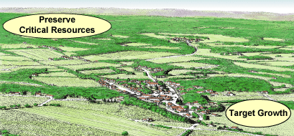
Transfer of Development Rights
Transfer of Development Rights (TDR) is an instrument used to redirect future development potential, from one location to another, in a way that is fair and equitable to the landowners involved, and one that supports community development, planning and conservation goals.
INTERNATIONAL ACADEMIC ASSOCIATION ON PLANNING, LAW, AND PROPERTY RIGHTS

Slide 4
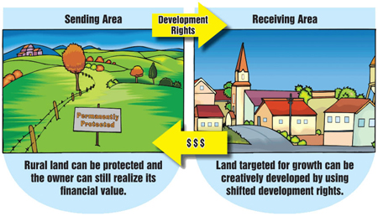
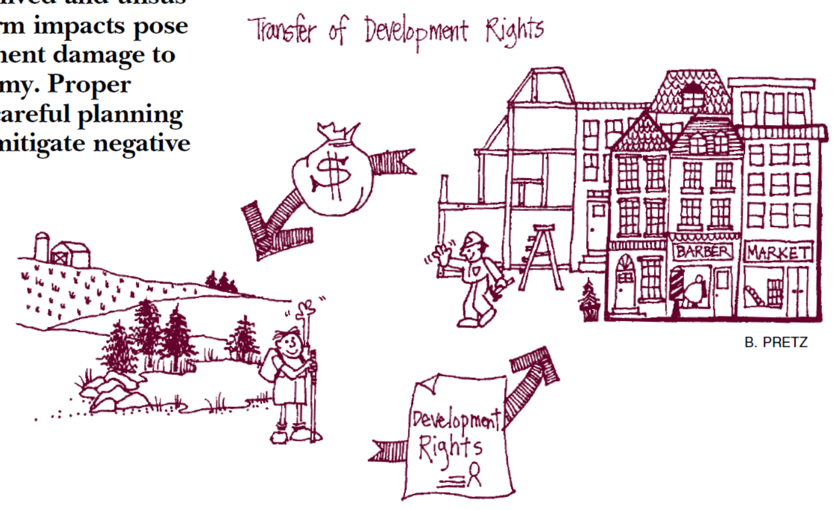
Transfer of Development Rights
INTERNATIONAL ACADEMIC ASSOCIATION ON PLANNING, LAW, AND PROPERTY RIGHTS

Slide 5
Transfer of Development Rights
Country | Number of TDR programs | Country | Number of TDR programs
United States | 282 | Japan | 1
Italy | 14 | Mexico | 1
France | 7 | Netherlands | 1
Australia | 6 | New Zealand | 1
Canada | 2 | Puerto Rico | 1
Brazil | 1 | Spain | 1
India | 1 | Taiwan | 1
Source: https://smartpreservation.net/tdr-updates/
INTERNATIONAL ACADEMIC ASSOCIATION ON PLANNING, LAW, AND PROPERTY RIGHTS

Slide 6
Transaction Costs
Concept and Definition:
First introduced by Coase (1937) in The Nature of the Firm, transaction costs refer to the expenses associated with exchanges or transactions that are not directly tied to the creation of goods being traded.
Application in Planning:
Introduced to planning by Alexander (1992), transaction cost analysis has been applied to various planning issues, including informal settlements, transport, infrastructure, and property development.
Relevance to Planning Policy Instruments:
Transaction costs have been used to assess TDR programs, ballot-box zoning, and land readjustment. Shahab et al. (2018) highlighted their variation over time and uneven distribution among actors, estimating transaction costs in Maryland’s TDR programs at 13%–21% of total TDR costs per transaction. Hou et al. (2020) argued that accounting for transaction costs enhances TDR program efficiency and effectiveness.
INTERNATIONAL ACADEMIC ASSOCIATION ON PLANNING, LAW, AND PROPERTY RIGHTS

Slide 7
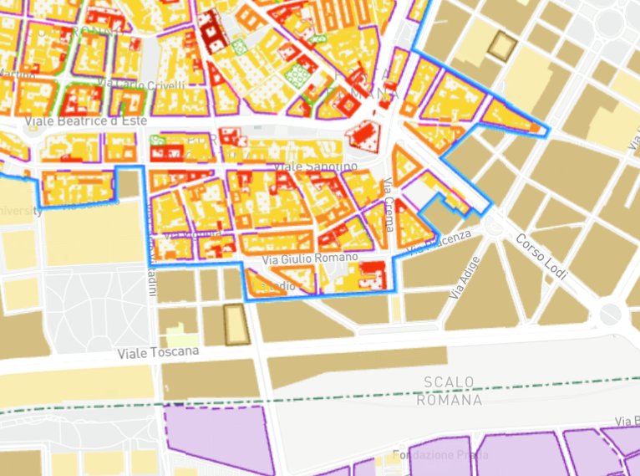
The Milan TDR Model
The City Plan (PGT), approved in 2012, incorporates multiple uses of TDR:
To transfer of development rights from parcels designated for new green spaces to built-up areas.
To enforce building restrictions on specific parcels.
To provide incentives for energy efficiency improvements and historic building restoration.
To promote densification in areas with high public transport accessibility.
INTERNATIONAL ACADEMIC ASSOCIATION ON PLANNING, LAW, AND PROPERTY RIGHTS

Slide 8
Results
INTERNATIONAL ACADEMIC ASSOCIATION ON PLANNING, LAW, AND PROPERTY RIGHTS

Slide 9
Conclusions
The study identifies five key activities: administration, TDR creation, contracting, retirement, and policy evaluation. The highest costs arise from legal documentation, land decontamination, and market uncertainties.
Milan’s TDRs are often traded multiple times before they are actually used in development projects. This speculative activity, which is less commonly reported in regional TDR schemes, has increased transaction costs by making it harder for developers to find available TDRs and by driving up prices.
Milan’s TDR program faces opportunistic behaviour and rent-seeking. Buyers hold TDRs for speculative profit, causing artificial scarcity, inflated prices, and higher development costs.
Milan's TDR program does not impose strict time limits on the use of TDRs, allowing them to be held indefinitely. This lack of a sunset clause has contributed to speculative accumulation and increased long-term costs for developers.
INTERNATIONAL ACADEMIC ASSOCIATION ON PLANNING, LAW, AND PROPERTY RIGHTS

Slide 10
Conclusions
Milan's urban context is characterised by high land values, land scarcity, and significant brownfield redevelopment. These factors make the TDR market more complex and transaction-intensive compared to regional schemes, where land supply is often more abundant.
In Milan, the lack of a structured mechanism to match buyers and sellers has led to inefficiencies, making it difficult to locate available TDRs, further increasing transaction costs.
To improve efficiency and reduce transaction costs, the study suggests:
a public WebGIS platform for transparency,
a TDR Bank to balance supply and demand,
time limits on TDR use, and
publicly owned TDRs to stabilise the market.
INTERNATIONAL ACADEMIC ASSOCIATION ON PLANNING, LAW, AND PROPERTY RIGHTS

Slide 11
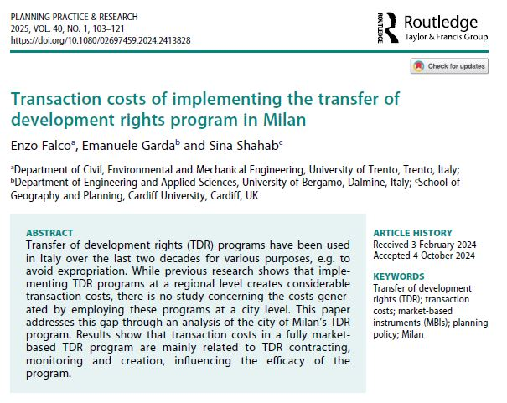
Diolch / Thank you
INTERNATIONAL ACADEMIC ASSOCIATION ON PLANNING, LAW, AND PROPERTY RIGHTS

