Slide 1

Impacts of anti-racism on research
Dr Sarju Patel
Lindsay Roberts
Ramona Naicker
Delyth Morris
4th June 2025

Slide 2

Shared principles for engagement for this session
The information in this session will introduce you to subjects and ideas that can be sensitive, emotionally challenging, and triggering for some people.
Because of this, it's crucial that you pay attention to your emotions, don't apologise for them, and take the time to consider their causes and the effects they are having on your wellbeing.

Slide 3
Overview of tutorial - https://xerte.cardiff.ac.uk/play_19208
Race is a social construct
Under-representation in research
Social construct of ‘race’ can cause health disparities
Race is often used as a proxy for biology
Genetic Ancestry

Slide 4

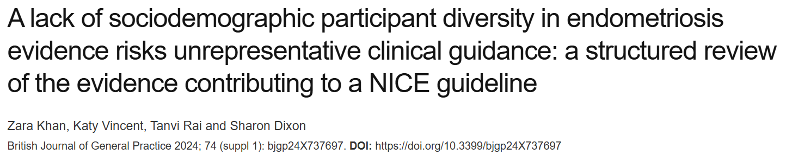
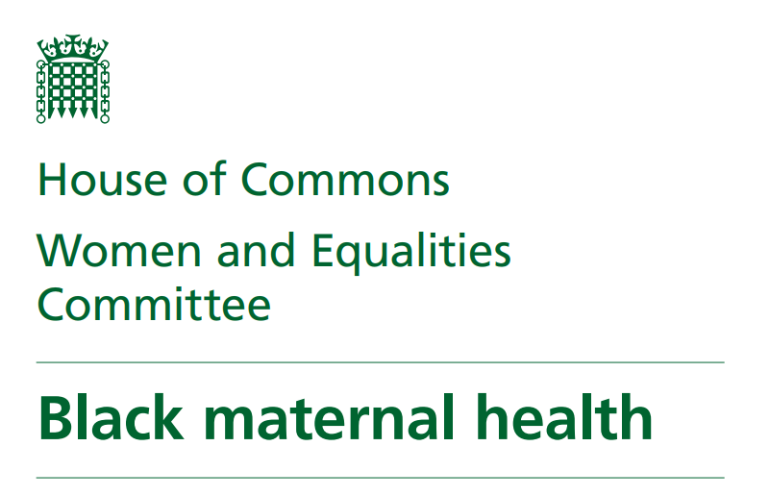
Black women were 3.7 times more likely to die than White women, and Asian women were 1.8 times more likely to die than White women
Notes:
Racial and Ethnic Disparities in European Breast Cancer Clinical Trials. Cancers 2024, 16(9), 1726; https://doi.org/10.3390/cancers16091726
A lack of sociodemographic participant diversity in endometriosis evidence risks unrepresentative clinical guidance: a structured review of the evidence contributing to a NICE guideline. British Journal of General Practice 2024; 74 (suppl 1). https://doi.org/10.3399/bjgp24X737697
House of Commons (2023). Black maternal health. Third Report of Session 2022-23. https://committees.parliament.uk/publications/38989/documents/191706/default/

Slide 5
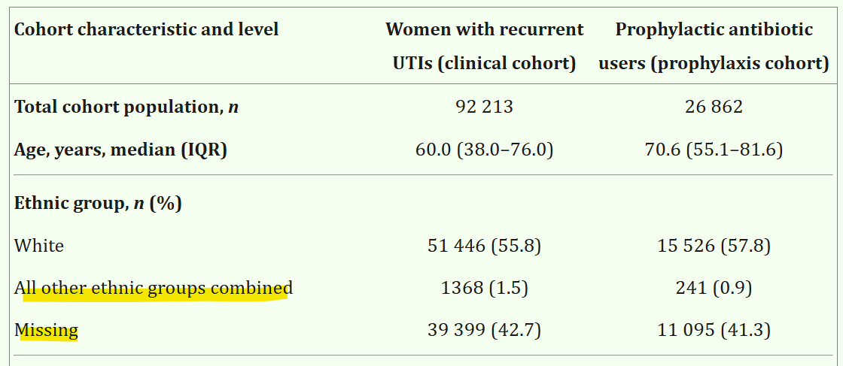
Notes:
Sanyaolu, L. et al. 2024. Recurrent urinary tract infections and prophylactic antibiotic use in women: a cross-sectional study in primary care. The British Journal of General Practice 74(746), pp. e619–e627. doi: 10.3399/BJGP.2024.0015.
Study on UTIs and prophylactics in women
An example of how methodological choices can reproduce inequity
42% of the cohort have missing ethnicity data. That’s nearly half the dataset. With so much missing, any conclusions or subgroup analysis by ethnicity would be statistically and ethically shaky. Yet they report it anyway, which is misleading.
"All other ethnic groups" - flattens all racialised people into a single, meaningless “non-White” group, lumping together Black women, South Asian women, East Asian women, Middle Eastern women, and more, without distinction.
Erases heterogeneity in experiences, risks, and outcomes.
Prevents intersectional analysis
Perpetuates invisibility of minoritised groups in data.
They never meaningfully address any of the above limitations
Suggests ethnicity wasn’t prioritised or meaningfully incorporated into the study design, even though racial and ethnic disparities in antibiotic prescribing and diagnostic thoroughness are well documented.
What they should have done:
Reported the limitation
Explained why ethnicity was included at all (if they knew it wouldn’t be usable)
Refused to make comparisons about ethnic groups given the data’s unreliability

Slide 6
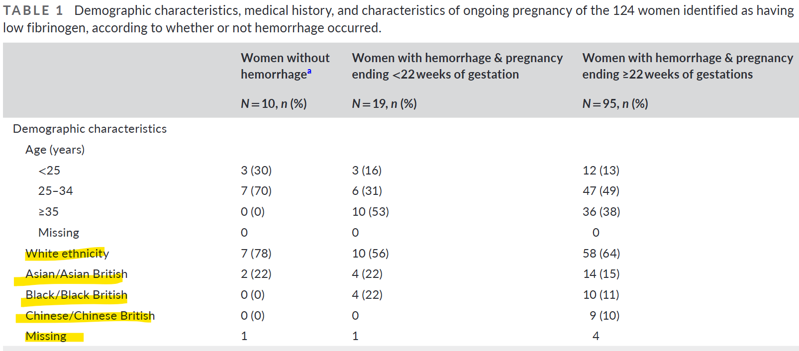
Notes:
Diguisto, C., Baker, E., Stanworth, S., Collins, P.W., Collis, R.E. and Knight, M. 2024. Management and outcomes of women with low fibrinogen concentration during pregnancy or immediately postpartum: A UK national population-based cohort study. Acta Obstetricia et Gynecologica Scandinavica 103(7), pp. 1339–1347. doi: 10.1111/aogs.14828.
Study on low fibrinogen during pregnancy and postpartum.
At first glance this looks much better than the previous study. However, while the categories say ‘diversity’, the analysis says ‘don’t care.'
This is a classic example of including ethnicity without including race.
Researchers counted people by ethnic label, but didn't examine racism or racialisation as explanatory variables, which is where the real disparities tend to emerge.
Very small numbers, but no explanation of how this affects analysis
Black/Black British: only 14 people total (11%)
Asian/Asian British: 20 people total (16%)
Chinese/Chinese British: 9 people total (7%)
6 entries are missing altogether.
With such small group sizes, any differences in outcomes by ethnicity can’t be reliably analysed, but the authors still note overrepresentation of Asian and Black women without exploring what that means or why.
Issues with categories:
"Chinese/Chinese British” is separated from “Asian/Asian British"
This risks singling out Chinese ethnicity unless there’s a clinical reason (none is given)
Whilst Asian likely means South Asian given the context, this is essentially just an assumption. Asian could mean any number of things here.
“White ethnicity” is overly broad. What is White ethnicity? White British? Irish? Eastern European migrants? Mediterranean background?
“Black/Black British” is also too broad. As with other groups, there’s no attempt to distinguish African vs. Caribbean vs. recent migrants vs. UK-born — despite known differences in maternal outcomes.
Ethnicity isn’t just a checkbox, it's meant to be a proxy for how people are racialised in healthcare settings. If the categories
don’t map to actual lived experiences, aren’t explained, aren’t analysed in relation to outcomes,
then you’re just ticking a box, not doing justice to the issue.

Slide 7
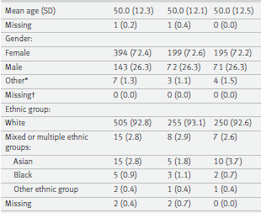
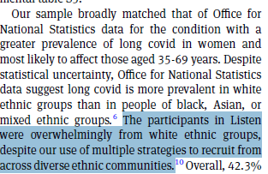
Notes:
Busse, M. et al. 2025. Effectiveness of a personalised self-management intervention for people living with long covid (Listen trial): pragmatic, multicentre, parallel group, randomised controlled trial. BMJ Medicine 4(1), p. e001068. doi: 10.1136/bmjmed-2024-001068.

Slide 8

Discussion topics
What are your initial reflections after hearing this presentation?
What would equitable representation look like in a research study?
How do your recruitment strategies acknowledge and address the barriers women of colour may face when participating in research?
How do you record and describe the populations involved in your research?
What’s one change you might make to your research practice after today?
Notes:
One discussion point per menti slide

