Slide 1


Workshop 1
Empowering Startups in Wales: Generative AI for Growth
Dr Ahmed Almoraish
almoraisha1@cardiff.ac.uk
This workshop is funded by Cardiff Business School, Cardiff University
Notes:
Design team notes:
This is intended to be a title slide.
Do not alter the logo size or position
Attempt to keep your title as close to 2 lines as possible
Do not alter font size
Do not change fonts
You may replace either font with the same font. For example, both lines may be in Franklin if desired.

Slide 2



Project Team
Dr Ahmed Almoraish: Lecturer in Marketing, Cardiff University
Dr Mehreen Ashraf: Lecturer and Co-Founder, Responsible AI Collective
Mahbubul Alom: Co-Founder & Chief AI Automation Officer, Calon AI Solutions
Reggie Al-Haddi: NYCA – Chairman
Dr Ahmed Abdullah: Lecturer in Business at SWU
Notes:
Design team notes:
This is intended to be a title slide.
Do not alter the logo size or position
Attempt to keep your title as close to 3 lines as possible
Do not alter font size
Do not change fonts
You may replace the image, but ensure the logo is still clearly visible

Slide 3











Project overview
Objectives

Slide 4

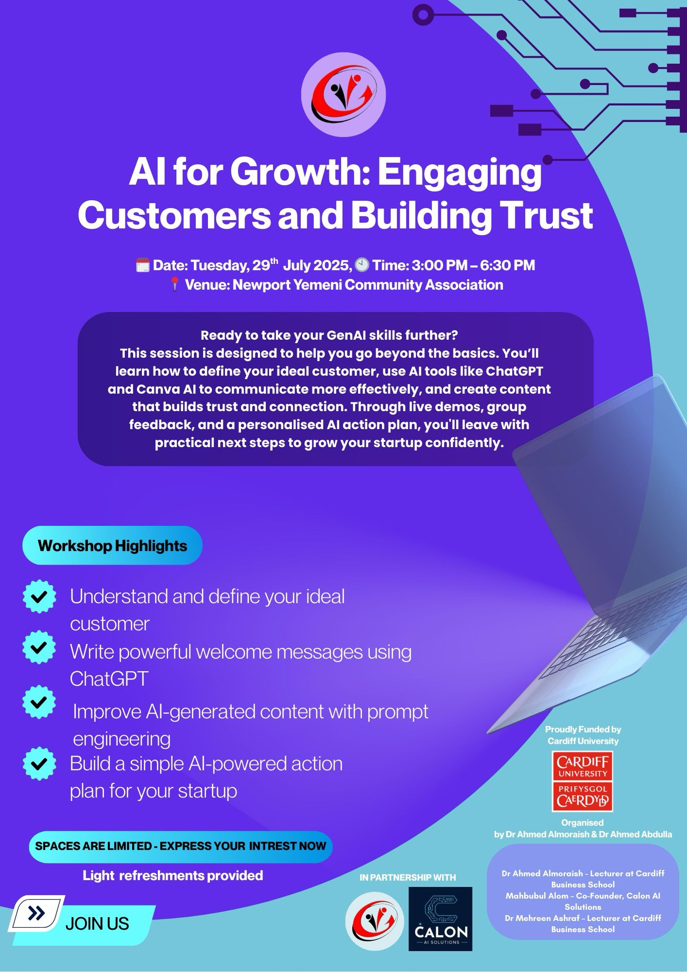

Slide 5

💬 Icebreaker
“What’s your idea or what would you love to start?”
No wrong answers!

Slide 6
What to expect from today’s session

Slide 7
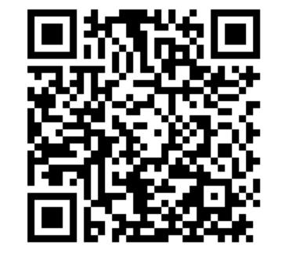
Please use your phone to scan the QR code and answer the pre session questions.

Slide 8
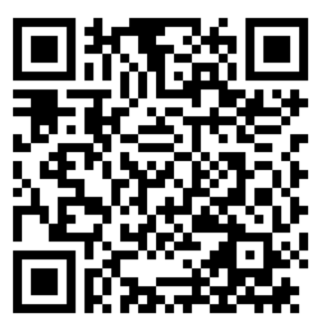
Please use your phone to scan the QR code and answer the post session questions.

Slide 9
