Slide 1

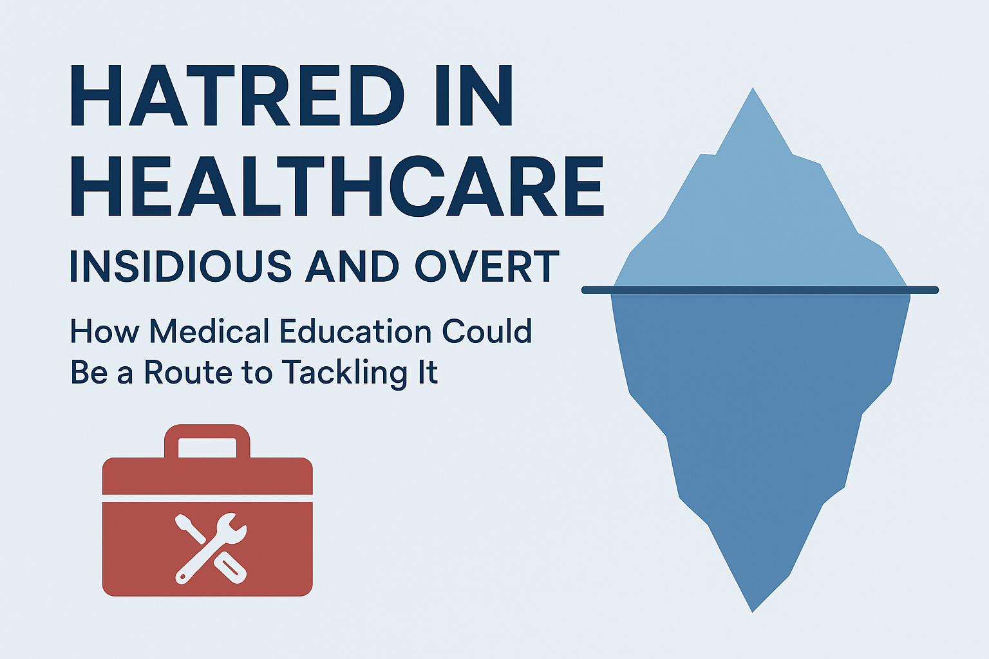

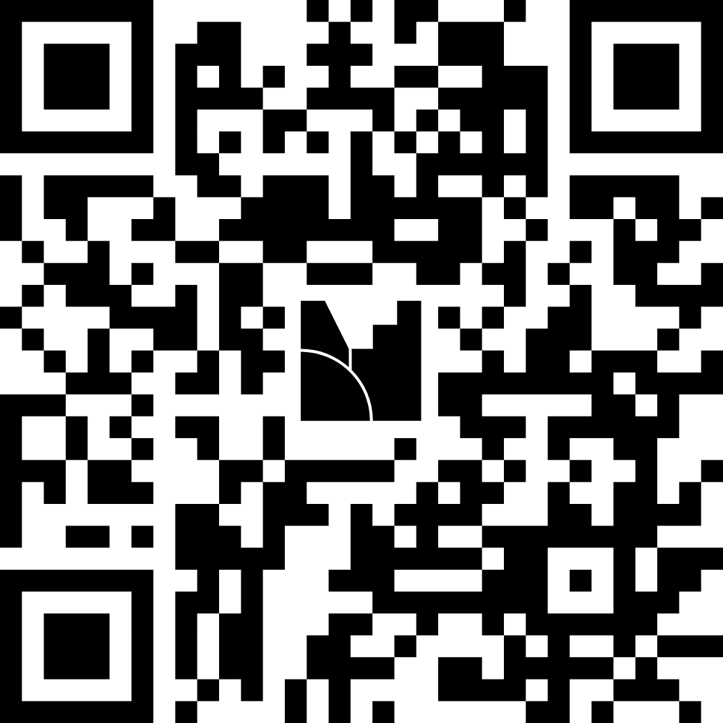
Dr Jo Hartland (they/them)
Dr Sarju Patel (he/him)

Slide 2
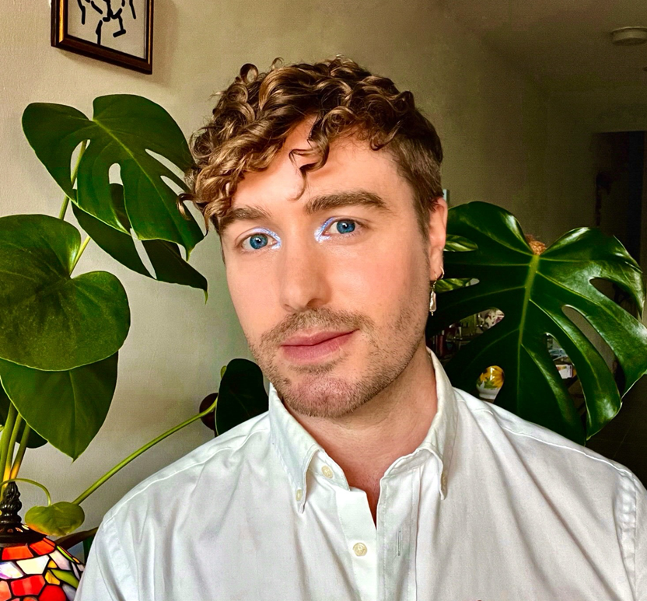
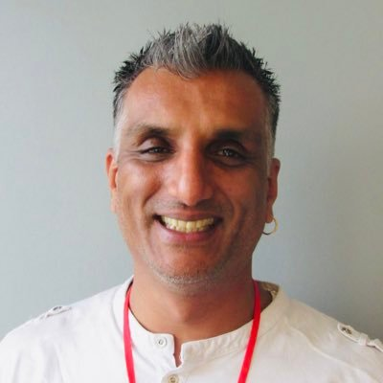
Introductions

Slide 3

Is healthcare political?

Slide 4

Should health education be political?
What do I even mean by that?

Slide 5
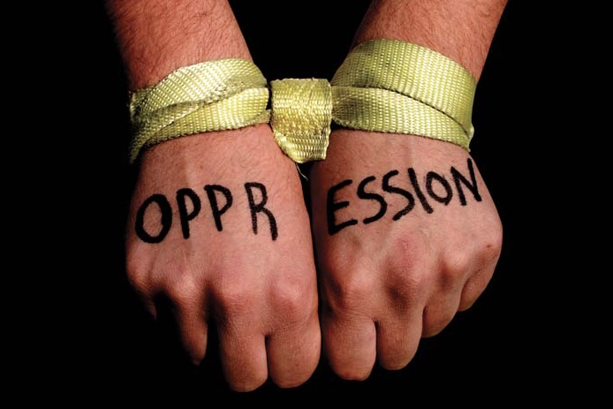
The problem with "Hatred"
Do we really think this is just about hate?
Hatred ignores other factors
What else drives polarisation?
Is there a better word?

Slide 6
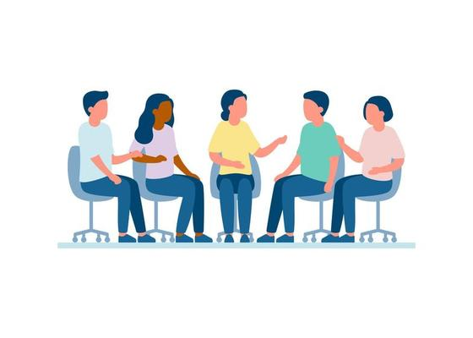
Question
Can you name any forms of oppression that exert power in healthcare and healthcare education?

Slide 7
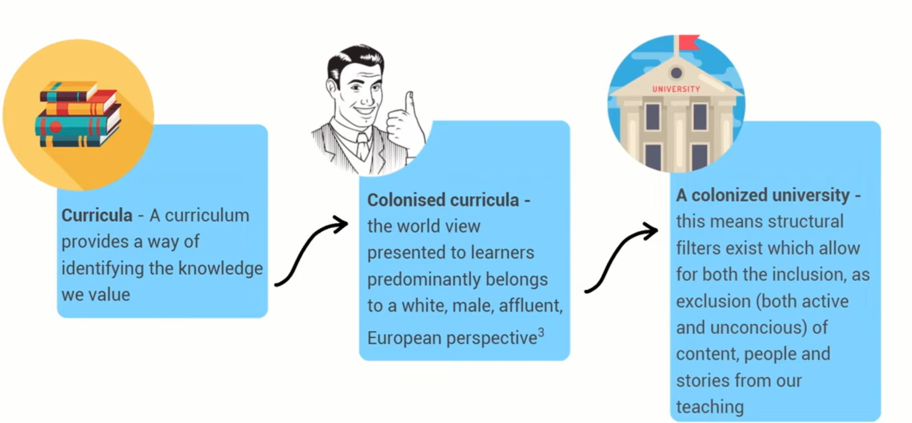
Colonisation of knowledge
Charles E. Decolonizing the curriculum. Insights the UKSG journal. 2019;32(1).

Slide 8
Medical curricula – oppression and hatred
Controlling health curricula controls population health
Absence, stereotyping and moralism often dehumanize people through their behaviours or diagnosis
What we teach and how we teach about says a lot about the lives we value
White Supremacy, Racism, Ableism, Eugenics, Queerphobia, Capilitism, Colonialism, Extractivism, Epistemic Injustice, …etc

Slide 9
The drivers for oppression are focused on achieving particular goals
What principles dictate this exclusion?
How do we decide who and what we value?
What is this designed to achieve?
What knowledge is filtered and politicised?
Which people and communities are excluded?
How does this occur?

Slide 10
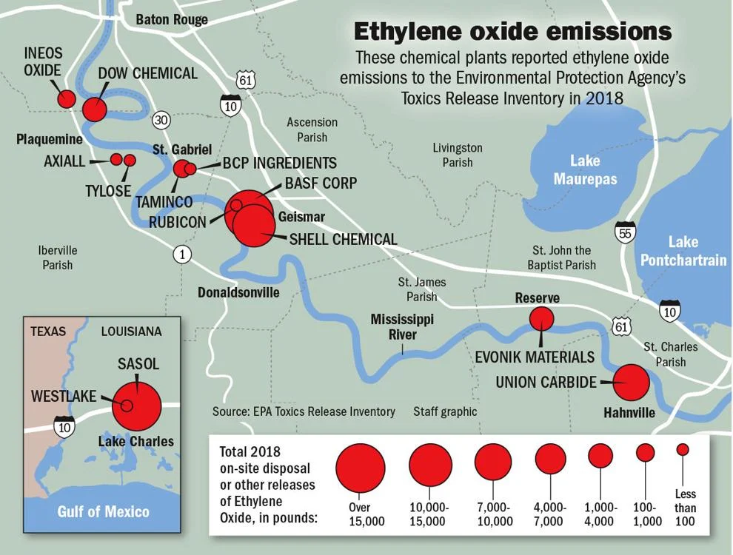
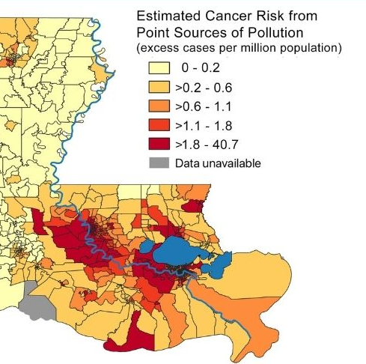
Planetary health – not a separate issue
85 miles stretch of land with >200 petrochemical plants and refineries and accounts for 25% of national production
These communities are predominantly Black and low income
In Reserve the risk of cancer is 50x the national average. High incidences of other illnesses e.g. asthma, preterm birth etc.
Considered a “sacrifice zone” where the right to extract in service of profit supersedes the right to health
Louisiana chemical corridor is the country's largest hot spot for toxic air, cancer risk | Environment | nola.com
Tulane study: Louisiana's severe air pollution linked to dozens of cancer cases each year | tulane

Slide 11
Question
Can you name any forms of anti-oppressive practice we can implement in healthcare and healthcare education?

Slide 12
Anti-oppressive praxis exists
Disability justice
Anti racism
Decolonisation
(Trans and POC Inclusive) Feminism
Queer theory
We must align work across multiple critical theories

Slide 13
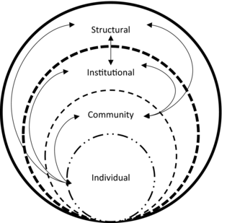
Multitiered Model of Oppression and Discrimination
(Torres et al, 2022)
Structural – System-wide forces rooted in social, economic, and political systems that shape health outcomes across populations.
Institutional - Policies, practices, and norms within specific institutions (e.g. hospitals, schools, prisons) that perpetuate unequal access to care or outcomes.
Community - Local norms, environments, and networks that shape health experiences and access to care.
Individual - Personal experiences, behaviours, and interactions influenced by social positioning, identity, and power dynamics.
Notes:
1. Structural Level
System-wide forces rooted in social, economic, and political systems that shape health outcomes across populations.
Examples:
Colonialism and racism embedded in healthcare systems, leading to persistent disparities in access and outcomes for racialised communities.
Austerity policies that defund public health services and social safety nets, worsening health for low-income populations.
Housing inequality driven by discriminatory policies (e.g., redlining, housing segregation), contributing to environmental health hazards (mould, overcrowding, pollution).
Patriarchal systems that undervalue women's health, especially reproductive and sexual health rights.
2. Institutional Level
Policies, practices, and norms within specific institutions (e.g., hospitals, schools, prisons) that perpetuate unequal access to care or outcomes.
Examples:
Medical school curricula that exclude or misrepresent conditions in Black, Brown, or disabled bodies.
Hospital policies that fail to provide language interpretation services, excluding non-English speakers.
Mental health services that disproportionately section Black men under the Mental Health Act in the UK.
Lack of accommodations for disabled patients or students in healthcare and education institutions.
3. Community Level
Local norms, environments, and networks that shape health experiences and access to care.
Examples:
Food deserts in low-income or racialised neighbourhoods where healthy, affordable food is inaccessible.
Stigma within communities (e.g., toward LGBTQ+ people or people with HIV) preventing individuals from seeking care.
Unequal distribution of health-promoting infrastructure like parks, clinics, or safe transportation in marginalised communities.
Community violence or policing that creates chronic stress and trauma, especially among youth and racialised communities.
4. Individual Level
Personal experiences, behaviours, and interactions influenced by social positioning, identity, and power dynamics.
Examples:
Healthcare discrimination where patients are not believed or listened to (e.g., Black women reporting pain during childbirth).
Internalised stigma leading to mental health challenges (e.g., among trans people or those with chronic illnesses).
Mistrust of healthcare providers due to historical and lived experiences of harm, leading to reduced engagement with care.
Limited health literacy due to educational inequities, making it harder for some individuals to navigate care.

Slide 14
A framework for injustice
Structural – Racism in UK society influences healthcare delivery, education, employment, and housing, all (below) of which affect maternal health outcomes.
Institutional - Black women are underrepresented in clinical curricula, research and health leadership.
Community - areas with high Black populations, there may be fewer maternity services, longer waiting times, and reduced access to midwifery continuity models
Individual - Black women often report feeling ignored or disempowered during childbirth, leading to traumatic birth experiences or missed clinical risks
Notes:
1. Structural Level
System-wide forces rooted in social, economic, and political systems that shape health outcomes across populations.
Examples:
Colonialism and racism embedded in healthcare systems, leading to persistent disparities in access and outcomes for racialised communities.
Austerity policies that defund public health services and social safety nets, worsening health for low-income populations.
Housing inequality driven by discriminatory policies (e.g., redlining, housing segregation), contributing to environmental health hazards (mould, overcrowding, pollution).
Patriarchal systems that undervalue women's health, especially reproductive and sexual health rights.
2. Institutional Level
Policies, practices, and norms within specific institutions (e.g., hospitals, schools, prisons) that perpetuate unequal access to care or outcomes.
Examples:
Medical school curricula that exclude or misrepresent conditions in Black, Brown, or disabled bodies.
Hospital policies that fail to provide language interpretation services, excluding non-English speakers.
Mental health services that disproportionately section Black men under the Mental Health Act in the UK.
Lack of accommodations for disabled patients or students in healthcare and education institutions.
3. Community Level
Local norms, environments, and networks that shape health experiences and access to care.
Examples:
Food deserts in low-income or racialised neighbourhoods where healthy, affordable food is inaccessible.
Stigma within communities (e.g., toward LGBTQ+ people or people with HIV) preventing individuals from seeking care.
Unequal distribution of health-promoting infrastructure like parks, clinics, or safe transportation in marginalised communities.
Community violence or policing that creates chronic stress and trauma, especially among youth and racialised communities.
4. Individual Level
Personal experiences, behaviours, and interactions influenced by social positioning, identity, and power dynamics.
Examples:
Healthcare discrimination where patients are not believed or listened to (e.g., Black women reporting pain during childbirth).
Internalised stigma leading to mental health challenges (e.g., among trans people or those with chronic illnesses).
Mistrust of healthcare providers due to historical and lived experiences of harm, leading to reduced engagement with care.
Limited health literacy due to educational inequities, making it harder for some individuals to navigate care.

Slide 15
What can education do?

Slide 16

Why Medical Education Matters
Identity formation
  “Professional” identity conflict
  Values and principles
Hidden and null curriculum
  What are we saying with how we present communities?
  What are we saying with their absences?
Multiplier effect
  Students are leaders and educators of the future

Slide 17
Too often work is focused on the individual solution, ignoring all other factors that can challenge oppression and hatred

Slide 18
Strategies: Curriculum
Equity & structural competency
  The impact of scio-economic factors on health
  How can students impact these?
Community voices
  Community knowledge valued and embededd
History of oppression in medicine
  Experimentation on enslaved peoples
  Harms of the eugenics movement

Slide 19
Strategies: Simulation and reflection
Standardised patients
  Who is shaping education
  What patients are seen and heard
Role-plays and case studies for bias/discrimination
  Empowerment to speak up
  Reflections on safe ways of doing so

Slide 20
Strategies: Assessment
Race/Ethnicity included in examination questions
  It is what we see, and we can’t hide from it
  Moves away from a Eurocentric expectation
Assess the assessment
  Reflective of the diverse population?
  Engage BAME people in the design of questions
Review examiner pass/fail biases
Reward empathy, equity, teamwork—not just technical skill

Slide 21
Strategies: Faculty & Culture
Faculty development
  Cannot just be “students” learning
  Systemic change is needed at all levels
Safe reporting & restorative practice
  Confidence that there will be action
  Empathy, accountability, and finding solutions together

Slide 22
Final thoughts

Slide 23

Liberation?
Health justice describes the ecosystem of community-led movements
What one small action will YOU take to challenge hatred in your role?
Think about learning beyond journals – social media, activism, books, plays, films, poetry
Embed educational solutions in community

Slide 24
Is healthcare political?

Slide 25
Should health education be political?
What do I even mean by that?

Slide 26
Questions
Jo.hartland@bristol.ac.uk
patels2@cardiff.ac.uk
Thank you

