Slide 1




#Physio25
Addressing undressing in Physiotherapy Education:
Time for a Rethink?
Chair: Amy Bendall ​
​
Facilitators: Sue Annetts; Jo-Dee Tame; Gareth Venn
​
​
​

Slide 2

#Physio25

Slide 3
Session Objectives:
1. To explore the issues that surround undressing in physiotherapy education with reference to both the existing literature and the student voice.
2. To collectively consider what are the best ways to learn anatomy and to practise physiotherapeutic skills, including the role of innovation ​within this.
3. To propose ways that educators can maximise the student experience to ensure an inclusive, positive and beneficial learning environment for all, whilst ensuring that high-quality learning and achievement of learning outcomes are met.
#Physio25

Slide 4

#Physio25
Discussion:
Share own experiences/thoughts on undressing for peer-physical examination to support learning in both academic and clinical settings:​
​
Pros and Cons of utilising this approach​
​
Potential alternative methods of achieving the same learning outcomes
4

Slide 5
#Physio25
The Literature – Key Themes
Gender​
​
Culture​
​
Religion​
​
Ethical
5

Slide 6
Our Student Voice
#Physio25
Themes following Frontline Article:​
​
Menstruation​
Shaving​
Fake tan​
Gender​
Body image
Themes ​from student projects:
Social dynamics
Fear of being judged
Initial reactions
Adaptions over time
Education and programme perspective
Working practices
6

Slide 7


The Informed Study Project
#Physio25
Web pages / pdf document informing applicants what is involved in studying physiotherapy (including undressing)​
Forms part of the fitness to practice declaration for offer holders​
Has evaluated well (from both a student and staff perspective)
Student quote: “The ISP clearly states what is required of prospective students, as well as what they can look forward to”
7

Slide 8
Discussion:
#Physio25
What opportunities are there to optimise the experience of undressing for peer-physical examination and ensure that education practices are inclusive and positive, whilst ensuring high-quality learning and achievement of learning outcomes?
8

Slide 9
#Physio25
Final thoughts – student quotes
“Having to undress yourself really makes you realise how vulnerable patients might feel.”​
“I think it’s…helpful for examining or assessing people. And it’s also important because we know how it feels to be a patient…”
9

Slide 10
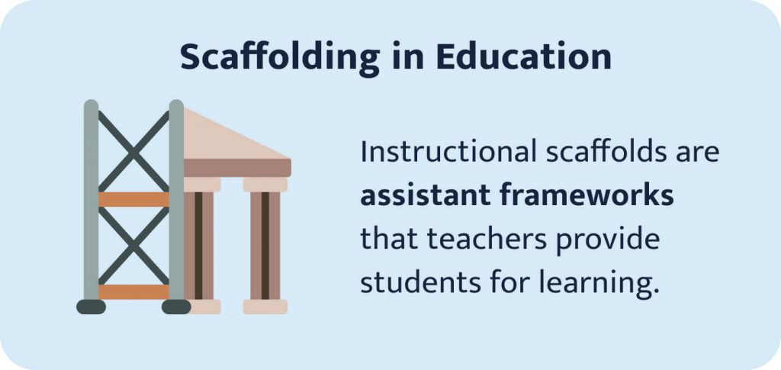
10

Slide 11

#Physio25
Addressing undressing in peer-physical examination:
Is it time for a re-think?
11

Slide 12
#Physio25
Diolch yn fawr
Contact: BendallA@cardiff.ac.uk
csp.org.uk/conference

