Slide 1
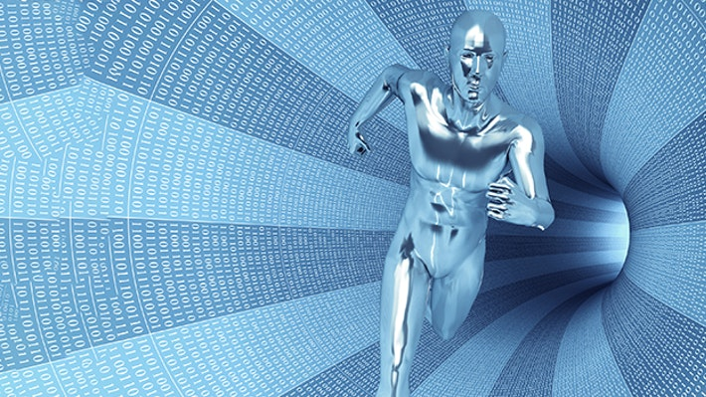

Towards a new EU approach on robot liability
Dr Christos Andrikopoulos
Lecturer in Law

Slide 2

OUTLINE
  LEGAL AND TECHNICAL CHALLENGES
  EU REGULATORY INITIATIVES
  ROBOT LIABILITY - NEW REGIME?
      CLAIMANT’S INTEREST
      AMENDMENT OF PRODUCT LIABILITY DIRECTIVE
      SECTOR-SPECIFIC RISK MANAGEMENT APPROACH

Slide 3
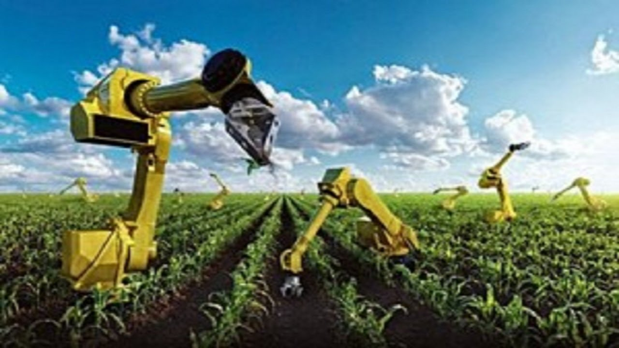
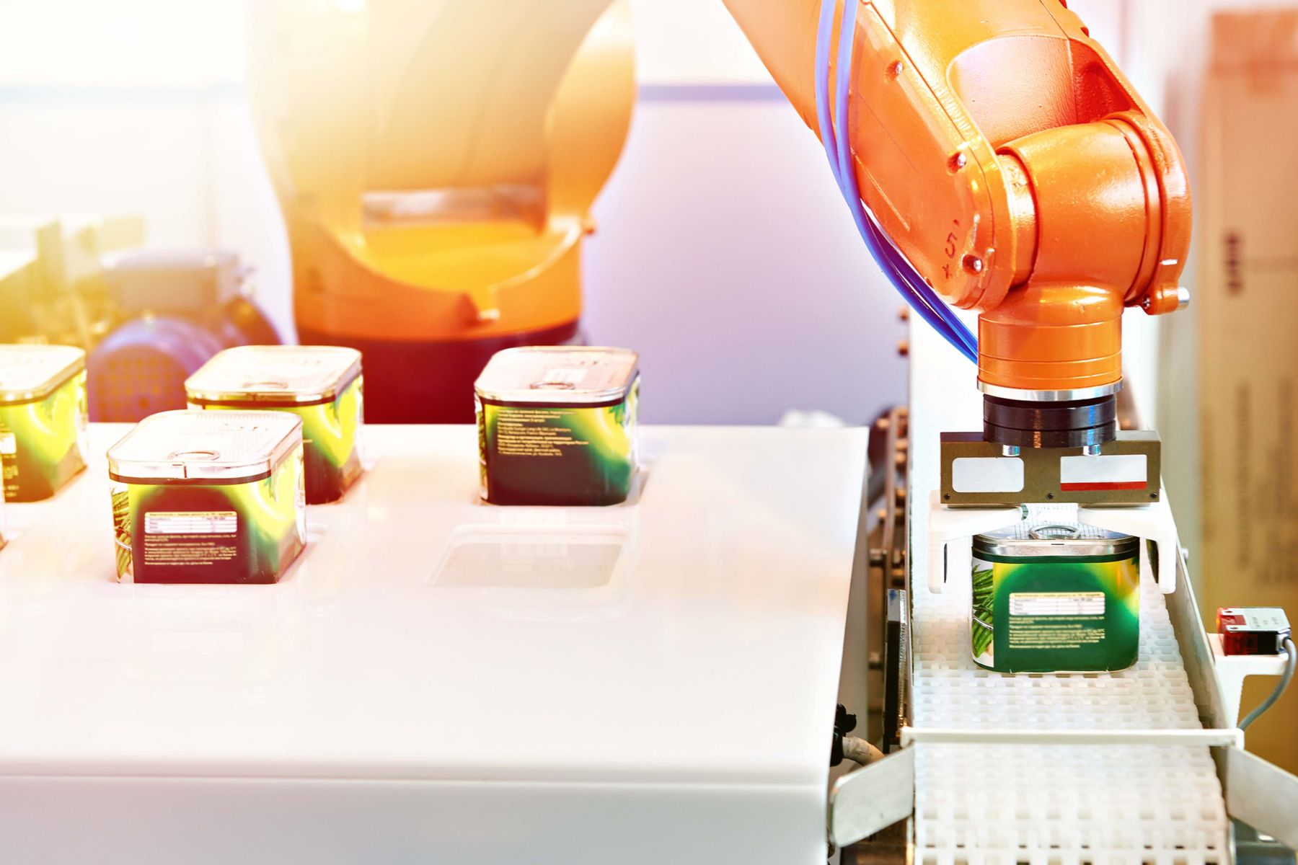
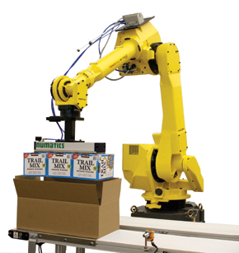
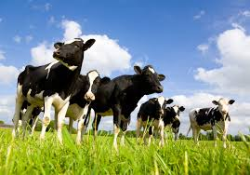
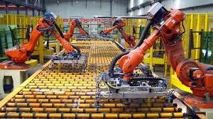
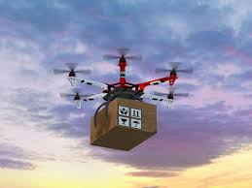
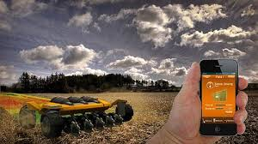
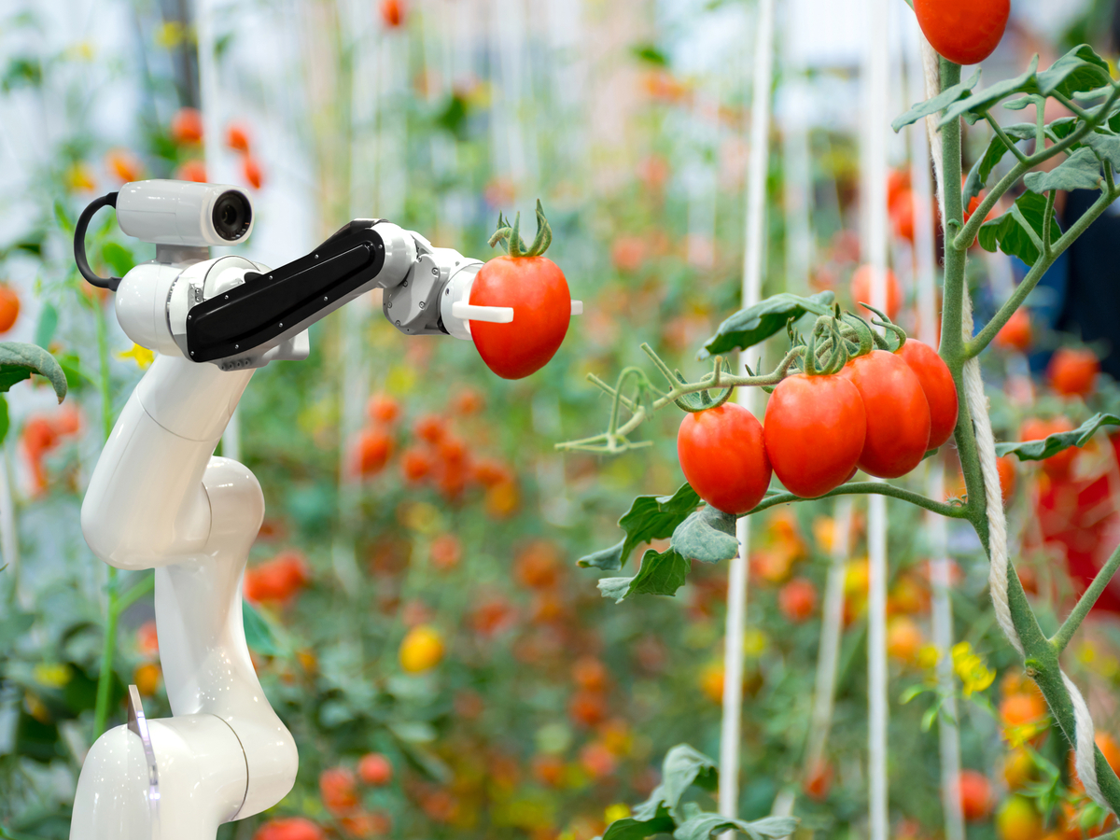

AGRO-FOOD SUPPLY CHAIN
AGRICULTURE
FOOD PROCESSING
FOOD DISTRIBUTION

Slide 4
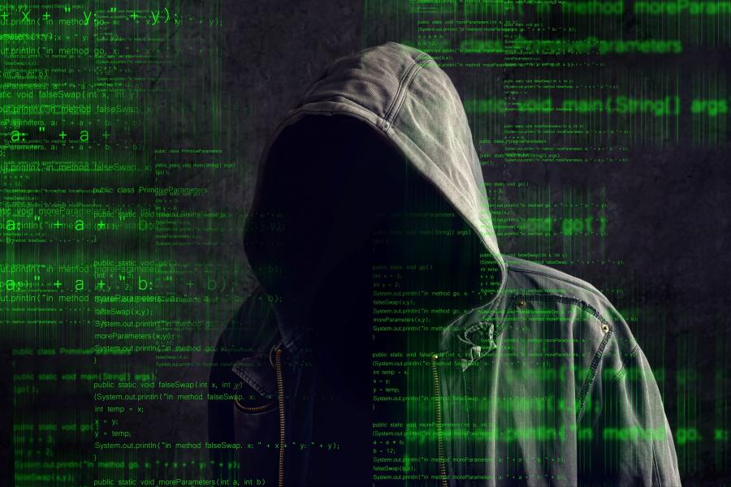
R E G U L A B I L I T Y
R E S P O N S I B I L I T Y

Slide 5

R E G U L A B I L I T Y

Slide 6
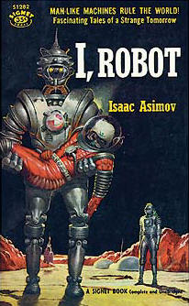
THE THREE LAWS OF ROBOTICS
A robot may not injure a human being, or, through inaction, allow a human being to come to harm.
A robot must obey the orders given it by human beings except where such orders would conflict with the First Law.
A robot must protect its own existence as long as such protection does not conflict with the First or Second Law.
Isaac Asimov (1950).
BUT: Law And Technology are Co-evolving Social Systems
                Niklas Luhmnann (1993)

Slide 7
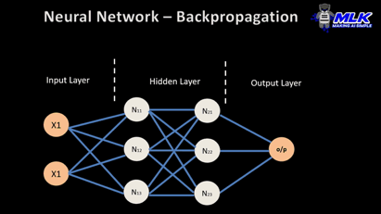
MACHINE LEARNING NETWORK
Notes:
S7
The comparison between law and machine learning is not entirely fanciful I think, and it is interesting that machine learning uses concepts similar to legal concepts.
This is a Machine learning network based on a neural model of interconnected nodes, which are organised into layers.
And this neural model of machine learning uses terms derived from Neuroscience, so we talk about synapses and neurons.
This is a kind of brain science model of machine learning It applies an input-output process involving self correcting algorithms - deep learning.

Slide 8
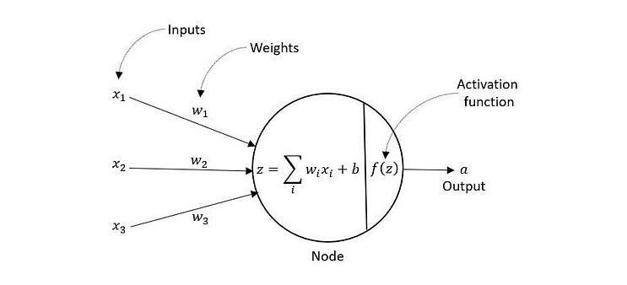
NODE DEMONSTRATION

Slide 9
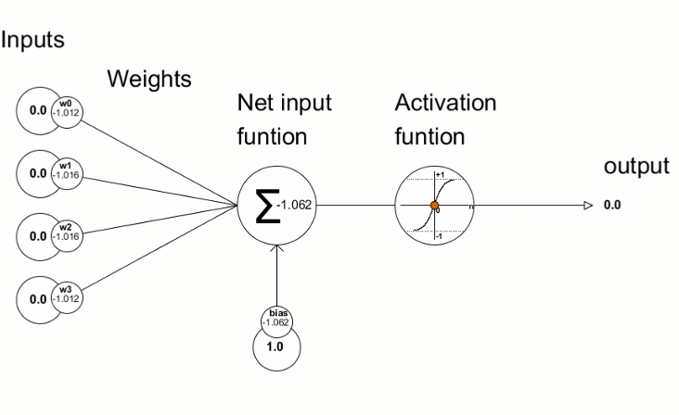
WEIGHTS IN ACTION

Slide 10
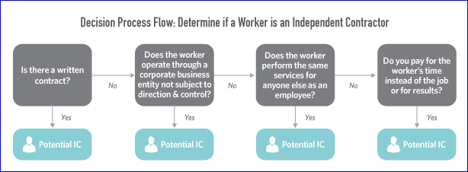
INPUT-OUTPUT PROCESS IN LEGAL CASES

Slide 11
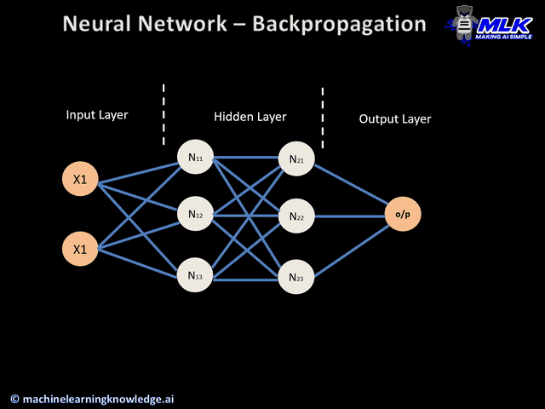
NEURAL NETWORK - BACKPROPAGATION

Slide 12
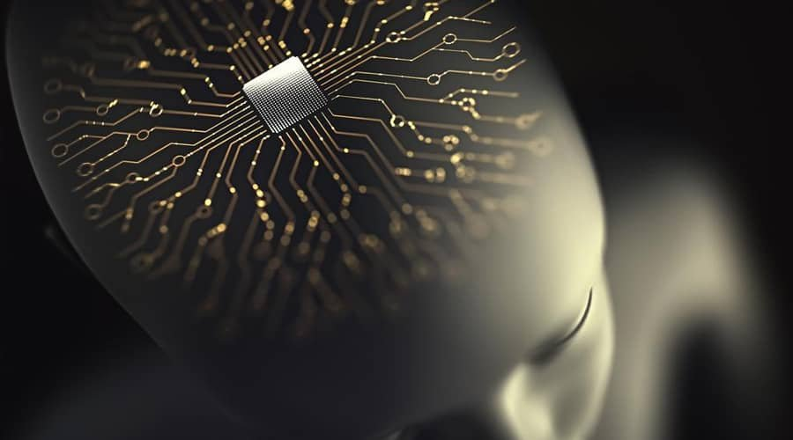
European Parliament report (2017)
with recommendations to the Commission on Civil Law Rules on Robotics
autonomous machines:
as electronic persons

Slide 13

AI AND THE LAW OF OBLIGATIONS
AI AND FAULT:
        How far the rules of negligence can be appropriately applied to decisions taken by AI?
ALGORITHMS AND AGENCY:
        Who should bear legal responsibility for decisions made by AI?
DEFECTIVE AI:
        What counts as defective AI?

Slide 14

EU LEGAL FRAMEWORK ON AI
European Parliament’s resolution on AI Act, P9_TA(2024)0138
Proposal for an AI liability directive, COM/2022/496 final
Proposal for a revised Product Liability Directive, COM(2022) 495 final
Proposal for a regulation laying down harmonised rules on AI, COM/2021/206 final
Proposal for a Regulation on Product Safety, COM/2021/346 final
European Parliament resolution on a civil liability regime for AI 2020/ 2014(INL)
Categories of AI-related risks:
minimal risk, limited risk, high risk, unacceptable risk

Slide 15
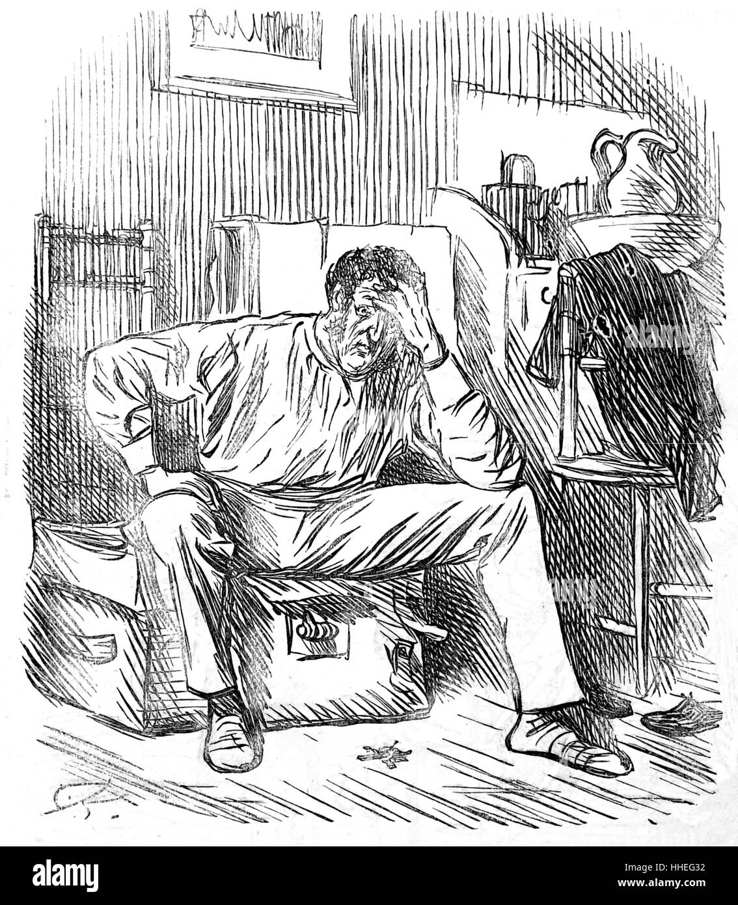
1st OBJECTIVE
Liability scheme by reference to the claimant’s interest
personal injury
reputational injury
damage to property
pure economic losses

Slide 16

2nd OBJECTIVE
Extending Strict Liability under Product Liability Directive
including specific intangible products
reversing the burden of proof
removing the development risk defense and the arbitrary damages threshold

Slide 17
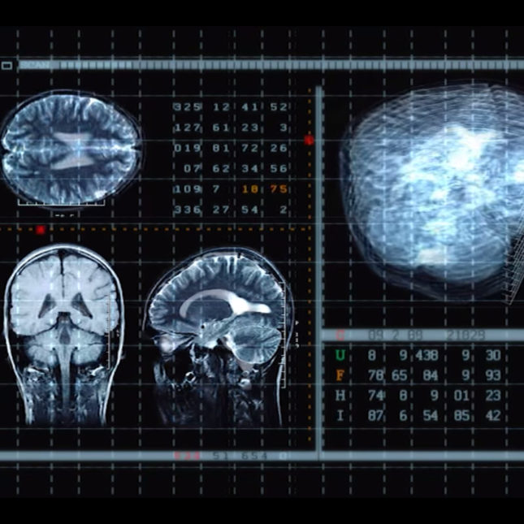
3rd OBJECTIVE
Introducing Legislation based on a Sector-Specific Risk Management Approach
Assigning strict liability to the party best placed to:
identify the risk
control and minimize the risk;
manage the risk, for example, through obtaining insurance
e.g. IBM’s Watson
(AI enabled diagnostic technology)

Slide 18
CONCLUSION
Recommending a new robot liability regime in the EU based on:
  the claimant’s interests
  the appropriate changes of Product Liability Directive
  an effective sector-specific Risk Management Approach
Notes:
.

Slide 19
T H A N K Y O U

