Slide 1
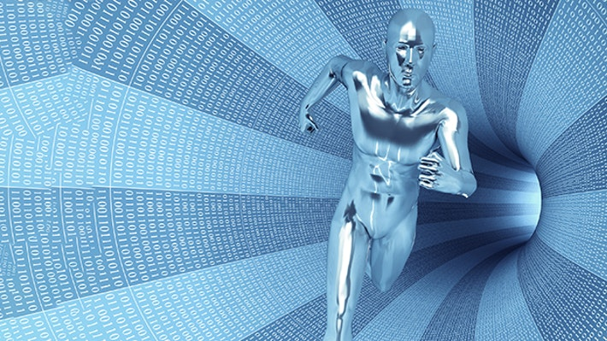

Law and Technology as Co-evolving Social Systems
Legal Aspects on Robotics
Christos Andrikopoulos
Lecturer in Law
Notes:
1

Slide 2
OUTLINE
LEGAL CHALLENGES IN ROBOTICS
QUALITY OF MACHINE LEARNING DECISIONS
ROBOT LIABILITY - NEW REGIME?
SECTOR-SPECIFIC RISK MANAGEMENT APPROACH
Notes:
To begin with the outline
First, I will discuss legal challenges in robotics
Then, I will briefly highlight points about the quality of machine learning decisions
Finally, I will present my recommendations for a new legislation based on SSRMA.

Slide 3
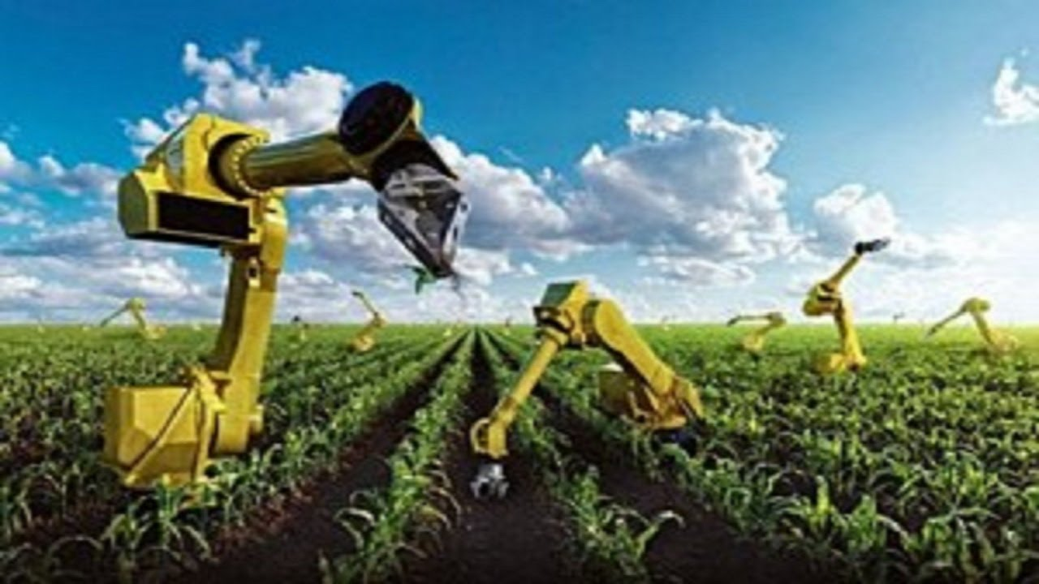
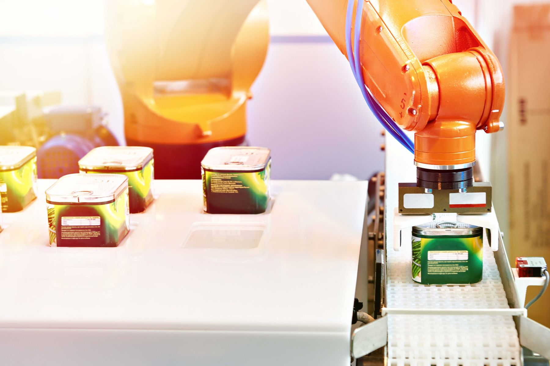
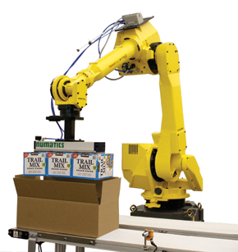
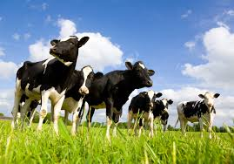
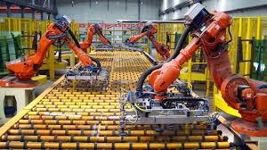
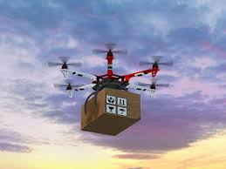
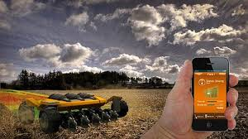
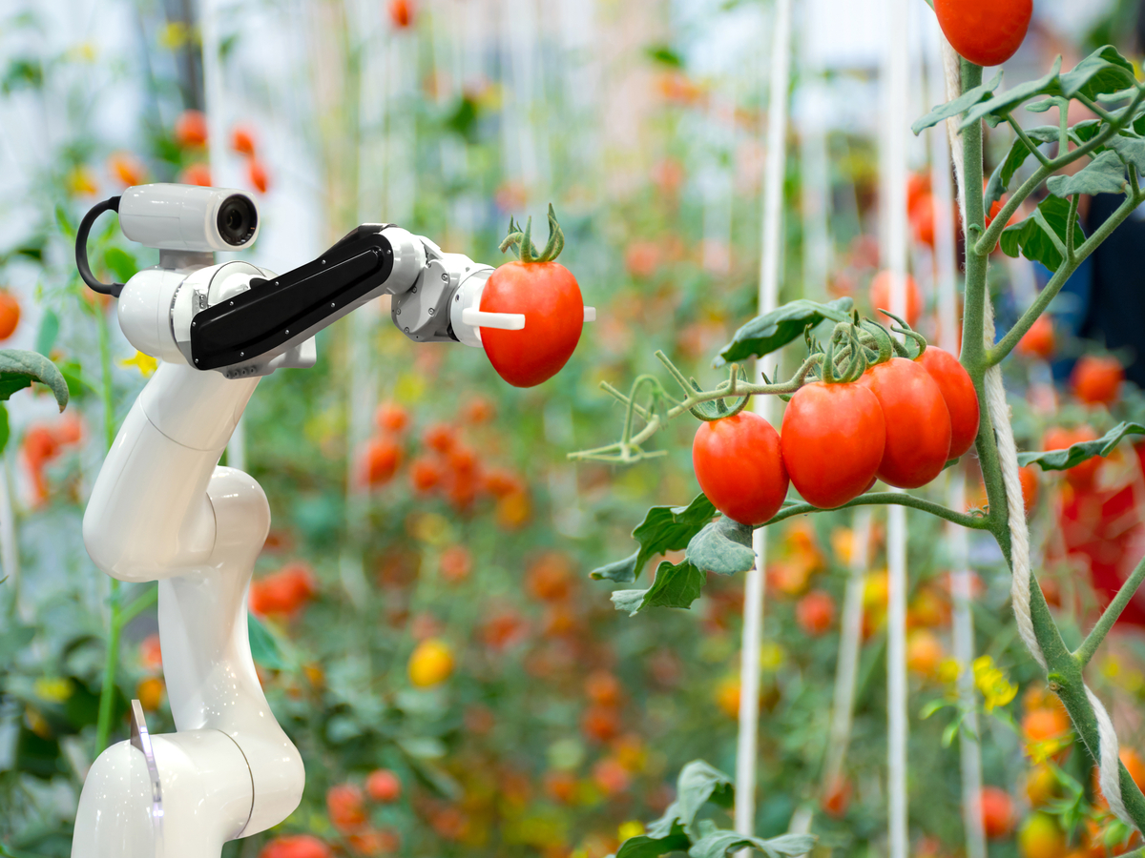

AGRO-FOOD SUPPLY CHAIN
AGRICULTURE
FOOD PROCESSING
FOOD DISTRIBUTION
Notes:
There is no doubt that the recent developments in Artificial intelligence play a significant role in almost every industry.
- For example, in the agro-food supply chain, robotics technology has already begun to transform modern agriculture, food processing and food distribution systems.

Slide 4

R E G U L A B I L I T Y
R E S P O N S I B I L I T Y
Notes:
However, there are important legal issues about responsibility.
- As Robots become more autonomous, the question of who is liable when something goes wrong is complicated.
Is the manufacturer liable, the programmer, or the user who gave a bad instruction?

Slide 5

R E G U L A B I L I T Y
Notes:
Also, there are important issues of regulability
… because of the inadequacies in the current legal system, that presumes linear causation, while the actions of autonomous robots can be nonlinear and unpredictable.

Slide 6
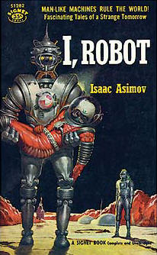
THE THREE LAWS OF ROBOTICS
A robot may not injure a human being, or, through inaction, allow a human being to come to harm.
A robot must obey the orders given it by human beings except where such orders would conflict with the First Law.
A robot must protect its own existence as long as such protection does not conflict with the First or Second Law.
Isaac Asimov (1950).
BUT: Law And Technology are Co-evolving Social Systems
Niklas Luhmann (1993)
Notes:
- Robots are currently designed, in a way that is analogous to the strict versions of “The Three Laws of Robotics”.
- According to these laws: A robot may not injure a human being, must obey the orders given it by human beings, and at the same time must protect its own existence.
- However, these abstract rules that simply prescribe how robots should act around humans cannot take into consideration the complexities of code-based approaches associated with highly sophisticated devices entering the real world.
- These laws cannot serve the recent developments in Machine Learning.
- But, there is no iron law in capitalism. If technology evolves, then the law must evolve and find appropriate ways to address the consequences of technological change.
.

Slide 7
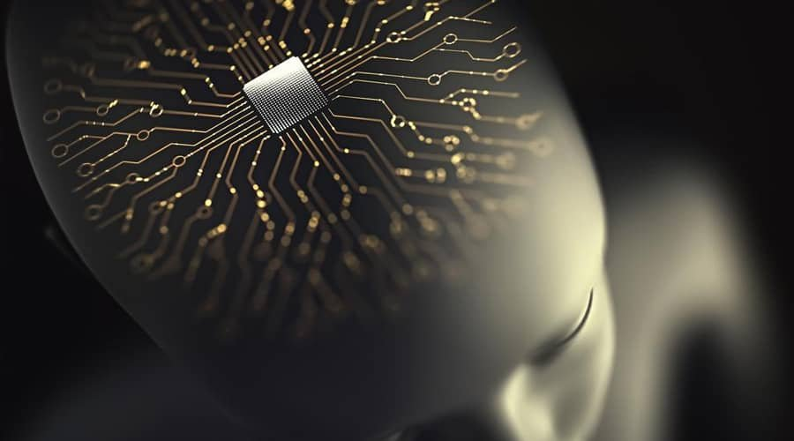
European Parliament report (2017)
with recommendations to the Commission on Civil Law Rules on Robotics
autonomous machines:
as electronic persons
Notes:
- In 2017, the European Parliament introduced the idea of ascribing legal personality to Robots, when making autonomous decisions and interacting independently.
- However, this is not a feasible option, because Robots would need to hold assets, such as humans and corporations, to pay any compensation claims against them.

Slide 8
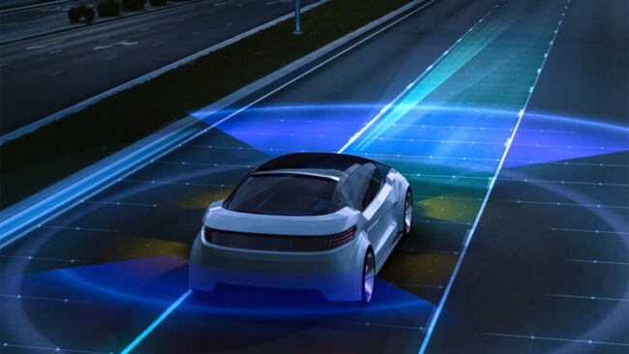
UK Automated and Electric Vehicles Act 2018
Notes:
Also other initiatives, such as the UK Automated and Electric Vehicles Act 2018, have very limited scope to cope with the complexities of AI.

Slide 9

EU LEGAL FRAMEWORK ON AI
European Parliament’s resolution on AI Act, P9_TA(2024)0138
Proposal for an AI liability directive, COM/2022/496 final
Proposal for a revised Product Liability Directive, COM(2022) 495 final
Proposal for a regulation laying down harmonised rules on AI, COM/2021/206 final
Proposal for a Regulation on Product Safety, COM/2021/346 final
European Parliament resolution on a civil liability regime for AI 2020/ 2014(INL)
Categories of AI-related risks:
minimal risk; limited risk; high risk; unacceptable risk
Notes:
- The proposed EU legal framework on AI is also insufficient, although it is the most comprehensive AI law in the world.
- It is based on a complex exercise in a taxonomy of dividing applications into minimal risk, limited risk, high risk, unacceptable risk.
- But, we cannot assign AI systems a specific risk profile – we do not have t the necessary data available yet to accurately determine the risks brought by emerging technologies.

Slide 10
Co-evolution of Law and Technology
Stages of the project:
1st stage
to develop technical instruments to diagnose the quality of machine learning decisions; identify its failures; and identify root causes of such failures
2nd stage
to build on these instruments to formulate robust legal principles attaching liability to different actors involved in the production/operation of faulty machine learning systems
Notes:
- So, it is important to see law and technology as two co-evolving systems.
- And find a trajectory for the co-development of legal responsibility on the one hand and machine learning and systems driven by it on the other.
- we should First develop technical instruments to diagnose the quality of machine learning decisions, and identify its failures and root causes of such failures.
- Then, building on these instruments, we could formulate robust legal principles attaching liability to different actors involved in the production/operation of faulty machine learning systems.
- Namely, the goal of this research is to formulate an adequate legal framework based on the quality of machine learning decisions.

Slide 11
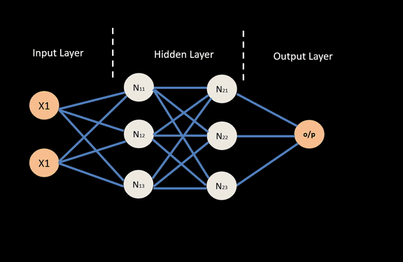
MACHINE LEARNING NETWORK
Notes:
Let me explain.
- This is a Machine learning network based on a neural model of interconnected nodes, which are organised into layers.
- This network applies an input-output process involving self-correcting algorithms - deep learning in the hidden layer -.
.

Slide 12
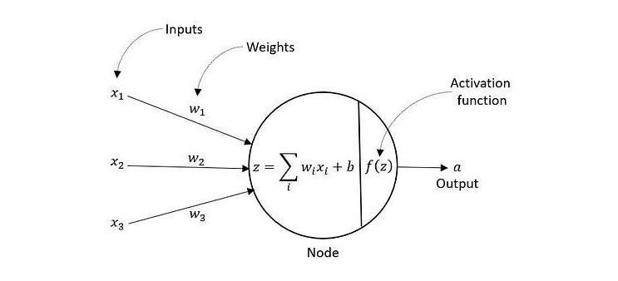
NODE DEMONSTRATION
Notes:
Each node receives a set of inputs, multiplied by a weight value, which will be optimised during the training process and learning.

Slide 13
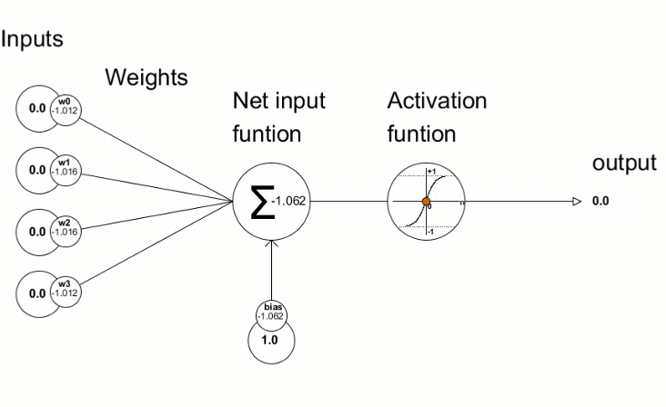
WEIGHTS IN ACTION
Notes:
- When the network is active, there is a constant input-output process, where nodes receive data.
- Computer scientists adjust weights in response to inputs from the environment involving self-correcting algorithms.

Slide 14
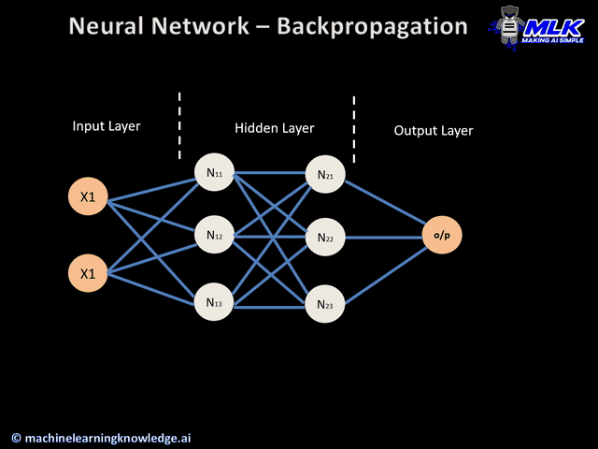
NEURAL NETWORK - BACKPROPAGATION
Notes:
- Of course, this can be massively speeded up using machine learning backpropagation and gradient descent.
- These mathematical ideas and machine-learning-based tools can have legal equivalence, and so they can help us to diagnose the quality of machine learning decisions in order to formulate an adequate regulatory framework on AI.
- So, for certain losses caused by AI, I think it may be preferable to adopt ad hoc legislation in specific sectors.

Slide 15
Introducing Legislation based on a Sector-Specific Risk Management Approach
ad hoc legislation in specific sectors (e.g. drones)
2. RMA would assign liability to the actor(s) best placed to:
identify the risk
control and minimize the risk
manage the risk
Notes:
- A sector-specific legislation can acknowledge the differences of robot applications in terms of technological traits, uses and regulatory concerns (for example, drones)
- Then, a RMA would assign liability to actors best placed to: (i) identify the risk; (ii) control and minimize the risk; and (iii) manage the risk, for example, through obtaining insurance.
- This is the area I focus on, and these are my recommendations/ co-evolution of law and tech.
- However, the question remains. Who could be liable for actions of extremely sophisticated AI systems that will be completely autonomous and independent?

Slide 16
R E S P O N S I B I L I T Y
R E G U L A B I L I T Y
Notes:
Again, this raises questions about responsibility and regulability.
- If for example the creator is liable, this does not mean this system will stop operating, because it is completely autonomous.
- Perhaps, it should be the system itself responsible, but how to regulate a technology that is autonomous and independent?
- For this reason, it is extremely important to start thinking about the Legal, Ethical and Political implications.
And figure out what kind of these technologies can be regulated without undermining the potential and the benefits provided by their independent nature.

Slide 17
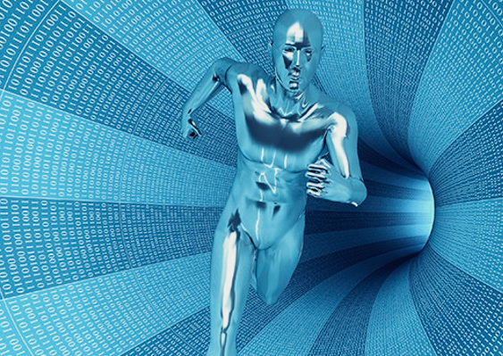
T H A N K Y O U

