Slide 1
Swearing as a Leadership Tool
Nick Wilson
Victoria University of Wellington
New Zealand
nick.wilson@vuw.ac.nz
Cardiff University
Wales

Slide 2
Introduction
Functions of swearing
Methodology
Meanings
Quantitative analysis
Qualitative analysis

Slide 3
Functions of swearing
Emphasis – an emphatic intensifier par excellence
McEnery & Xiao 2004
Solidarity/group membership – swearing occurs more among friends
Daly et al 2004
Stapleton 2003
Insults/offense – different people judge swearing to be more or less offensive
Jay & Janschewitz 2008

Slide 4
Methodology
Amateur rugby team in New Zealand
Data collected over one year
Ethnography
Match-days and training sessions
Swearing noticeable as high frequency
Swearing is unmarked

Slide 5
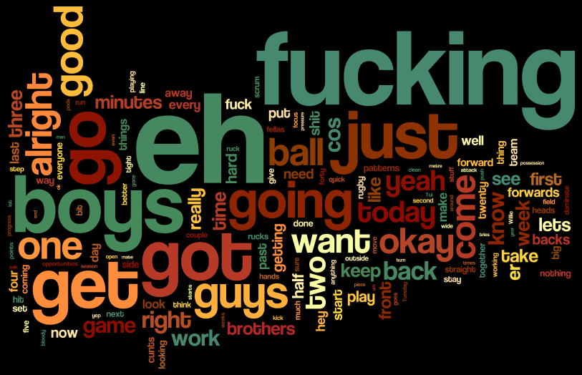
Match Day

Slide 6
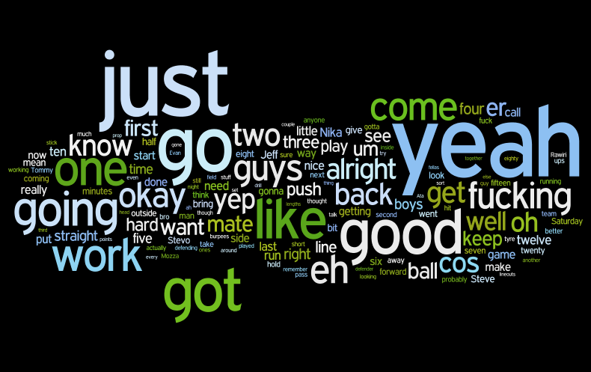
Training Session

Slide 7
Swearing in the rugby corpus
Context | Recorded Words | Swearword Count | Normalised Frequency (per 1000 words)
match | 13558 | 306 | 22.56
training | 10448 | 91 | 8.71

Slide 8
Local Meaning and Indexicality
High frequency swearing
Masculinity
In-group membership
Youth
Rugby stereotype

Slide 9
Swearword | Match | Training | Total
arse | 9 | 4 | 13
arses | 1 |  | 1
bastards | 1 |  | 1
bitch | 1 | 1 | 2
bitching |  | 1 | 1
bloody | 10 | 3 | 13
blue-arsed |  | 1 | 1
bullshit | 1 | 1 | 2
cunt |  | 1 | 1
cunts | 19 | 4 | 23
damn |  | 1 | 1
fuck | 28 | 12 | 40
fucked | 5 | 2 | 7
fucker |  | 1 | 1
fuckers | 1 |  | 1
fucking | 191 | 51 | 242
hell | 6 | 1 | 7
prick | 1 |  | 1
shit | 31 | 5 | 36
shithot |  | 1 | 1
shitload |  | 1 | 1
shitwork | 1 |  | 1
Grand Total | 306 | 91 | 397

Slide 10
Communicative Events
Frontstage and backstage
Main speakers
Player-dominated
Coach-dominated
Mixed
Function
Match | Training
team meeting | training huddle
pre-match huddle | training drill frontstage
during match | de-brief
half-time huddle | performance feedback
post-match huddle | leaders backstage
 | player backstage

Slide 11
Swearing by event (match/training)

Slide 12
Swearing by event (frontstage/backstage)

Slide 13
Swearing by event (coach/player/mixed)

Slide 14
Leadership Roles
Coaches
Head Coach
Assistant Coach
Captains
Captain
Co-captain
Vice-captain

Slide 15
Styles of Leadership Discourse
1 2 3 4 5 6 7 8 9 10 11 12 13 14 15 16 17 18 19 20 21 | Tommo: | it might not happen in the first scrum it might not happen in the- in the scrum in the sixtieth minute but by the end of the game I want to make sure and I want see from you guys that we dominate their tight five I want us to be aggressive entering the collision zone so when we're going int- into breakdowns when we're carrying or going into a tackle I want to see us aggressive up front and I want to see that all day I want it controlled but I want it aggressive out of the aggression it means that we go forward [...] it's us going forward all day and it's got to happen up front okay?
1 2 3 4 5 6 7 8 9 10 11 12 13 14 15 | Jon: | forwards we're in these cunts' faces all fucking day we dominate these cunts [...] but we're fucking into them alright? I want to see cunts fucking get bent over backwards eh? first scrum I want to hear fucking ribs getting broken alright? [...] tackles we fucking nail these cunts alright? no fucking mercy hardcore and we're fucking ruthless are we up for it boys?

Slide 16
Functions of Swearing
Tommo – Half-time
first ten minutes
when we stuck to our patterns
we scored two good tries and then we just dropped our level
dropped to these guys’ level
for coming in from the side .. stupid fucking cheap shots
get that shit out of the game there’s no fucking place for it here
.. ok?
Jon – Half-time
we’ve got the tools it’s just us
alright boys
fucking heads up boys
heads up this in our grasp eh?
ten eight-
er twenty eight’s nothing fucking nothing
Parky – Half-time
let’s do our own bloody jobs first forget about the talk ..
do our jobs and then work ..
the second thing is
WORK your arse off off the ball okay?
Criticism
Advice/Directive
Encouragement

Slide 17
Swearing by Speaker and Event

Slide 18
Speaker and Speech Act

Slide 19
Engendering Solidarity
 | Parky Ata Parky Ata Parky Ata Ata | sometimes you don't always get it a hundred percent right mate cos it all depends on the camera footage as well yeah yeah yeah and you'll see that like in the [team name 2] .. I think um Dodds took over in the second half yeah and fucking some parts of it after doing it I felt seasick you know ? [laughs] just cos the camera's moving around it's like .. hold it still man [laughter]

Slide 20
Swearing as a Leadership Tool
Used to motivate
Used to signal group membership
Used to engender solidarity
Used to criticise
A local practice used as a leadership tool

Slide 21
Daly, Nicola, Janet Holmes, Jonathan Newton and Maria Stubbe. 2004. Expletives as solidarity signals in FTAs on the factory floor. Journal of Pragmatics 36: 945–964.
Jay, Timothy and Kristin Janschewitz. 2008. The pragmatics of swearing. Journal of Politeness Research. Language, Behaviour, Culture 4: 267–288.
McEnery, Anthony and Zhonghua Xiao. 2004. Swearing in Modern British English: The case of fuck in the BNC. Language and Literature 13: 235–268.
Stapleton, Karyn. 2003. Gender and swearing: A community practice. Women and Language 26: 22–34.

