Slide 1

Qualitative interviews as a collaborative space: lessons from visual research methods to encourage a more participatory approach
Aimee Grant, Dawn Mannay, Melanie Morgan, Dunla Gallagher, Ruby Marzella
GrantA2@Cardiff.ac.uk @grant_aimee

Slide 2





Acknowledgements
Co-investigators: Dr Dawn Mannay, Prof Shantini Paranjothy
Research team: Dr Melanie Morgan, Mrs Dunla Gallagher, Ruby Marzella

Slide 3
Overview
Rationale:
  moving away from researcher dominance
Study 1: Artefact facilitated interviewing
Study 2: Longitudinal participatory visual research:
  Timeline facilitated life history interview
  Collaging
  Sandscapes
Reflections for practice

Slide 4
Researcher led interactions
Wide recognition in social sciences that researchers should reflect on power relations in research (Coffey 1999)
Semi-structured interviews place the researcher in a position of control and dominance
  Our own presentation as academics with consent forms etc
  Questions
  Dictaphone
This may make some participants feel we are the ‘expert’ on the topic we are asking them about
Health professionals may reject this, but what about marginalized participants?

Slide 5
Moving towards the visual
Visual methods: artistic or creative methods to represent the world
A Plethora of texts have emerged from anthropology and social sciences (Rose 2012, Mannay 2016, Van Leeuwen and Jewitt 2001)
Techniques do not have to require high ‘creativity’ among participants; different approaches for different groups
Visual methods may be participatory, partially participatory or non-participatory
  Visual methods are one challenge to researcher dominance IF used in a participatory way

Slide 6
Two studies
Artefact facilitated interviewing
freely available for download: Grant, A. Mannay, D and Marzella, R. (2017). People try and police your behaviour’: the impact of surveillance on mothers and grandmothers’ perceptions and experiences of infant feeding. Families, Relationships and Societies. DOI: 10.1332/204674317X14888886530223
2. Longitudinal study with pregnant women:
Visit 1: Timeline facilitated life history interviews
Visit 2: Thought bubbles
Collaging
Sandscape
Under review: Grant, A.; Morgan, M; Gallagher, D; Mannay, D. “I think there is a time and a place”: an exploration of smoking during pregnancy, place and stigma using qualitative visual methodologies. Critical Public Health
Forthcoming: Mannay, D., Creaghan, J., Gallagher, D., Marzella, R., Mason, S. and Morgan, M. Grant, A., (2017). Negotiating closed doors and constraining deadlines: the potential of visual ethnography to effectually explore spaces of motherhood and mothering. Journal of Contemporary Ethnography.

Slide 7
Study 1: artefact facilitated (dyad) interviewing
Aim: to understand infant feeding decision making among mothers and grandmothers from deprived areas of south Wales
Dyads
Artefacts
Pre-interview instructions
Mediated accounts

Slide 8
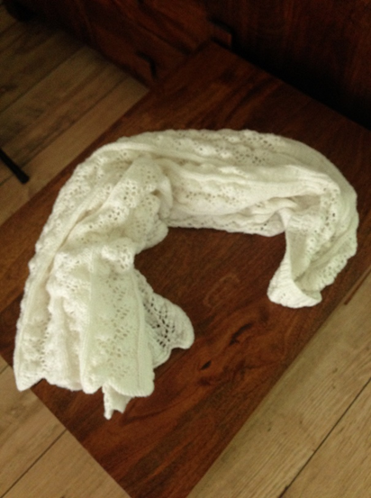
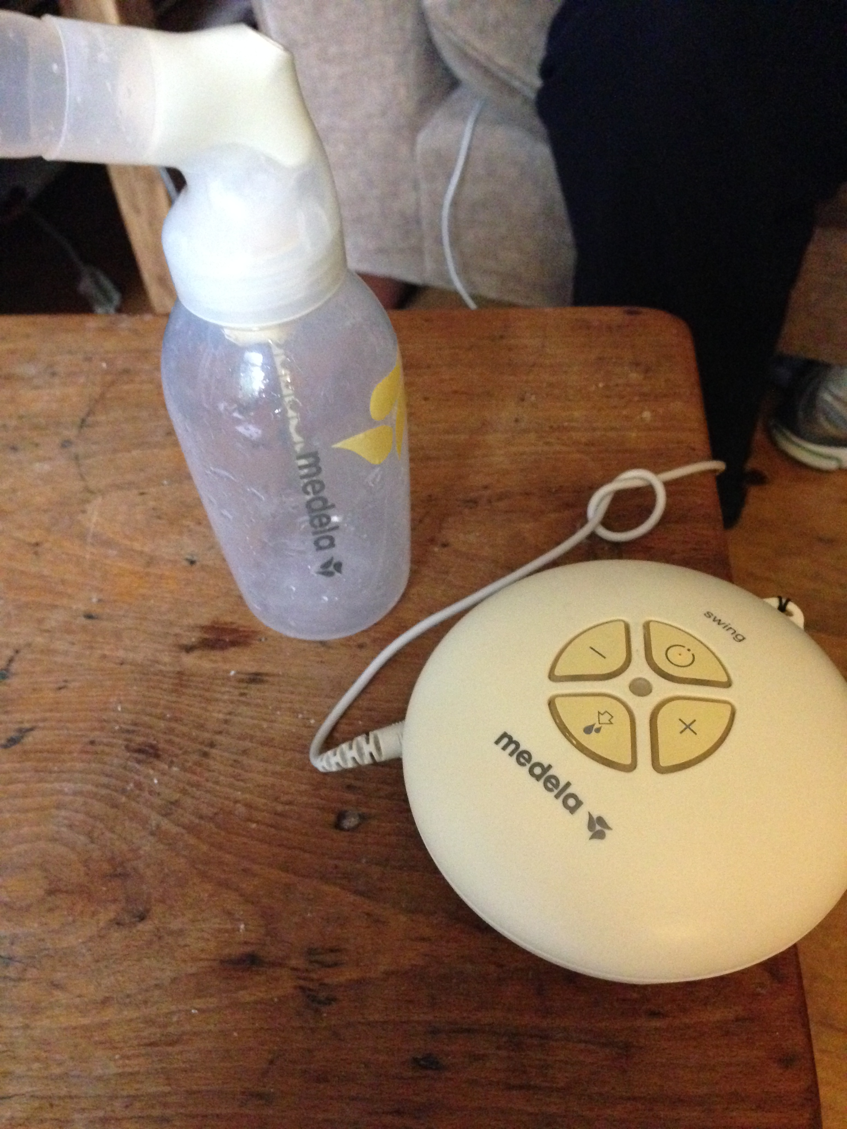
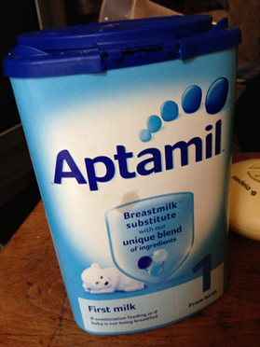
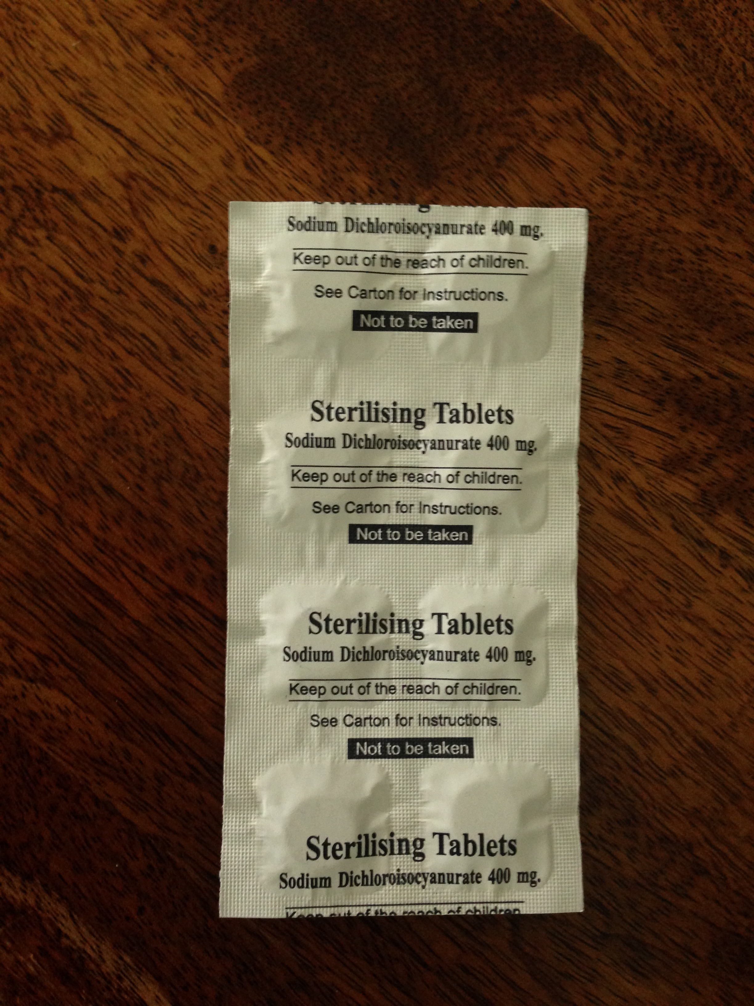
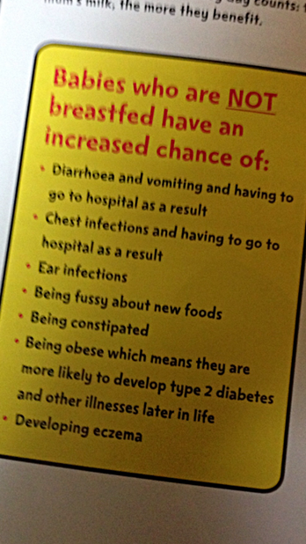
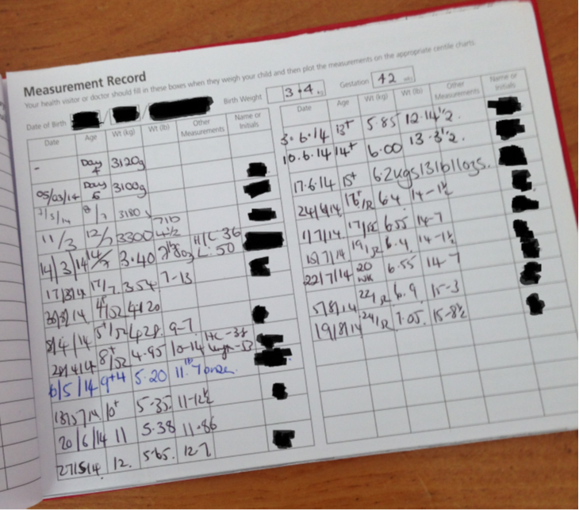
A broad range of accounts from mothers

Slide 9
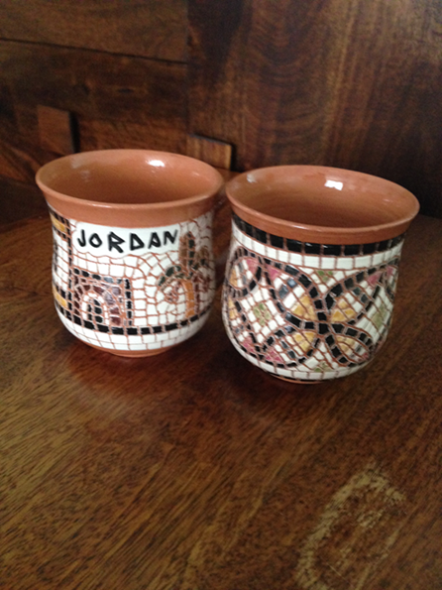
Strangers police pregnancy, and infant feeding, which influences mothers (1)
M: Yeah, he said you can’t have this you can’t have that he didn’t ask us what we wanted he said the only things you can have are um cheese and pickle he brought things we could have but he didn’t ask if we liked ‘em he didn’t he didn’t ask if we wanted them…and he even went to the chef about what I can have instead of asking me what has your health visitor said you can have…
GM: …but it was really weird because for, for, like I couldn’t believe how interfering like from when I was pregnant …but like when I was pregnant no one cared (laughter) you could say oh I’ll have a double vodka and coke with my fag (laughter) and it was like yeah no problem (laughter) so it’s just totally different…yeah people try and police your behaviour

Slide 10
Cont…
M: Me and my partner went to a coffee shop and we was heating up a bottle um for (our daughter) and then the cleaner this man was, (he was) just cleaning around the tables, who worked there and he came up to me and said ‘Are you breastfeeding?’ and, like I said yes I was and I didn’t really take offense to it but if I wasn’t then I’d feel quite like…its intrusive…like I wouldn’t walk up to him and say ‘What did you have for your lunch today?’ (laughter) like why are you asking me what my child has for milk?
M: d’you know what (laughs), it’d be easier just to give her (my baby) a bottle (of infant formula) from all these different inputs here and left right and left.

Slide 11
Study 2: Longitudinal qualitative research with pregnant women
Aim: to understand health and wellbeing during pregnancy in a wide sense among women claiming benefits and living in deprived areas of south Wales
Recruitment strategies
  Trusted community groups
  Social media
  Posters in deprived areas
3 interviews, in two phases
Incentive of £25 per phase provided
Small gift (bibs) and card sent when baby born

Slide 12
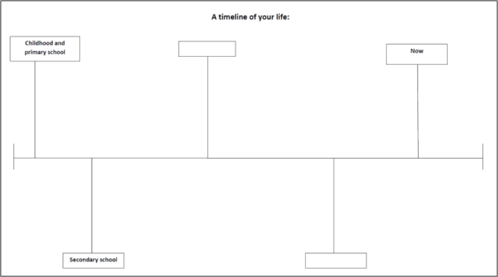
Timeline facilitated life history interviews

Slide 13
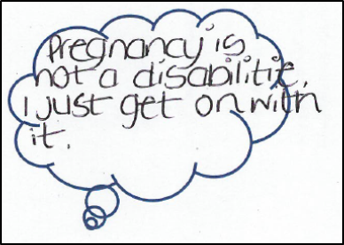
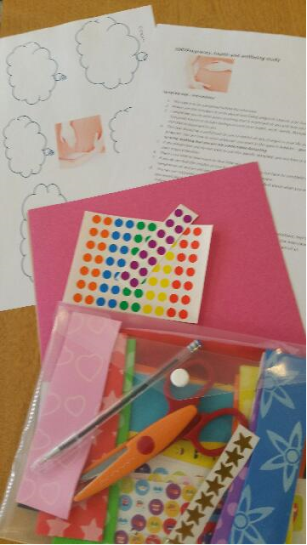
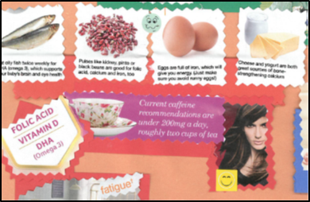
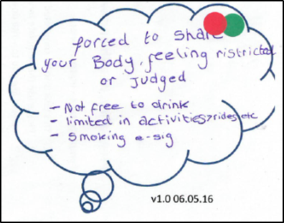
Collaging and thought bubbles

Slide 14
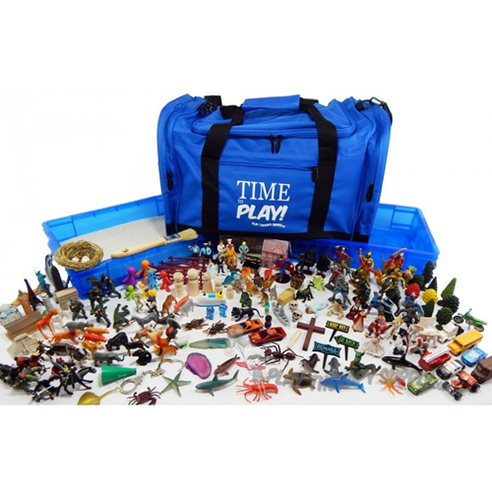
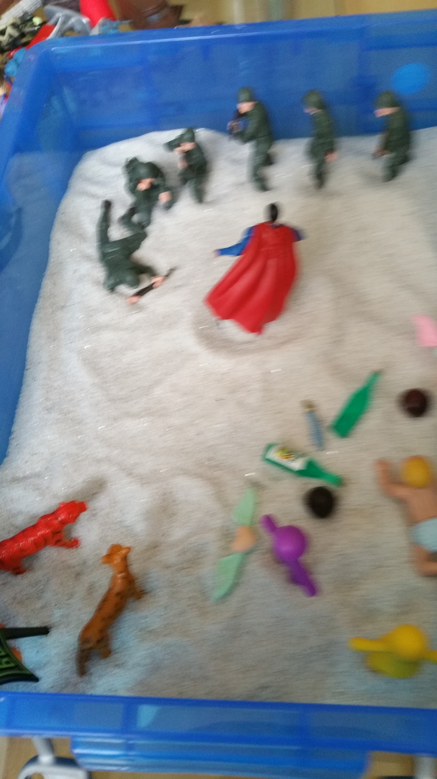
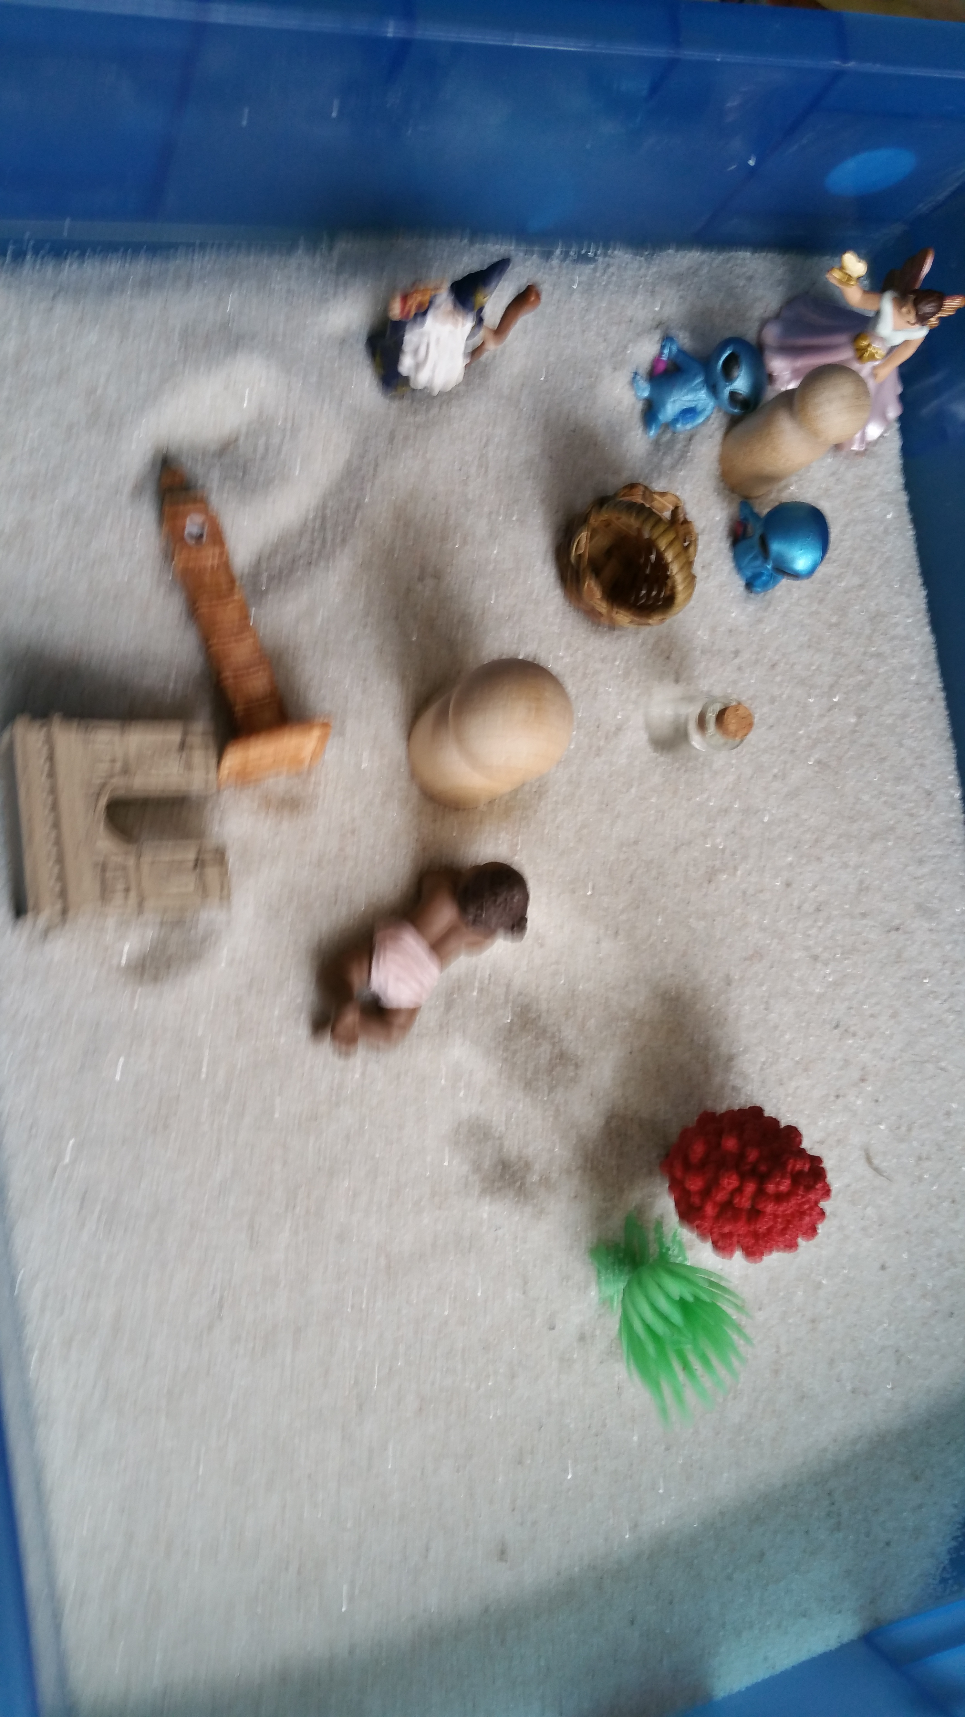
Sandboxing dyad interviews
Participant Interviewer

Slide 15
Engagement with methods
Participant | 1st Pre-Interview Timeline Task | 1st interview word count | 2nd Pre-Interview Pregnancy Bubbles Task | 2nd Pre-Interview Collage Task | 2nd Interview Sandboxing task | 2nd interview word count
001 | ✓ | 21,462 | ✓ | x | ✓ | 15,294
002 | ✓ | 2,836 (audio recording equipment fail) | ✓ | x | ✓ | 12,584
003 | ✓ | 8,043 | x | x | ✓ | 12,292
004 | ✓ | 17,036 | ✓ | ✓ | ✓ | 17,792
005 | ✓ | 6,680
006 | ✓ | 4,787 | x | ✓ | ✓ | 7,824
007 | ✓ | 9,714 | x | ✓ | ✓ | 11,494
008 | ✓ | 9,116 | ✓ | x | ✓ | 12,253
009 | x | 6,532 | ✓ | x | ✓ | 10,237
010 | x | 9,339 | ✓ | x | ✓ | 11,130

Slide 16
Reflections on power
Incentives
Rich source of data – uncover new meanings of what is important
  A cup is more than just a cup
  Build on the literature on smoking in pregnancy
The importance of trust – linked to interviewer empathy and regular contact
Changing stories – reflexivity and researcher physicality
Methods – too much choice; “getting it right!”

Slide 17





Thank you
@CTRCardiffUni
@grant_aimee
@dawnmannay
Any Questions?
GrantA2@Cardiff.ac.uk
MannayDI@Cardiff.ac.uk
MorganML1@Cardiff.ac.uk
CassidyD@Cardiff.ac.uk

